Slide 1
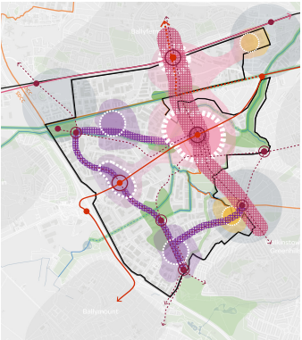
City Edge Project: Update
LUPT SPC
24th February 2022

Slide 2
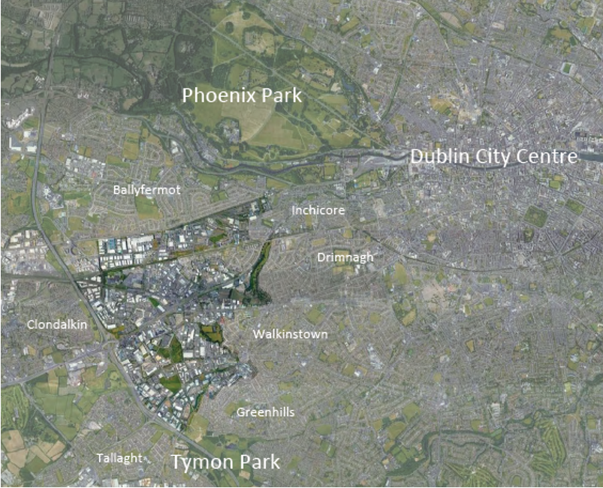
City Edge Project area in context of surrounding areas and Dublin City Centre

Slide 3
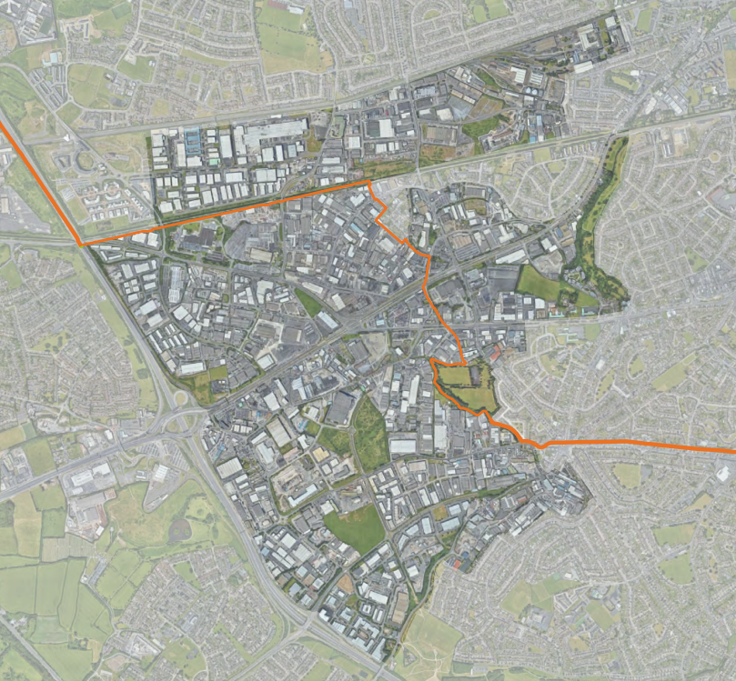
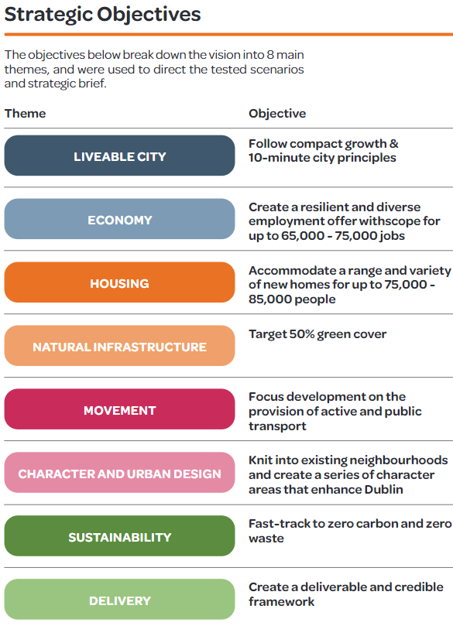
DCC
SDCC
DCC
SDCC
City Edge Project area showing boundary between SDCC and DCC jurisdictions

Slide 4
Housing Analysis

Slide 5
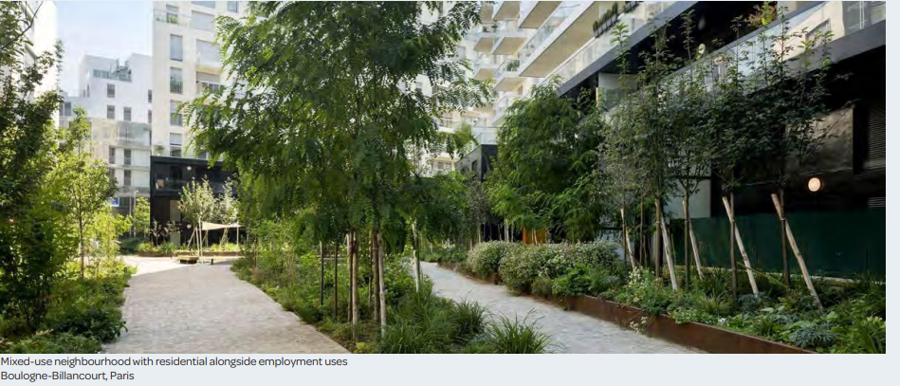
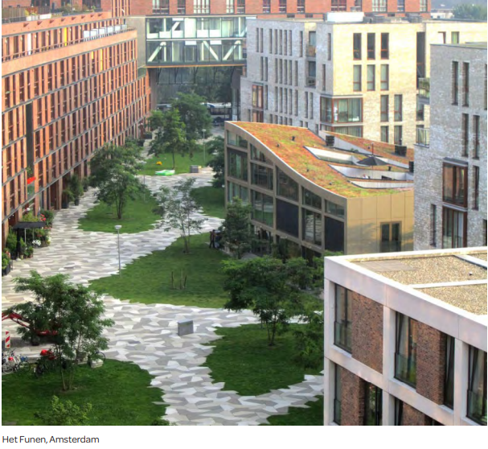
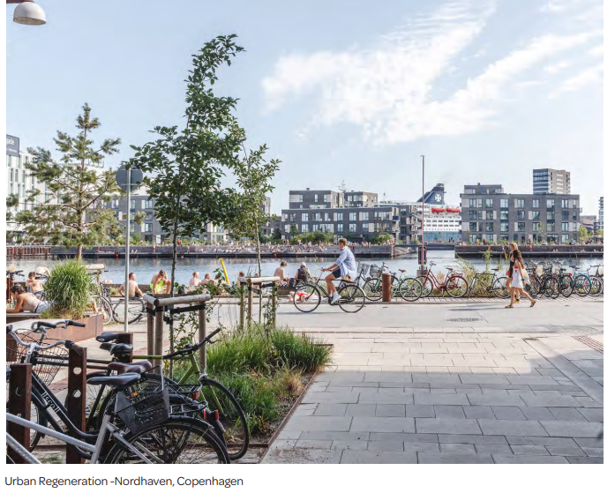
Housing Analysis
Review of permissions within the City Edge area.
Review of international case studies.
Tenure Type – social housing, private rental, cost rental, affordable, private owned, etc.
Dwelling Mix – mix of sizes and tenures; accommodation for older people and students, etc.
Typologies – apartments, houses, residential with employment and mixed use, etc.
Density – will vary according to location.
Quantum – how much housing is required? RSES figures/CDP figures are not reflective.

Slide 6
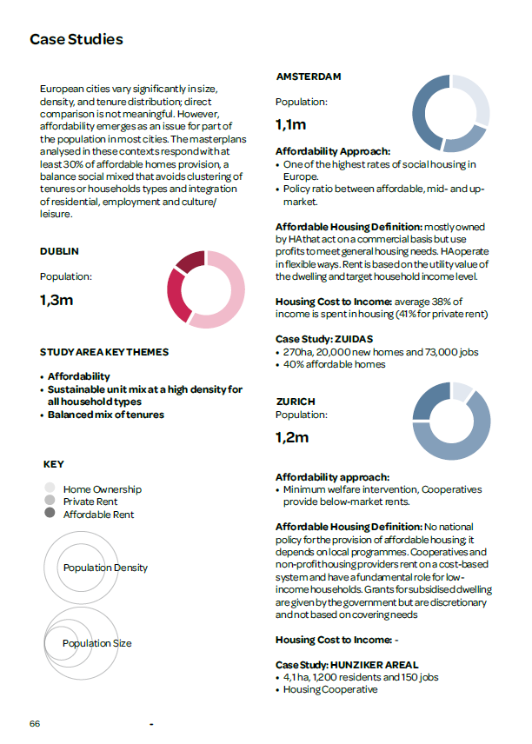
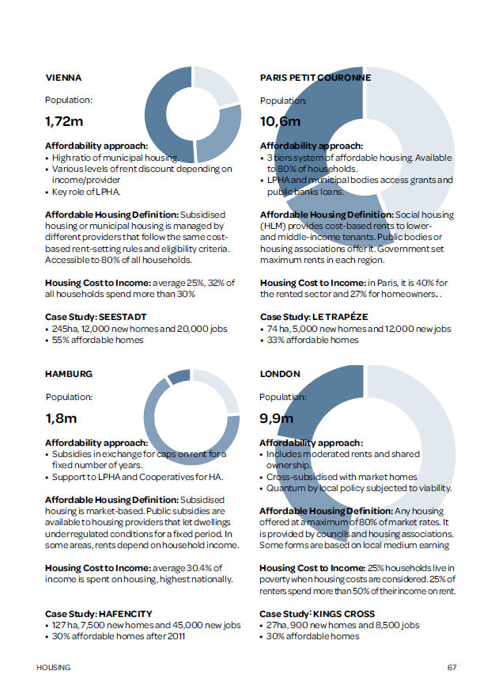

Slide 7
Natural Infrastructure

Slide 8
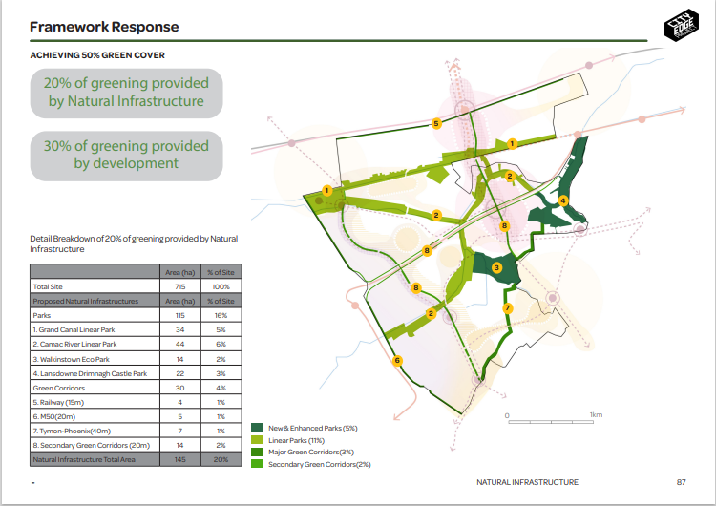
Draft – Subject to Change

Slide 9
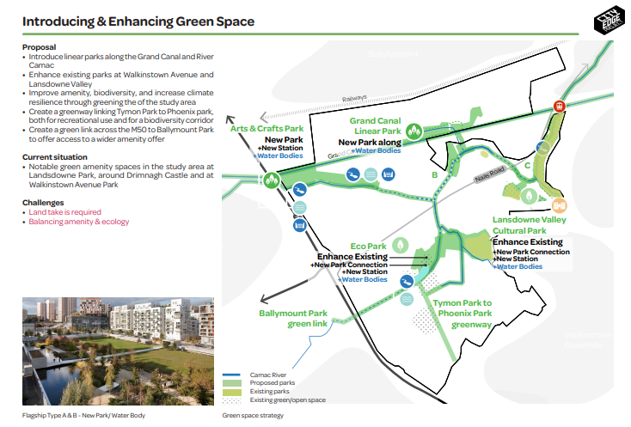
Draft – Subject to Change

Slide 10
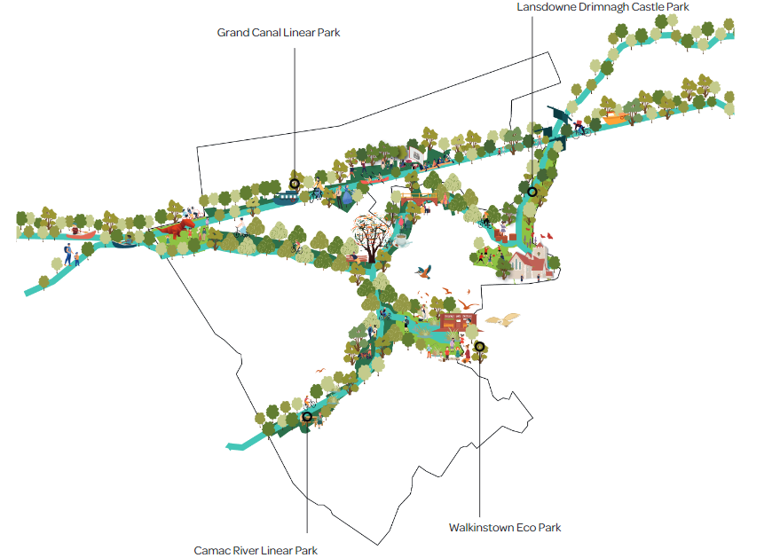
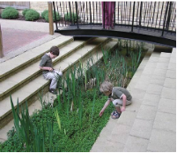
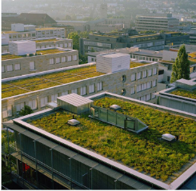
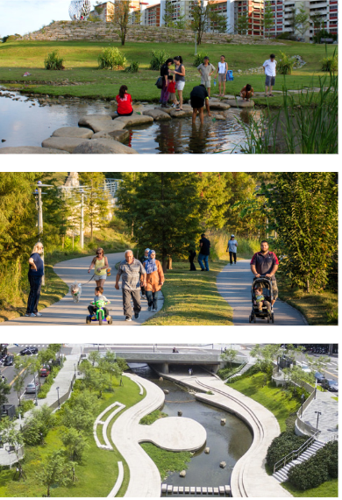
Draft – Subject to Change

Slide 11
Districts and Character Areas

Slide 12
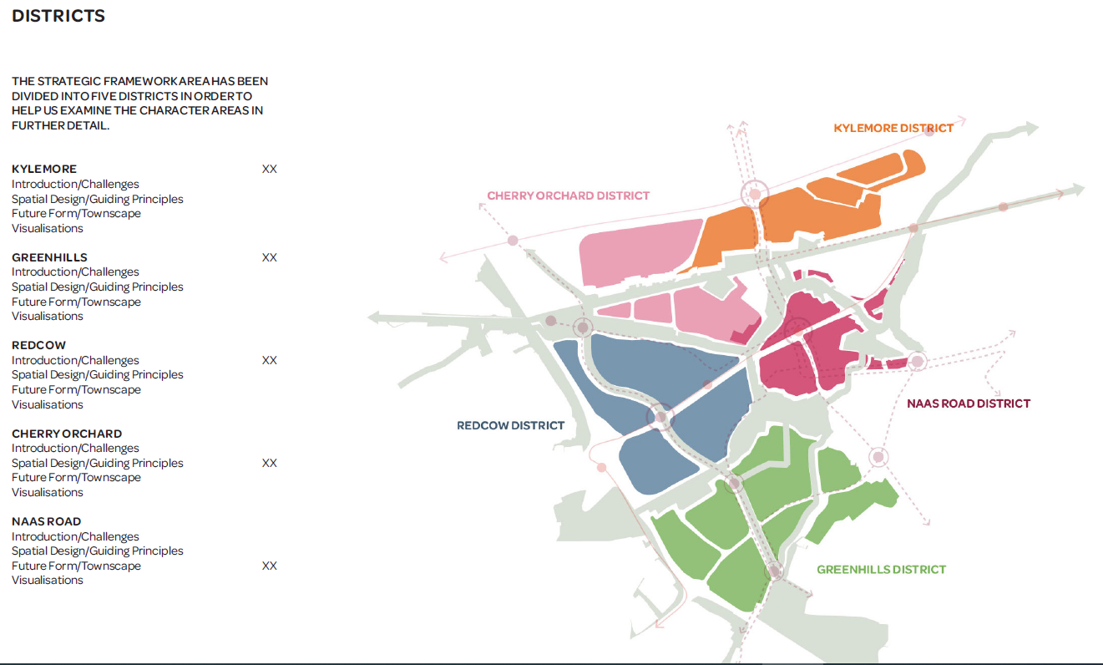
DRAFT – Subject to Change

Slide 13
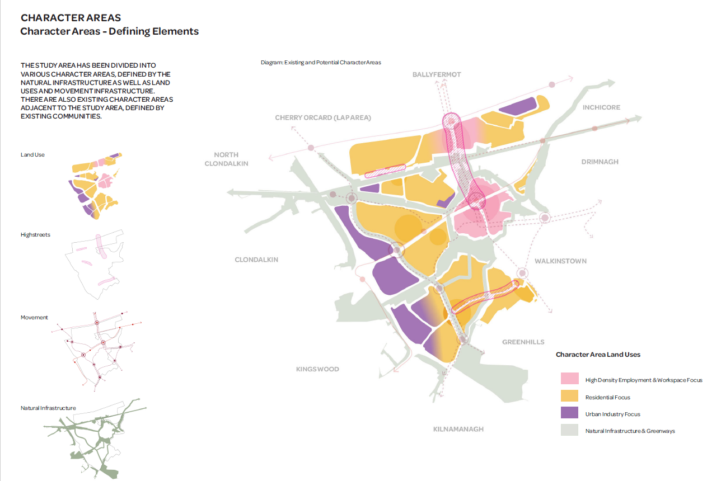
DRAFT – Subject to Change

Slide 14
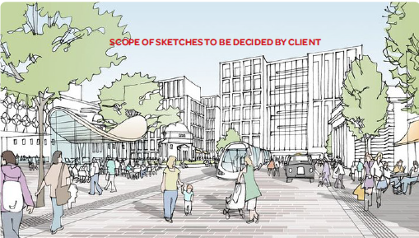
Examples of Block Typologies
DRAFT
Examples of Street Typologies

Slide 15
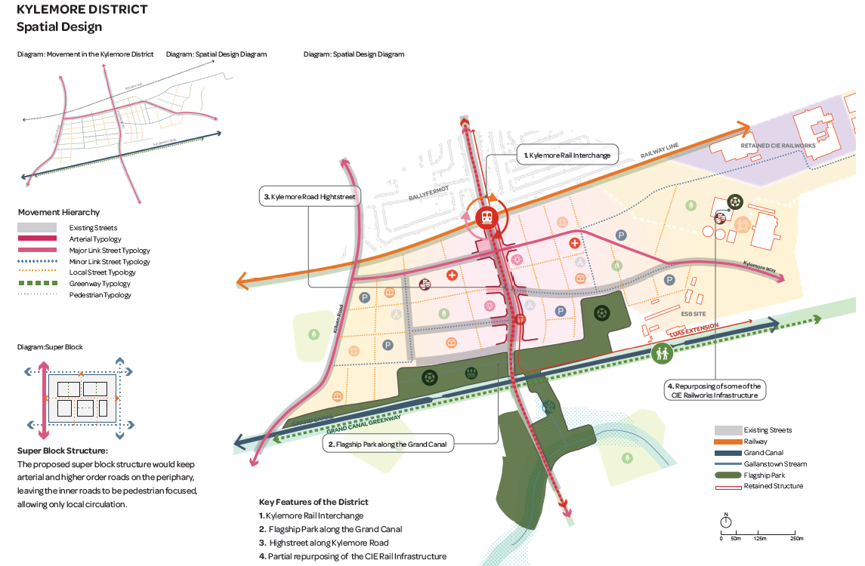
DRAFT – Subject to Change

Slide 16
Infrastructure Required

Slide 17
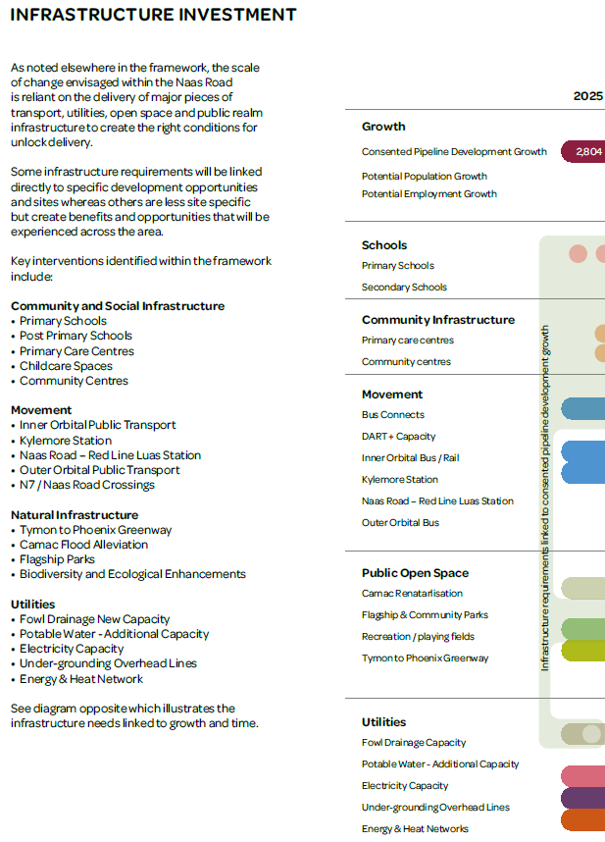
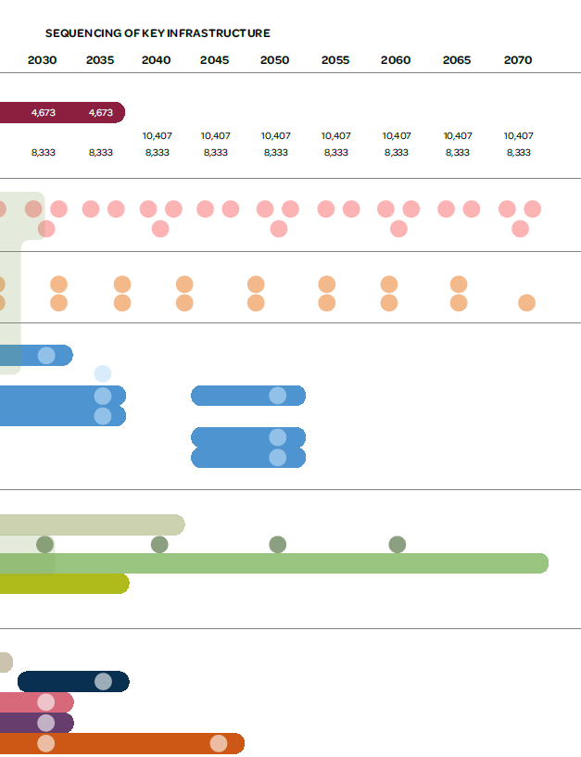
Draft – Subject to Change

