Slide 1
LUPT SPC
Briefing 24/02/2022
Content:
Overview of Large-Scale Residential Development (LRDs)
Compliance legislation
Eoin Burke Senior Planner

Slide 2
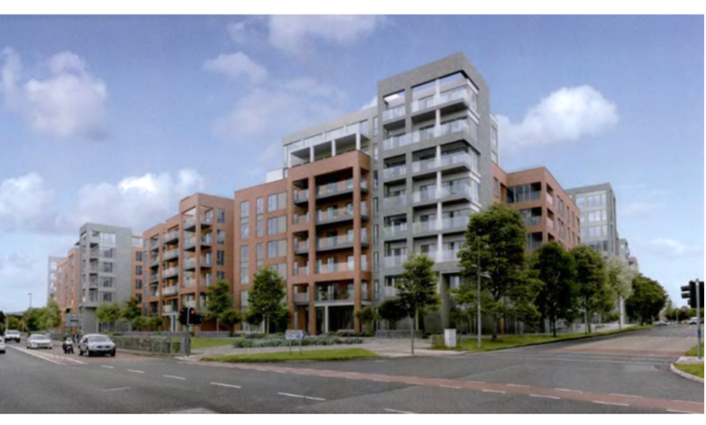
Large Scale Residential Development (LRD) – Background
Programme for Government – Our Shared Future – committed to not extending Strategic Housing Development (SHD) process
Housing for All – Action 12.3 – commits to new planning process for large residential development to replace SHD process.
Main Point
Restores two stage planning process – decision making for LRDs returns to Planning Authority with right to appeal to An Bord Pleanala.
Current SHD process is 3 stages – Pre Planning with Planning Authoirty, Pre Planning with ABP and application to ABP

Slide 3
Large Scale Residential Development (LRD) – Legislation
Effective from December 17th 2021
Planning and Development (Amendment) (Large-scale Residential Development) Act 2021
Planning and Development (Large-scale Residential Development) Regulations 2021 (SI 716 of 2021)
Planning and Development (Large-scale Residential Development Fees) Regulations 2021 (SI 720 of 2021)

Slide 4
LRD Process Overview
1.
Pre Planning (PA)
2.
LRD Meeting/ Opinion (PA)
3.
Planning Application (PA)
4. Appeal (ABP)
Mandatory Pre Planning Consultation
Maximum of 4 weeks for Planning Authority to carry out after request
Request for LRD Meeting & Opinion to Planning Authority
Maximum of 4 weeks for LRD meeting to take place
Maximum of 4 week after LRD meeting for Planning Authority to issue opinion
(8 week total timeline)
Application lodged to Planning Authority under Section 34 of Act (8 weeks timeline for decision)
Restrictions on further information issues
Requirement for applicant to have received an LRD Opinion within last 6 months
Appeal of decision to ABP
16 weeks timeline for ABP to decide appeal

Slide 5
Large Scale Residential (LRD) – When this process?
- Developments of 100 housing units or more, or student accommodation developments comprising 200 bed spaces or more, or a combination of same.
The two main changes under the new LRD arrangements will allow for:
o Up to 30% of the gross floor space of the proposed development to be for other uses, instead of the 15% cap under the SHD arrangements.
o Mixed developments combining housing and student accommodation to be classified as an LRD where the threshold is met for either element.
- LRD not applicable to Strategic Development Zones (e.g Adamstown & Clonburris)

Slide 6
Large Scale Residential (LRD) – Some More Detail
Stage 1 – Pre Planning
Mandatory
4 week timeframe to hold
Stage 2 – LRD Meeting/ Opinion
Planning authorities required to complete the LRD meeting and LRD opinion process within 8 weeks of the request for such meeting from the developer
4 weeks to hold the LRD meeting with the developer followed by
4 weeks for the planning authority to issue an LRD opinion on whether the proposals constitute a reasonable basis for submitting a planning application on the LRD proposals.
Without prejudice
Specified documentation is required to be submitted by the developer/ prospective applicant relating to the proposed development with their LRD meeting request – new application form in Regulations
LRD opinion will be valid for 6 months
No public consultation – LRD Meeting/ Opinion documents not available to public until planning application lodged
Receipt by Planning Authority and issuing of LRD Opinion by Planning Authority published on Weekly List

Slide 7
Large Scale Residential (LRD) – Some More Detail
Stage 3 – Planning Application
Developer must make the application documentation available for public viewing on a dedicated website
Further Information restricted:
Requests for further information by local authorities on LRD planning applications may only be sought once and only in relation to matters of technical or environmental detail, or both, that were unforeseen at the time of the LRD opinion and the time of lodging the LRD application, or new matters raised during the LRD planning application public participation process.
Planning Authority to notify elected members of the receipt of an LRD planning application. No presentation to ACM
Full Application Fee to Planning Authority (currently only 50% under SHD)
A penalty, payable to the developer, will apply to the planning authority (3.5 times the application fee paid or €10,000, whichever is the lesser) for late decisions on LRD planning applications
New supplementary application form
Must state LRD application in public notice and create a website

Slide 8
Large Scale Residential (LRD) or Strategic Housing Development (SHD)
Transition from SHD to LRD:
SHD prospective applicants/ developers already in receipt of an SHD opinion under the SHD arrangements on the commencement of the Act (17 December 2021) will have 16 weeks to submit an SHD application to the Board from the 17 December 2021 (April 17th 2022).
SHD prospective applicants/ developers who have formally commenced consultations with the Board and are awaiting an SHD opinion on the commencement of the Act (17 December 2021) will have 16 weeks to submit an SHD application to the Board from the date of receipt of the SHD opinion.
SDCC Context – 17 sites with SHD Opinion or in SHD consultation with ABP.

Slide 9
Large Scale Residential (LRD) or Strategic Housing Development (SHD)
Amendment Applications
When considering applications for amendments to previously approved SHDs or LRDs, the planning authority shall be limited to solely considering the proposed modifications to the previously permitted development and not to reconsidering the original application again in combination with the proposed new modifications.
Alterations to SHD planning permissions shall no longer be submitted to the Board under section 146B and shall instead be submitted to the relevant local planning authority for determination.
The planning authority may determine that pre- application consultations under section 247 and the LRD opinion of the planning authority are not required in cases where the proposed development is substantially the same as the previously permitted development.

Slide 10
Large Scale Residential (LRD) – How Many?
SHD Numbers from January 1st 2019 to 31st December 2021
 | SHD 1 | SHD 2 | SHD3
Year | No. | No. | No.
2019* | 31 | 14 | 7
2020* | 17 | 11 | 12
2021* | 15 | 13 | 11
 | 63 | 38 | 30
* | SHD1 & SHD2 are categorsed by year lodged with SDCC; SHD3 by ABP Decision Date if known or CE Report to ABP if no ABP Decision
Date of Table | 07/01/2022

Slide 11
Large Scale Residential (LRD) Appeals
Planning Authority decisions can be appealed to An Bord Pleanala
Time limit of 16 weeks for ABP decision
Limited scope for “further information” requests
Financial penalty for late decisions
Any party to a judicial review challenge in the High Court may apply to appeal the High Court judgement and have the appeal referred directly to the Supreme Court, bypassing the Court of Appeal

Slide 12
Planning Compliance Change
Planning and Development (Amendment) Act 2018 (Commencement) Order 2021 (SI 714 of 2021)
Section 34 (5) of Act:
(5) The conditions under subsection (1) may provide that points of detail relating to a grant of permission be agreed between the planning authority and the person carrying out the development and, accordingly—
(a) where for that purpose that person has submitted to the planning authority concerned such points of detail, then that authority shall, within 8 weeks of those points being so submitted, or such longer period as may be agreed between them in writing, either—
(i) reach agreement with that person on those points, or
(ii) where that authority and that person cannot so agree on those points, that authority may—
I) advise that person accordingly in writing, or
II) refer the matter to the Board for its determination,
and, where clause (I) applies, that person may, within 4 weeks of being so advised, refer the matter to the Board for its determination,
or
(b) where none of the events referred to in subparagraph (i) or in clause (I) or (II) of subparagraph (ii) occur within those 8 weeks or such longer period as may have been so agreed, then that authority shall be deemed to have agreed to the points of detail as so submitted.”.

Slide 13
Planning Compliance Change
Summary:
Statutory 8 week time period for assessment of compliance with planning conditions requiring agreement
Statutory deadline applies to compliance submitted from December 17th 2021 – regardless of planning permission grant date

