Slide 1
Corkagh Park Part 8 Update – February 2022

Slide 2
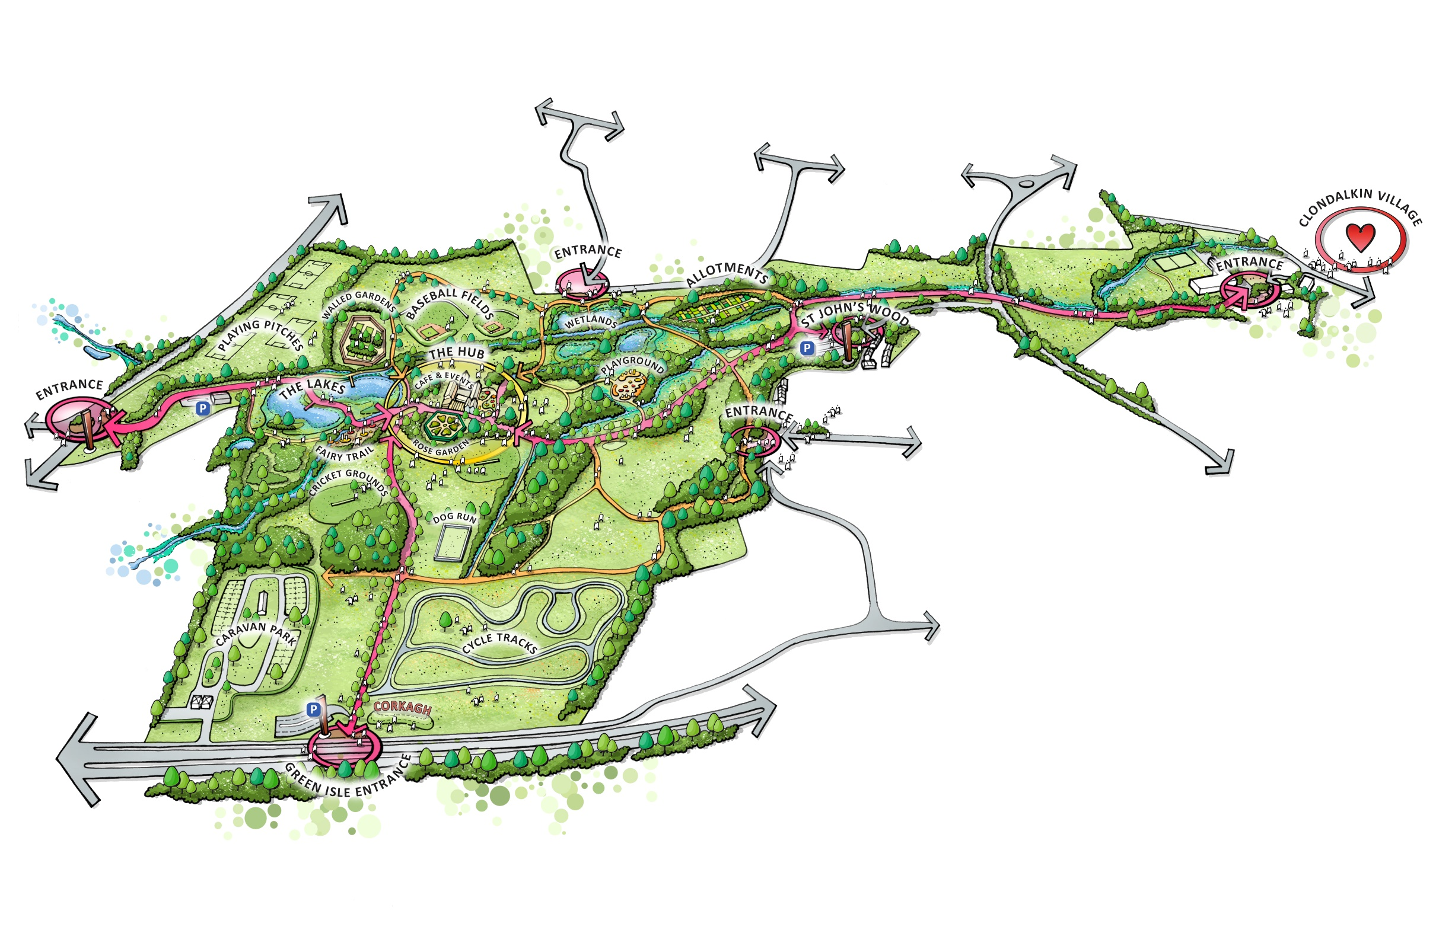
Overall Vision Sketch
A new centre of the park that serves as a destination has been identified. It will be well-linked to car parks and other components adding to the sense of place for local and regional visitors. Care has been taken to ensure that all proposed elements respond to and work in harmony with the strong cultural heritage found in the park as well as other existing features.

Slide 3
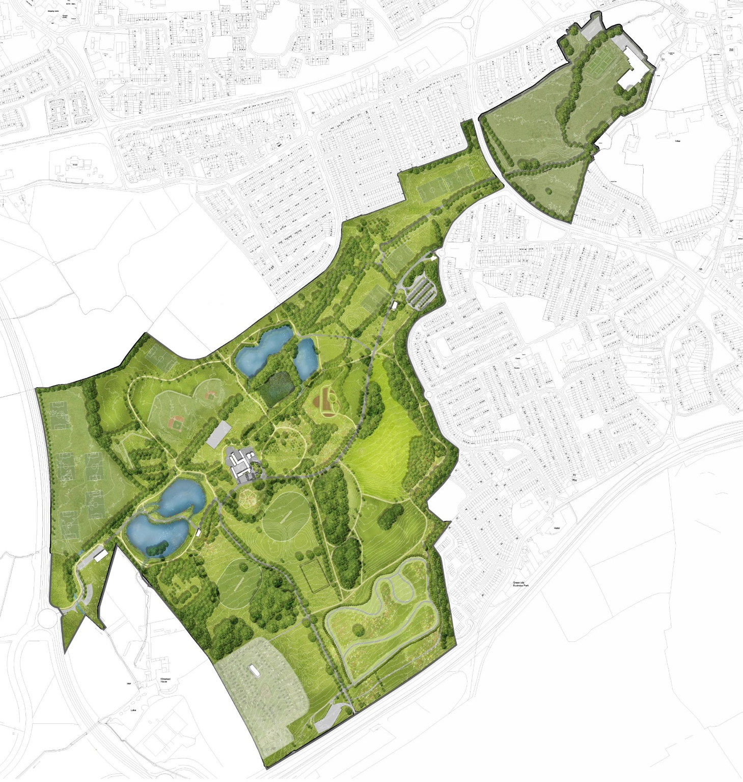
Corkagh Park Part 8
Part 8 advertised 20th Dec 2021 to 9th February 2022
The Hub Zone
St John’s Wood car park and entrance
Outer Ring Road Entrance
Green Isle Road car park and entrance
St Johns Wood Drive pedestrian entrance
Kilcarbery Entrance
Camac Valley Camping park Link
Fairy Woodland Trail
Primary and Secondary Routes
2
6
5
9
1
8
3
7
4

Slide 4
Proposed Development and Extent
Provision of wayfinding and signage installations;
Enhancement of the primary and secondary routes;
Construction of a new 'hub zone' to include a Café building with 10 no. public toilets, kitchen, storage, serving area and internal seating; multi-use events space with a stage and hard-standing area; soft-landscaping with formal seating areas; picnic areas; amenity lawn; mounds; incidental play area; and planting;
Removal and replacement of trees that are in poor health or pose a risk to safety;
Upgrading of St. John's Wood Car Park to include resurfacing; improved pedestrian links and footpaths, dropped kerbs and crossings; replacement of existing gates; reorganisation of internal vehicular routes; 11m high arrival beacons at St. John's Wood Car Park Entrance; future-proofing for EV charging points;
Upgrading and extension of Green Isle Car Park and park entrance to include relocation and widening of existing entrance; addition of a native edge plant buffer; 11m high arrival beacons at Green Isle Car Park Entrance; future-proofing for EV charging points;
Enhancements to the Fairy Woodland Trail including new play features; new seating; new pedestrian link from the lakes; retention and protection of existing mature trees; addition of native ornamental shrubs and grasses;
Upgrading of entrance and construction of a new footpath linking existing car park to the Outer Ring Road; future-proofing for EV charging points and extension of car park; and 11m high arrival beacon at Outer Ring Road Entrance;
Provision of a new pedestrian entrance from Kilcarbery Grange Development;
Provision of a new pedestrian link between the Camac Valley Camping Park and Corkagh Park;
Enhancements to pedestrian entrance and boundary at St. John's Wood Drive
Proposed planting, furniture and landscape works associated with the proposed development.
All associated and ancillary site works associated with the proposed development.

Slide 5
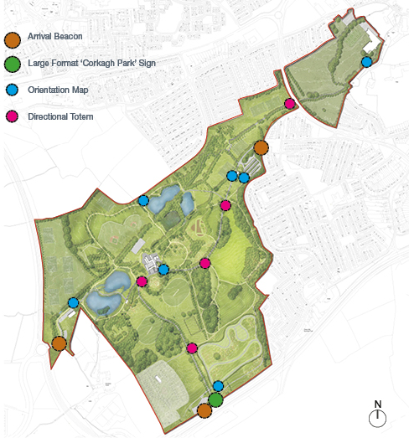
Wayfinding and Signage
Signage
Primary and Secondary Routes

Slide 6
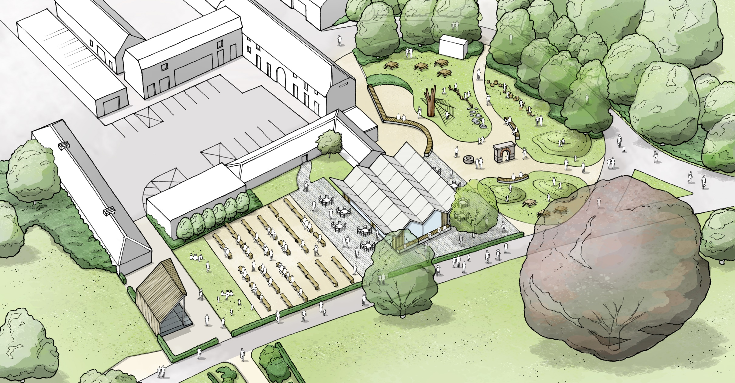
The Hub Zone

Slide 7
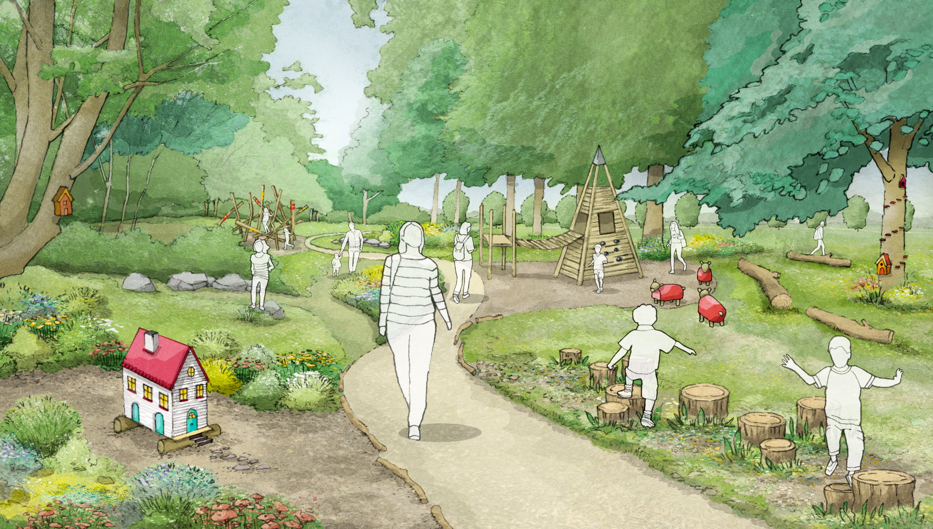
The Fairy Woodland Trail

Slide 8
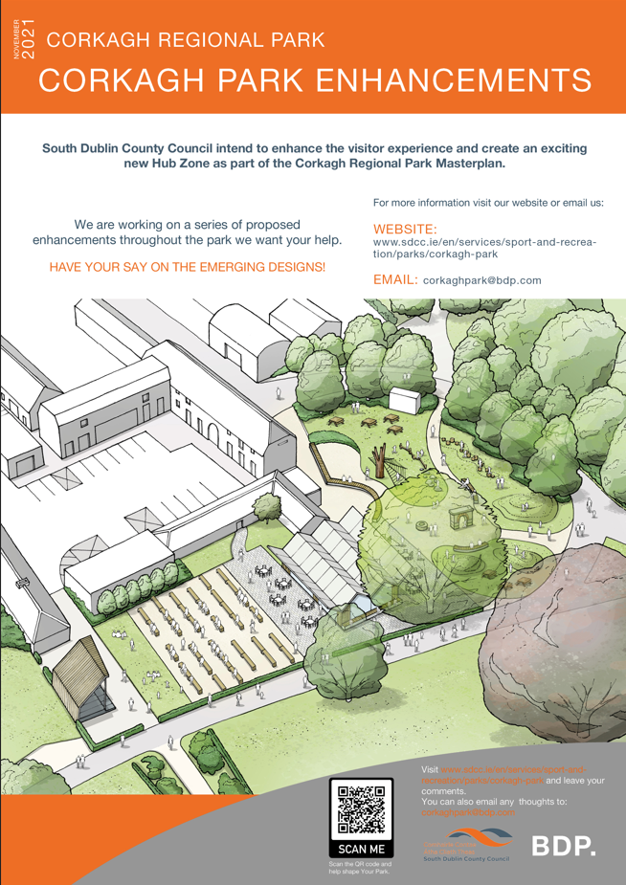
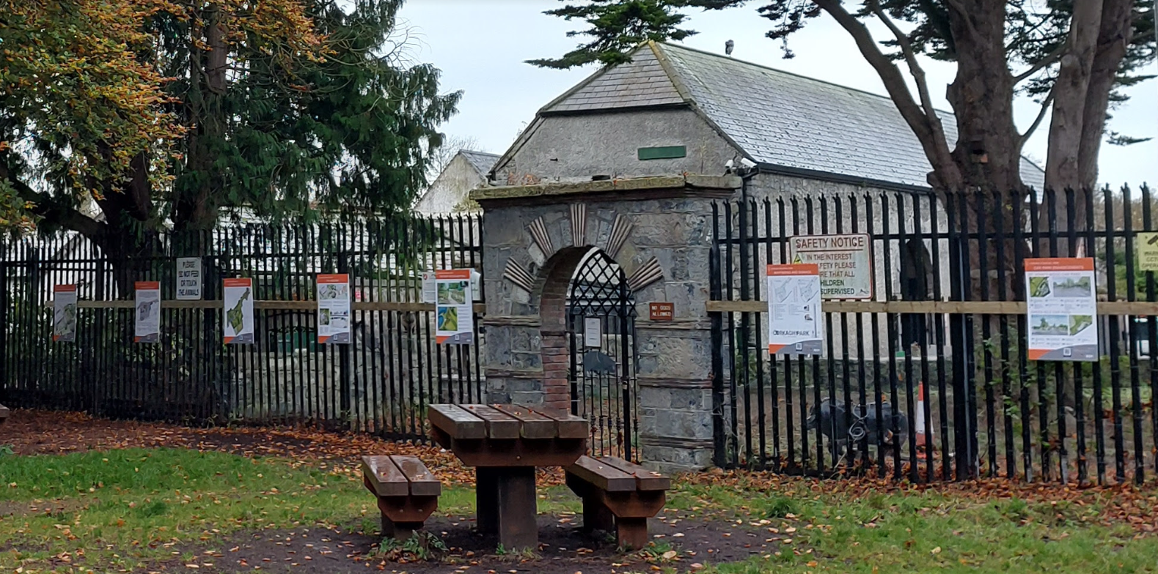
Summary of the Part 8 Process to date
Non-Statutory Period
Initial presentation to Elected Members.
Consultation with SDCC staff.
Public Online Webinar via Microsoft Teams.
Website display of information with link and email address to post comments to.
Postcard with information on how to view and share thoughts on the enhancements.
Event Day in Corkagh Park (Covid-Safe) with display boards and attended by design consultants.
Statutory Period
Part VIII advertised on 20th of December 2021.
Public Consultation period set to conclude 9th February 2022.
Issue of CE report and recommendation.
A number of submissions were made during the Statutory Consultation process. They have been summarized and responded to in the CE Report.

Slide 9
Issues Raised: please see CE report for full summary, response and recommendation in relation to the submissions received.
Addition of sports amenities/facilities
Upgrade of the Existing Recreational Facilities
Ecology
Security and Privacy
New Footpath adjacent to Cherrywood Crescent
Signage
Car Parks and Vehicular Traffic
Proposed Hub Area and Provision of Shops, Café and Outdoor Market
Suggestions for alternative uses of the Building in the Hub Zone
Architectural Conservation
Provision of cycle parking and wider pathways for cyclists
Pedestrian and Cycle Routes and access to the park
Air Traffic
Litter Control and Maintenance
Camac Flood Alleviation Scheme

Slide 10
Recommendations for Part 8 Adoption
Following consideration of the submissions the Chief Executive is of the view that the issues raised by way of the submissions can be satisfactorily addressed during the detailed design stage and the operational and management stage and as outlined in the foregoing report.
It is recommended that, as the proposal is in conformity with proper planning and sustainable development, the Council proceed with the Part 8 proposal for the proposed enhancements and upgrades at Corkagh Park, Clondalkin Dublin 22 as proposed; with the exception of the following change to the Part 8 proposals:
That the proposed section of footpath, adjacent and parallel to Cherrywood Crescent be removed from the current Part 8 proposals

Slide 11
Thank you

