Slide 1
Housing Delivery Update Report Housing Strategic Policy Committee Meeting 10th February 2022

Slide 2
Housing Delivery 2021
Local Electoral Area | LA Build | AHB Build | Part V | Total Build | Total Acquisitions | Total Leasing | Grand Total
Clondalkin | 0 | 14 | 14 | 28 | 0 | 36 | 64
Lucan | 0 | 90 | 49 | 139 | 1 | 15 | 155
Tallaght Central | 0 | 0 | 1 | 1 | 1 | 26 | 28
Tallaght South | 0 | 22 | 34 | 56 | 1 | 62 | 119
Rathfarnham-Templeogue | 0 | 11 | 1 | 12 | 0 | 8 | 20
Palmerstown- Fonthill | 2 | 0 | 0 | 2 | 0 | 12 | 14
Firhouse- Bohernabreena | 0 | 0 | 39 | 39 | 1 | 0 | 10
Total | 0 | 137 | 108 | 247 | 4 | 159 | 410
Housing Output 2020/21 By Delivery Type (& vs. Projected) | BUILD |  |  |  |  |  | LEASING |  | ACQUISTIONS
 | BUILD |  |  |  |  |  | LEASING |  | ACQUISTIONS
Year | LA Build | AHB Build | Part V Build | PPP Build | Total Build | Build Target | Leasing Total | Leasing Target | LA | AHB | Total
2020 | 0 | 156 | 108 | 109 | 373 | 467 | 119 | 120 | 13 | 20 | 33
2021 | 2 | 137 | 108 | 0 | 247 | 245* | 159 | 150* | 3 | 1 | 4
 | Original 2021 DHLGH Targets |  |  |  |  | 408 |  | 190
* 2021 pipeline revised due to impact on programme of delivery during Level 5 restrictions.

Slide 3
Housing Action Delivery Plan 2022-2026
Draft HDAP 2022-2026 submitted to DHLGH on 17th December 2021 Detailed updates to SPC & Area Committees once approved by DHLGH to include: scheduled delivery by LEA, tenure & unit size with timelines
Social Housing: Council Construction Sites Large Council-led mixed tenure sites AHB proposals Part V yield Leasing
Affordable Housing: Purchase/Cost rental Large Council owned Sites AHBs - Cost Rental Equity Loan (CREL) Private mixed tenure developments National Home Affordable Purchase Shared Equity Scheme Additional Part V yield – extra 10% Clonburris - URDF

Slide 4
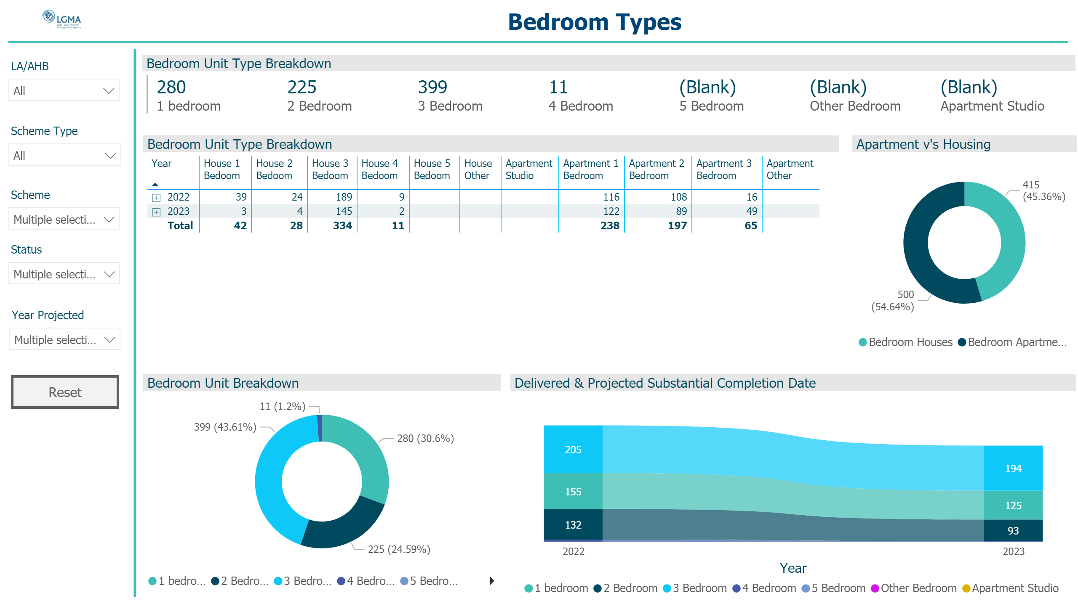
Bedroom
Notes:
image
No alt text provided
Bedroom Unit Type Breakdown
No alt text provided
textbox
No alt text provided
slicer
No alt text provided
slicer
No alt text provided
slicer
No alt text provided
slicer
No alt text provided
slicer
No alt text provided
basicShape
No alt text provided
basicShape
No alt text provided
Bedroom Unit Type Breakdown
No alt text provided
Bedroom Unit Breakdown
No alt text provided
Delivered & Projected Substantial Completion Date
No alt text provided
Apartment v's Housing
No alt text provided
actionButton
No alt text provided

Slide 5
Housing For All Delivery Targets 2022-2026 Social Housing
Targets | 2022 | 2023 | 2024 | 2025 | 2026 | TOTAL
Build | 400 | 703 | 718 | 772 | 788 | 3,381
Leasing | 40 | 90 | 120 | 40 | 0 | 290
Total | 440 | 793 | 838 | 812 | 788 | 3,671
Challenges: Phasing out of leasing & associated Part V delivery Staff resources / Technical capacity New tenures – Affordable Purchase/Cost rental Approval process – mixed tenure Increasing construction costs/inflation Cost of materials/ supply of materials

Slide 6
Approved/Proposed Developments by LEA (1)
LEA | Site | No. | Update
Clondalkin | Riversdale | 25* | On site, due for completion Sept 2022
 | Nangor/”eircom” site | 93 | Contractor appointed Jan 2022
 | Lindisfarne | 19 | Tender advertised closed 4th Feb 2022
 | Sallypark (Clúid/Part V) | 83 | On site, due for completion June 2022
 | Ballynakelly (Túath/Part V) | 4 | On site, due for completion June 2022
 | Nangor Road (Simon) | 10 | Tender to be re-advertised Q2 2022
 | Alpine Heights | tbc | Feasibility Study Q2 2002
 | Deansrath / Melrose | tbc | Feasibility Study Q2 2002
 | Oldcastle Park | tbc | Design to ACM Q2 2022
 | Kilcarbery 2 | tbc | Feasibility Study Q4 2002
 | Graydon (Part V) | 15 | On site, due for completion Q3 2023
 | Cloverhill (Part V) | 4 | Due for completion 2023
 | New Road Clondalkin (Part V) | 2 | Due for completion 2023
Rathfarnham/Templeogue | Templeogue Village | 11 | On site, due for completion March 2023
Firhouse/Bohernabreena | Homeville | 16 | On site, due for completion Sept 2022
 | Pearse Brothers Park | 10 | Design team to be appointed Q 2022
 | Castlefield | tbc | Feasibility Study Q4 2020
 | Stocking Lane | tbc | To be considered for AHB / Priority Needs
 | Scholarstown Wood (Part V) | 14 | On site, due for completion Q1 2023

Slide 7
Approved/Proposed Developments by LEA (2)
LEA | Site | No. | Update
Tallaght Central | Old Bawn | 12 | Tender advertised due to close Feb 2022
 | Fernwood/Maplewood (Clúid) | 40 | On site–due for completion June 2022
 | Whitestown Way (Clúid) | 81 | On site–due for completion Q1 2023
 | Mountain Gate (Part V) | 7 | Due for completion 2023
 | St. Aongus’ Green | 10 | Design team to be appointed Q2 2022
Tallaght South | St. Catherine’s (SDCC) | 12 | On site–due for completion Oct 2022
 | St. Catherines (Sophia) | 2 | On site–due for completion Feb 2022
 | Rossfield | tbc | Part 8 Q2 2022
 | Elder Health (Part V) | 2 | On site, due for completion Q3 2023
 | Parklands Citywest | 54 | 7 for completion Nov 2022, bal June 2023
 | Citywest Village & Mews (Part V) | 27 | On site, due for completion Q2 2023
Lucan | Aderrig (Part V) | 25 | 2 x unit in Q2 2022 & balance in Q4 2023
 | Somerton Phase 2 (Part V) | 24 | On site, due for completion Q2 2023
 | St Helens/Somerton (Part V) | 12 | On site, due for completion Q2 2023
 | Tandys Lane (Part V) | 24 | Due for completion 2023
 | St Helens Plaza (Part V) | 4 | Due for completion 2023
Palmerstown Fonthill | St. Mark’s | 38* | On site–due for completion Dec 2022
 | Balgaddy | 69 | Tender advertised Feb 2022
 | Old Lucan Rd (Túath) | 4 | Tender to be advertised Q1 2022
 | St. Ronan’s | 9 | Design team to be appointed Q2 2022
 | Kennelsfort Road | 25 | Due for completion 2023

Slide 8
SDCC Owned Large Sites
Kilcarbery: 1,034 homes with 30% social (310 homes)
Also includes affordable housing - 74 cost rental & 50 “discounted” homes
Initial social, affordable purchase and cost rental homes due for delivery Q2 2022
Killinarden: 620 homes including 125 social homes & 372 affordable purchase
SHD stage 2 meeting with An Board Pleanála 10th February 2022
Delivery from late 2023 (subject to planning)
Clonburris: Phases 1 & 2 comprising approx. 400 homes (120 social) under design
Part 8s for Phase 1 (Kishogue) & Phase 2 (Canal Extension-Ashwood) to Council Q2 2022
Rathcoole: Revised proposal to be developed
To be considered in Q1 2022 once draft County Development Plan meetings concluded in March.
Belgard Square North - Cost Rental Apartments
Tender currently being prepared for appointment of ER team to be followed with tender for contractor in Q2 2022

