Slide 1
Tallaght to Knocklyon Active Travel Route
Headed Item for CMAS Meeting

Slide 2
Tallaght to Knocklyon Active Travel Route Update
This scheme will deliver a new safe, segregated active travel route running from Tallaght Village, along Old Bawn Road to the junction at the Old Mill Pub. The route will the continue along Firhouse Road to Ballycullen Road and will cross the M50 using the existing pedestrian/cyclist bridge. East of the M50, the route runs along Knocklyon Road, through Dargle Wood to Templeroan Road and on to Ballyboden Way.
The Scheme will deliver all of the following benefits:
Form part of the wider active travel network in South Dublin by delivering:
sections of routes 6, 8, 9, and 19 of Cycle South Dublin
portions of routes S05, S06, and 10A of the GDA Cycle Network

Slide 3
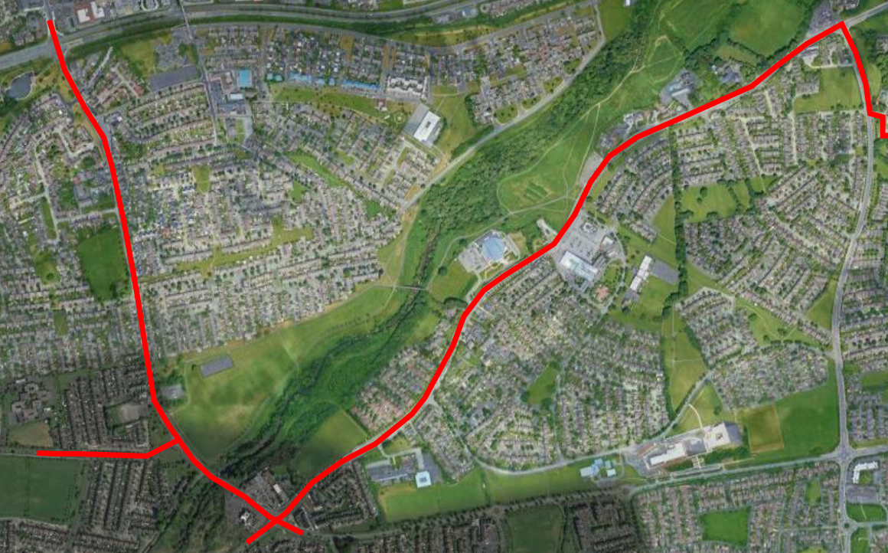
Tallaght To Knocklyon Active Travel Route Maps and Drawings

Slide 4
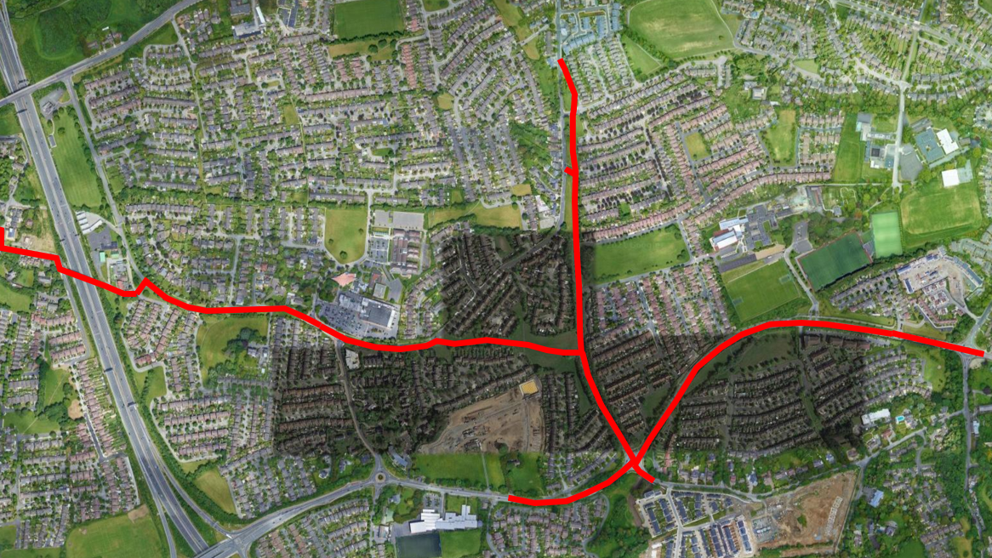

Slide 5
Tallaght to Knocklyon Active Travel Route Update Cont’d
Provide safe segregated walking and cycling facilities between desire locations such as residential area, schools, business, recreational centres etc.
Improve interconnectivity and permeability between neighbourhoods
Encourage modal shift from private car use to active and sustainable travel
Incorporate urban realm improvements and greening where possible

Slide 6
Tallaght to Knocklyon Active Travel Route Update Cont’d
Part 8 (2012) currently in place and being assessed against current design standards
Initial focus of design is on Old Bawn section, followed by Firhouse Road, and then the Knocklyon section.
Where feasible, secondary links to schools, residential areas etc. being incorporated into the scheme

Slide 7
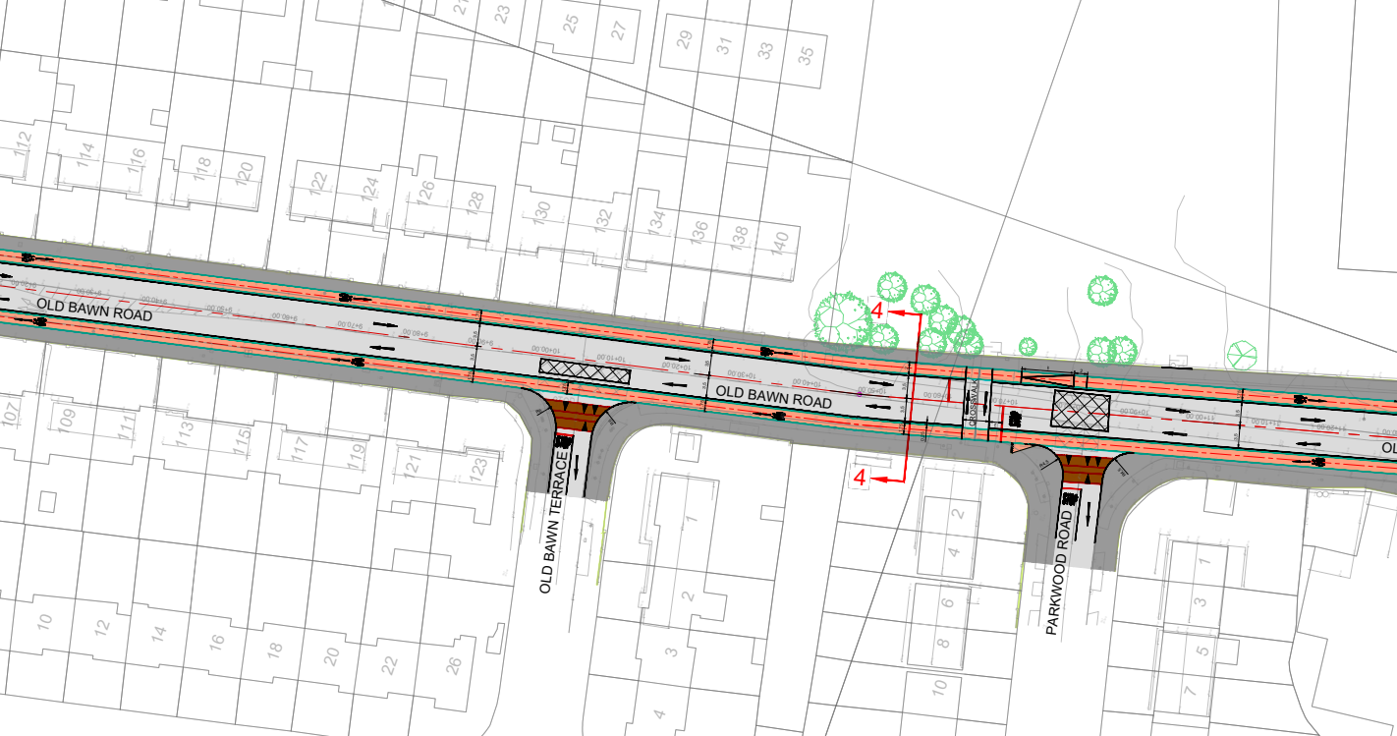

Slide 8
