Slide 1
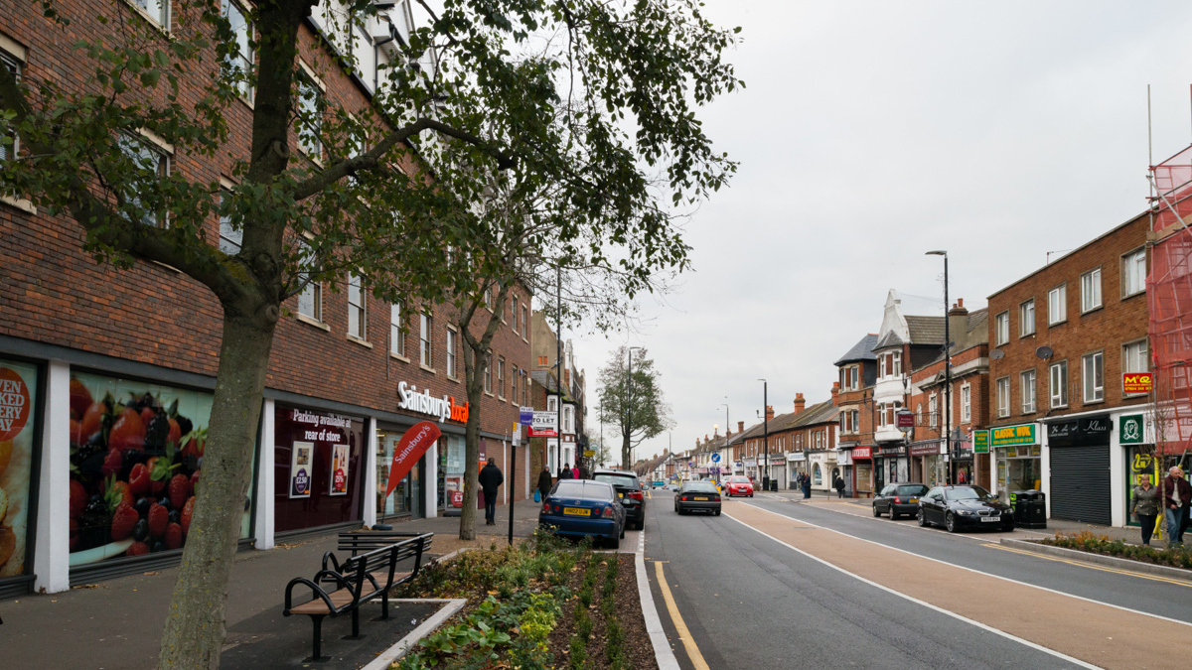
SOUTH DUBLIN COUNTY COUNCIL
DISTRICT CENTRE ENHANCEMENT PROGRAMME
Castletymon Shopping Centre
Public Consultation Summary

Slide 2
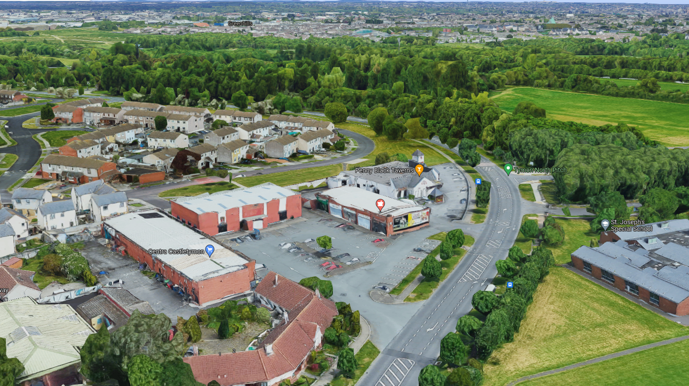
Objective 2
Make the common areas within, and adjacent to, the centres more user friendly

Slide 3
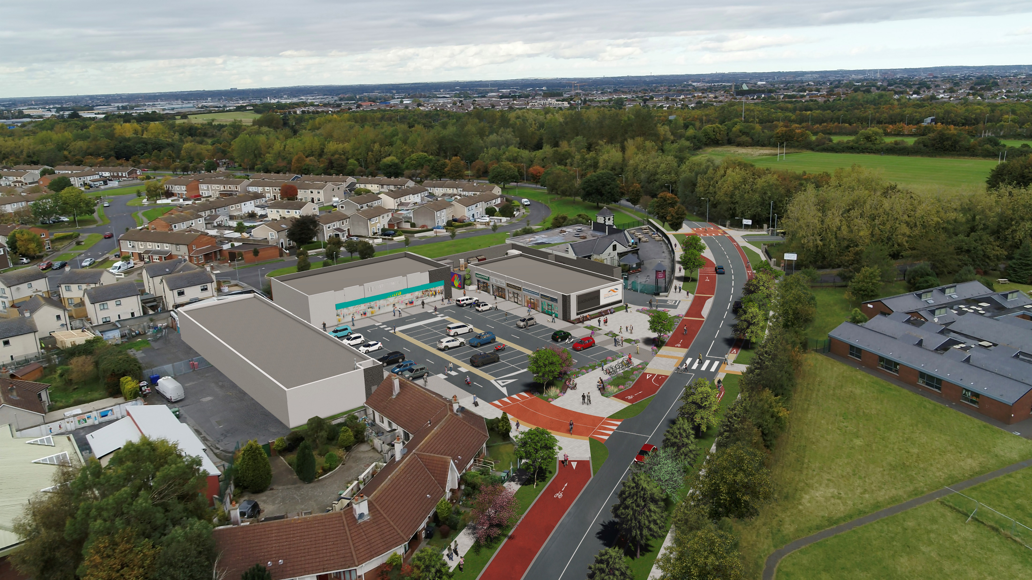

Slide 4
Public Consultation – 9th November 2021 to the 4th of January 2022
Newspaper Notice issued in the Tallaght Echo and in the Evening Herald
4 Site notices were erected around the centre
Traders were all notified directly about the Public Consultation
Virtual Consultation Room was launched; https://www.dcepconsultation.com/
SDCC’s Consultation Portal Page was also launched; https://consult.sdublincoco.ie/en/consultation/castletymon-enhancement-project

Slide 5
Castletymon Enhancement Project’s Public Consultation has now closed.
7 submissions were received however 2 submissions were withdrawn before the closing date.
The key items raised during the submissions are as follows;
A request for increased green space in Landscaping
Request for additional bicycle parking (bike shelter) and should be moved to a more prominent location for passive surveillance
Request to give over vehicle parking space for bicycle parking
Request for parent & child spaces, e-charger spaces in the car park
Request for new Bus shelter (Stop #2427)
Request for wider cycle lanes and tie-ins (continuation of cycle)
Request for signalised toucan crossing
Request to retain all car parking spaces.

Slide 6
Programme;
The Part 8 Report is to be presented to Council on the 14th of February 2022.
If approved the scheme will be progressed to Detailed Design immediately.
With the intention that construction will begin in Q3 of 2022.

