Slide 1


Review of LEO South Dublin Activities 2021 and introduction to LEDP 2021-2024
Presentation to EETD SPC 9th February 2022
Notes:
Welcome from LEO
Review of Activity previous years and Activity for 2021 Year to date
South Dublin LEO Development Plan Framework 2021-2024
Key priorities for South Dublin LEO Development Plan Framework 2021-2024
Engagements with Enterprise Ireland
What next for South Dublin
Dublin Regional Development Plan 2022 -2024

Slide 2
Agenda
Comparison M1 & M2 – 2021 Vs 2020
2021 Recap
M1 Overview / Financial Supports
Training & Mentoring Supports
Business Supports
Programmes
South Dublin LEDP 2021-2024
What’s next………….
Questions……………….

Slide 3
LEO South Dublin provided over €2.1m in support to local businesses in
2021
€1m+ Spent supporting local companies develop their online business
€926k
of Business Start-up, Expansion and Feasibility Grants Approved supporting 38 new jobs with potential for additional job creation
€200k approved for Agile Innovation Projects
Over 2450+ attendees at over 140 training courses
1344 hours of free mentoring support provided to local businesses
40 Businesses helped to get export ready through training and grant support
Local Enterprise Office South Dublin – 2021 Recap

Slide 4
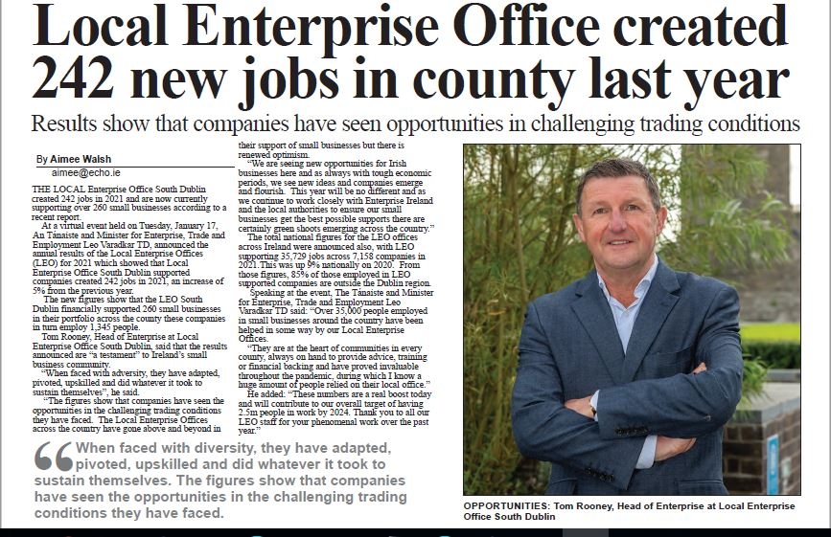
LOCAL ENTERPRISE OFFICE SOUTH DUBLIN NOW SUPPORTING OVER 260 SMALL BUSINESSES AND 1345 JOBS ACCORDING TO NEW FIGURES
242 new jobs created in 2021
3% job increase from 2020
8th year of YoY jobs growth
Net employment gain of 37 in 2021
260 total small businesses employing 1345 people supported by LEO South Dublin
Extract from recent press release on Jobs growth……………..20th January 2022

Slide 5
M1 Overview
Notes:
Key Stats Review recent years and discuss to date
During the past 2017 to 2021 period South Dublin recorded a steady level of achievement in the numbers of entrepreneurs, owners and managers who successfully accessed financial supports and enabling them to plan, grow and sustain productivity, innovation, and competitiveness.
Successful funding applications increased year on year from 18 in 2018 to 30 in 2020 across Feasibility, Priming and Business Expansion supporting the creation of 39 jobs in 2020. M1 – Priming €487K / B Exp €328K and Feas - €81K
Year to date on 2021 we have had a further successful 28 funding applications supporting 37 jobs and expect to exceed our 2020 achievements
Significant growth in the value of Financial Funding since 2018 despite the challenges of Brexit and Covid. Across the sectors software represents 1 in 5 successful applications and this is growing followed by business services, food, manufacturing and customer services.
We are seeing a growth in Communication & Media, Fashion (sustainable fashion) and Green/Environmental services business development
Looking at the sectors in this we have
Food Manufacturing & Processing 5
Communications, Media & Entertainment Services 4 adj for Smart Studios
Furniture/Light Consumer Goods Manufacture & Other 6
Software/IT 9
Services – Environmental / Ed Special Needs 2
Health - Services 2
Business Services – tech supported services 3 –

Slide 6
Financial Supports TOVS – Trading Online Voucher Scheme
Notes:
Application and Approvals for 2021 still exceed normal levels by in excess of 100%

Slide 7
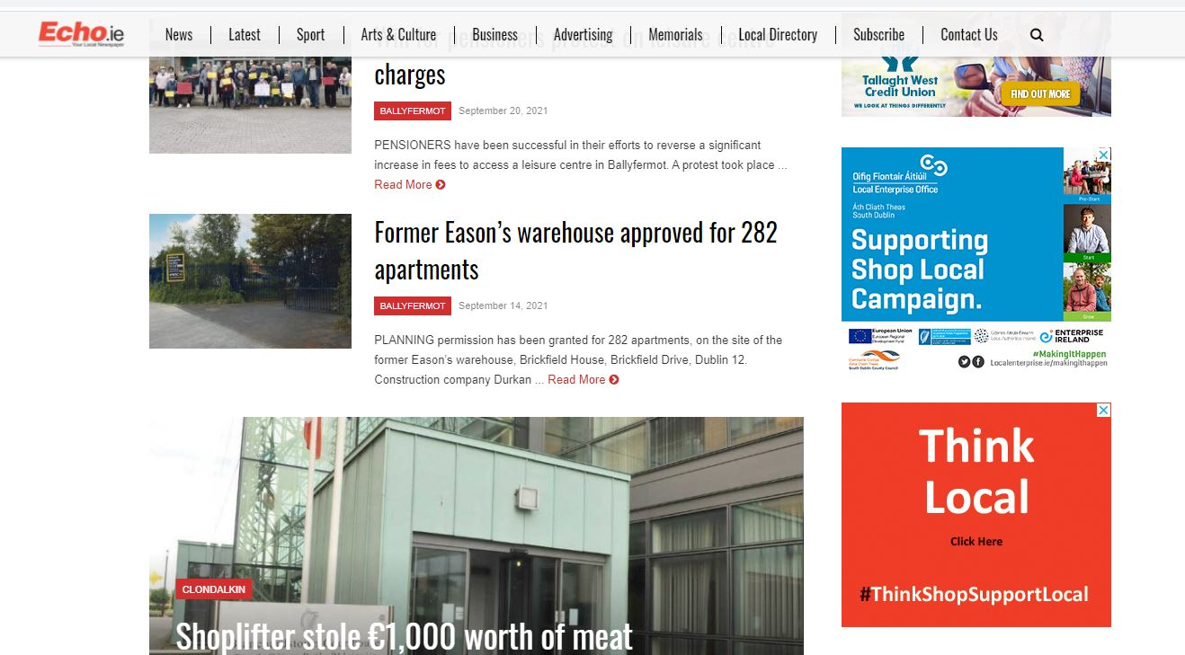

Trading Online Voucher
Notes:
A total of 781 Trading Online Vouchers (TOV) were approved over the period of 2017-2020 of which 672 vouchers were approved in 2020 alone ( from 1425 applications).
TOV 672 value support €1.68
(Annual average was 50 per year in prior years to 2019)
In 2021 despite the reduction in % grant support we have approved 121 applications year to date
Key sectors securing Customer Services – (Health & Wellness, Hair & Beauty, Gyms), Business Services ( Fi
Local campaign with The Echo
200+ businesses signed up
Weekly client focus
Look for Local - + 700 TOV clients listed / supported by national campaign
Expanded specific training course aimed at helping TOVS recipients develop and drive their online presence
High levels of participation in Social Media and e-commerce training

Slide 8
Business Supports Mentoring & Training

Slide 9
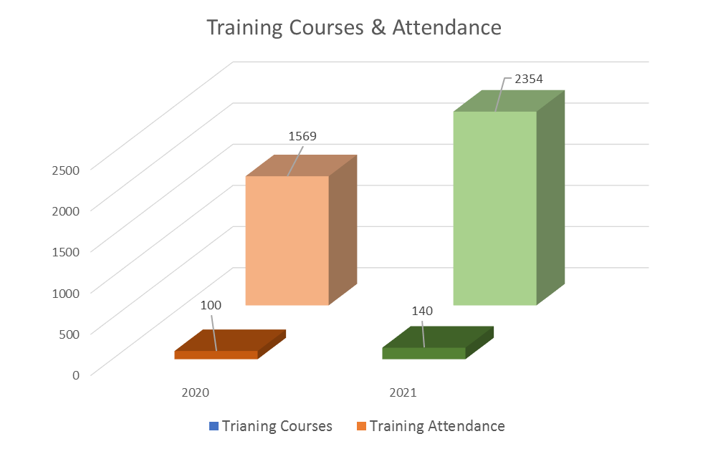
Training Programmes
Notes:
While training has been growing steadily from year to year the move to virtual saw a doubling in participation in 2020 over 2019
During 2020 we have put on 116 Training programmes which were attended by 1798 participants ( a number already exceeded in 2021
Most popular training is across the Social Media and Web-development workshops, followed by Business Management, Sales and Marketing and Finances for SME’s

Slide 10






Start Your Own Business
3. Further Training
Start Your Own Business
Client Progress
1 to 1
2. SYOB
1. SYOB Mentor Briefing Session
Idea
Notes:
Start Your Own Business (SYOB) programmes increased year on year from 8 2019 to 10 in 2020 and to 12 in 2021
SYOB is Core Training Support
During 2020, we conducted a review of the programme.
2021 we introduced a three stage programme
SYOB – Are you Ready Workshops
Enhanced SYOB with core modules and addition of 1 to 1 coaching sessions
Advanced / Progression training – Growth and Acceleration planned for Q4 2021

Slide 11



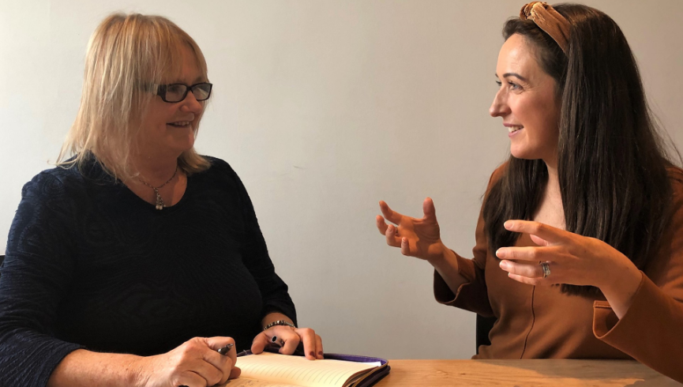









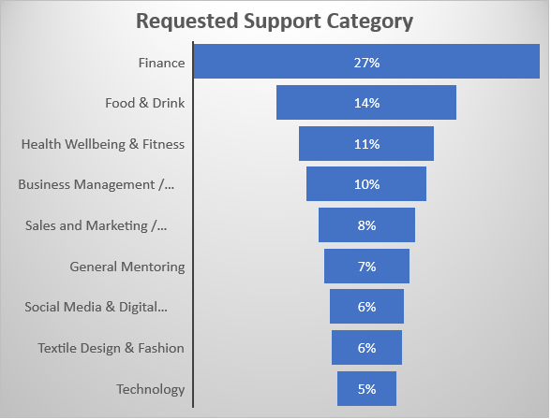
Mentoring Programme
Notes:
In 2020 we procured a larger mentor panel to cater for the growing of businesses and the wider diversity of their challenges.
We have close to 50 mentors across 13 panels to ensure we have the spread of expertise to support our clients
Panels are as follows
Finance
Food & Drink
Business Management & LEAN
Sales, Marketing & International Trade
Social Media & Digital Marketing
Textile Design & Fashion
Technology
Website / SEO / TOVS
Human Resources
Legal
Social Enterprise
1 to 1 Mentoring increased by 220% in 2020 with 441 sessions up from 201 in 2019 and further expansion of services were achieved with the move to
Online assignments and participants increased from 452 in 2018 to 881 in 2020.
2021 we had 548 Mentoring assignments up from 5043 in 2020

Slide 12


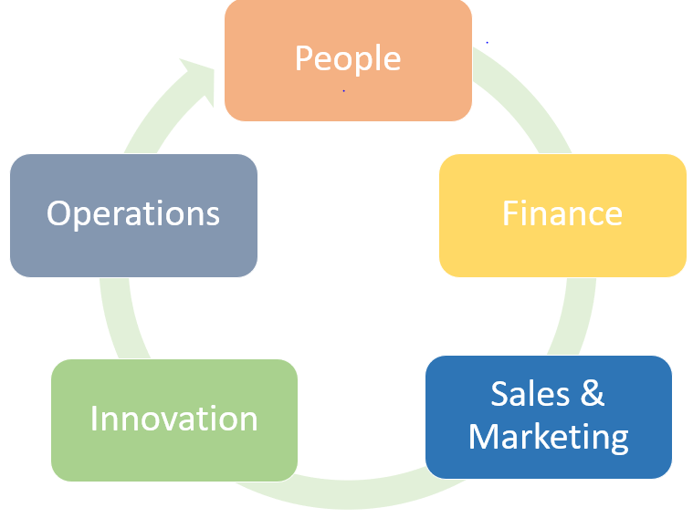

LEAN, Green and Leadership Development Programme
Leadership Development
Notes:
Understanding of what lean thinking is, how this approach can be applied to your business,
lean waste, and most importantly eyes for waste.
Lean is about helping businesses to increase performance and competitiveness.
Lean tools and techniques are helping companies across the globe to address competitiveness issues within their businesses by building the capability of their people to identify problems, improve operations and create a more innovative organisation.
Lean for Micro organised on a Dublin Regional basis with a minimum of 5 programmes per year
Increased focus on clients to participate on Lean for Micro in 2021
Continuing to see a growth in uptake
2019 7
8
11 (ytd)
Building on participation of LEO clients in the Green for Micro Programme to get them started on their journey to greater sustainability is another key target for LEO South Dublin.
Green for Micro Activity Year to date
12 Applications – 9 Approvals -
Collaboration with Sustainability Officer SDCC & SD Chamber
Possibility to identify and progress further initiatives and investments to support Green programme will be considered over the 2021-2024 period.
Rolling out an expanded Leadership Development in 2022 to build on engagements with clients to support their business growth and enabling their leadership development
New programme introduced in 2021 aimed at preparing SMEs to be ‘export ready’ by improving their strategic, sales & marketing, business planning, productivity and leadership capabilities.
South Dublin Export Development Programme introduced in July 2021
2nd Programme commenced October 2021
12 targeted companies involved in each programme.
Sectors:
6 Tech
6 Food/ Drink
12 Clothing/ Products/ Manufacturing
“Very valuable, would definitely recommend to other businesses seeking to work opportunities abroad”
“The course provided us with some new avenues for identifying new sales leads & business opportunities.
New South Dublin Exporters Network being established
TAME grants also available for our Exporters – uptake was low in 2020 with just XX but applications improving and will certainly grow in 2022 as it is so accessible for early stage exporters

Slide 13
Business Continuity Voucher
Notes:
Received 672 Applications
BCv – 552 funded – support cost €1.38

Slide 14






Opportunities from COVID
Free
Mentoring
Financial
Support
Networks
Programmes
Free Training
Reconnect
Connect
Notes:
South Dublin approved 552 Business Continuity Vouchers
These were provided across wide range of sectors many of which are older businesses with no previous relationship with SD LEO
Many are now returning to us for supports across Training, Mentoring and Business Supports
Examples include e.g.
RVF
Paper Assist
MEC Springs
Smart Studio
All above are signing up for LEAN / GREEN & EXPORT
COVID/Brexit key challenges businesses are reporting
Recruitment Logistics Rising costs of Materials / more recently Energy is a big concern
Uncertaintity – still hanging over businesses
Highlighted Opportunity for LEO to connect with businesses < 10 employees who have not been connecting with LEO or EI previously who we are targeting for training but who could greatly benefit from other grants particularly around LEAN, Green and Innovation and Digitisation.

Slide 15
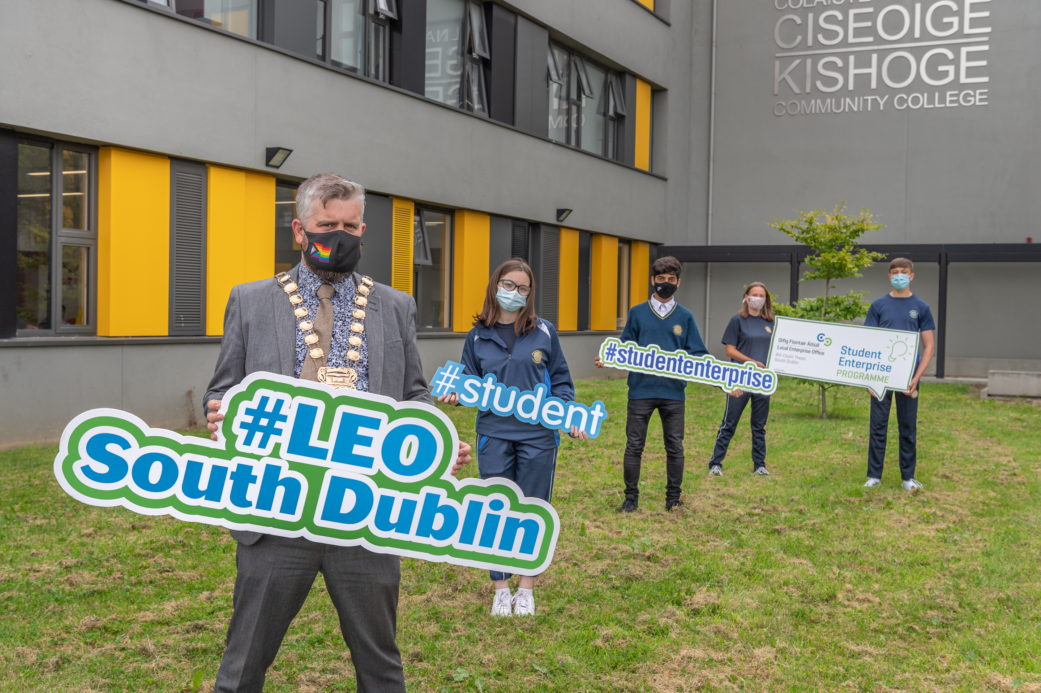

Student Enterprise Programme
Notes:
Entrepreneurship as a Career
19 Schools and 643 Students participated in 2019/2020 Programme
Enhanced programme for 2021/22 academic calendar
Workshop with teachers provided insight into additional support that could enhance engagement.
Want to enhance resources to support increased schools engagement in the county where almost a third (12) of our 38 secondary schools in the county are designated DEIS.
In addition to the core programme LEO South Dublin will
Mentor support for both teachers and project teams
Training videos specific to project deliverables – available anytime
Easier Access to seed support
Interim reviews with teachers to address barriers
19 schools have signed up for2021 / 2022 programme

Slide 16
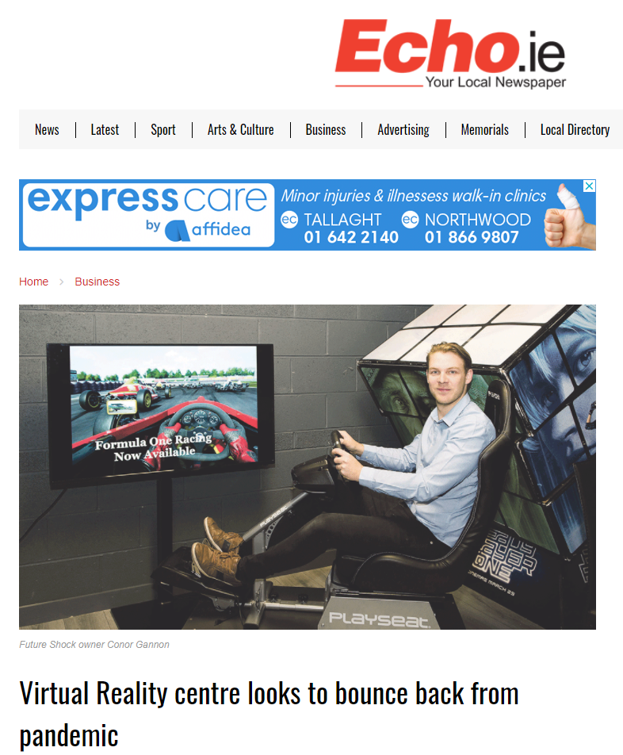
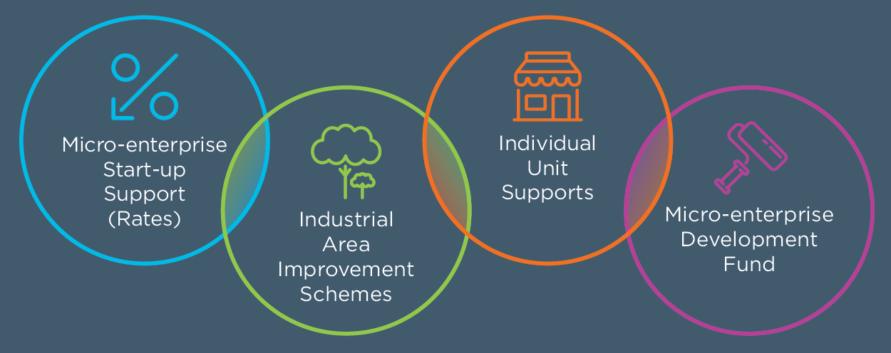


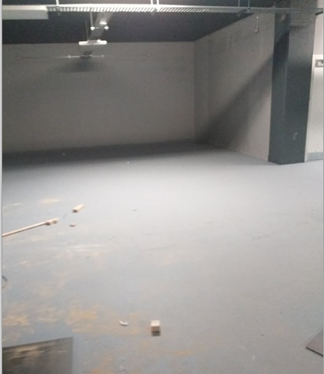
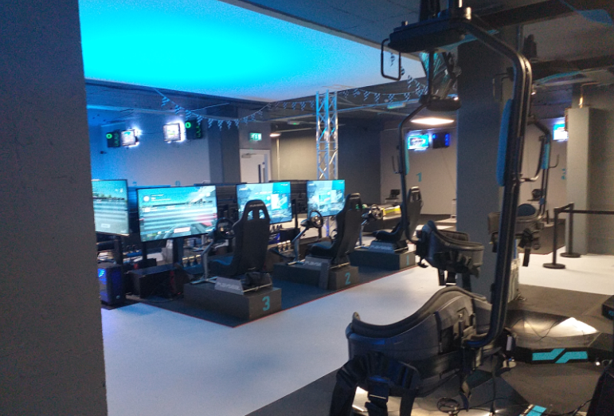
South Dublin Business Supports
Business Support Fund
Sustainable Business Programme
Notes:
There are four funds specifically designed to address key issues for businesses in the County. Two of the funds support physical works and are aimed at encouraging occupiers to improve the investment potential of industrial estates or units in which they are resident, in particular those industrial estates experiencing high levels of obsolescence, dereliction, vacancy and abandonment. Two of the funds are specifically aimed at supporting existing small scale businesses and start-up businesses utilising previously vacant units.
Industrial Area Improvement Schemes Eligible expenditure of up to €75,000 – 50% support, plus individual Unit support of xx % up to €5,000 expenditure
Eligible expenditure of up to €75,000 – 50% support plus additional Rates holiday for new Micro Enterprise occupiers over first 2 years of business activity from units within unit.
Industrial Area Improvement Schemes
Applications for Microenterprise Unit Support Industrial Unit Ind Area
9 + 6 rates support 1
019 11+ 3 Rates support 8 1
8 + Rates support 12 1
2 10 + 9 Rates Support 7
The scheme is intended to improve the appearance of independently owned shops fronting public streets. Eligible expenditure of up to €11,5000 will receive 50% support – with a competition to select ‘Shopfront of the Year’ Award annually.
2019 – 19 applications
2020 – 14 applications
2021 – 32 applications
Continue and expand the Sustainable Business Programme to small businesses across the County in collaboration with the South Dublin Chamber.
This programme is a coming together of South Dublin Chamber, South Dublin County Council and South Dublin County LEO in a partnership arrangement that is both unique and effective in providing the 6,000 businesses of South Dublin County with a focused support intervention available to all ratepayers in the county
The core work of the Sustainable Business Programme is to provide a link to the wide range of services and resources available to local business in an easily accessible format without undue bureaucracy, as well as feeding back information from these businesses to inform local economic development policy. The key to the programme’s success is listening to businesses and working with them to understand their needs and to share with them what is available to assist in addressing these needs.

Slide 17

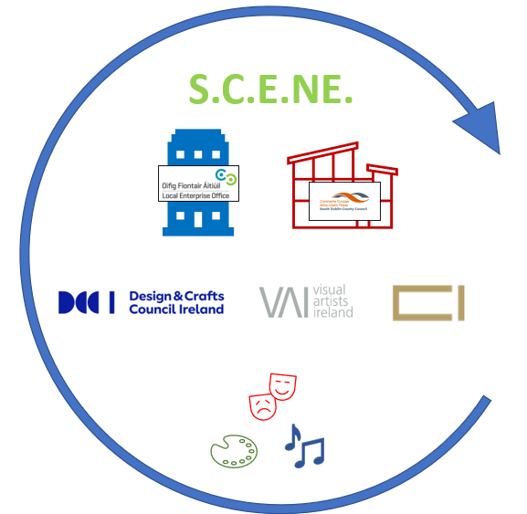



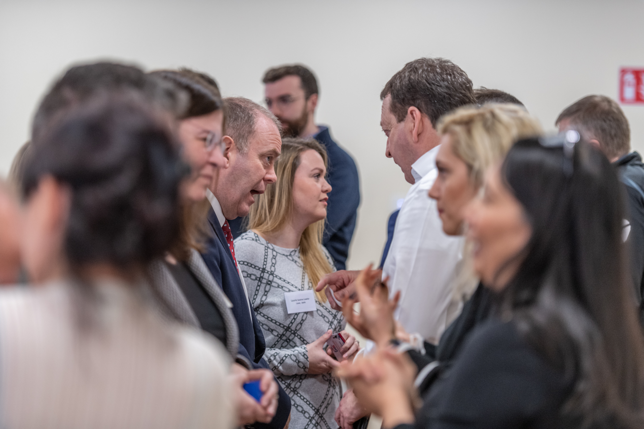



NETWORKS
Dublin Food Chain
Notes:
Networks and Networking
Create new Networks around SME Leaders and expand the membership and programme of activities for existing and newly established networks
Dublin Food Chain – iThe Dublin Food Chain is a marketing and networking forum that represents many of the outstanding food and drink producers, retailer,& distributors that are based throughout Dublin City and County.
Dublin Food Chain is a collaborative initiative of Local Enterprise Offices in the Dublin area, and supported by Bord Bia. The Dublin Food Chain is part of an ongoing effort to harness the power of the 'collective', in order to ensure that Co. Dublin's unique food heritage benefits from the attention it deserves
NEWS / SCENE / Micro Exporters / Lean
Actively promoted the benefits of membership
Focus on developing the business skills of the members
Work with a steering group to guide the development
Survey members to understand the diversity and help guide the activities of the network
Encourage member to member engagement
Set out s progressive calendar of training addressing core business areas.
Provide for networking events to encourage collaboration
Year to date on 2021 we have a SCENE – linking Creates and Designer as a network for workshops, events and peer to peer facilitation and to members signpost to wider supporting service to grow Creative Enterprises
further Networks and setting up Exporters Network – which has just 30 members at present and next event is planned for December next.
Dublin Food Chain – Dublin Regional Collaboration
Clustering – key focus
Upskill on Clustering planned as a key Action under Dublin Regional enterprise Plan 2021-2024l Dublin Region LEO plan to Develop a strategy to enable and cultivate the formation of sectoral clusters in the Dublin region.
South Dublin Med-Tech/ Bio Tech Cluster in association with Tallaght Hospital and TU Dublin Tallaght &
South Dublin Tech cluster

Slide 18



Working with Enterprise Ireland
LEO Clients transferring to EI
2019 13
2020 10
2021 4
LEO / EI Collaborations
Regional Collaboration
HPSU – meet with HPSU team at Regional level and directly
Competitive Start Fund
Export Development – collaborating on development of South Dublin programme and providing feedback to EI Kompass programme
Agile R & D
Centre of Excellence - Monthly meetings / Daily contacts and continuous support
Workshops – EI representation
Thanks to EAC South Dublin

Slide 19
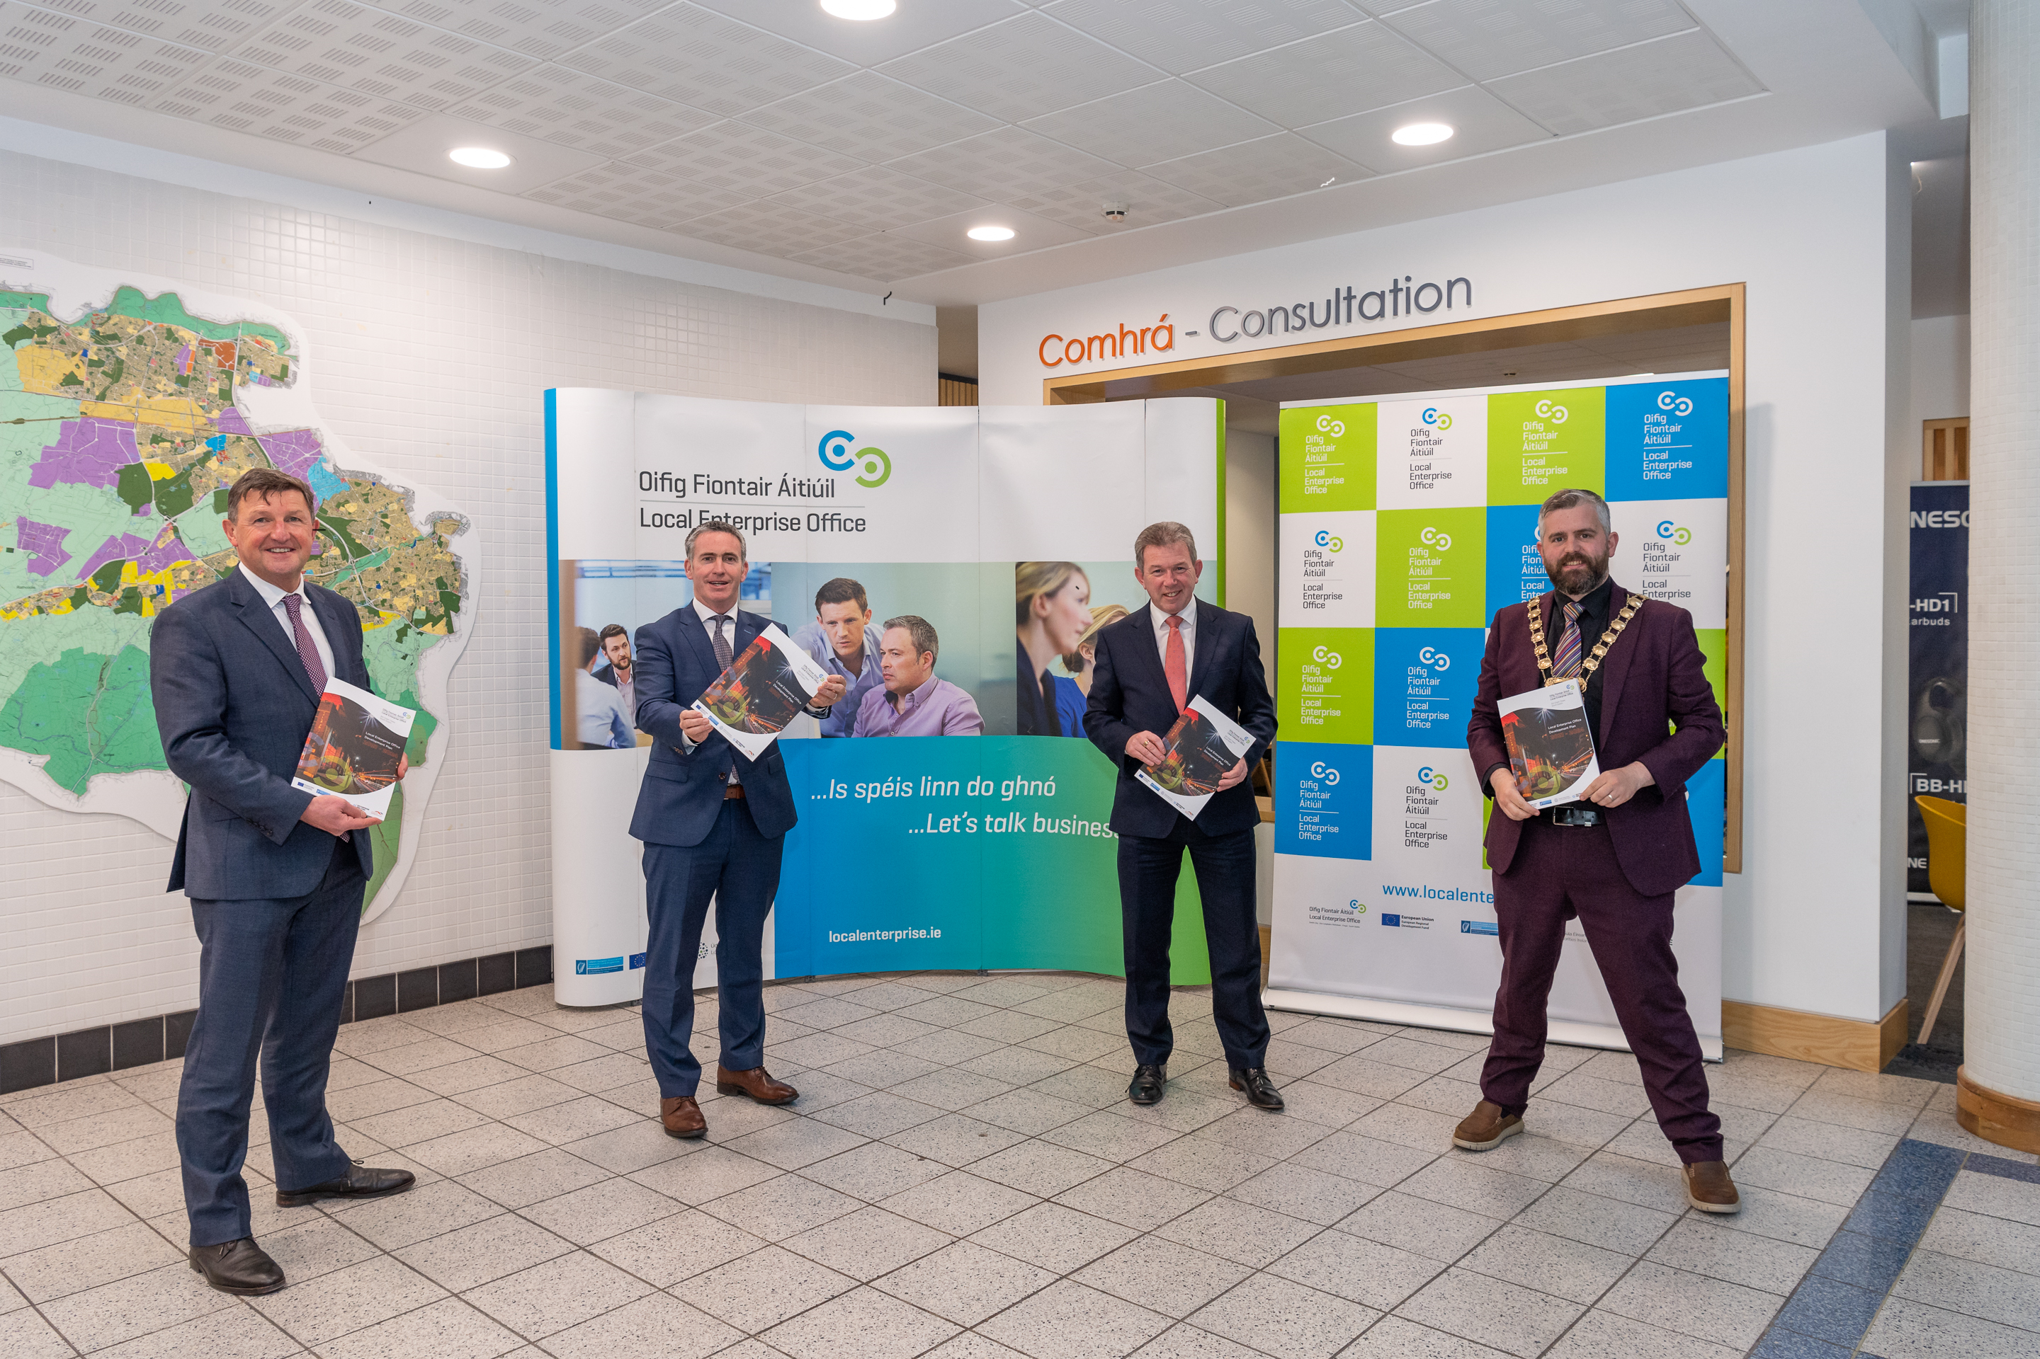
LEO South Dublin LEDP 2021-2024 launched by Minister English
November 2021
South Dublin
What’s next…..
Notes:
Key Stats Review recent years and discuss to date
During the past 2017 to 2021 period South Dublin recorded a steady level of achievement in the numbers of entrepreneurs, owners and managers who successfully accessed financial supports and enabling them to plan, grow and sustain productivity, innovation, and competitiveness.
Successful funding applications increased year on year from 18 in 2018 to 30 in 2020 across Feasibility, Priming and Business Expansion.
Year to date on 2021 we have a further………………………….

Slide 20
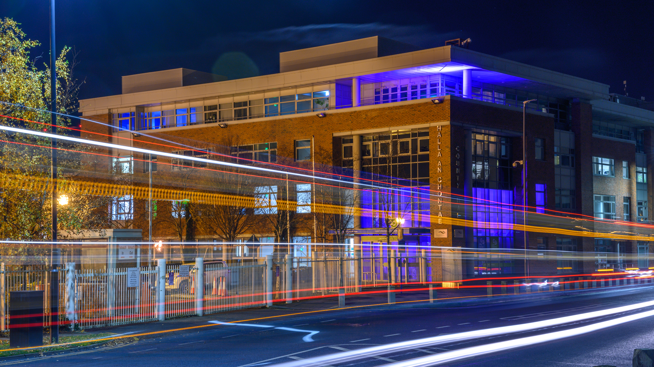
South Dublin LEO Development Plan 2021-2024
Mission Statement
Local Enterprise Office (LEO) South Dublin aim to promote entrepreneurship, foster sustainable business start-ups, and develop existing micro and small businesses to drive job creation and to provide accessible high-quality supports for your Business ideas.
Notes:
South Dublin LEO Development Plan Framework 2021-2024
Increase exports
Build resilience
Increase productivity
Prepare for the Low carbon economy
Embrace the Digital economy
Innovate
Be managed by ambitious & capable individuals
Fuel regional growth

Slide 21
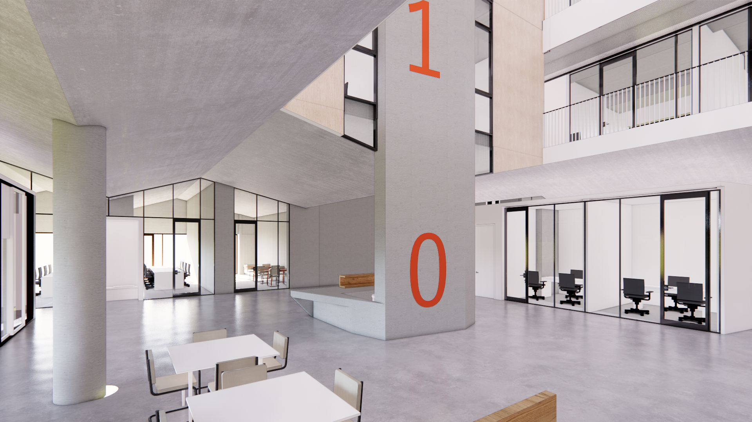
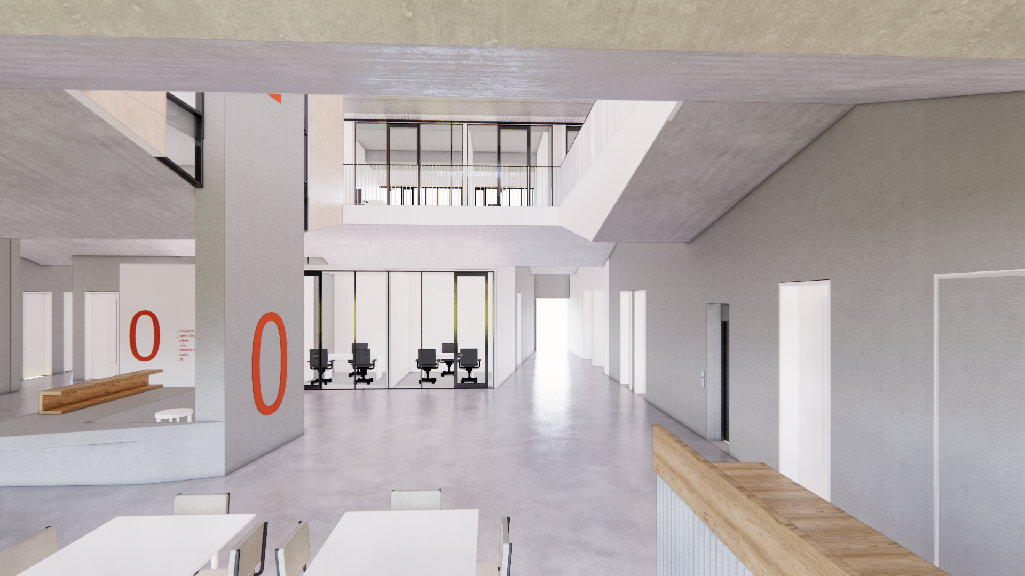
LEO South Dublin Objectives
LEO South Dublin puts local micro and small business at the heart of job creation.
Promote South Dublin as a location for Tech Business Start-ups while we progress the construction and commissioning with Oxford Innovation of the Tallaght based innovation / enterprise centre due for completion Q1 2023.
State of the art 3,000m2 facility over 4 floors in the heart of Innovation Quarter in between TUH and TUD Tallaght campus.
Notes:
OI – expertise
Oppoerunities for Tallaght Innovation Centre to network with UK Innovation Centres
Allow us to hold Networking and other Events for the wider business community

Slide 22
Strategic Priorities for South Dublin LEO
Food Sector Think Big Space
Notes:
AWS Think Big Space Tallaght
Collaboration between SDCC / AWS / LEO and Foroige
Ensure that students, staff and the community have equity and access to resources for learning about cloud computing and technology
Become an educational incubator empowering students, staff and community to solve real-world problems through technology.
Be a catalyst to inspire future builders through discovery, innovation, and creativity.
Provide a unique learning environment.
Provide adult learners opportunities to improve their skills and knowledge of technology as potential applicants for the tech workforce
Food Sector Focus
Draft Strategic Food Sector Plan 2022-2025
Our Vision
For South Dublin to be the ‘go to’ location for innovative and sustainable food producers to start and grow their food business within a thriving, vibrant and attractive county where food is created by the community, for the community, within the community.
Opportunity for expansion for Food Producers – additional production units / food consumers and retailers – indoor/covered market
Tourism , Craft and Design Sectors Focus
Delivery of new Tourism (capital) projects will create new business opportunities – namely DMVC and Rathfarnham Courtyard & Stables
Development of strong ‘Food sector’ will enhance the local and visitor experience
Schools Enterprise Programme
Targeting increased 2021/22 engagement with additional workshops enhanced resources (digital also) and mentoring support for our future schools programme
Copy on Tourism

Slide 23
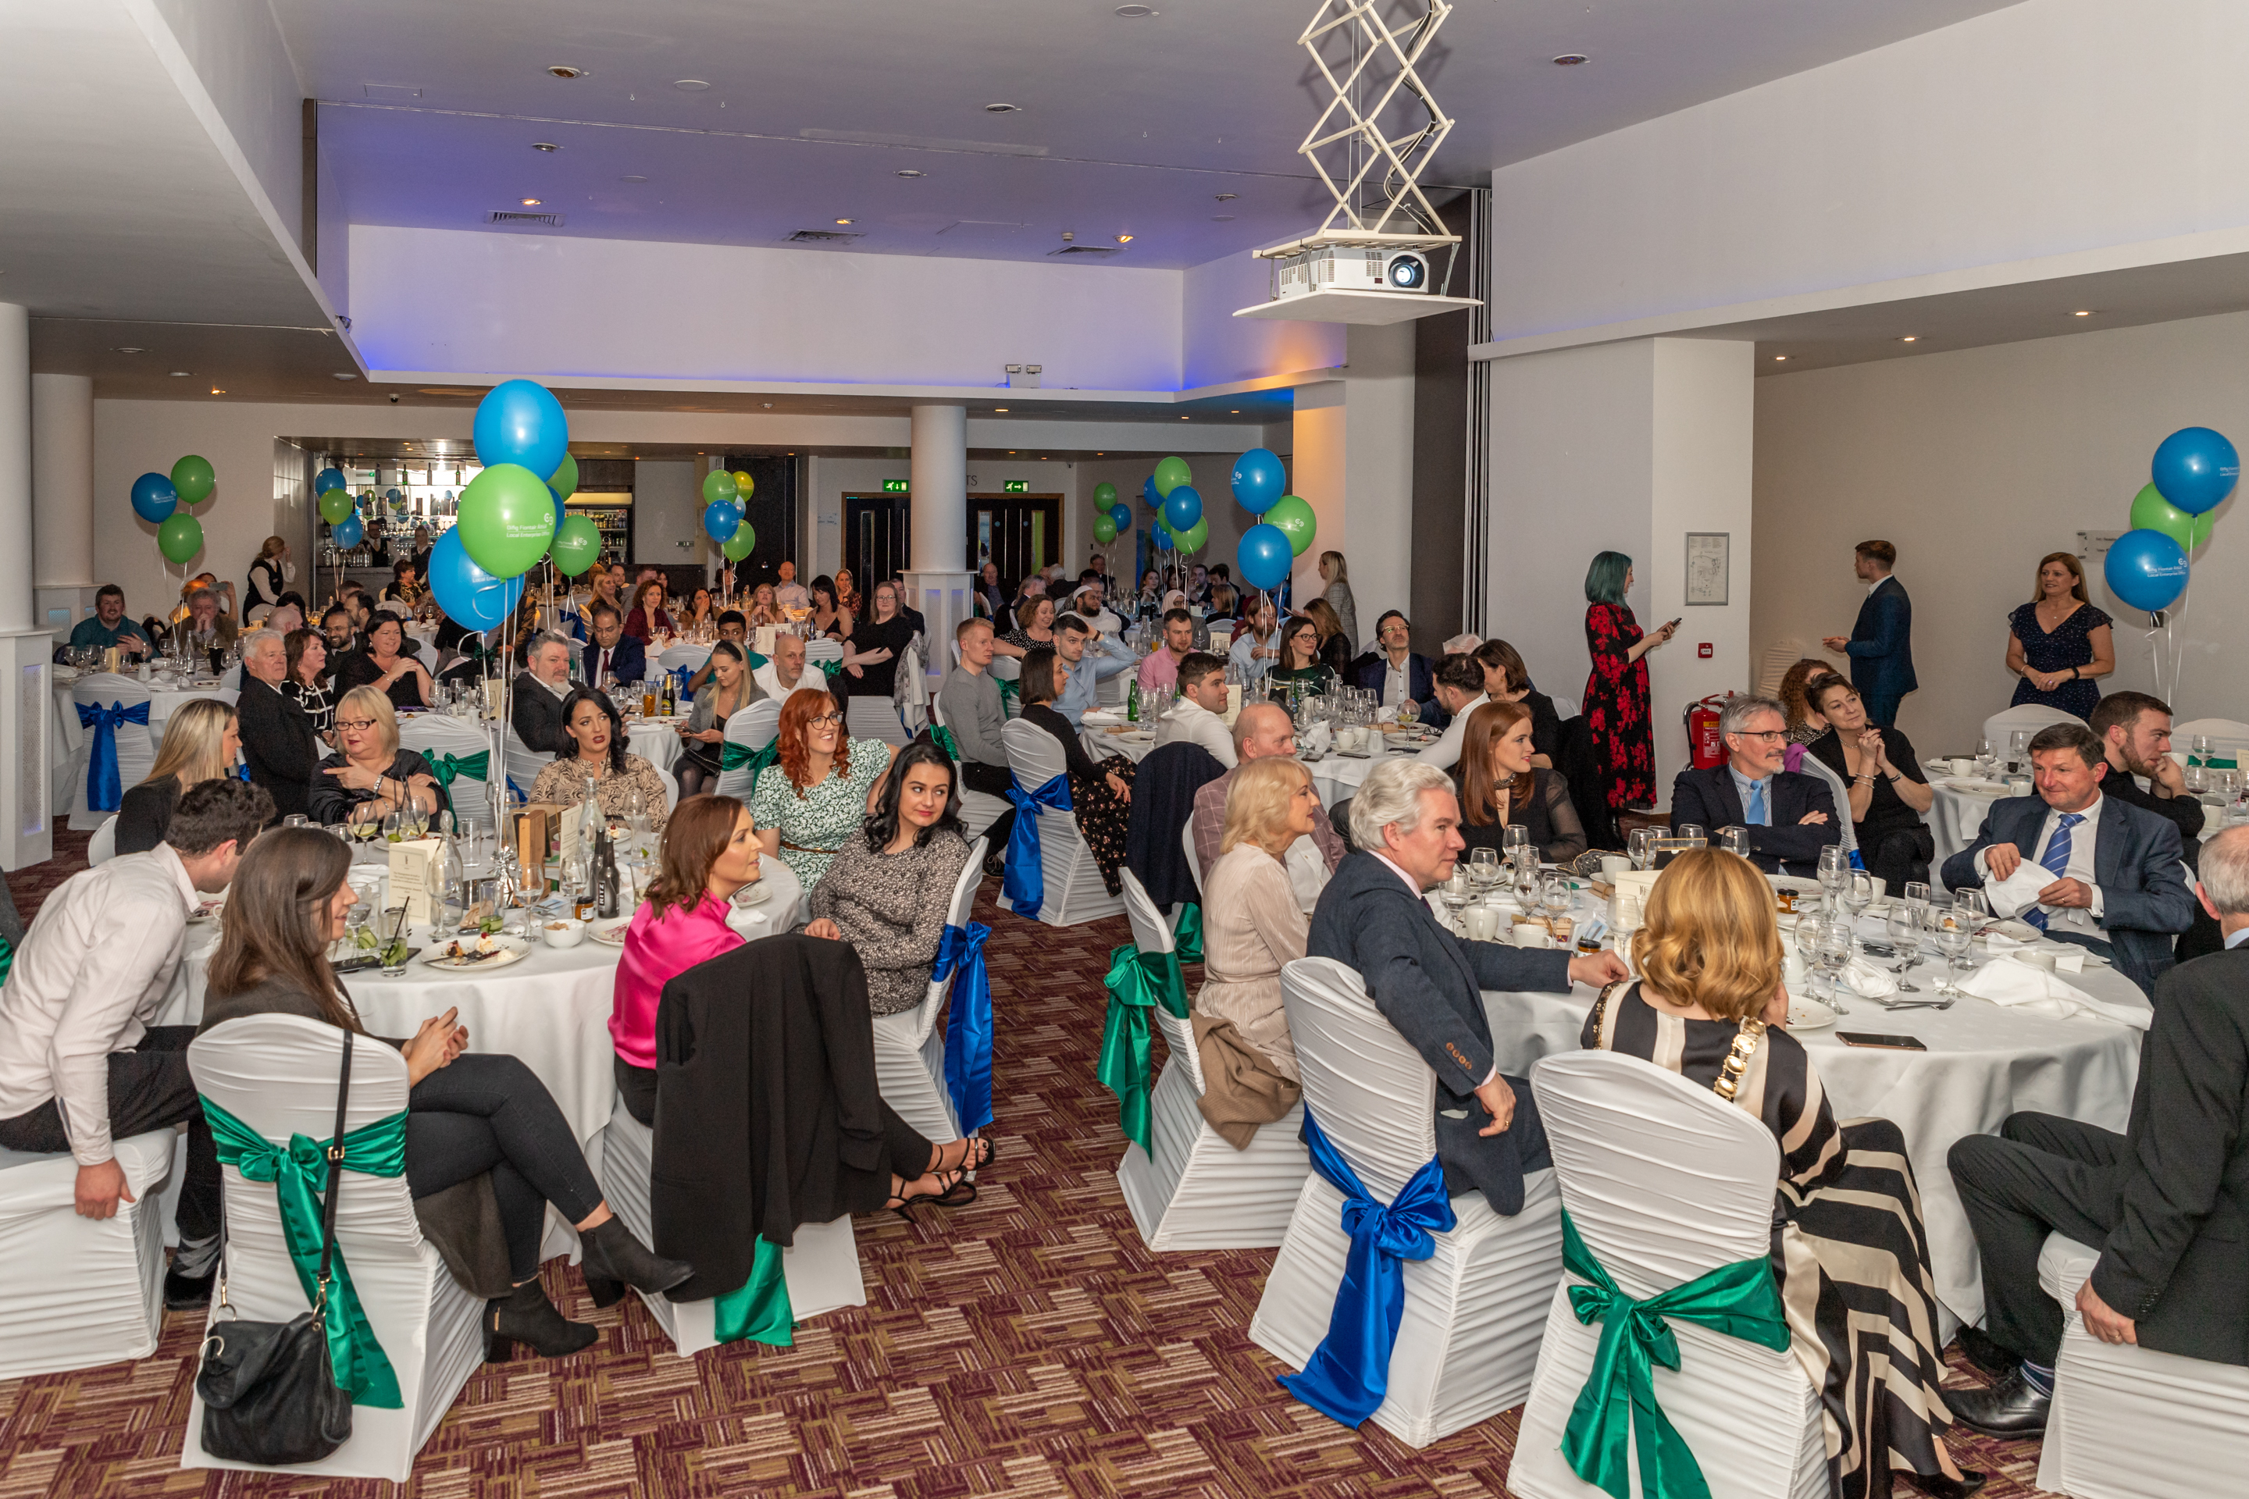
Strategic Priorities for South Dublin LEO
Digitalisation & Competitiveness
Green/Sustainability
Innovation
Exporting/ Internationalisation
Leadership Development
Networks and Clustering
Notes:
Currently actioning our Strategic Priorities
Continuing to expand and grow our Networks
Need as a group to Upskill on Clustering – this is planned under Dublin Regional enterprise Plan for all LEO to support plans to explore opportunities to develop local cluster. In particular
South Dublin Tech cluster to include Tallaght Hospital and TU Dublin
Clustering – key focus
Upskill on Clustering planned as a key Action under Dublin Regional enterprise Plan 2021-2024l Dublin Region LEO plan to Develop a strategy to enable and cultivate the formation of sectoral clusters in the Dublin region.
South Dublin Med-Tech/ Bio Tech Cluster in association with Tallaght Hospital and TU Dublin Tallaght &
South Dublin Tech cluster

