Slide 1
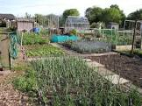
SURVEY ON ALLOTMENTS IN SOUTH DUBLIN COUNTY COUNCIL

Slide 2
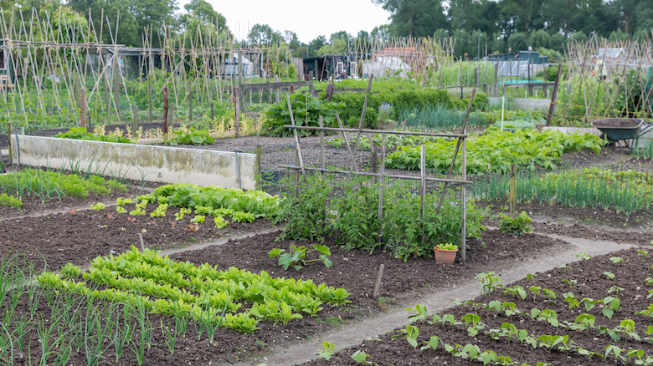
600 Surveys issued by post, including those on waiting lists. 56% returns received.

Slide 3
ALLOTMENT LOCATIONS Break down of returns
Friarstown 54% (161)
Tymon 62% (8)
Corkagh 62% (24
Mill Lane 50% (37 )

Slide 4
Questions asked
Size of Allotment held
How many hours spent on allotment
What things do you enjoy about having an allotment
What do you find challenging about having an allotment
Overall conditions/facilities
Would you like to see SDCC more involved in maintenance – if yes how do you think these works should be funded
Are there areas you’d like to see improved
Further comments
What is a reasonable annual fee

Slide 5
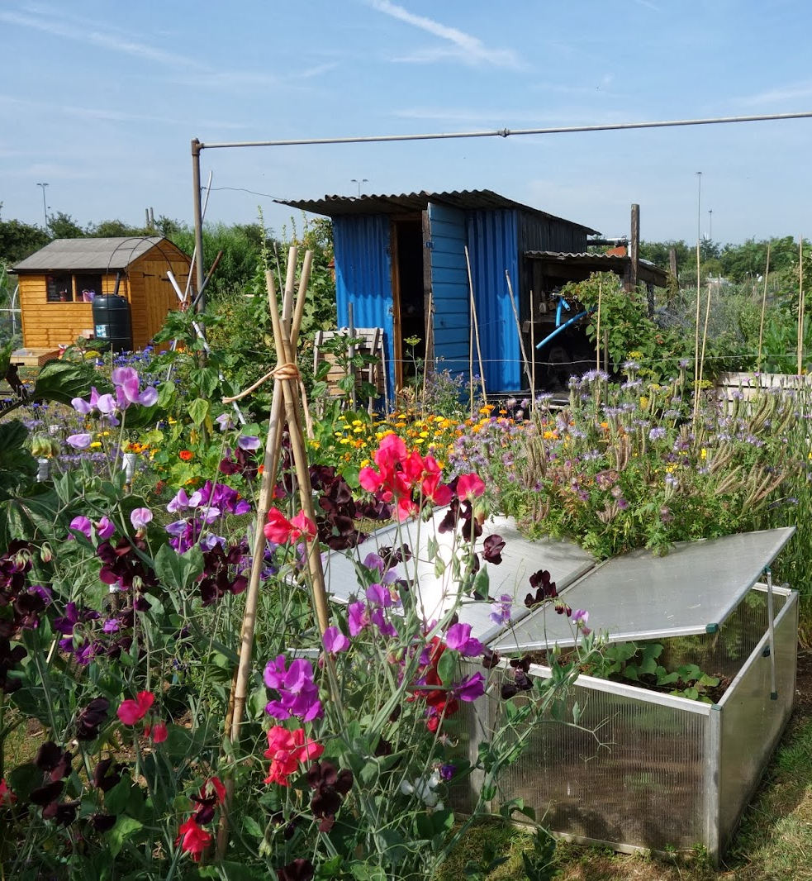
SAMPLE OF REPLIES
142 had allotment sized between 101 & 200 sqm
133 spent 10 – 20 hours on allotment
151 grow fruit & veg
85 like the outdoors/fresh air
86 found weed control the most challenging
87 were happy with the overall conditions/facilities
174 would like to see the Council more involved in maintenance
134 thought this should be funded from SDCC overall budget
64 felt vacant plots should be allocated more quickly

Slide 6
SIZE OF ALLOTMENT

Slide 7
HOW MANY HOURS SPENT ON ALLOTMENT SITE

Slide 8
WHAT THINGS DO YOU ENJOY ABOUT HAVING AN ALLOTMENT

Slide 9
WHAT DO YOU FIND CHALLENGING ABOUT HAVING AN ALLOTMENT

Slide 10
The overall condition/facilities at my allotment

Slide 11
Would you like to see SDCC more involved in maintenance works at your allotment site

Slide 12
If yes how do you think these works should be funded

Slide 13
Are there areas of allotment administration/management you would like to improve

Slide 14
What do you think is a reasonable annual fee

Slide 15
Further comments
Would like help with posts in the ground
More connections to tap/hose on the ground
Proper toilet facilities
Communal plot/polytunnel/room
electric/automatic gate
Smaller allotment for beginners

Slide 16
THANK YOU

