Slide 1
SDCC Sustainable Drainage Systems (SuDS) Explanatory, Design and Evaluation Guide
Environment , Water and Climate Change
Strategic Policy Committee Meeting
February 2022
Notes:
Introductions
Presentation on Sustainable Drainage Systems (SuDS) and SDCC SuDS guide project

Slide 2
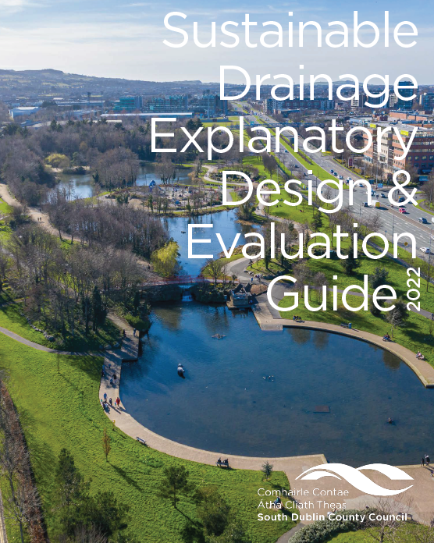
SDCC Sustainable Drainage Explanatory, Design & Evaluation Guide 2022

Slide 3
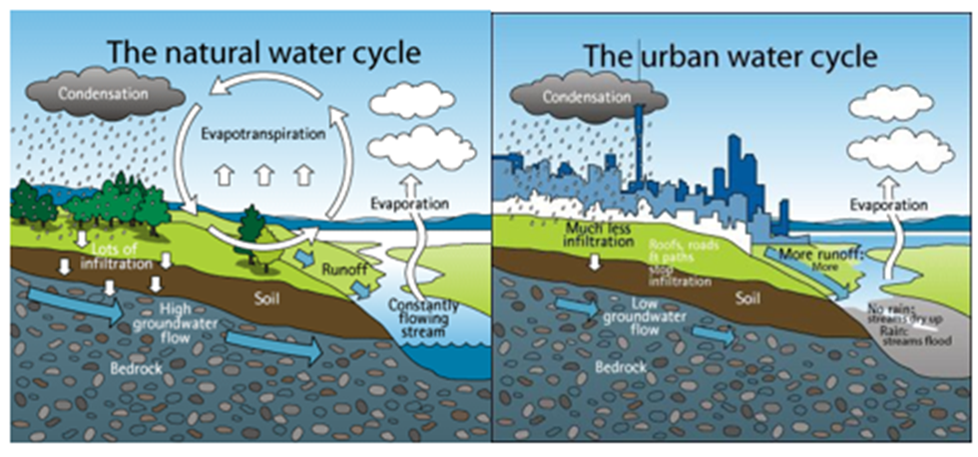
The Water Cycle

Slide 4
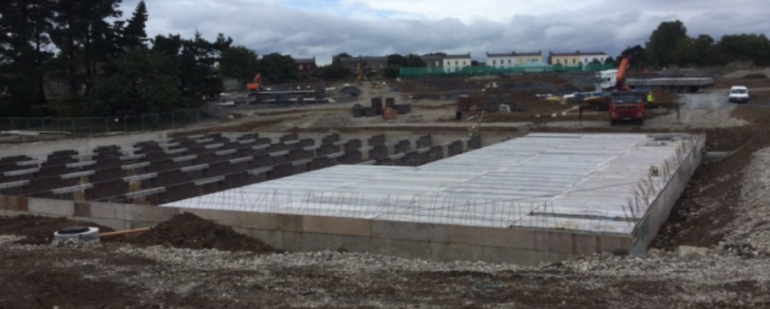
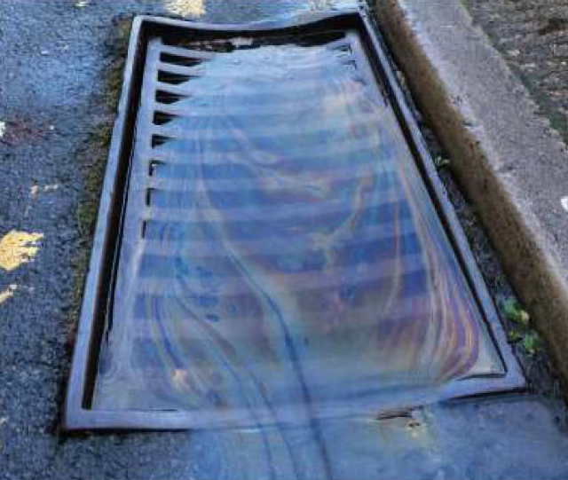
Traditional Surface
Water Drainage
“Hard Engineered” Gully and piped systems
Underground Concrete attenuation tanks
Petrol Interceptor
Very little treatment
No natural losses
No public amenity or biodiversity value

Slide 5
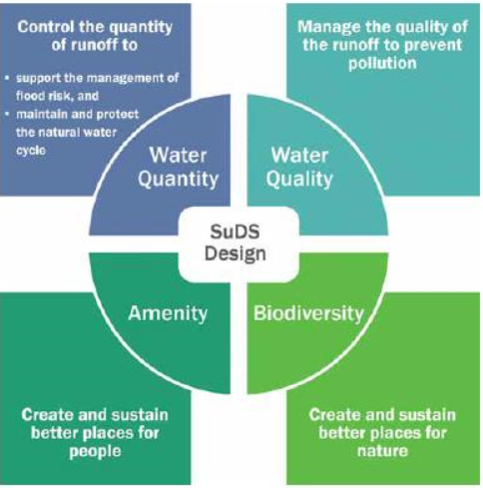
What are Sustainable
Drainage Systems (SuDS)?
The “4 Pillars”
‘Sustainable Drainage Systems or SuDS is a way of managing rainfall that minimises the negative impacts on the quantity and quality of runoff whilst maximising the benefits of amenity and biodiversity for people and the environment.’
Notes:
Definition - “Sustainable Drainage or SuDS is a way of managing rainfall that minimises the negative
impacts on the quantity and quality of runoff whilst maximising the benefits of amenity and biodiversity for people and the environment’.
Water Quantity
Manage and control runoff volumes and flow rates from impermeable surfaces, reducing the impact of urbanisation on flooding
Provide opportunities harvesting rainwater run for use close to where it falls
Promote groundwater and aquifer body recharge
Protect natural flow regimes in watercourses
Encourage evapotranspiration from planted and other storage areas
Water Quality
Maintain and where possible improve water quality by reducing occurrences of polluted rainwater runoff
Establishes a treatment train for water conveyance using sustainable, natural means.
Biodiversity
The water within a SuDS scheme is vital for the growth and development of plants and animals. Biodiversity benefits can be delivered by even small, isolated components, but the greatest value is likely to be delivered where SuDS are planned as part of wider green landscapes and they can assist with wildlife connectivity.
Provide attractive habitats for flora and fauna near watercourses for feeding and nesting.
Public Amenity
Water adds to the attractiveness of an area.
The presence of water allows people to have an increased connection with nature
Creates more interesting landscapes for play and recreation
Can improve air quality
Carbon reduction and sequestration

Slide 6
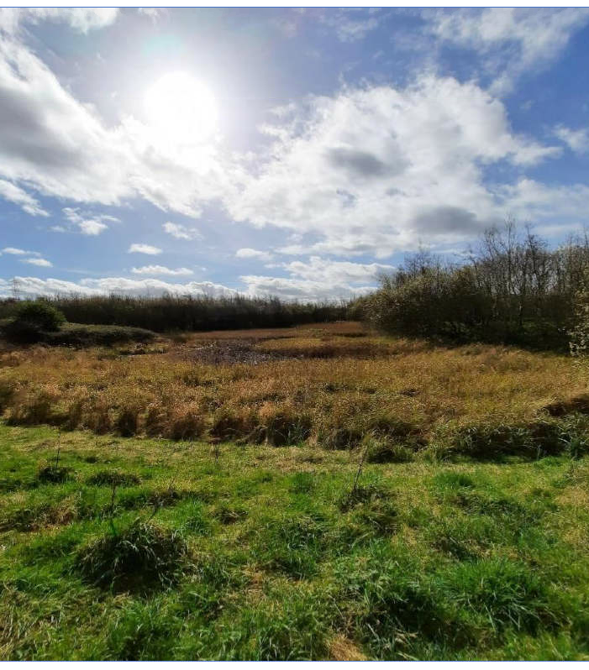
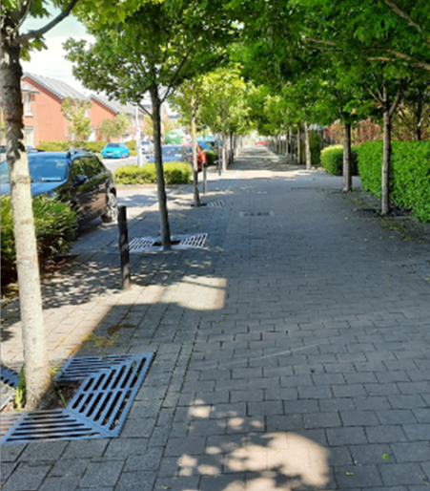
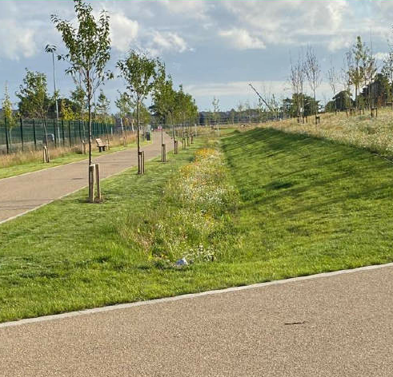
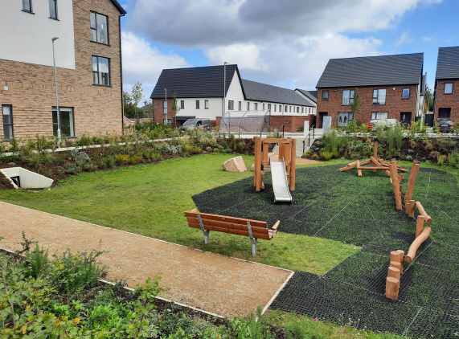
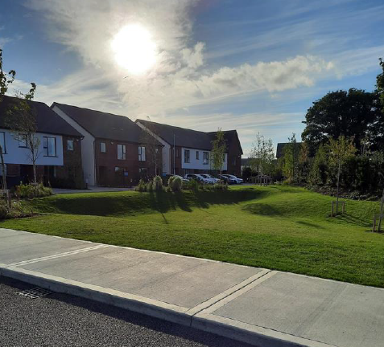
Pond/Wetland
Tree Pits
Swale
Detention Basin
Types of SuDS Features
Swales
Tree Pits
Detention Basins/Attenuation Ponds
Wetlands
Soakaways
Detention Basin
Notes:
Run through examples and locations
Some case studies in the county will form part of the guide

Slide 7
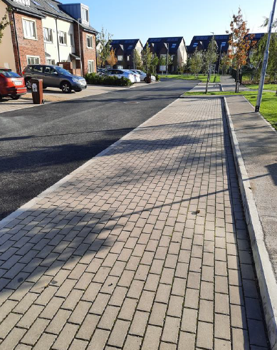
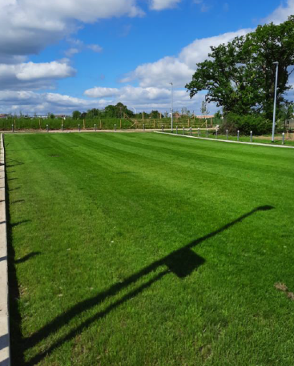
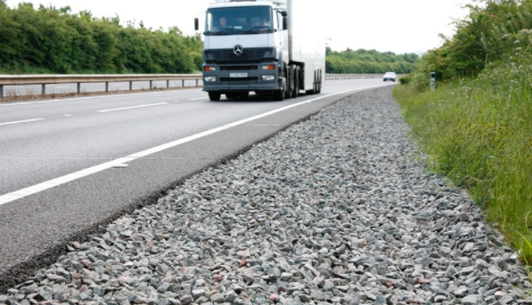
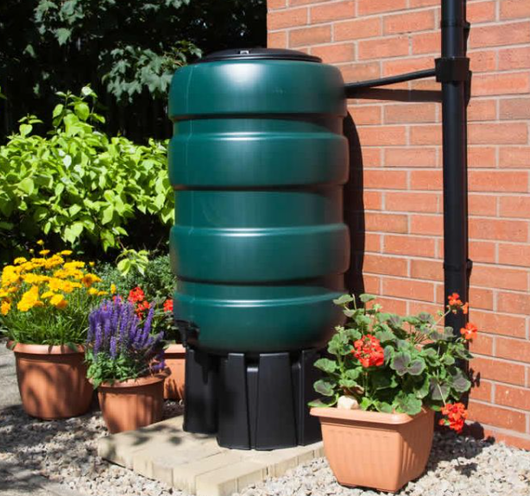
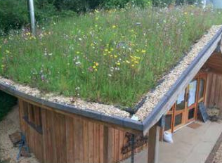
Permeable paving
Grass Paving
Filter Drain
Water Butt
More types of SuDS Features
Rainwater Harvesting
Porous Surfaces
Green / Blue roofs
Filter Drains/Filter Strips
Bioretention Raingardens
Green Roof
Notes:
Run through examples and locations
Some case studies in the county will form part of the guide

Slide 8
SDCC SuDS Explanatory, Design and Evaluation Guide
Main SuDS Guide for SDCC and private led developments
Easy to read
Focus on “How to implement SuDS” rather than what is SuDS
Guidance on Concept, Outline & Detailed design stages
SuDS requirements in South Dublin (CDP 2022-2028 Planning Policy)
Due for publishing early Feb 2022

Slide 9
SDCC SuDS Explanatory, Design and Evaluation Guide - Contents

Slide 10
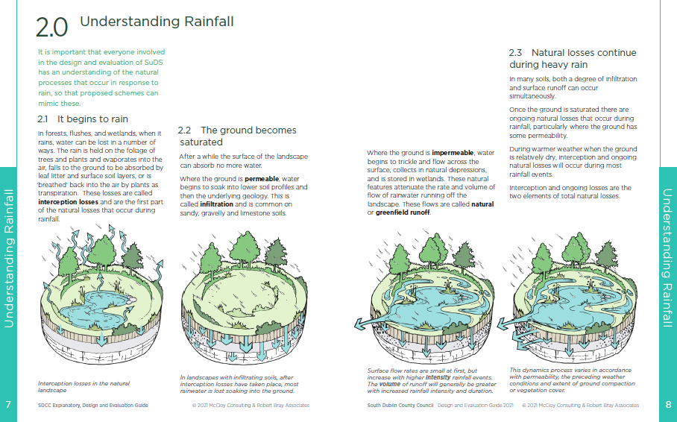
SDCC SuDS Explanatory, Design and Evaluation Guide – Introduction

Slide 11
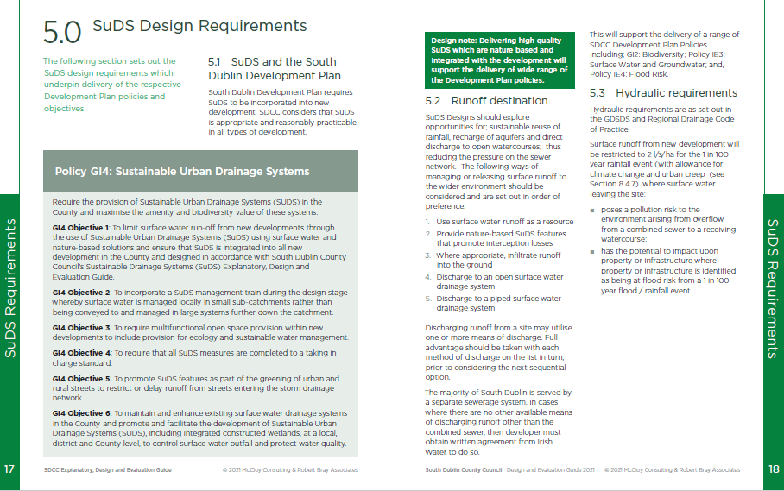
SDCC SuDS Explanatory, Design and Evaluation Guide – Policy

Slide 12
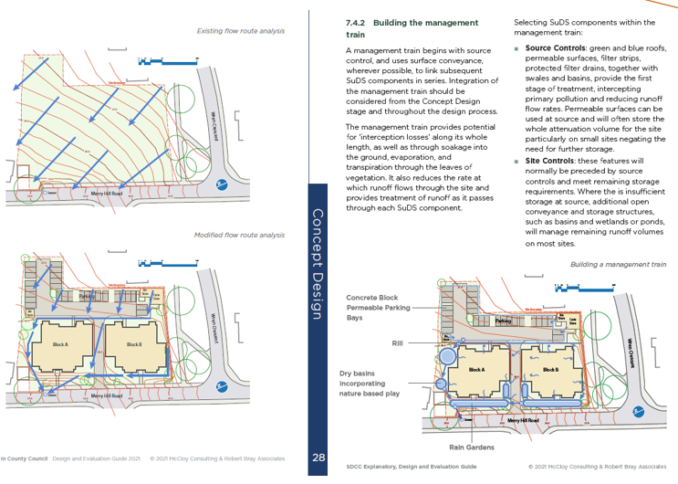
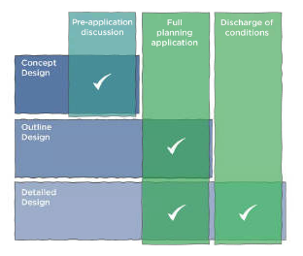
SDCC SuDS Explanatory, Design and Evaluation Guide – Concept Design

Slide 13
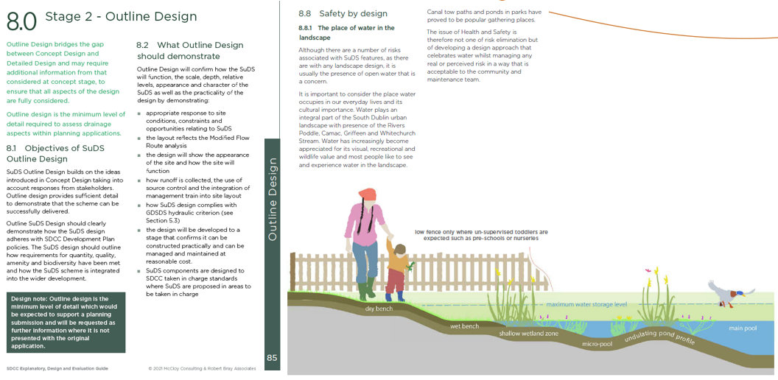
SDCC SuDS Explanatory, Design and Evaluation Guide – Outline Design

Slide 14
SDCC SuDS Explanatory, Design and Evaluation Guide – Detailed Design

Slide 15
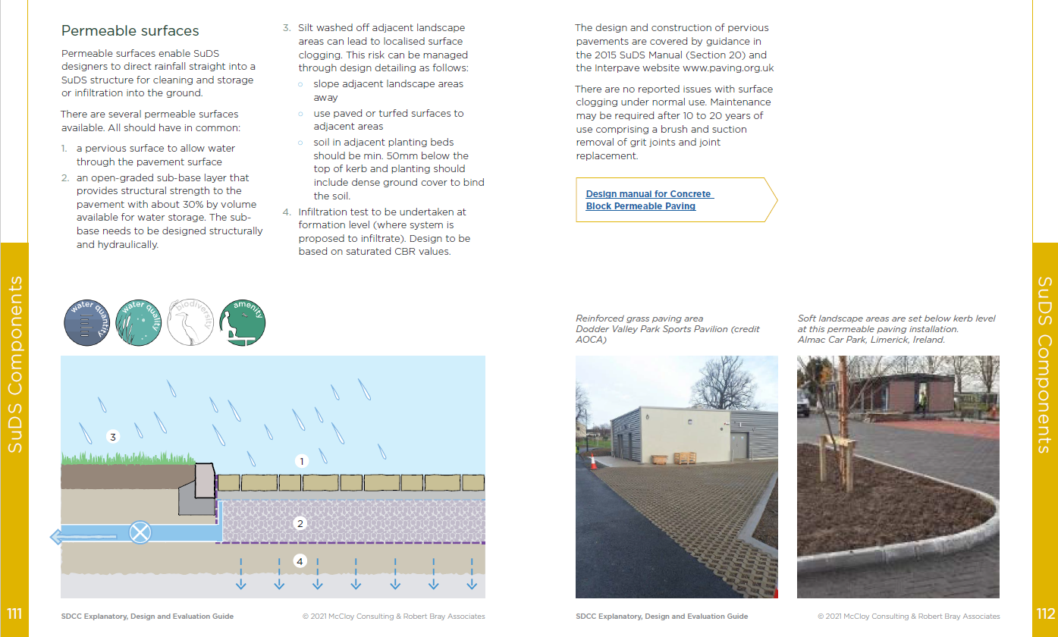
SDCC SuDS Explanatory, Design and Evaluation Guide – SuDS Components

Slide 16
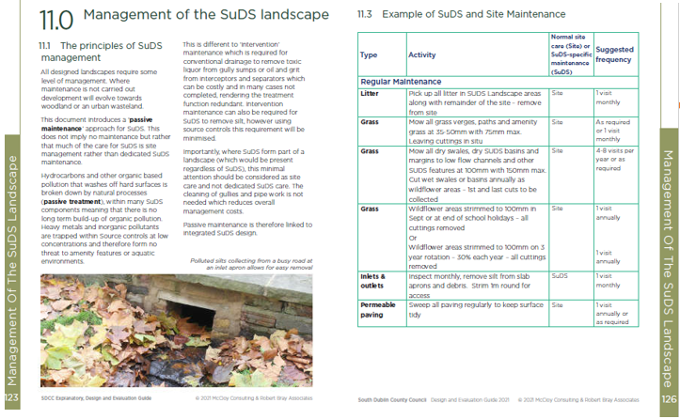
SDCC SuDS Explanatory, Design and Evaluation Guide – Management of SuDS

Slide 17
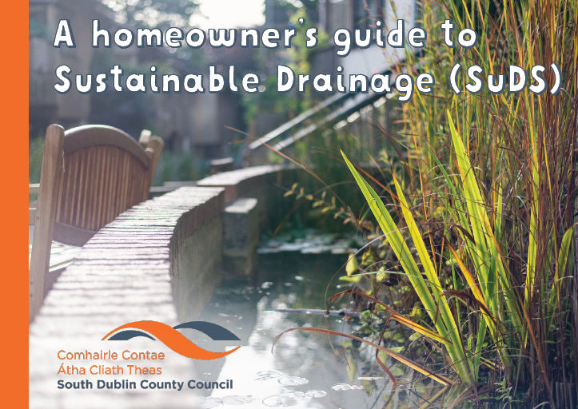
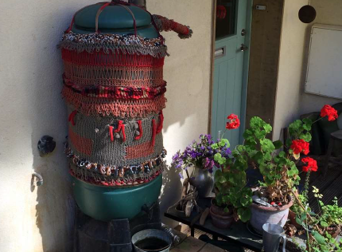
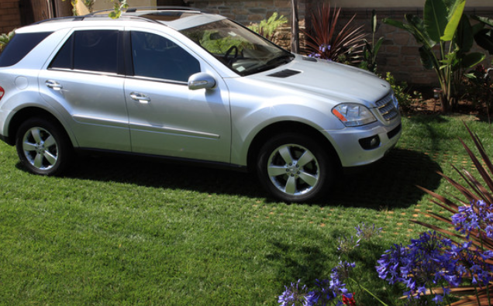
SDCC SuDS Homeowners “Ladybird” Guide
For use of domestic homeowner
Easy to read, Not too technical
Guidance on domestic types of SuDS
De paving
Water harvesting
Green roofs
Rain Gardens…etc
Due for publishing in February 2022

Slide 18
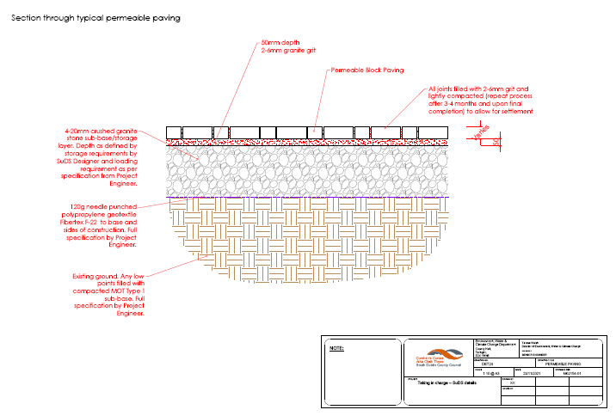
SDCC SuDS Standard Details
Suite of construction details to standardize SuDS components in South Dublin
For use of internal departments for South Dublin County Council developments and external developers for SuDS to be taken in charge
Workshop held with internal departments involved in Taking in Charge to discuss and agree details.
(Jan 2022)
Due for completion February / March 2022

Slide 19
SuDS Training and Workshops
SuDS Training will be delivered by McCloy Consulting End of March/Early April 2022
Aimed at internal South Dublin County Council staff from range of departments (ie. Planning, Roads, Public Realm, Drainage etc.)
5 Modules to be held over 2 weeks
FOUNDATION
A PLANNERS PERSEPCTIVE
A DESIGN PERSPECTIVE
A HYDRAULIC PERSPECTIVE
A MANAGEMENT PERSPECTIVE
Workshop for external developers to introduce the Guidance document to be held Summer 2022

Slide 20
Thank you
Notes:
Questions

