Slide 1
Shopfront Grant Scheme
County Promotion Unit

Slide 2
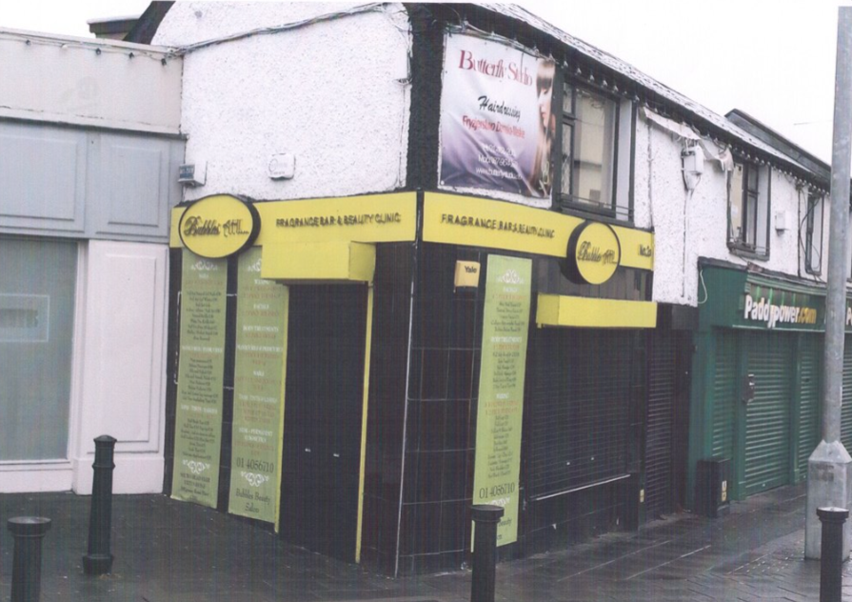
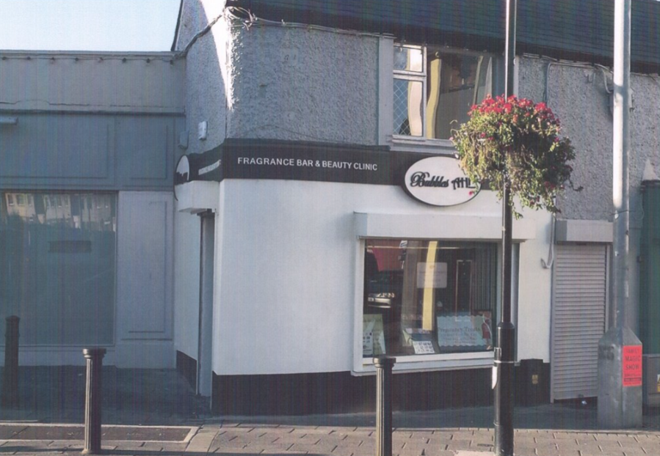
Purpose of the Scheme
The Shopfront Grant Scheme is intended to improve the appearance of independently owned shops fronting public streets.
Grants are available for something as simple as painting of the shop, replacing signage or even replacing the entire shopfront.
Grants are available up to 50% of the overall cost of works.

Slide 3
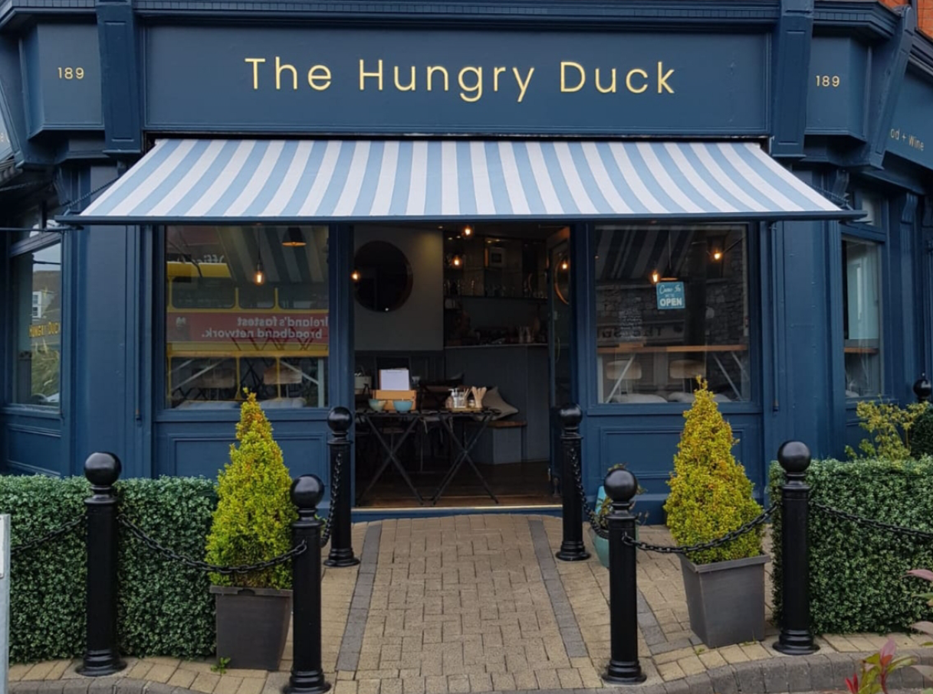
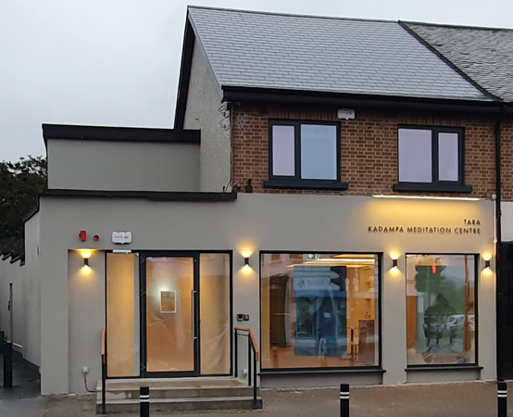
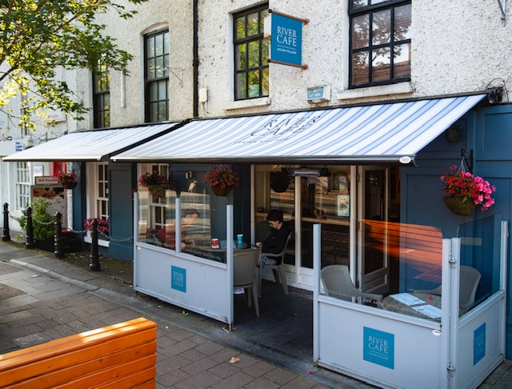
2021 Statistics
Applications Received | 34
Applications Completed | 17
Applications Carried forward to 2022 | 14
Total Grant Payments | €50,015

Slide 4
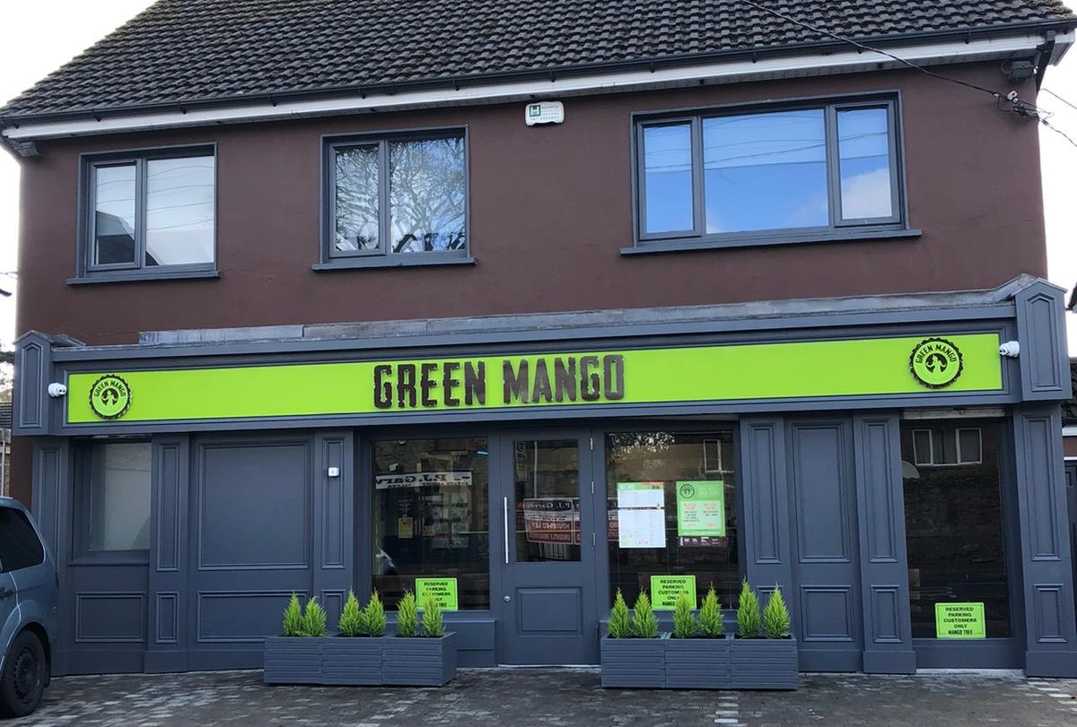
Winner of Best Designed Shopfront 2021 Green Mango, Lucan

