Slide 1
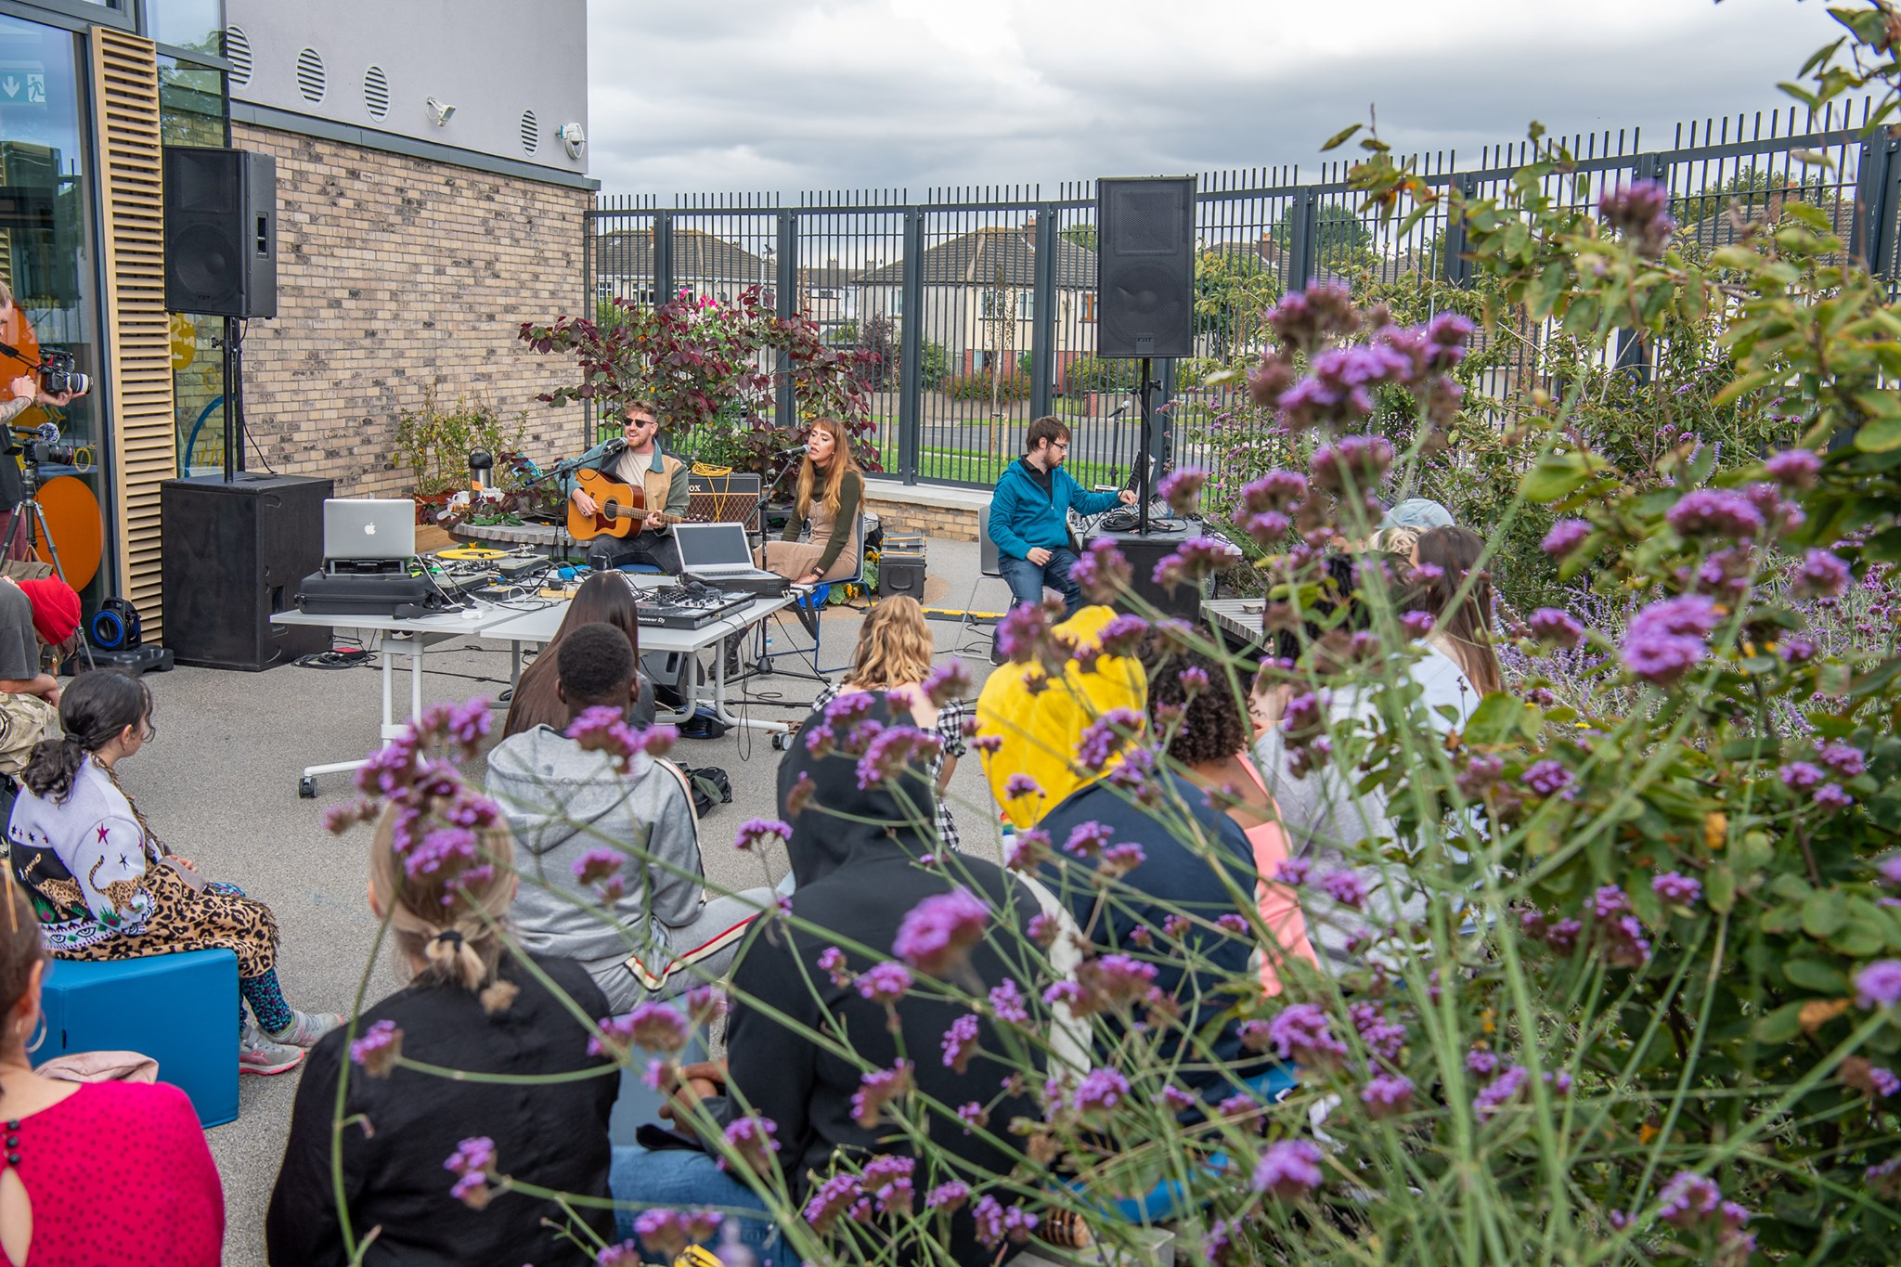
North Clondalkin Library
Creative Studio
Rosena Hand

Slide 2
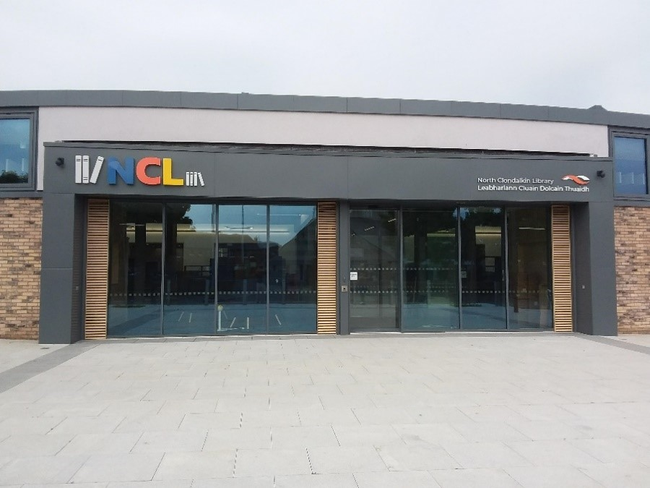
Creative Studio

Slide 3
Creative Studio
1
The Idea

Slide 4
Creative Studio
1
The Idea
2
The Process

Slide 5
Creative Studio
1
The Idea
2
The Process
3
The Set-up

Slide 6
Creative Studio
1
The Idea
2
The Process
3
The Set-up
4
Engagement

Slide 7
Creative Studio
1
The Idea
2
The Process
3
The Set-up
4
Engagement
5
Video

Slide 8
Creative Studio
1
The Idea
2
The Process
3
The Set-up
4
Engagement
Video
6
The Future
5

Slide 9
The Idea
Creative Studio
1
3

Slide 10
The Idea
Creative Studio
1
The Background
3

Slide 11
The Idea
Creative Studio
1
The Background
USP
3

Slide 12
The Idea
Creative Studio
1
The Background
USP
Unique Offering
3

Slide 13
The Idea
Creative Studio
1
The Background
USP
Unique Offering
3
Specialised Knowledge

Slide 14
The Process
Creative Studio
2
3

Slide 15
The Process
Creative Studio
2
3
Public Service Innovation Fund

Slide 16
The Process
Creative Studio
2
3
Public Service Innovation Fund
€ 23,000

Slide 17
The Process
Creative Studio
2
3
Public Service Innovation Fund
County Architects Department
€ 23,000

Slide 18
The Set-up
Creative Studio
3
3

Slide 19
The Set-up
Creative Studio
3
NCL Creative Studio Use Agreement
3

Slide 20
The Set-up
Creative Studio
3
NCL Creative Studio Use Agreement
How to Book
3

Slide 21
The Set-up
Creative Studio
3
NCL Creative Studio Use Agreement
How to Book
Software
3

Slide 22
The Set-up
Creative Studio
3
NCL Creative Studio Use Agreement
How to Book
Software
3
Equipment

Slide 23
Engagement
Creative Studio
4
3

Slide 24
Engagement
Creative Studio
4
Organised Programmes
3

Slide 25
Engagement
Creative Studio
4
Organised Programmes
Local Young Patrons
3

Slide 26
Engagement
Creative Studio
4
Organised Programmes
Local Young Patrons
3
Sessions with local Secondary Schools

Slide 28
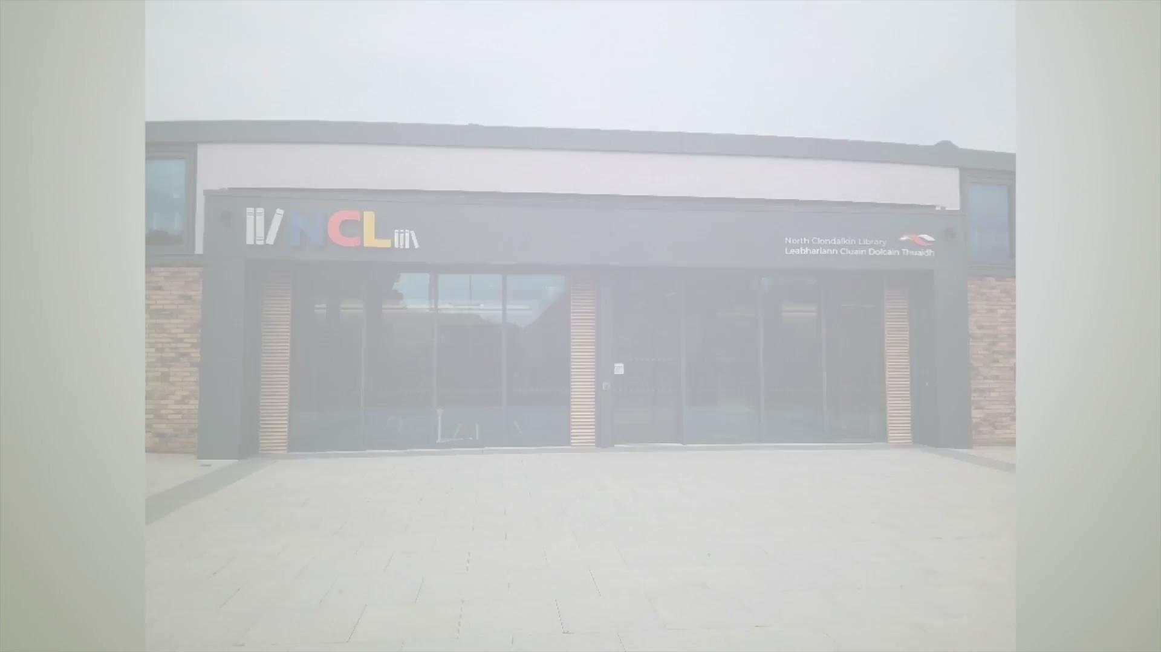

Slide 29
The Future
6
Creative Studio
3

Slide 30
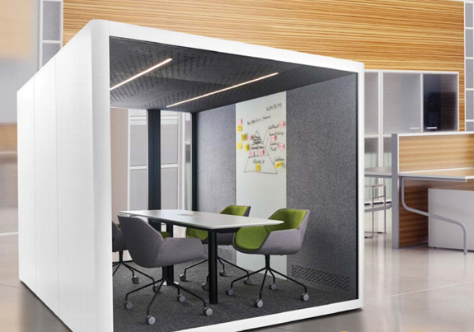
The Future
6
Creative Studio
Acoustic Meeting Pod
Public Service Innovation Fund 2021
3

Slide 31
The Future
6
Creative Studio
Acoustic Meeting Pod
Impact & Plans for Branch-wide library service
Public Service Innovation Fund 2021
3

Slide 32
Thank you for Listening
Creative Studio
North Clondalkin Library
Rosena Hand

