Slide 2
Our Spaces

Slide 3
Our branch network
3 large, full-time libraries: Tallaght, Ballyroan, North Clondalkin
3 medium sized, full-time libraries: Castletymon, Clondalkin, Lucan
3 mobile libraries
1 part-time “Library Hub”: Palmerstown

Slide 4
What next?
New, large, full-time libraries for Adamstown and Citywest
New “Library Hub” for Rathcoole
New mobile library… with a difference

Slide 5
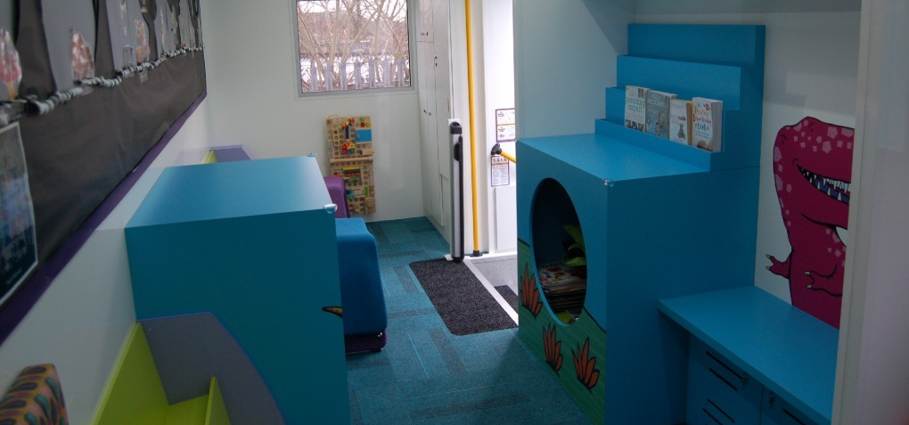
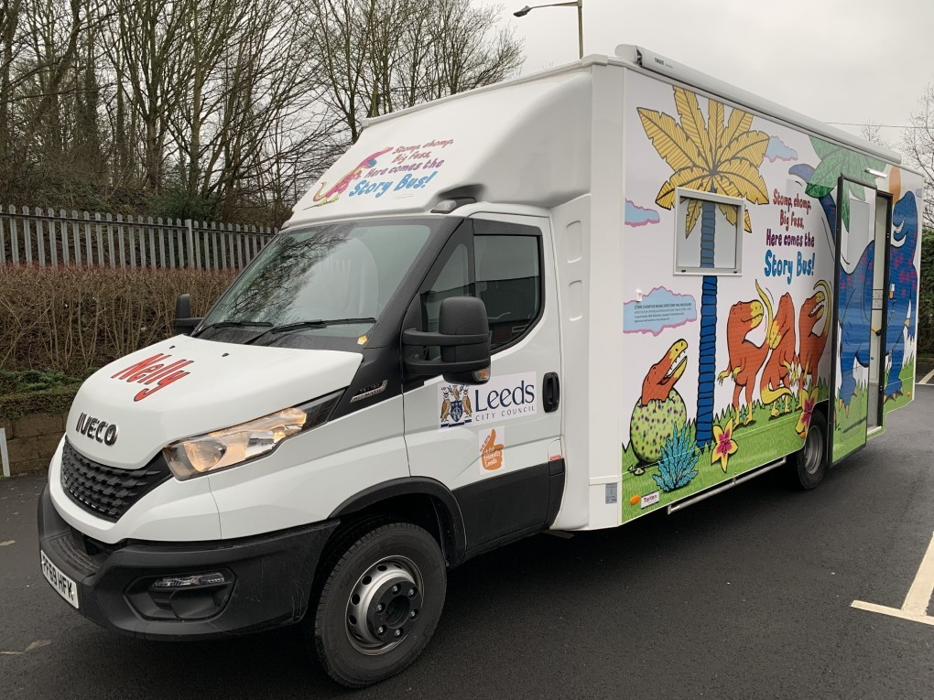
New approaches to Mobile Libraries
Use of electric/hybrid vehicles
Smaller vehicles to allow greater service agility
Mobile library to promote and augment the full breadth of library services:
Computer labs
Makerspaces
Storytelling

Slide 6
Revitalising our network

Slide 9
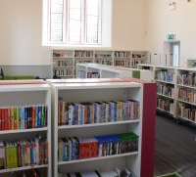
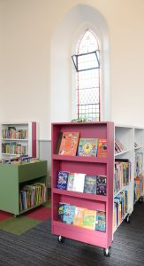
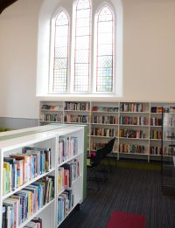
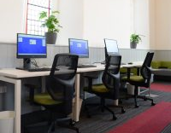

Slide 10
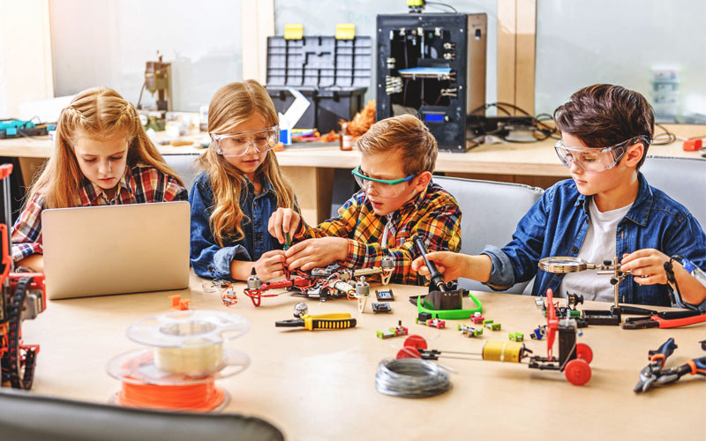
Other uses of space
Makerspace and more…

Slide 11
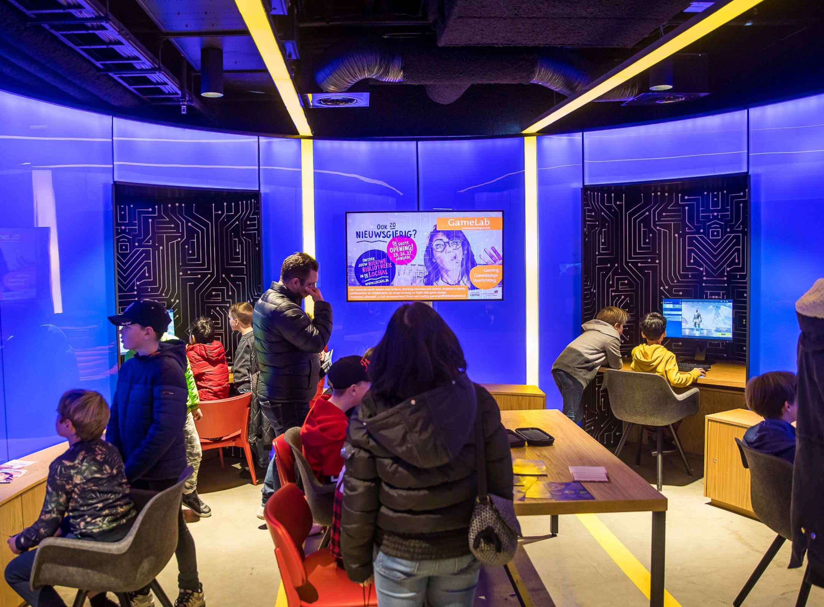
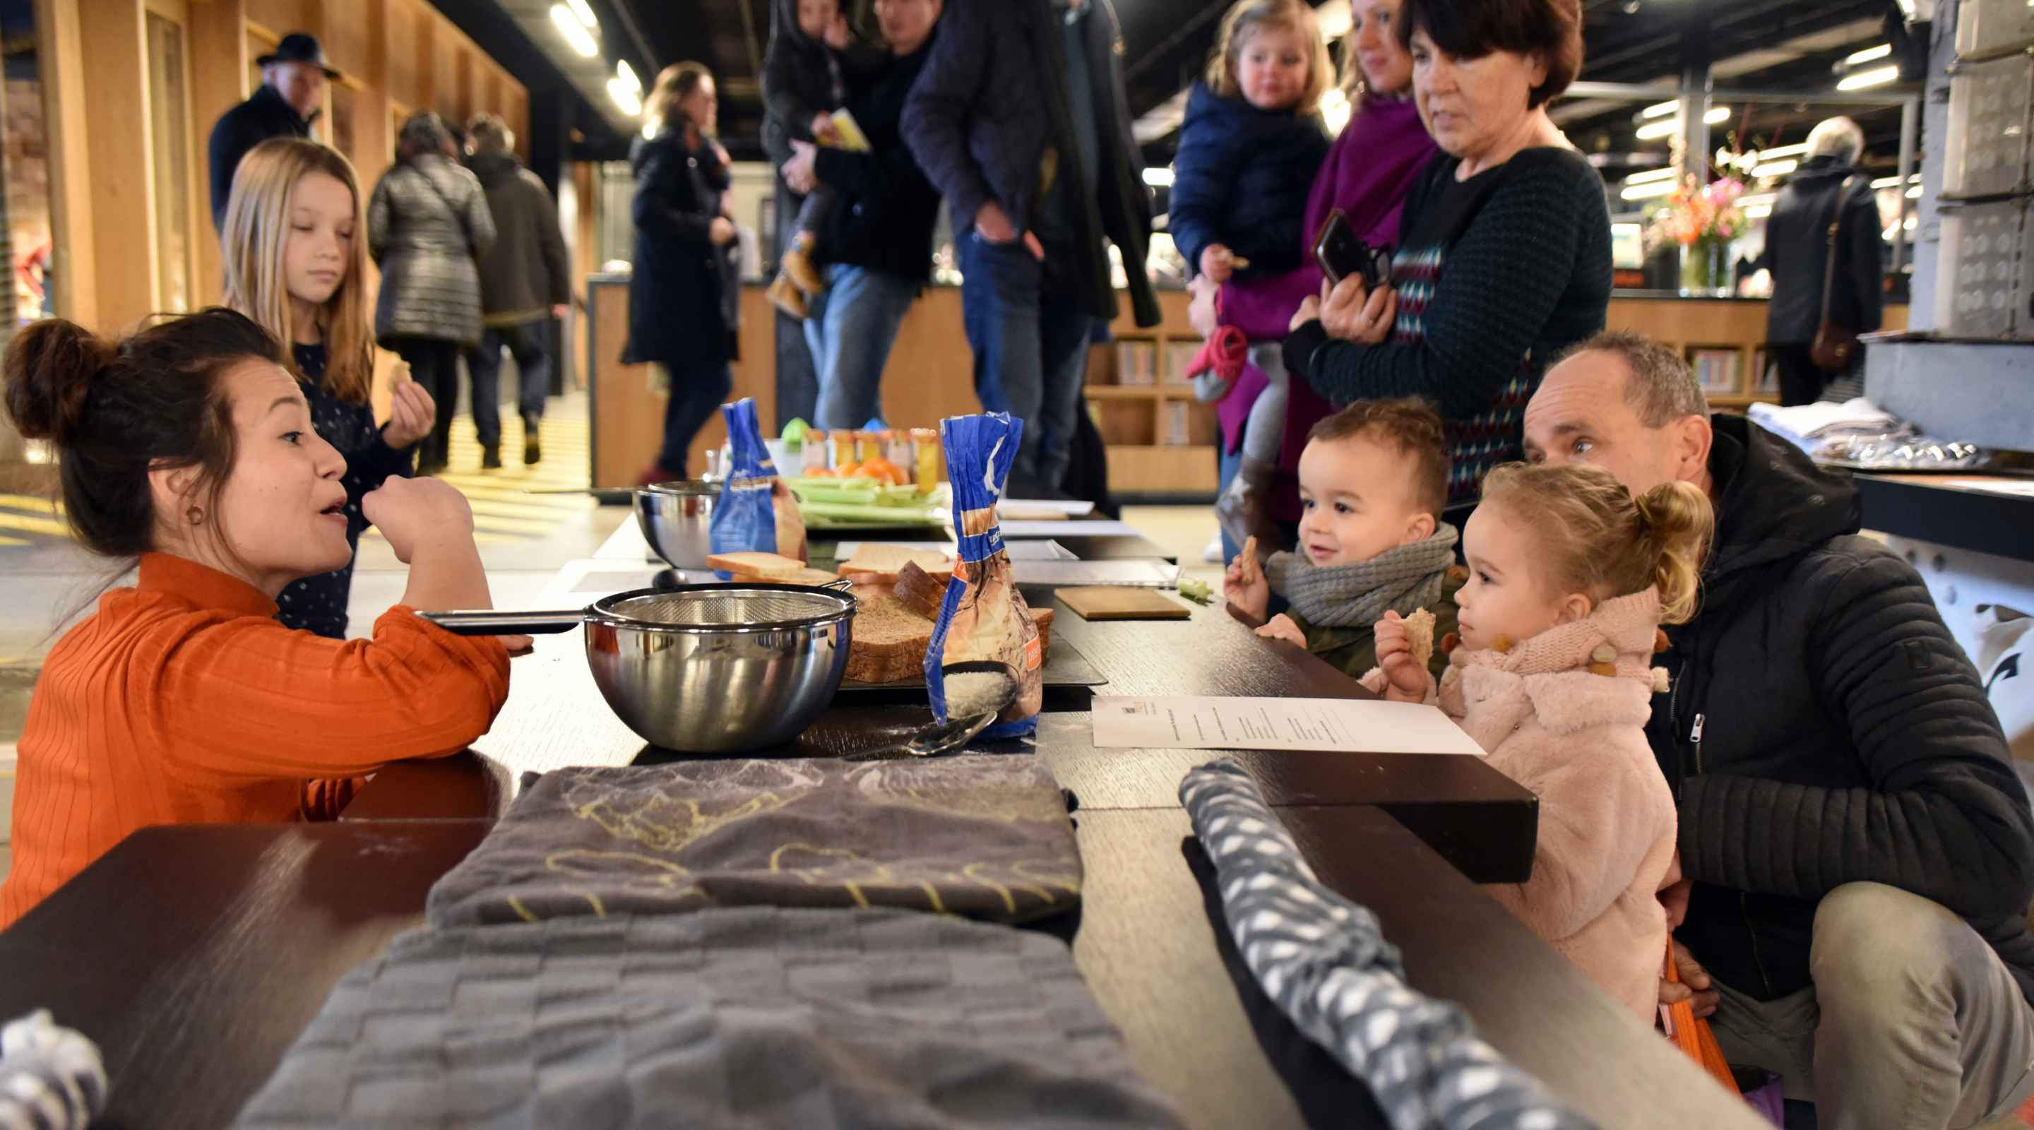
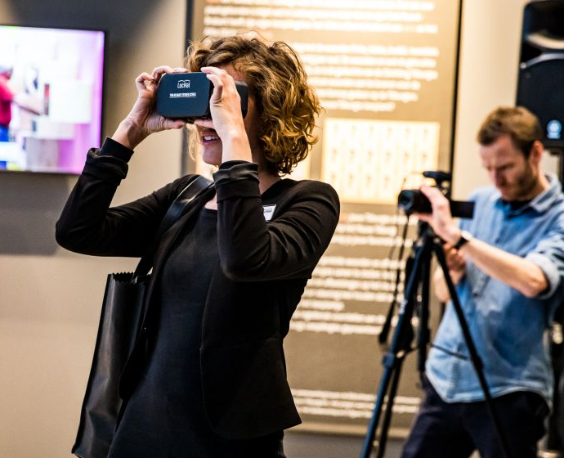
Foodlab
Communities coming to together through food, supporting healthy living
Gamelab
Constructive engagement with gaming
Timelab
Explore local history, another way to share our history and heritage collections
Quiet Space
Libraries come full-circle…

