Slide 1
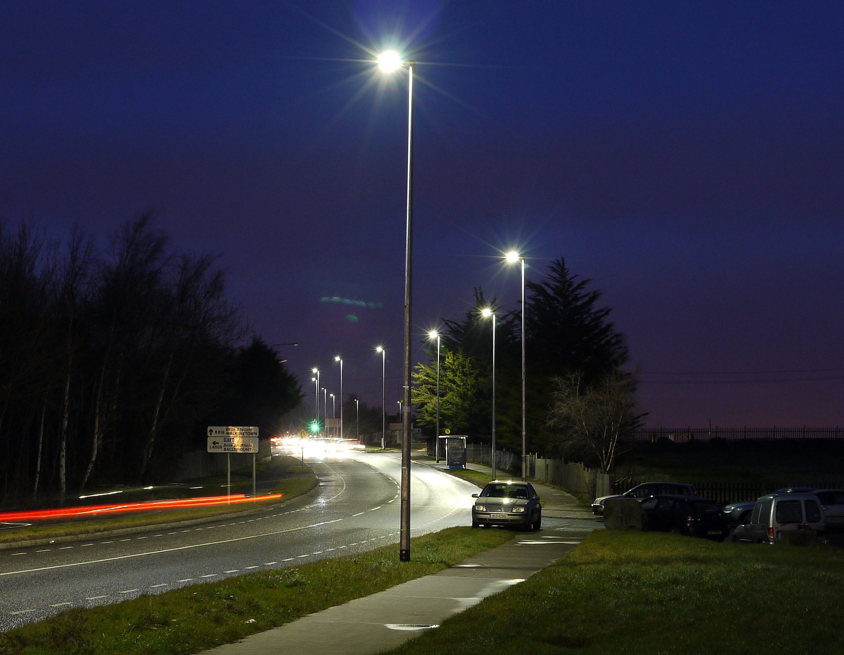
Energy Efficiency LED Upgrade Jan – Jun 2022
Land Use Planning and Transportation
January 2022

Slide 2
Current status Jan 2022
1,561 Lanterns upgraded to LED in 2021
Total upgrades to LED to date approx. 13,500
9,500 SOX lanterns still to be upgraded
Electrical surveys are ongoing to identify suitable upgrade candidate locations
Aim to upgrade 1500 in 2022, 750 of these from January to June

Slide 3
Update on 2021 Programme
Target of 1500 upgrades met
All estates previously presented were surveyed
Very few were suitable for upgrade without ESB intervention as per the ESB Supplementary Agreement.
Alternative estates were surveyed and those suitable were upgraded in order to ensure targets were met.

Slide 4
2022 Programme
The estates from last year’s programme that were unsuitable for upgrade will be prioritised under the ESB Supplementary Agreement programme
We are working towards the ESB Supplementary Agreement programme being “live” for Q3 of 2022
In the meantime we have identified the following estates for upgrade in Q1 & Q2

Slide 5
Upgrade Programme Jan-Jun 2022
Electoral Area | Location |  | Location
Firhouse/ Bohernabreena | Prospect | Rathfarnham/Templogue | Templeogue Lodge
Firhouse/ Bohernabreena | The Beeches | Rathfarnham/Templogue | Ballymount Cross
Firhouse/ Bohernabreena | Taylors Court | Rathfarnham/Templogue | Ballymount Road
Clondalkin | Newcastle Manor | Rathfarnham/Templogue | Ballymount Road Lower
Clondalkin | JFK Industrial Estate | Rathfarnham/Templogue | Ballymount Drive
Clondalkin | Wheatfields | Rathfarnham/Templogue | Wellington Lane
Clondalkin | Ballynakelly | Lucan | Esker Lawns
Clondalkin | Tay Lane | Lucan | Westbury
Clondalkin | Cold Cut Rd | Lucan | Uppercross
Rathfarnham | Coolamber Court | Lucan | St Loman’s Road
Rathfarnham | Knocklyon Road | Lucan | Fairgreen
Tallaght Central | Belgard Road | Lucan | Rockwood

Slide 6
Agreements with External Bodies
Status of ESBN Agreement;
There have been agreements in principle with the ESBN/CRU for the treatment of Direct-Fed Lighting and for Legacy Cables since May 2021
There have been delays in moving these agreements towards implementation.
SDCC, in tandem with other LA’s and National Working Groups, are continuing to apply pressure to the above bodies to finalise these agreements.
We are optimistic that a full resolution will be in place by the start of Q3.

