Slide 1
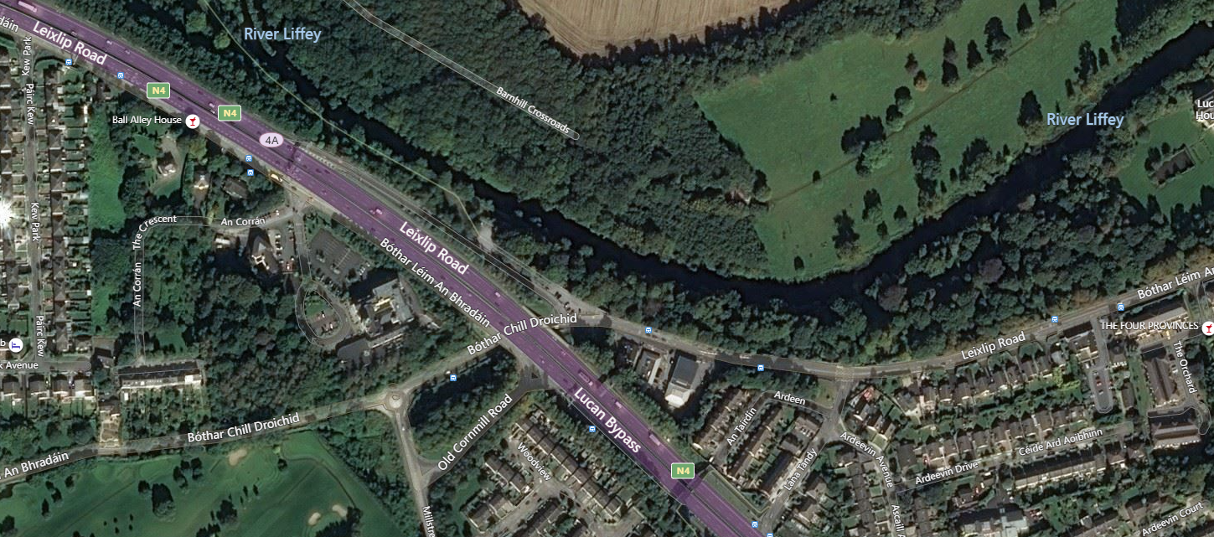
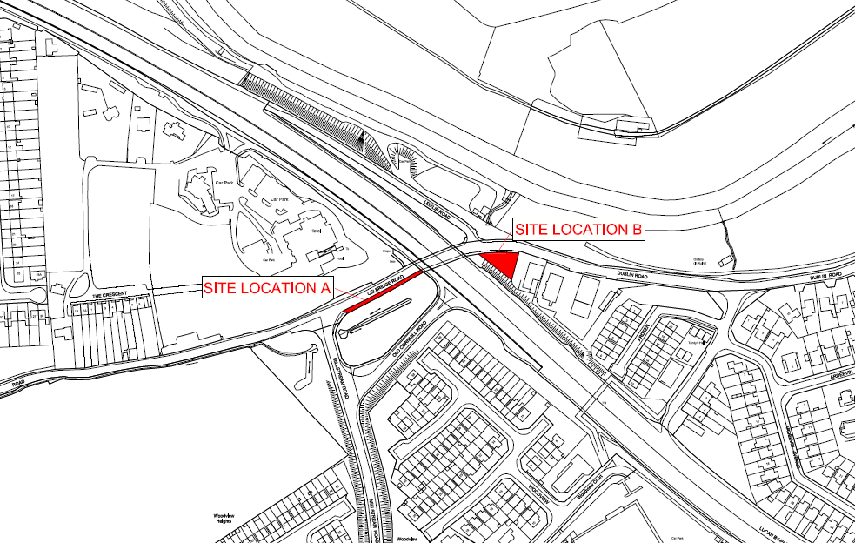
January Council Meeting
Part 8 Lucan Demesne Car Parks
Context for the Project
SDCC Development Plan, SDCC Tourism Strategy
SDCC’s capital budget
Lucan received funding under the Destination Towns Scheme; supported by Fáilte Ireland; this project supports same.
Lucan Demesne Car Parks will provide the necessary amendments to current parking infrastructure at Lucan Demesne to support Lucan destination town scheme and enhance the sense of place and significance for the area,
Special consideration paid to accessibility, amenity, positive ecological balance and aesthetics to enhance the existing area and facilitate visitors to the park.

Slide 2
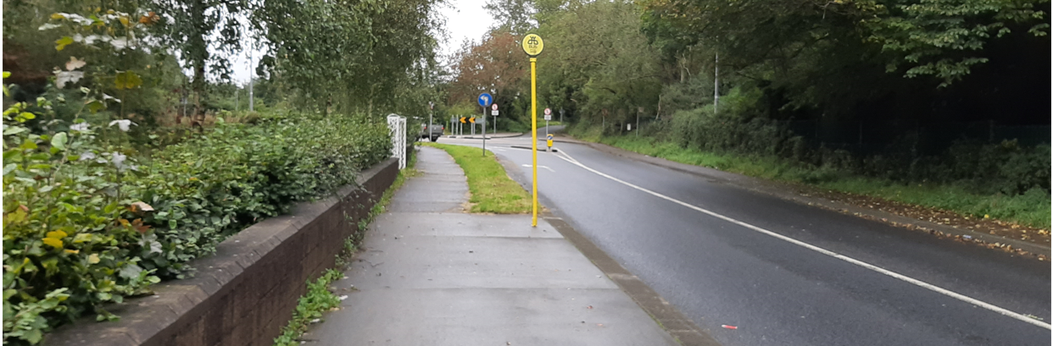
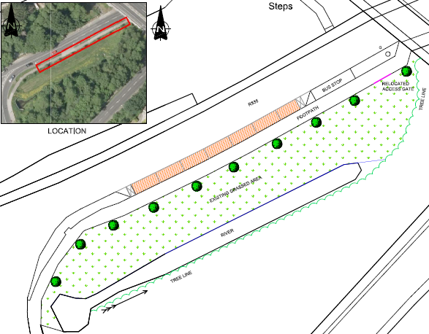
Lucan Demesne Car Park Location A
Design Summary
On-street parking,
7 no. Spaces proposed,
90m from Lucan Demesne,
Low level wall to be relocated,
All affected trees and shrubs to be replaced and additional trees planted.

Slide 3
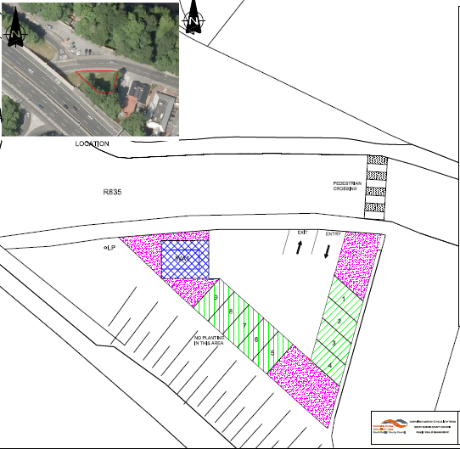
Lucan Demesne Car Park Location B
Design Summary
Off-street Parking
10 no. spaces
1 no. WA space
Permeable grasscrete pavement
Elderly parking is proposed
Future provision for E-vehicles will be provided
Trees to be retained – Selective pruning. Additional planting to be provided.
Cycle parking
Crossing to be finalised along with overall plaza proposal.

Slide 4
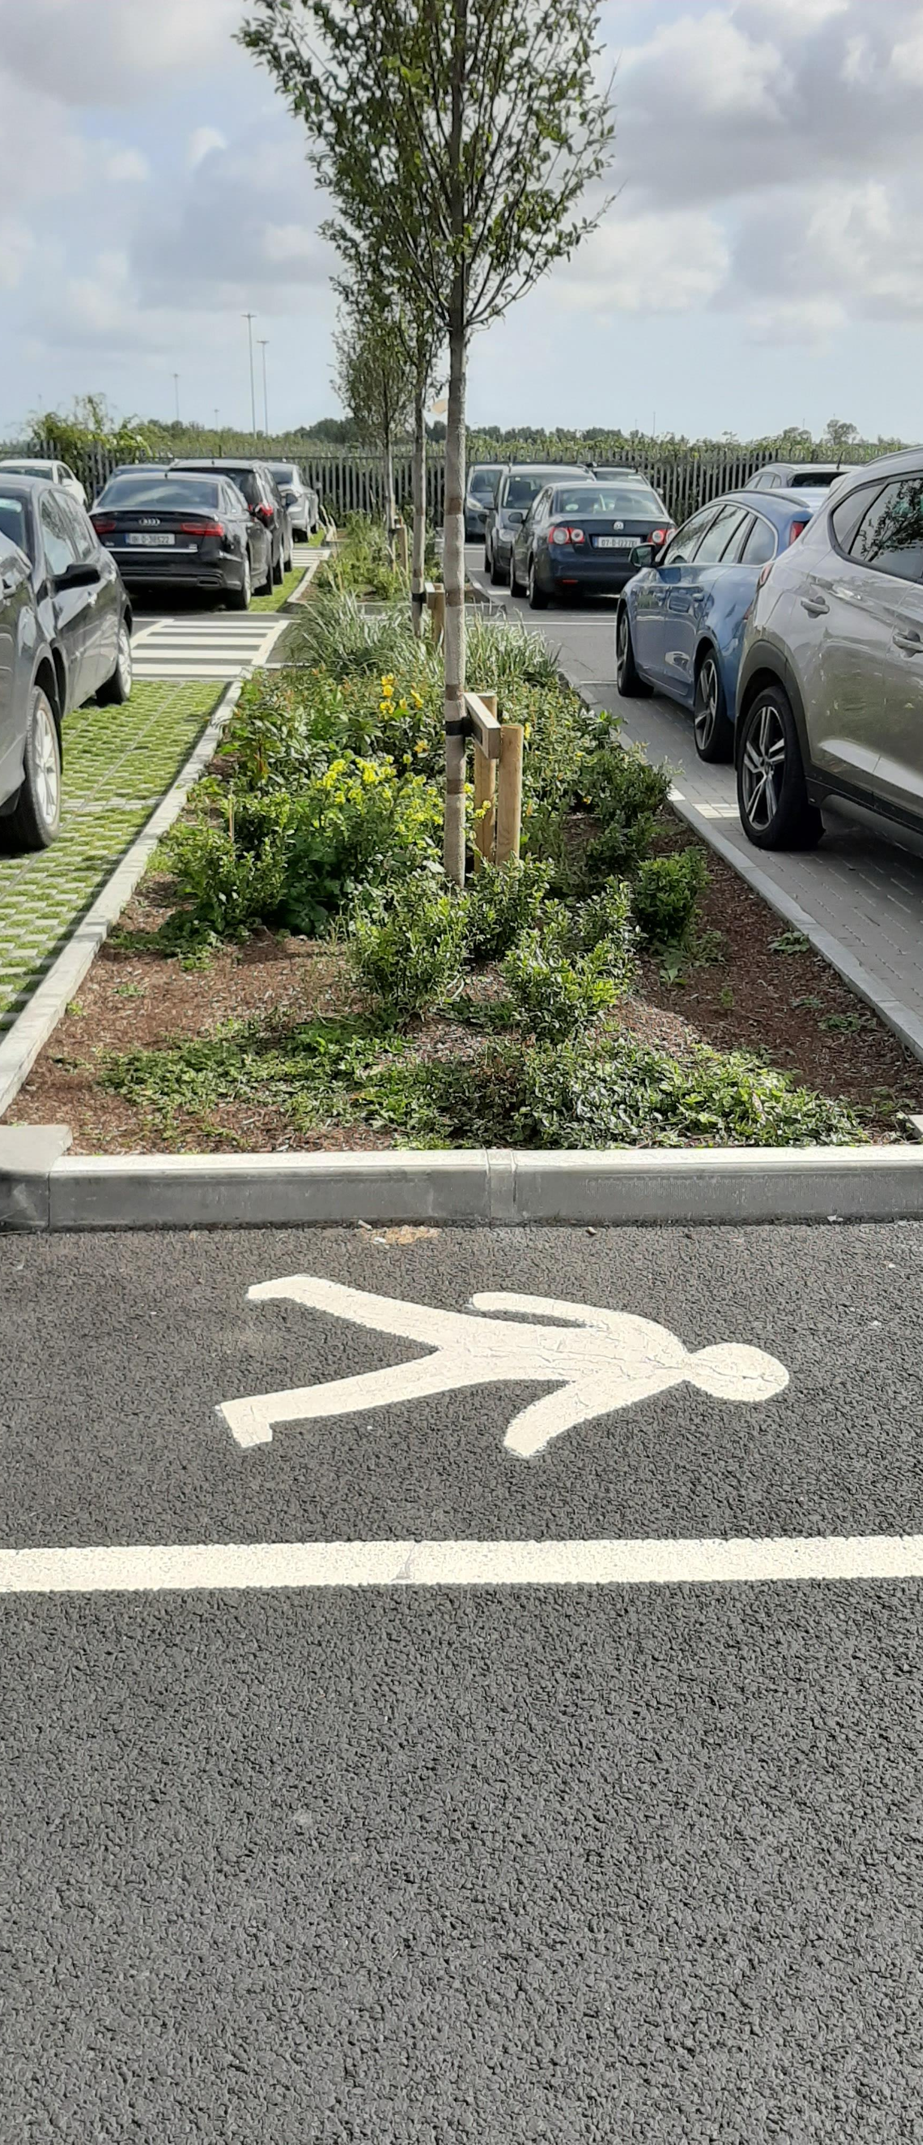
Part 8 Lucan Demesne Car Parks
Part 8 process:
The Part 8 process extended from the 14th October to the 26th November 2021
The plans and particulars were available for inspection online on the Council’s Public Consultation Portal website (http://consult.sdublincoco.ie)
Or in person by appointment at the County Hall.
Submissions or observations could be made in writing up to 5pm on 26th Nov 2021 and could be submitted either via post or online.
3 submissions were made by the closing date and these are summarised and responses and recommendations are made within the CE Report.

Slide 5
January Council Meeting
Part 8 Lucan Demesne Car Parks
CE Recommendation:
It is recommended that, as the proposal is consistent with the County Development Plan and the proper planning and sustainable development of the area, that the Council proceed with the Part 8 proposal for the development of Proposed Car Parking Facilities at Lucan Demesne, In the townland of Lucan, Dublin.

Slide 6
January Council Meeting
Part 8 Lucan Demesne Car Parks
Thank you.

