Slide 1
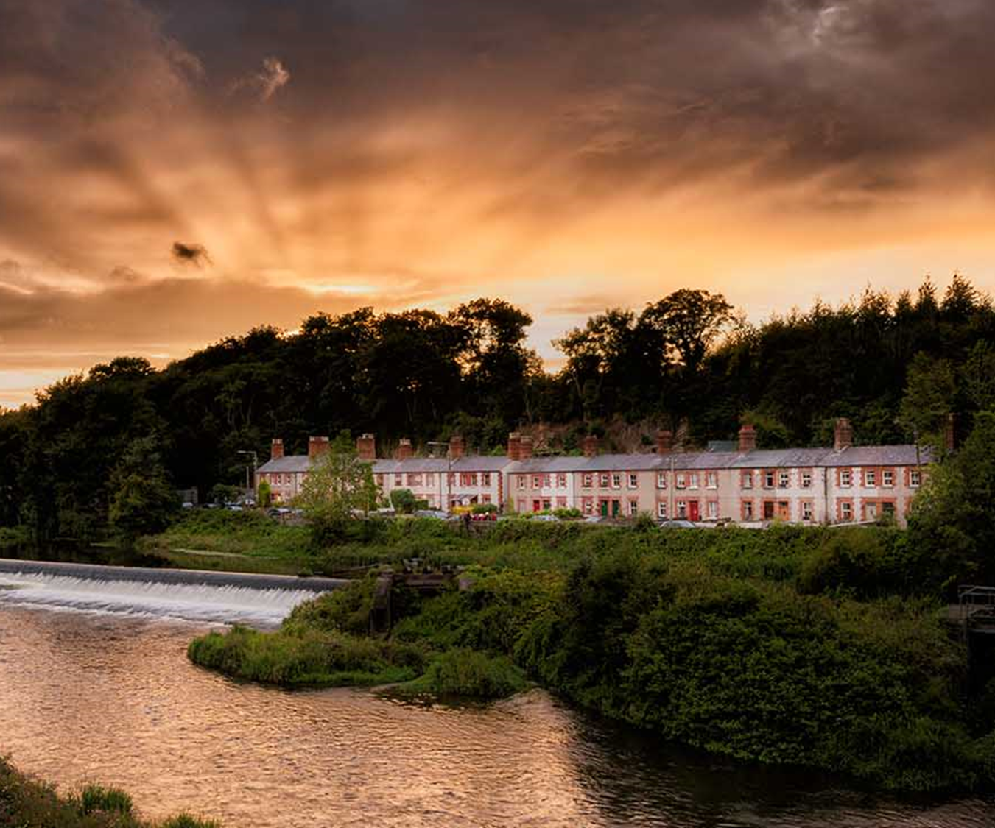
LUCAN
Tourism Product and Proposition Plan
ACM Presentation 16/12/21

Slide 2
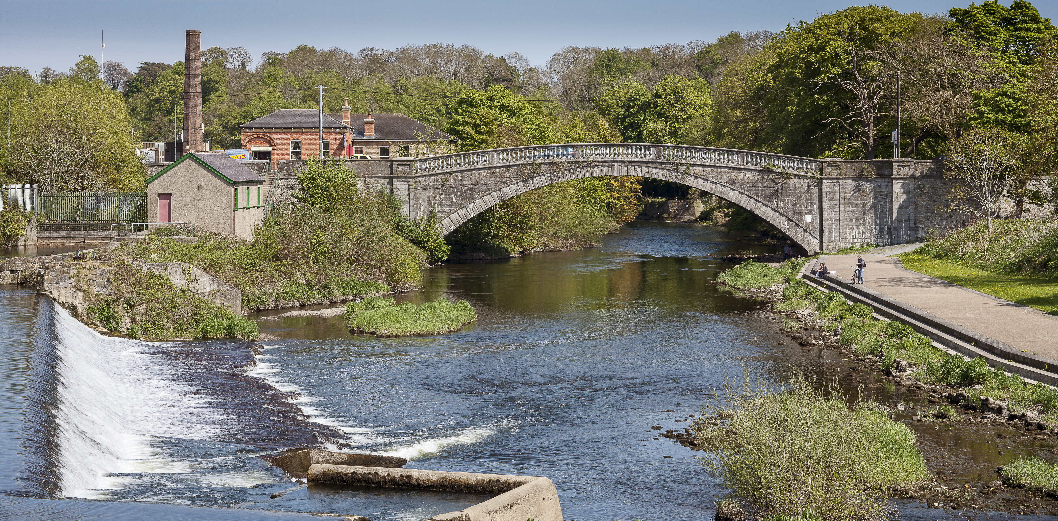
The Big Idea
Lucan awarded funding under Fáilte Ireland’s Tourism Destination Towns Initiative.
One part of a wider proposed multi-million euro investment by SDCC to develop the town which includes public realm improvements and Canal Loop Greenway,
Lucan has access to a large market of potential tourists

Slide 3
What We Knew About Lucan
A village with an interesting history and a good supply of natural resources.
Strengths in the areas of built and natural heritage.
Neither of these are of a destination-level in their own right,
The combination of heritage character, and green and blue spaces provides a basis for further development that is attractive to a wide variety of consumers.
Heritage on its own is unlikely to be sufficient to draw any significant level of tourism, given the abundance of heritage assets across Dublin.
Notes:
The architecture of the area is particularly important in establishing a sense of place for tourists and much of the Village is within an Architectural Conservation Area.
Traffic dominates the area, creating an unwelcoming environment for pedestrians and cyclists.
A need to open out the core of the Village to provide a sense of arrival. (Addressed through public realm works)
Key areas where tourists would congregate in the Village are either closed off (the Green) or difficult to find from the village (the Weir Park and other parks, including the Demesne) (Addressed through orientation and wayfinding)

Slide 4
What We Needed To know
The answer to two simple questions:
Why Visit Lucan?
What do we need to do to encourage people to visit Lucan?
Answer these through a:
Tourism Product and Proposition Plan
Notes:
To develop a tourism product and proposition plan that would:
• review the Lucan area tourism product to identify gaps and opportunities to enhance the offering;
• devise a simple and practical roadmap of interventions by relevant stakeholders (council/community/commercial) with a view to creating possible and/or enhanced saleable experiences, sustainable tourism collaborations and connections;
• develop themes for Lucan and a proposition that can be given to the Council for inclusion in marketing and communications strategy.

Slide 5
How was this plan put together?
Highly Experienced Destination Development consultant who lead the development of the Destination Towns Development Guidelines on behalf of Fáilte Ireland, was engaged.
They undertook:
Desk Research
Consultations and Survey
Mystery Shop/Inspection Visit
Gap Analysis
Comparator Study and Benchmarking
Ideation Workshops
Notes:
- Desk research, including a thorough review of relevant strategies and plans
- consultations with key stakeholders and members of the local community
- online public survey
- audit of existing tourism and related products/experiences
- mystery shop and study visits, including a tourism commentary of the developing Greenway
- comparator study
- in-depth discussion/workshopping to test direction
- professional analysis and gap analysis

Slide 6
consultation
Fifteen one-to-one consultations undertaken by phone, video and in-person
General Findings:
A general welcome for the development of Lucan for visitors, though scepticism about ability to address key barriers, especially traffic and water quality.
A general acceptance that Lucan is not an ‘easy sell’ as a tourism destination.
Business community is positively inclined towards opportunities to develop new/expanded experiences.
The unique ‘village green’ nature of the core is seen as the key asset.
The public realm work at the three locations of the Weir, the Green and the Demesne are very welcome, although not all understand what is involved.
Most mentioned the Ambassador’s Residence and the desire that an arrangement might be reached that would allow access.
Notes:
The consultants are grateful to all those in the local community who shared their opinions with them, and provided information and insight.

Slide 7
Online survey
Via an online platform that was promoted through Council channels (Cllrs, Social Media, Press) as well as via the Chamber of Commerce and local contacts.
The community is clearly interested in the topic, with 494 respondents to the survey - the highest the consultant had experienced on similar projects.
95% of respondents are supportive of the proposal to develop Lucan for tourists - the few that aren’t are primarily concerned about traffic and capacity.
The parks are clearly popular with 77% visiting St. Catherine’s Park and 68% visiting the Demesne once a month or more.
However, most (74%) have never participated in a Liffey activity or taken part in a guided heritage trail (73%).
Notes:
The community is clearly interested in the topic, with 494 respondents to the survey - the highest the consultant had experienced on similar projects.
95% of respondents are supportive of the proposal to develop Lucan for tourists - the few that aren’t are primarily concerned about traffic and capacity.
In terms of community usage of assets, the parks are clearly popular with 77% visiting St. Catherine’s Park and 68% visiting the Demesne once a month or more.
However, most (74%) have never participated in a Liffey activity or taken part in a guided heritage trail (73%).

Slide 8
Gap analysis
Gaps identified, notably in the range and number of activities and attractions. If Lucan is to develop as a tourism destination, it needs to be able to keep tourists occupied for a longer period of time than it currently can.
Wayfinding and interpretation strategy
Improved evening and retail offer.
Animation and events strategy.
More fast-paced outdoor activities.
Share-worthy experiences/sites that are easily booked and suitable for casual users / families
Connectivity between key points such as hotels, city centre and shopping centre
Emphasise child-friendly dining
Notes:
There are clearly gaps - most fundamentally in the range and number of activities and attractions in the area that would keep tourists occupied for a day or more. If Lucan is to develop as a tourism destination, it needs to be able to keep tourists occupied for a longer period of time than it currently can.

Slide 9
Comparator review
Østerbro in Copenhagen and Enfield and Lee Valley Park in the UK.
This final selection was based on a number of key criteria, including:
their proximity to a significant city destination, in order to review how they managed to differentiate themselves;
comparable population sizes;
similarity of basic assets, to establish how these assets have been used;
sustainable development, that ensures the needs of residents is respected and that tourism does not over-power the destination.
Notes:
There has been a focus on integrating resident and tourism needs. Osterbro was selected as the first city neighbourhood where the tourism agency worked with local players to ensure that tourism supports residents’ needs/wishes in creating an area that is more attractive for both locals and tourists.
Given that Lucan is at the early stages of tourism development, it has the opportunity to integrate the local population from the start, building towards the delivery of a tourism ‘experience’ that is embedded within the fabric of the community.

Slide 10
Ideas and findings distilled via focus group came up with a recommended marketing proposition for Lucan as a tourism destination harnessing its strengths which can be articulated as follows:
“An historic village that is the gateway to a natural playground - within easy reach of the city, where Dubliners and tourists alike come to be active, renew and reconnect”

Slide 11
Two Key Themes
the ‘Village Green’
‘Gateway to a Natural Playground.’
Notes:
This proposition is supported by two key themes around which tourism experiences and marketing can be developed:
the ‘Village Green’ and
‘Gateway to a Natural Playground.’

Slide 12
Dublin’s Village Green
A shared green space that is used by the community throughout the year and from morning to night.
What is required?
the development of the central green area in the village as a space that is suitable for animated year-round Village Green experiences, (Outdoor cinema, Markets, outdoor dining, performances – a place where things happen)
supported by dining, retail, heritage and activities in the immediate and wider area including the parks.
Notes:
Giving expression to this theme requires two key drivers:
Audience: The proximity of a popular family attraction in the area may provide an opportunity to tap into the domestic family market.

Slide 13
Gateway to Dublin’s Natural Playground
An extensive green area that provides city dwellers with space to breathe with a programme of events, for day and night use
What is required?
the integrated development of Lucan’s parks and water as locations for a wide range of outdoor experiences;
the provision of additional activities and experiences through private operators;
the availability of supporting services, facilities and experiences in Lucan village;

Slide 14
What’s in it for the local businesses?
Commercial Opportunities
Water Based Activities on River Liffey
Leisure And Activity Equipment Hire
Commercial Accommodation
Notes:
Retail/Dining/Daytime/Night time offerings/Locally produced products/Packaging of saleable experiences

Slide 15
What do we need to do?
A number of interventions are required, primarily in the areas of:
• Co-ordination of approach
• Expansion of available product
• Animation
• Orientation and information
• Built heritage
• Natural heritage
Notes:
In order to develop Lucan more fully as a tourism destination and in order to bring the proposed marketing proposition to life, a number of interventions are required, primarily in the areas of:

Slide 16
Anything else to consider?
Key constraints are identified that need to be addressed. They
include:
Traffic management
Public realm
Wayfinding and interpretation
Water quality
Need to create a visitor welcoming environment
Notes:
Key constraints are identified that need to be addressed, although they are outside the scope of this project. Some of these are currently underway, while others require further action.
Traffic Management - to create a visitor welcoming environment that supports pedestrianisation.
Carrying capacity of village green – Weir and Demesne offer good opportunities to disperse visitors from the Village green
Water Quality - Considerable opportunity for casual and activity-based water use in the Village and Demesne if a combined Agency solution can be found to ensuring water quality is consistently of a sufficient standard to support increased marketing and utilisation
Need to create a visitor welcoming environment that supports pedestrianisation.

Slide 17
How do we do it?
A gradual approach to development is recommended and simple actions can get the ball rolling.
What is required?
Strategies and Programmes
Animation Strategy
Public Realm Improvements
Wayfinding and Interpretation Plan
Programme of events and experiences
Nature on the doorstep initiative

Slide 18
How Do We Deliver It?
SDCC – Project Lead
Through a Cross -Sector Working group (SDCC/Commercial/Community)
Tourism Group
Tidy Towns and Local Community

Slide 19
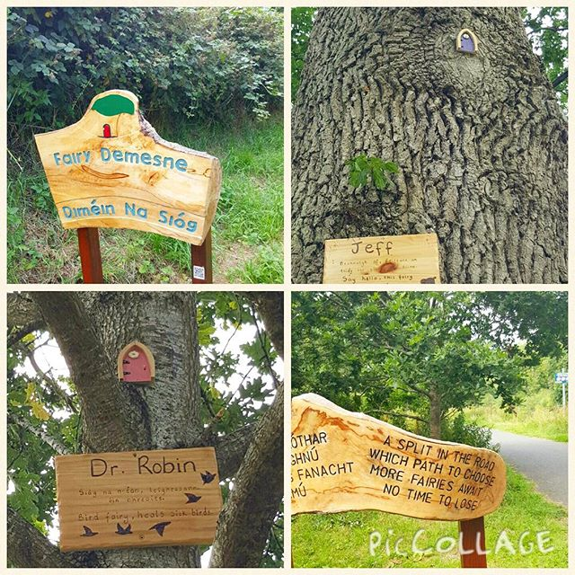
Next Steps
Integrate w/ Public Realm Improvements
Wayfinding and Interpretation Plan
Cross-sector Working Group
Activation/Animation Strategy
Programme of Events/ Experiences
Nature on the Doorstep Initiative

