Slide 1


Kiltipper Park

Slide 2

Part 8 Planning
In May 2020, South Dublin County Council submitted a Part 8 Planning Application for proposed works
at Kiltipper Park. The proposed development of the public park includes for the following:
Construction of 30 additional parking spaces with adjacent access footway and lengthened access roadway;
New shared surface entrance and access pathway;
Provision of 1 GAA pitch with vertical ball-stop netting and associated features
Provision of 2 soccer pitches and associated features
Provision of children’s playground area and linear natural play areas
Integrated landscape features including woodland area;
All associated swales, drainage, wetland areas and ancillary works
All incidental park furniture such as benches, signage and bins
All ancillary works.
This proposal had also undergone Appropriate Assessment Screening under the Habitats Directive
(92/43/EEC) and screening for Environmental Impact Assessment under the EIA Directive 2014/52/EU.

Slide 3
Part 8 Planning - Proposed Site Layout Plan

Slide 4
Part 8 Planning Conditions
Approval for this Part 8 planning application for the proposed works at Kiltipper Park was granted at a South Dublin County Council meeting on 13th July 2020 with the following amendment incorporated below:
“That this Council requests the Chief Executive to look at the reorientation of the soccer and GAA pitches to maximise distance from the houses on Ellensborough Grange”
During this Council meeting, a discussion was held about the local clubs and their specific requirements, and the need for sports pitches within the local area that needs to be facilitated. It was noted that during the detailed design stage the Council will consider options to maximise distance from the houses at Ellensborough Grange.
“That as the proposal is in conformity with proper planning and sustainable development and is supported by the Council’s Sports Pitch Strategy, the Council will proceed with the Part 8 proposal to construct the public park’s development as proposed at Kiltipper Park including the amendment.”

Slide 5
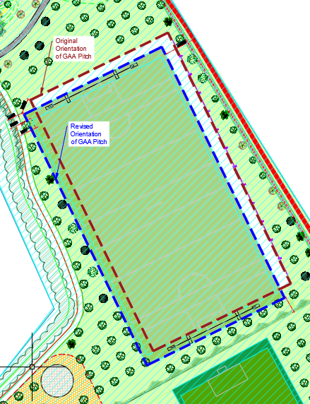
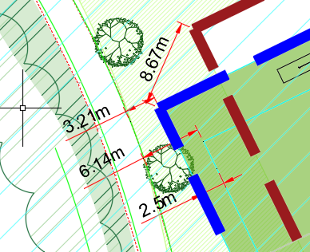
Consideration of Planning Conditions
South Dublin County Council has taken into consideration the Conditions from the Part 8 Planning Application. The image presented shows the original orientation of the GAA Pitch (Red Line) and revised orientation of the GAA Pitch (Blue Line).
The revised orientation is the maximum distance the GAA pitch can be repositioned while still providing a 3.21 metre separation from the existing pathway running along the western edge of the public park.
The orientation of the GAA Pitch cannot be moved any further due to the following:
Close proximity to entrance and car park to the north.
Close proximity to the existing footpath along the western edge of Park.
Avoid further encroachment on the natural habitats (meadows and hedgerows) further into the Park.
Natural topography of park dictates optimal location for flat surface.
After an exploratory review of the proposed GAA pitch, it has been determined that the pitch can be relocated in a south-westerly direction by a distance of 8.67 metres approximately, away from the houses at Ellensborough Grange.

Slide 6
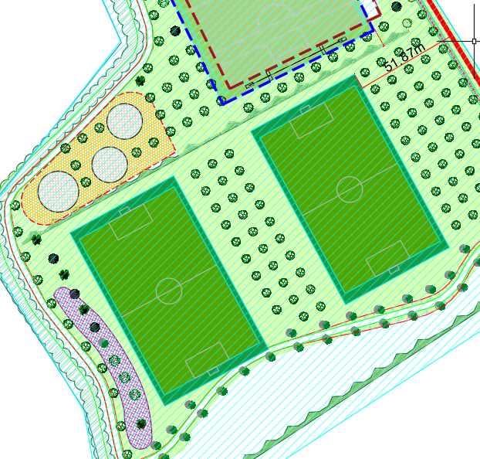
Consideration of Planning Conditions
The location and orientation of the Soccer Pitches have also been considered by South Dublin County Council as part of this Condition.
From a thorough examination the orientation of the Soccer Pitches will remain unchanged due to the following:
Close proximity to GAA Pitch to the north.
Close proximity to the existing footpaths to the west and south.
Avoid further encroachment on the natural habitats (meadows and hedgerows).
Natural topography of park dictates optimal location for flat surface.
Therefore it has been determined that with a separation distance in excess of 51 metres, the Soccer Pitches are a satisfactory distance from Ellensborough Estate.
Extensive planting will be placed between the pitches and Ellensborough Estate.

Slide 7
Kiltipper Park – Phase 2 Programme
The proposals for Kiltipper Park are being delivered on a phased basis.
The tender for the construction of Phase 2 is currently underway.
This phase includes completion of access points, footpaths, hedgerow improvements and viewing areas.
The Projected Programme for Kiltipper Park is outlined below:
Key Dates | Project Stage
December 2021 | Compilation of Tender Pack
January 2022 | Tender Documents Issued
Q1 2022 | Contractor Appointment
Q2 2022 | Construction Commencement on Site
Q4 2022 | Completion

Slide 8

Thank you

