Slide 1
Innovation Centre
Update

Slide 2
Plan
Singular landmark 4 storey building
Views in 4 directions and southwards to the Dublin Mountains over the public park
Public area on ground floor with town hall space and café – open building designed to see through from side to side
Outdoor south facing café terrace space engaging with park
Central atrium space gives visual connection to upper levels
Lettable offices in various sizes on upper floors informed by Oxford Innovation - the successful operator
Break out space and tea stations on each level – space for conversations and chance encounters to happen
Provides a new location for work opportunity and employment
2 stair cores and one lift
Integrated staff facilities
Day and night presence

Slide 3
Space Allocation
Description | % | Sq. M
Gross Internal Floor Area | 100 | 3019
Nett Area | 72.8 | 2188
Nett Lettable Area | 58.7 | 1773
Reception / Town Hall | 3.5 | 105
Café | 2.6 | 78
Caré - Kitchen | 1 | 30
Meeting Rooms | 4 | 120
Staff Office / Management Suite (Incl Directors Office) | 1 | 30
Pre-Business Area | 1.7 | 52
Comms Room | 0.3 | 9
Nett Internal Area | 72.8 | 2197
Common Area | 21.9 | 662
Internal Partitions | 5.3 | 160
Gross Internal Floor Area | 100 | 3019
Unit Type | Quantity
2 Person Suite | 5
3 Person Suite | 9
4 Person Suite | 16
5 Person Suite | 1
6 Person Suite | 6
7 Person Suite | 6
8 Person Suite | 1
9 Person Suite | 1
13 Person Suite | 1

Slide 4
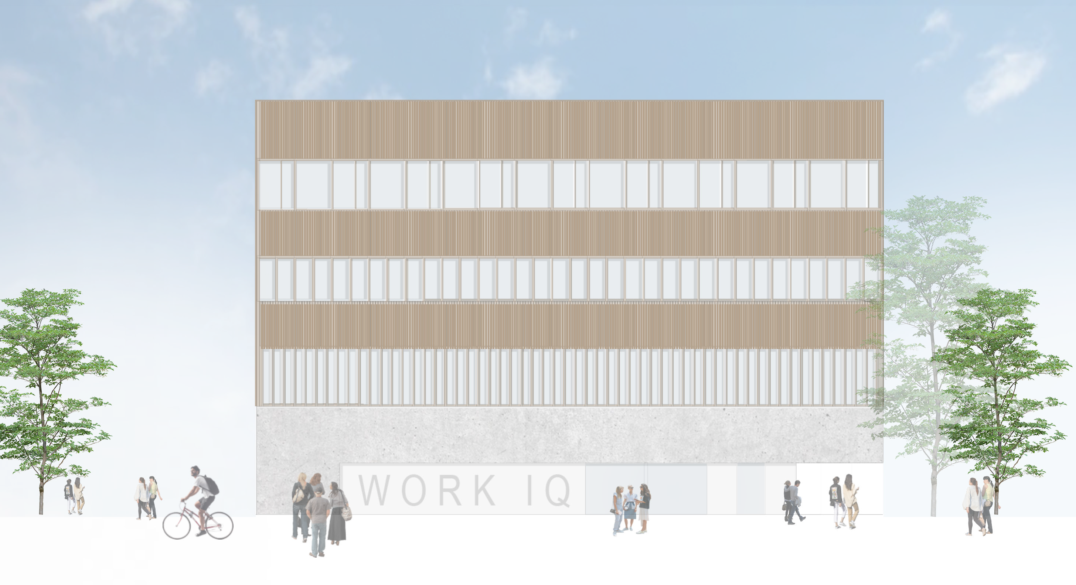

Slide 5
Project Stages
Design & Operation
Planning, Design & Construction
Stage 1
Advice on specific site selection within the preferred location.
Stage 1 - Planning
Stage 2
Advice on the planning and design of the building on the identified site.
Stage 2 - Detail Design
Stage 3
Operation and management of the completed innovation/enterprise space.
Stage 3 - Construction Tender
Stage 4 - Project Implementation
Stage 5 - Project Completion

Slide 6
Innovation Centre Tallaght
Timeline
Project Stage | Status | Date
Planning | Complete | 14/12/2020
Detailed Design | Complete | 10/06/2021
Final Tender- Construction | Closed and final selection in pregress | 20/12/2021
Project Implementation | Due to commence | 07/03/2021
Project Completion | Due to commence | 26/05/2023

Slide 7
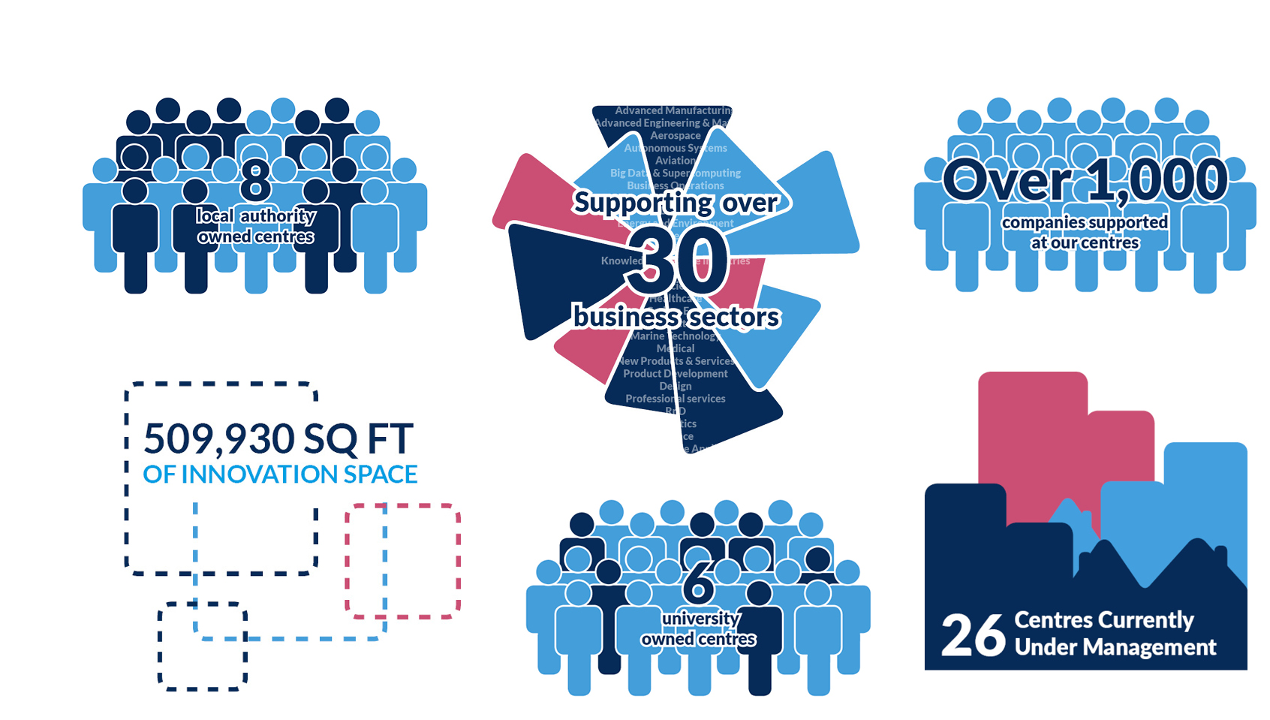
Oxford Innovation
Founded by The Oxford Trust to provide support to science, technology and knowledge-led early stage companies
They have 30 years of experience of running spaces and places to support SMEs and entrepreneurs
They are the largest operator of innovation centres in the UK*
Their clients are universities, research & major science site owners, public sector, private investors and charities
They deliver a range of objectives for clients; support to high-growth SMEs & spin outs, on-going revenue and financial sustainability, economic development, jobs growth, profile and business engagement

Slide 8
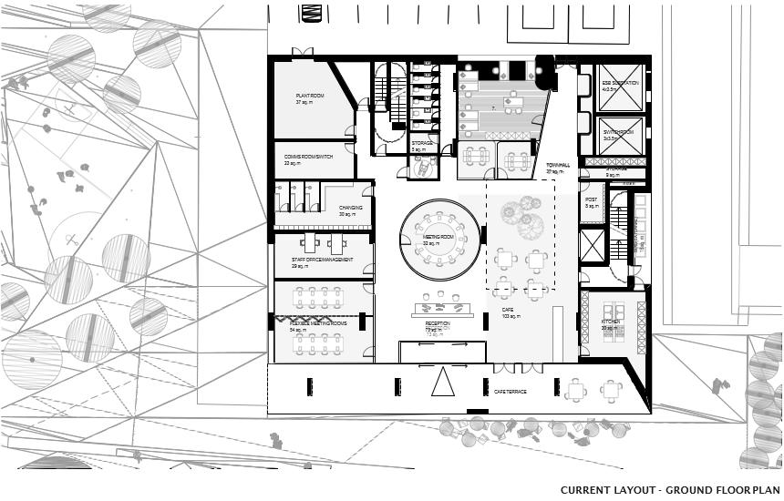

Slide 9
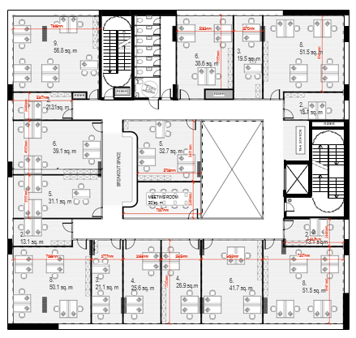

Slide 10
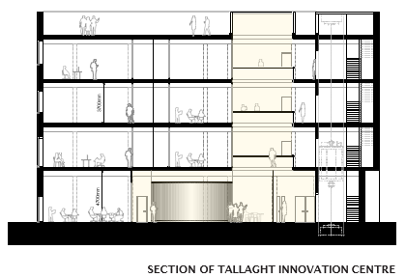

Slide 11

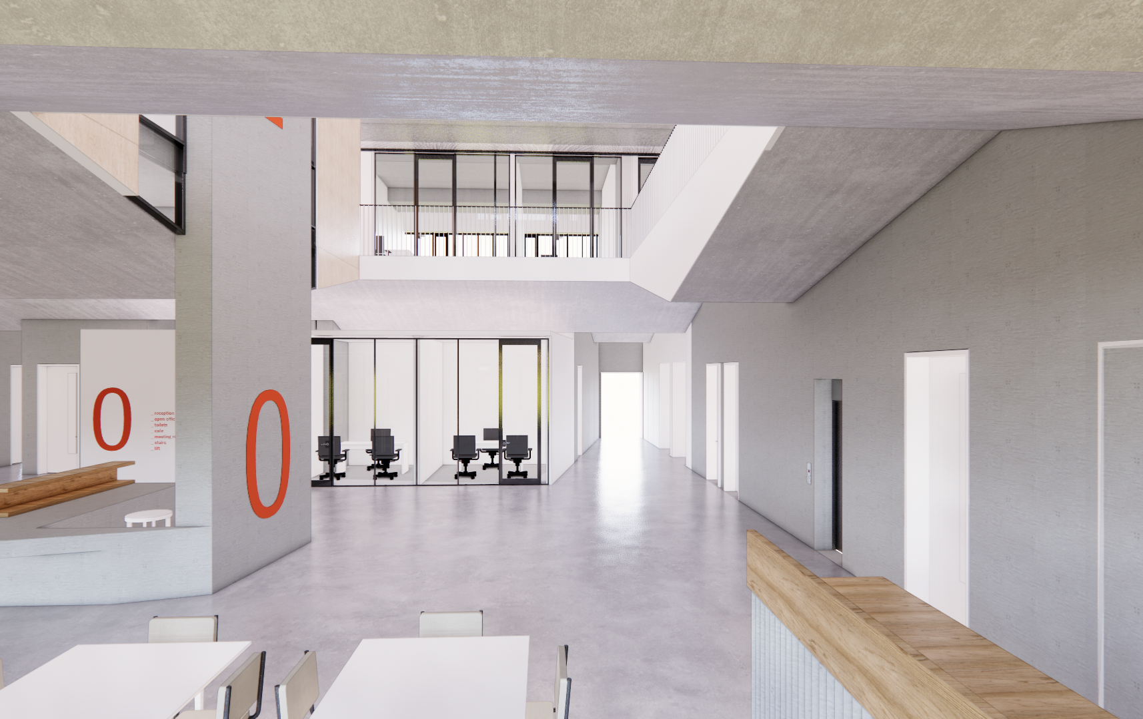

Slide 12
Thank You!

