Slide 1
Street Improvement Management Guide
- Local Transport Interventions For All Road Users
Context:
Population of Dublin increased 9% in the last 10 years
Surveys continue to demonstrate that speeding is occurring at some locations
More Active Travel – Increased Interactions with Vehicles
SDCC must provide facilities for all road users (Disability Act 2005)
Objectives of Guidance Document
To Create Local Transport Interventions to benefit All Road Users
  Encourage Walking, Cycling and Public Transport use
  Improving Safety at Junctions
  Small Permeability Schemes
  Appropriate Additional Pedestrian Crossings
  Traffic Calming Measures where vehicle speeding is happening
  Support Universal Access for Vulnerable Users

Slide 2
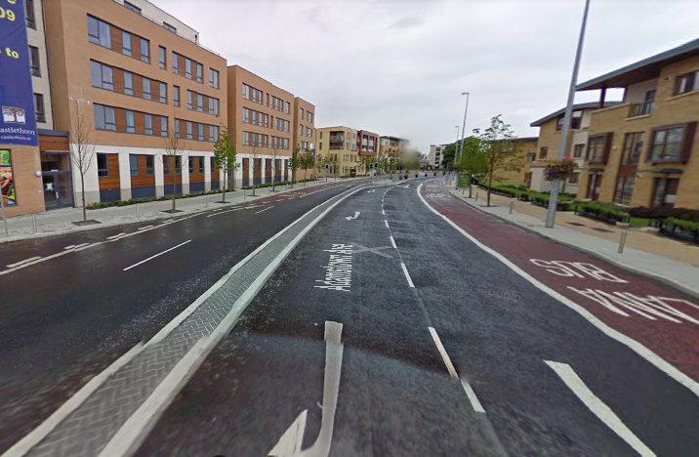
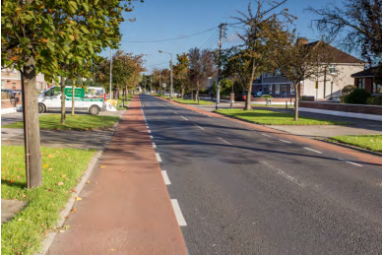
Types of Traffic Calming Proposed – horizontal control measures
Central Reserve, tree planting and coloured asphalt- e.g. Adamstown
Shared Surfaces – e.g. Wainsfort Road

Slide 3
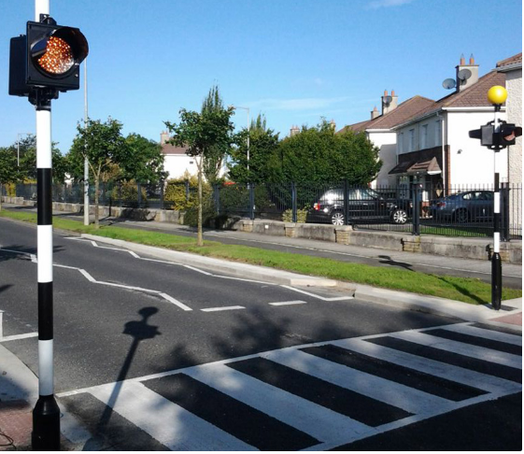
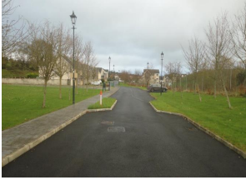
Types of traffic calming – horizontal control measures
Belisha / Toucan Crossings
Buildout/ Chicane /Tree Planting

Slide 4
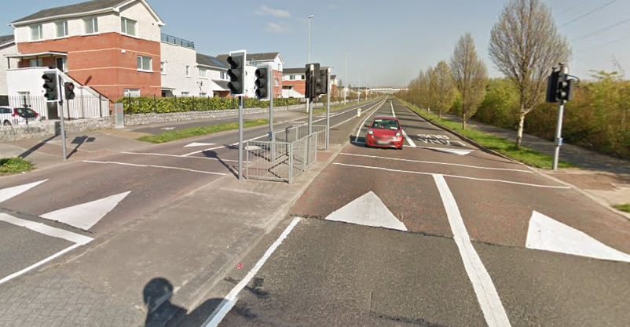
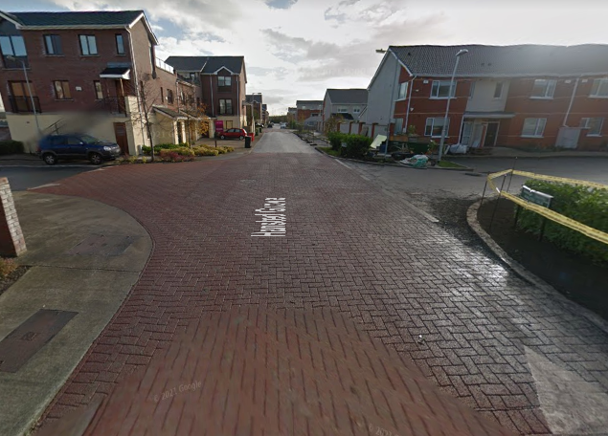
Types of Proposed Traffic Calming – raised tables and varied surfaces
Paved raised tables – varied surface Texture and Colour
Raised Tables/ Speed Tables – e.g. Lucan

Slide 5
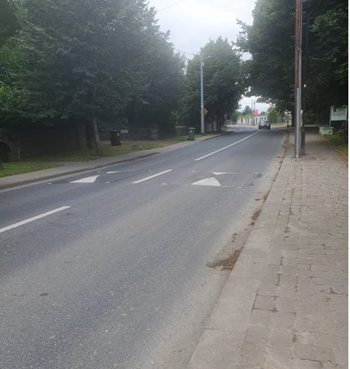
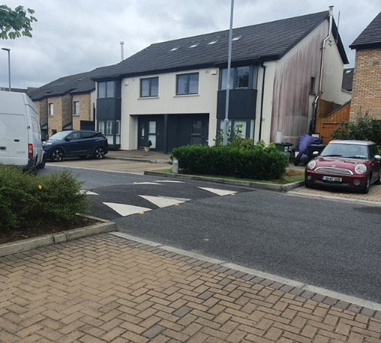
Types of Traffic Calming Proposed – vertical control measures
Bus Cushion – e.g. Newcastle
Ramp – e.g. Hunters Lane

Slide 6
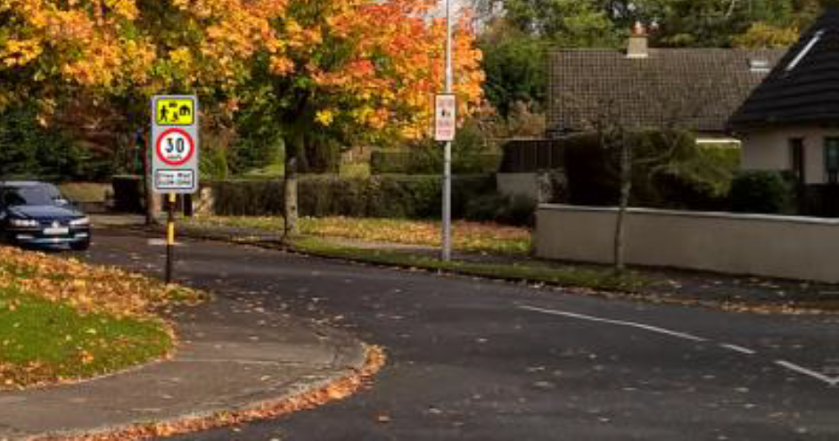
Slow Zones in Housing Estates

Slide 7
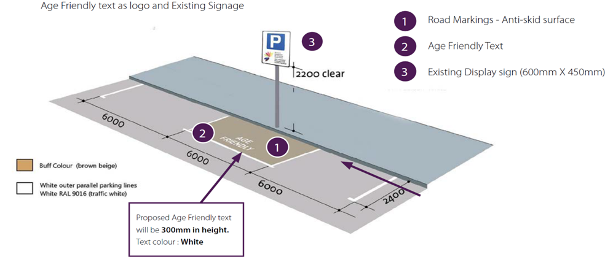
Universal Access – Disability and Other Groups

Slide 8
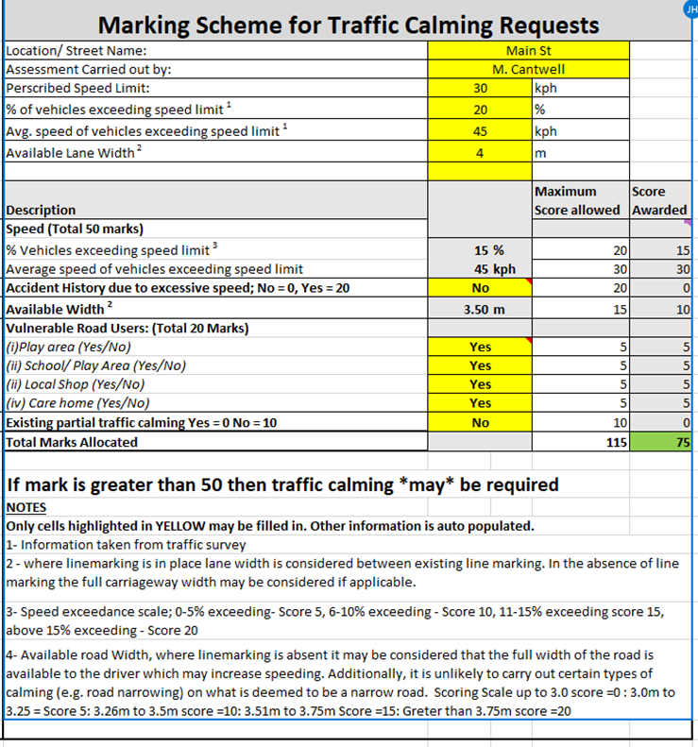
Traffic Calming
Assess Traffic Calming Requests
Priority List of Schemes created
Public Consultation and Agreement
Agree a Proactive Programme of Works with the Members
A range of alternative Traffic Calming Measures to be implemented
Multiple measures are found to Work Best

Slide 9
Street Improvement Management Guide
Recommendations
1. Informed by existing standards and practice across Ireland and Europe, it is proposed to adopt the following Street Management Objectives on our existing Road Network:
• Encourage walking, cycling and the use of public transport.
• Improve permeability across the County
• Improve safety at junctions for all road users
• Introduce additional crossing points on our streets at key desire lines.
• Reduce traffic speed to protect vulnerable road users through
the use of Traffic calming works
• Support universal travel access for vulnerable groups.

Slide 10
Recommendations:
  2. South Dublin County Council’s Street Improvement Guide will only apply to Local Collector Roads and Access Roads with a Speed Limit of 50km/h or less that carry primarily residential, limited commercial and social traffic (schools etc) and may also have significant pedestrian and cyclist traffic.
The Types of Interventions to be used to deliver the Objectives above are:
• Build Outs
• Central Reservations
• Ramps and Bus Cushions
• Reduction in vehicle road space.
• Enclosure /Tree Planting or on street parking where appropriate
• Shared Mode Road Space
• Colour or material changes to denote Shard Surfaces
• Slow Zone designation in Housing estates (30km/h)
• Signalled Pedestrian crossings at Appropriate Locations
• Traffic Signal coordination to control Traffic Flows and Speed (SCOOT system)
• Better access for vulnerable road users such as Mobility Impaired and Age Friendly Parking Spaces

Slide 11
Recommendations
SDCC shall adopt Table 1 Marking Scheme for Traffic Calming Requests on existing roads and estates to assess the need and prioritise Traffic Calming schemes that SDCC shall carry out. manner. This marks each scheme in a quantifiable and consistent manner.
The Implementation of Traffic Calming measures will be at a network level to ensure consistent traffic speeds across the neighbourhood.
5. The Traffic Section recommends that a series of Pilot Study Trials of retrofit Traffic Calming in combinations are conducted to assess the effectiveness of the various measures. The best performing combination of measures shall be rolled out as the preferred interventions throughout the county.

Slide 12
Recommendations
6. SDCC are committed to use a wider range of appropriate traffic calming combination measures throughout the County. The possible range of traffic calming measures are illustrated in Appendix 6 of the Appendices Report.
7. In all proposed Traffic Calming schemes, a consultation process should take place with elected members (TMM), Residents and Resident Groups by, An Garda Síochána, Fire, Ambulance and Bus Services where relevant.
8. The Slow Zone Sign, introduced in the Guidelines for Setting and Managing Speed Limits in Ireland (March 2015 Edition), is a sign to be used in housing estates where a 30 km/h speed limit is being applied.

Slide 13
Recommendations
9. SDCC shall write to the Department of Transport, the CCMA and the NTA to get a workshop organised to update the warrant guidance to incorporate vulnerable users and key desire lines into the methodology for pedestrian crossing location selections.
10. SDCC is committed to developing an Age Friendly Parking Policy for the County.

Slide 14
Next Steps….
Any Feedback on the documents to me at:
JHegarty@SDublincoco.ie
Informal meeting of SPC Group to finalise the “Street Improvement Management Guide”
Tentative Date and Time: 6 January 2022 @ 17:30
Bring to full Council for Noting February 2022
End

