Slide 1
Draft GDA Transport Strategy 2016-2042 published revising the adopted 2022-2035 Strategy Aims: “To provide a sustainable, accessible and effective transport system for the Greater Dublin Area which meets the region’s climate change requirements, serves the needs of urban and rural communities, and supports economic growth.” Public Consultation: There is currently a Public Consultation which runs up until Friday 17th December 2021

Slide 2
There are several Online Information Sessions
Here are several Zoom Meeting Links that you can join to get further Information on the Draft Transport Plan :
23rd November @18.30
Registration Link: https://us06web.zoom.us/webinar/register/WN_wbwtUDwaSBKSfMqFpx-39g
25th November @13.00
Registration Link: https://us06web.zoom.us/webinar/register/WN_PRZ00qQ9S2ypciTOCmF7_Q
2nd December @13.00
Registration Link: https://us06web.zoom.us/webinar/register/WN_O7MlzLzhSg6Y1EIvQ5KD3A

Slide 3
Draft GDA Transport Strategy 2016-2042
The Draft Transport Strategy seeks to address all aspects of land-based GDA transport and sets out a variety of actions covering:
Planning for Sustainable Transport
Integration and Inclusion
Walking, Accessibility and Public Realm
Cycling and Personal Mobility Vehicles
Public Transport – Bus, Luas, Metro and Heavy Rail
Roads
Traffic Management and Travel Options
Freight, Delivery and Servicing
Climate Action Management

Slide 4
Draft GDA Transport Strategy 2016-2042
Particular Projects in South Dublin
Public Transport
5 no. Bus-Connects Core Bus Corridors
Additional Radial Core Bus Corridors
Orbital Core Bus Corridors
Zero Emissions Bus Fleet; New Bus Stops and Shelters; Local Link and Demand Responsive Transport
Dart + South West from Hazelhatch to Heuston
Luas Extensions
Luas extension to Clondalkin
Luas to Tallaght / Kimmage
Luas to Tallaght / Knocklyon
A light rail line from Lucan to the City Centre

Slide 5
Draft GDA Transport Strategy 2016-2042
Active Travel Projects
Cycle South Dublin Programme – NTA committed to fund schemes
Ensuring that all urban areas will be served by high quality pedestrian facilities
Universal Access – for disability groups
Support for wayfinding systems and their integration into journey planning apps
Climate Action
Legislation requires a total reduction of 51% in CO2 emissions over the period to 2030

Slide 6
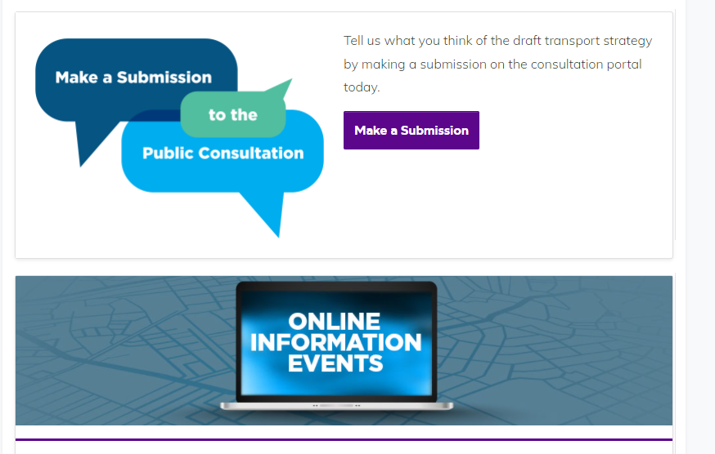
Draft GDA Transport Strategy 2016-2042
What are SDCC committed to doing in relation to the Public Consultation?
SDCC will discuss the Draft Plan at the LUPT SPC
SDCC will make a multidisciplinary submission on the Draft GDA Transport Plan
I have given you the links on the Information sessions planned
To Make a Submission The Link is: Ctrl+Click
https://www.nationaltransport.ie/gda/

