Slide 1
SHD Application Ref: SHD3ABP-311616-21
Applicant: MacCabe Durney Barnes Ltd.
Location: Stocking Lane, Ballyboden, Dublin 16
Presentation to: R.T.F.B. ACM 9th Nov 2021
Jim Johnston
Senior Executive Planner

Slide 2
Timelines
SHD Lodged with ABP on 11/10/21
5 Week Obs by 5.30pm on 15/11/21
8 Wks SDCC report due on 6/12/21
16 Week Decision due from ABP on 8/2/22
S.247 pre-planning meeting with SDCC as follows:
SHD1SPP001/20 on 3/2/20
Tripartite meeting ref SHD2ABP-310111-21 held on 23/6/21 with An Bord Pleanála, the applicant and SDCC.
Consultations

Slide 3
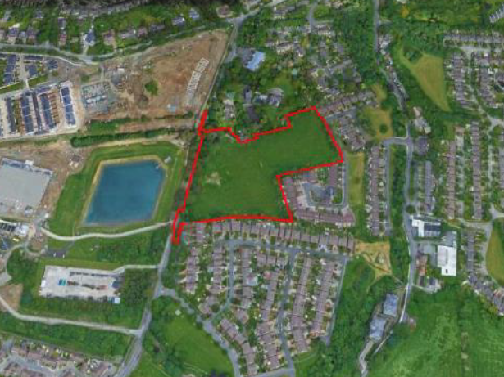

Slide 4
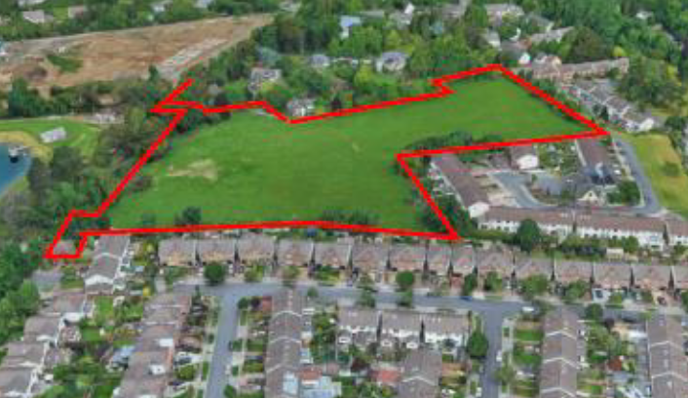

Slide 5
Proposed Development
• 131 residential units including:
- 21 houses (1 no. 3-bed; 11 no. 4-bed; 9 no. 5-bed) of up to two-storey plus roof storey.
- 2 duplex apartment units (2 no. 2-bed) in a three-storey high block.
- 108 apartment units (29 no. 1-bed; 59 no. 2-bed; 20 no. 3-bed) in ten apartment blocks up to four-storeys
• A creche of c. 128 sqm at the ground floor of Block L.
• A shop of c. 65 sqm at the ground floor of Block G, with associated storage.
• A total of 167 car parking spaces, of which 88 are at surface level and 79 in the basement under apartment Blocks F and G, 5 are dedicated visitor parking spaces.
• A total of 288 cycle parking spaces and 5 no. motorcycle spaces.
• A new vehicular access onto Stocking Lane.
• A new pedestrian and cycle access to the Springvale estate to the east.
• New roads, footpaths and cycle paths and connections within the site
• A new pedestrian crossing on Stocking Lane to the north west.
• The expansion and upgrade of the existing pedestrian crossing on Stocking Lane to the south west.

Slide 6
ABP comments – the Bord requested that the following issues be addressed
Sunlight and daylight/overshadowing analysis showing an acceptable level of residential amenity for future occupiers and existing residents
Transport assessment of access points between the site and Springvale to the east, including assessment of vehicular, cyclist and pedestrian access options
Schedule of accommodation to indicate compliance with Apartment Guidelines 2020
A Building Life Cycle report in accordance with Apartment Guidelines 2020
A landscaping plan including details of all proposals for the communal open space
Full details of boundary treatment
A rationale for the proposed car parking provision including car parking management, car share schemes and a mobility management plan

Slide 7
ABP comments continued:
8. Construction and Demolition Waste Management Plan
9. Responses to issues raised in the Public Realm report and Water Services report of 13th may 2020 and detailed in addendum C of Planning Authorities Opinion
10. Where the applicant considers that the proposal is a material contravention of the Development Plan, other than in relation to the zoning of the land, a statement indicating the Plan objectives concerned and why permission should, nonetheless, be granted
11. Screening report to determine if EIA is required

Slide 8
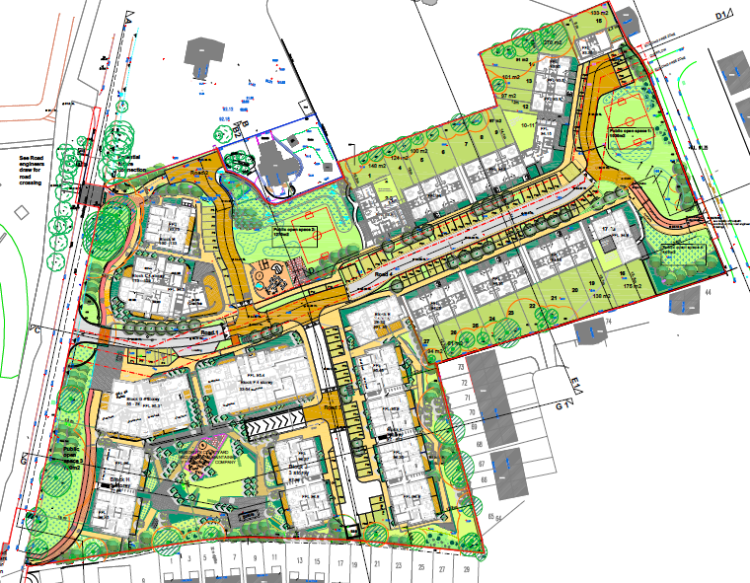

Slide 9
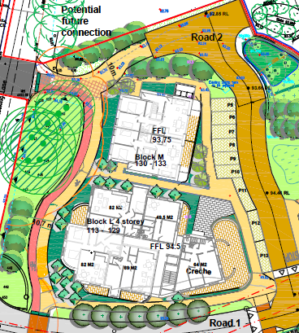

Slide 10
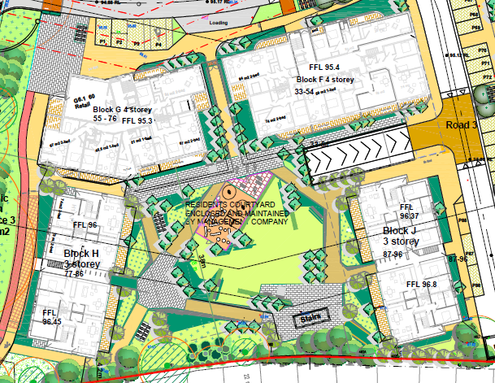

Slide 11
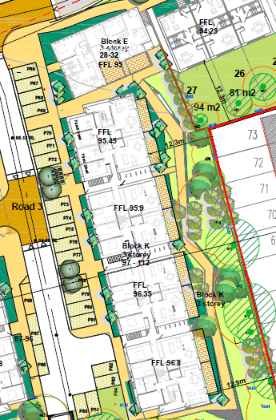

Slide 12
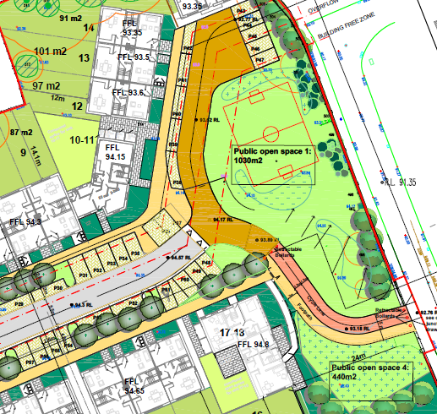

Slide 13
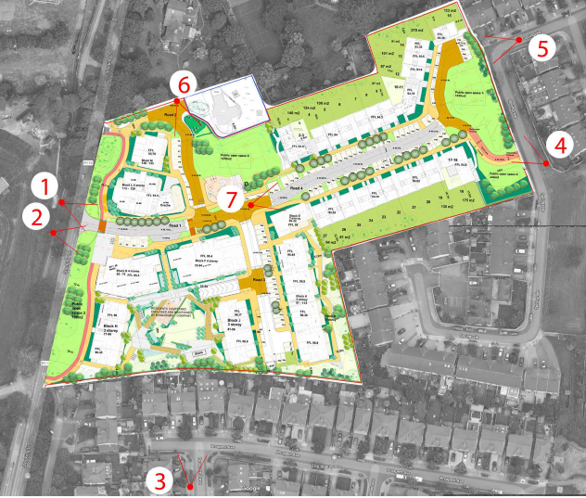

Slide 14
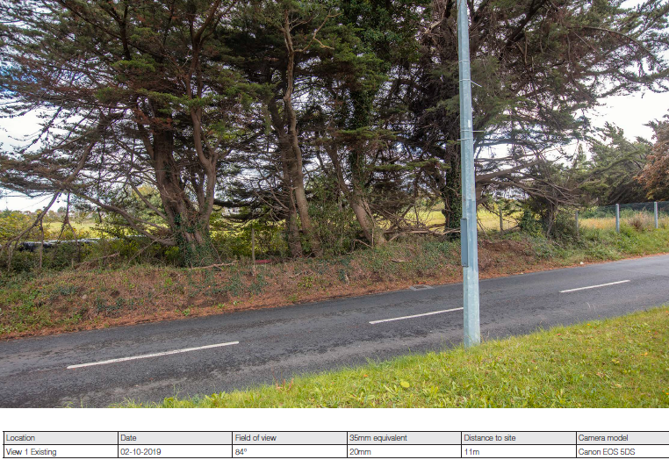

Slide 15
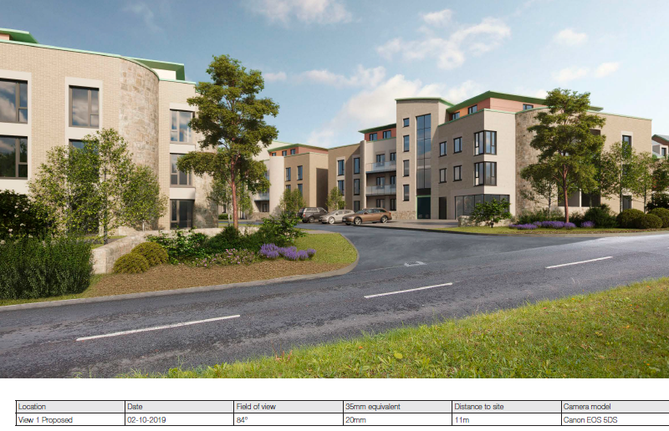

Slide 16
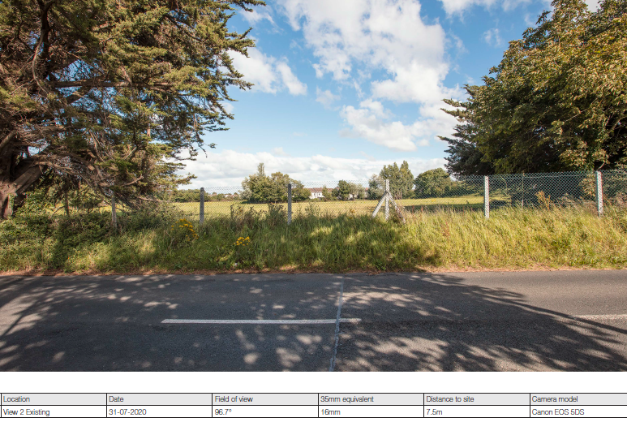

Slide 17
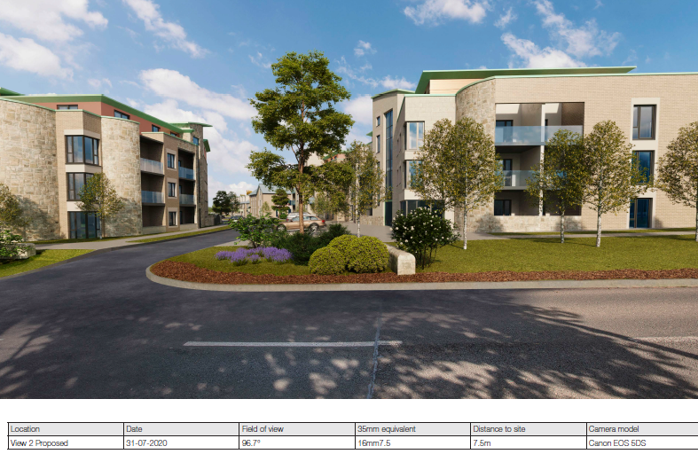

Slide 18
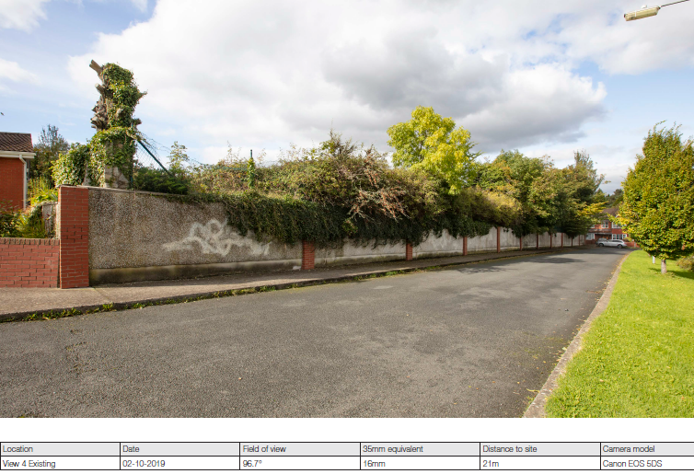

Slide 19
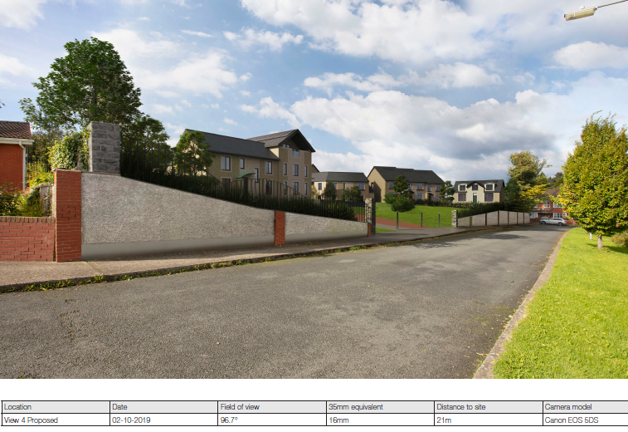

Slide 20
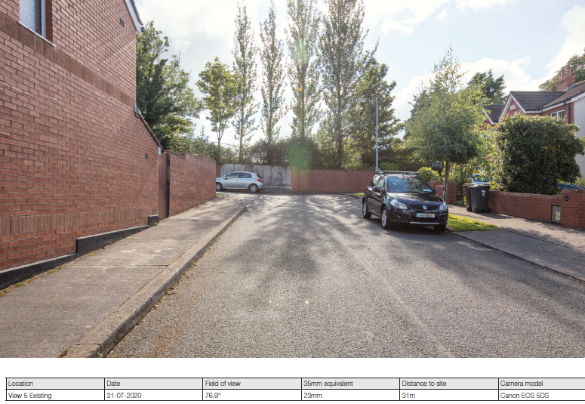

Slide 21
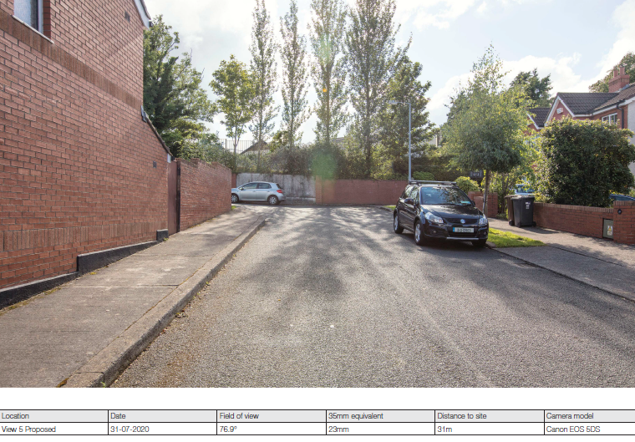

Slide 22
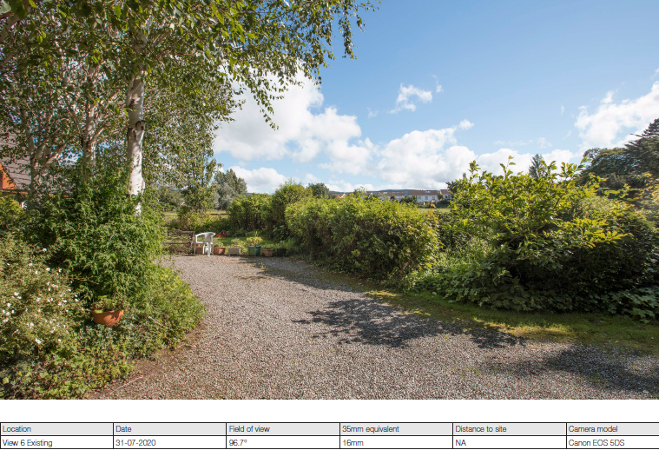

Slide 23
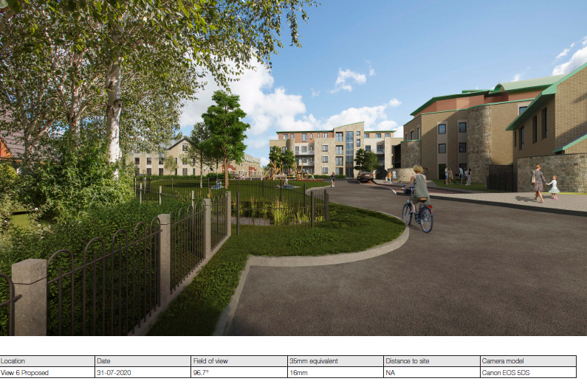

Slide 24
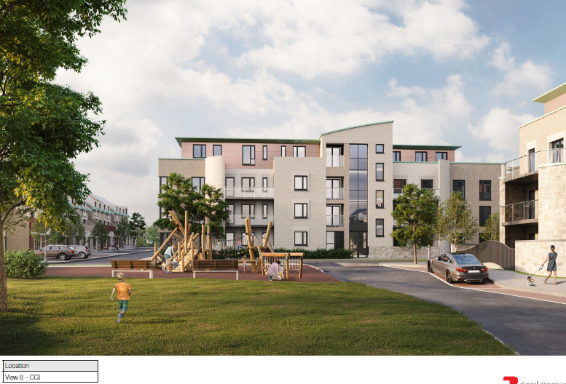

Slide 25
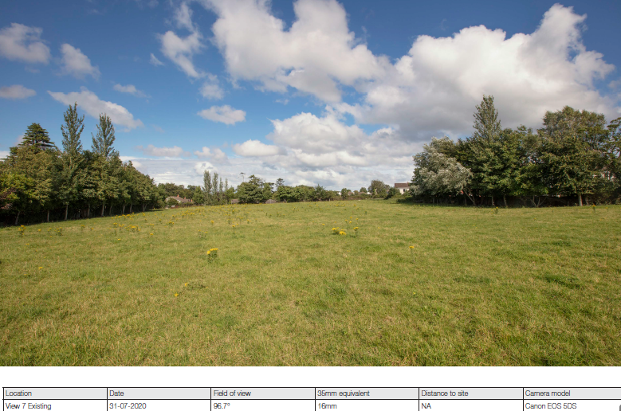

Slide 26
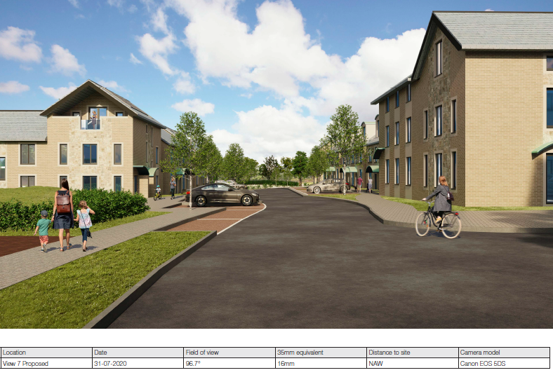

Slide 27
Statistics for Proposed Development
Proposal - 131 residential units (108 apts 21 houses 2 duplex units) comprising:
21 houses - 1 no. 3-bed, 11 no. 4-bed, 9 no. 5-bed
108 apts in ten apt blocks - 29 no. 1-bed, 59 no. 2-bed, 20 no. 3-bed
2 duplex apartment (2beds) units in a three-storey high block -
Site area – 2.47ha.
Density – 54 uph
Creche - 128 sqm at the ground floor of Block L.
Shop - 65 sqm at the ground floor of Block G, with associated storage.
Car parking spaces - (167 of which 88 are surface and 79 in the basement under apartment Blocks F and G, 5 are dedicated visitor parking spaces.
Bicycle parking - 288 and 5 motorcycle spaces.
Plot Ratio – 0.54
Site Coverage – 20%
Height – 2 to 4 storeys
Dual Aspect apartments – 82%
Public Open Space – 3,510sq.m. (14% of site area)
Communal Open Space - 3,077sq.m. (apartments and duplex)
Applicants website - www.stockinglaneshd2.com.

Slide 28
Thank You
Questions

