Slide 1
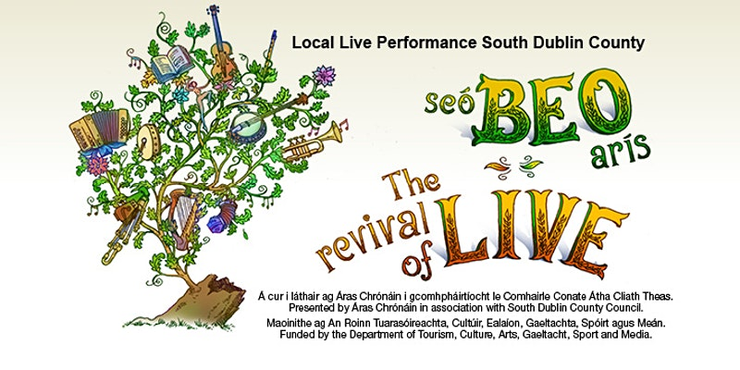
Outdoor and Indoor performance November and December
40 Covid Care Concerts
25 Concerts Áras Chronáin/Brú Chronáin
6 Library Concerts: Pennies from Heaven and the Cotton Club Quartet
1 NOISE Music Concert (NCL)
1 Dancers/Street Performer & Bunraku Puppeteer event - MacUillium Estate
1 Solstice Concert – Pearse Museum
1 Street Arts /Circus Performer / Stilt Walker & Festive Costume to add to Lights Street Event - Unwrapped, Chamber Square
4 events, Tandy’s Lane Park, a Lucan Park, Rathfarnham Castle Park, Liffey Valley.
Local Live Performance Phase II

Slide 2
support individual professional artists to develop their artistic practice working with and/or producing work for early childhood arts.
Bursary range: €500 - €5,000
The closing date: 2pm, 1st of December 2021
Promoted by the 4 Dublin Local Authorities

Slide 3
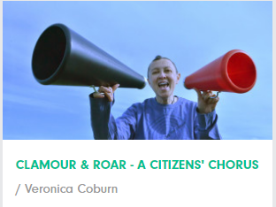
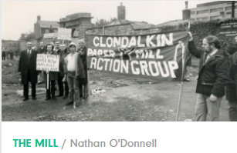
Public Art
IN CONTEXT 5 - Connect South Dublin County Council’s Public Art Programme 2021-2025 under the Per Cent for Art scheme.
Public Art Working Group

