Slide 1
Eastern - Midlands Regional Waste Management Plan
South Dublin County Council
Environment & Climate SPC
2nd November 2021

Slide 2
Regional Office Activities
National Issues
Prevention

Slide 3
National Issues

Slide 4
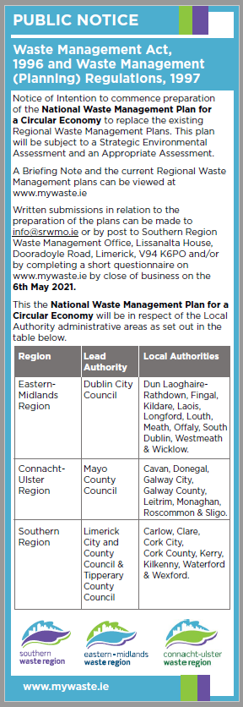
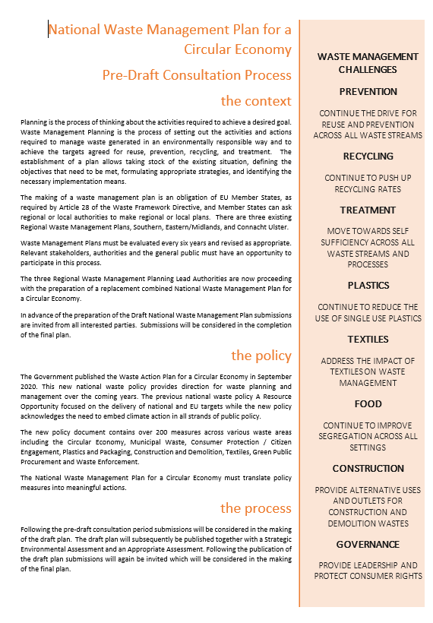
National Waste Management Plan for a Circular Economy

Slide 5
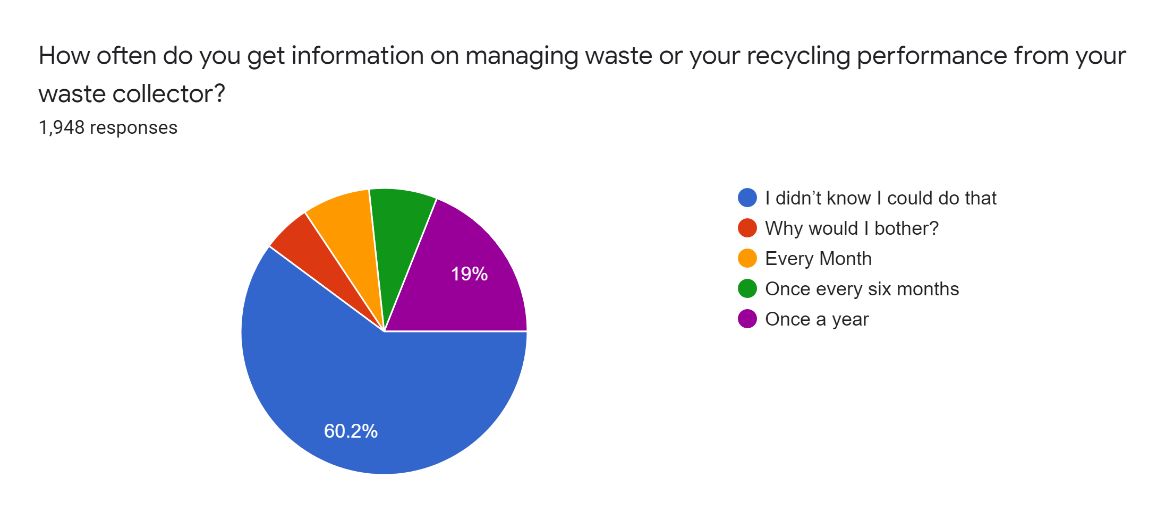
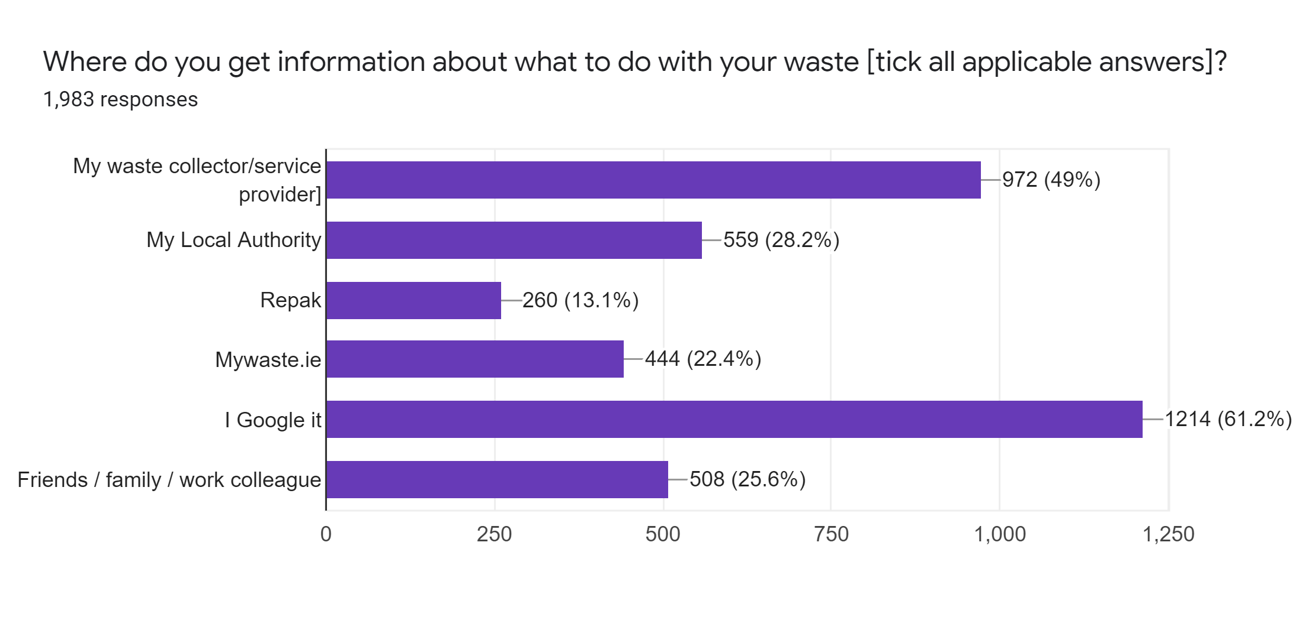
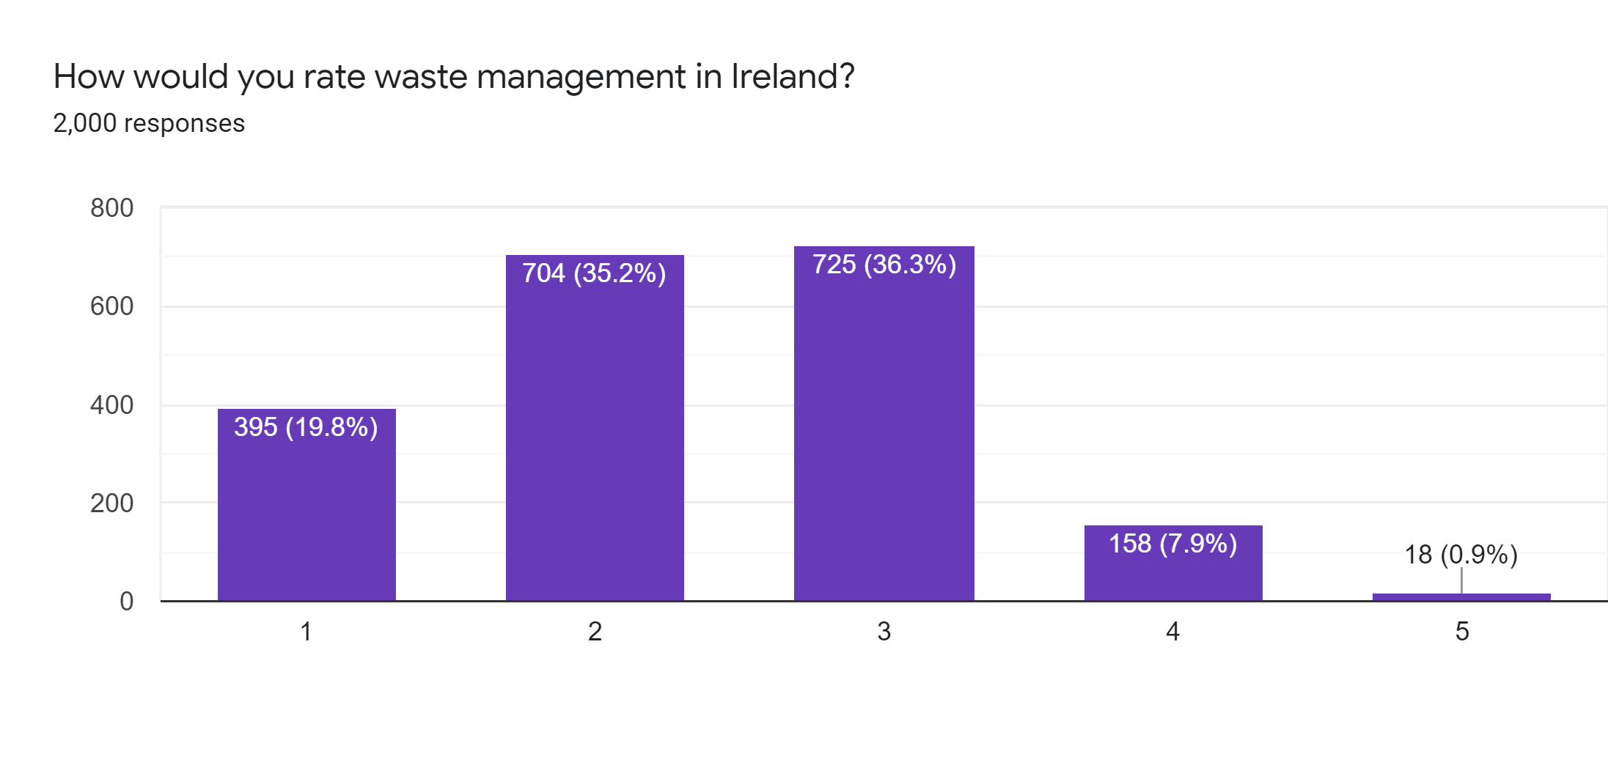
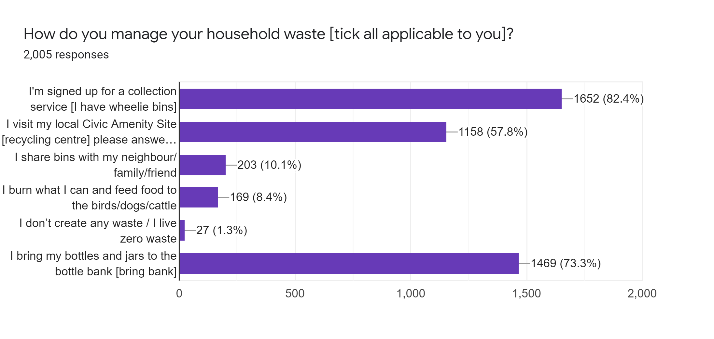
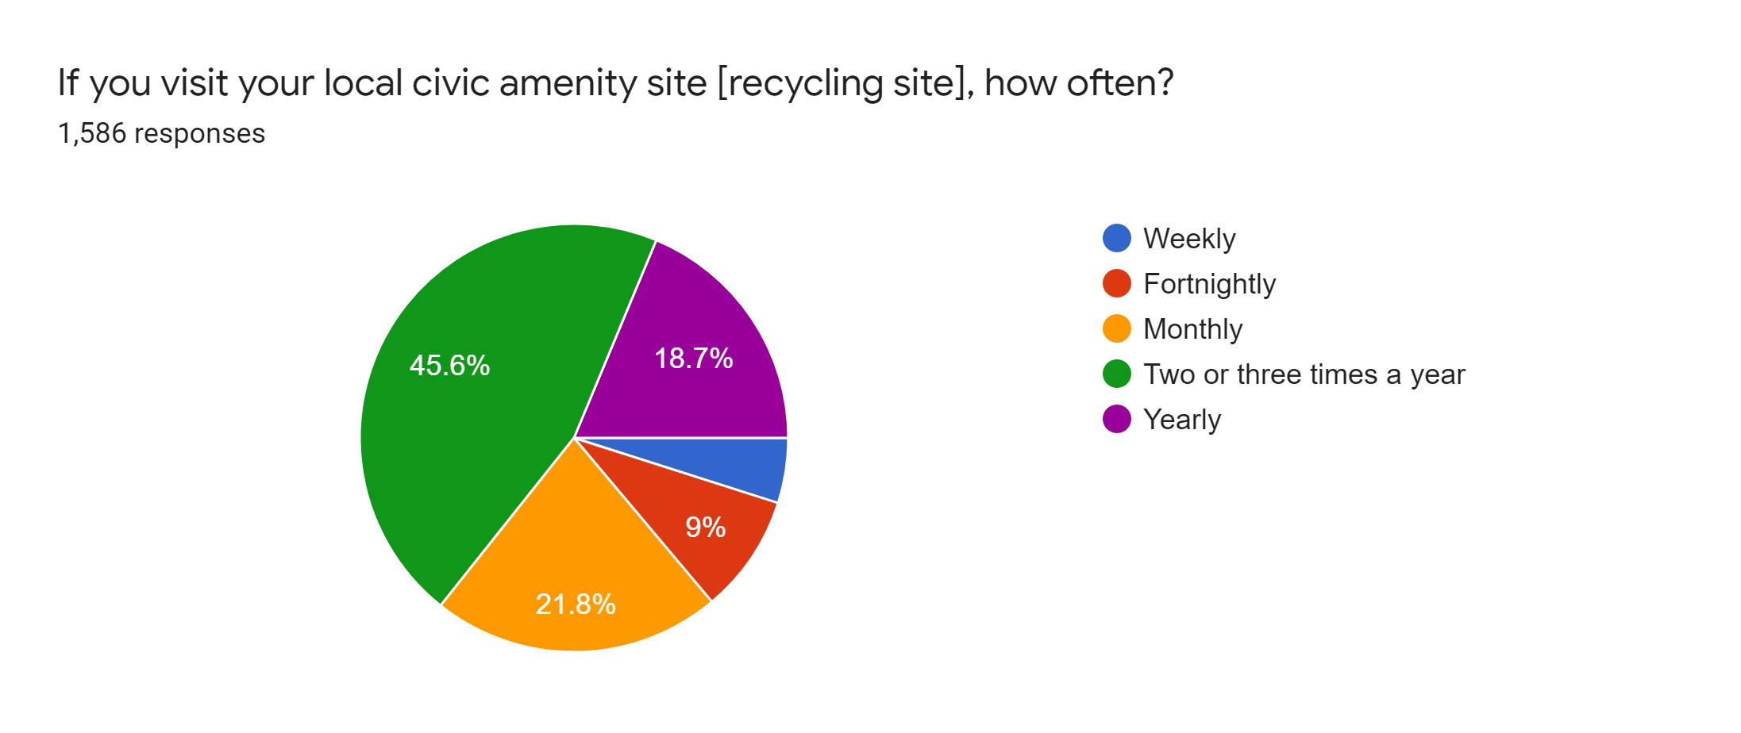
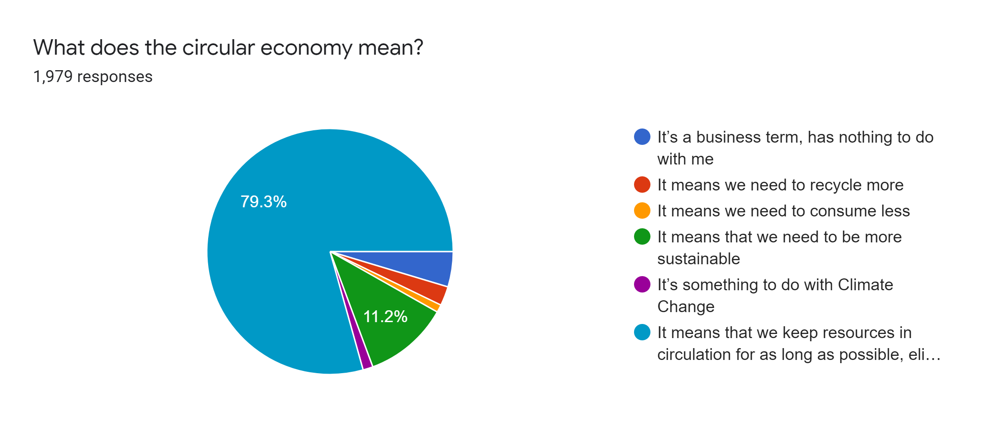
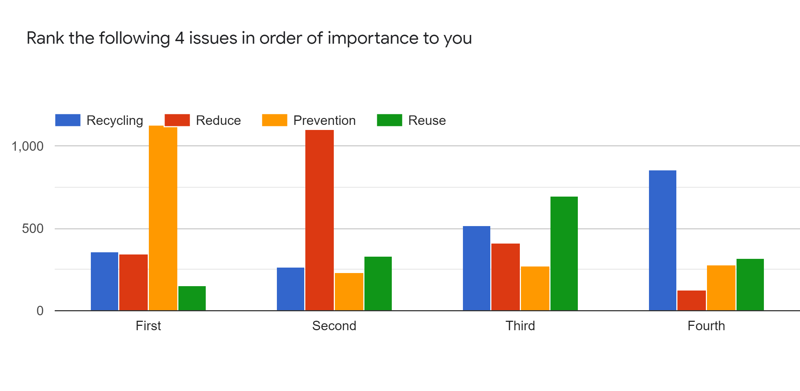
Pre-Draft Consultation Survey Results - 2,000+ Respones

Slide 6
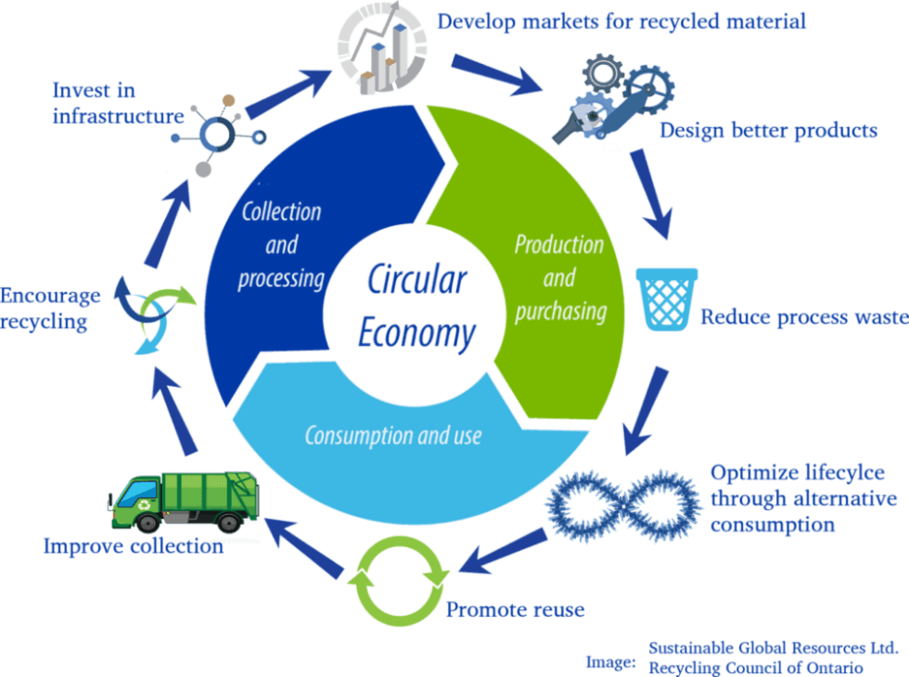
National Waste Management Plan for a Circular Economy
Plan Thematics
Consumption
Compliance
Capture
Plan Structure
Plan Context
Plan Core
Plan Delivery
Plan Appendices
Plan SEA/AA

Slide 7
National Waste Management Plan for a Circular Economy
Pre Draft Consultation
Evaluation Report
Consultancy Appointment
Preparation of Draft Plan & SEA
Review of Draft Submissions
Publication of Final Plan & SEA
Quarter 1 2021
Quarter 3/4 2021
Quarter 2 2022
Quarter 2 2021
Quarter 1 2022
Public Consultation on Draft Plan & SEA
Pre Draft Submissions Report
Tender for Consultancy

Slide 8
Other relevant National Developments
Circular Economy Strategy ( Final Strategy Q4)
National Prevention Programme for a Circular Economy (Final Programme Q4)
Circular Economy Bill ( Currently going through Oireachtas)

Slide 9
Waste Prevention
Awareness Campaigns and Projects

Slide 10
Always on advertising – Picnicking

Slide 11
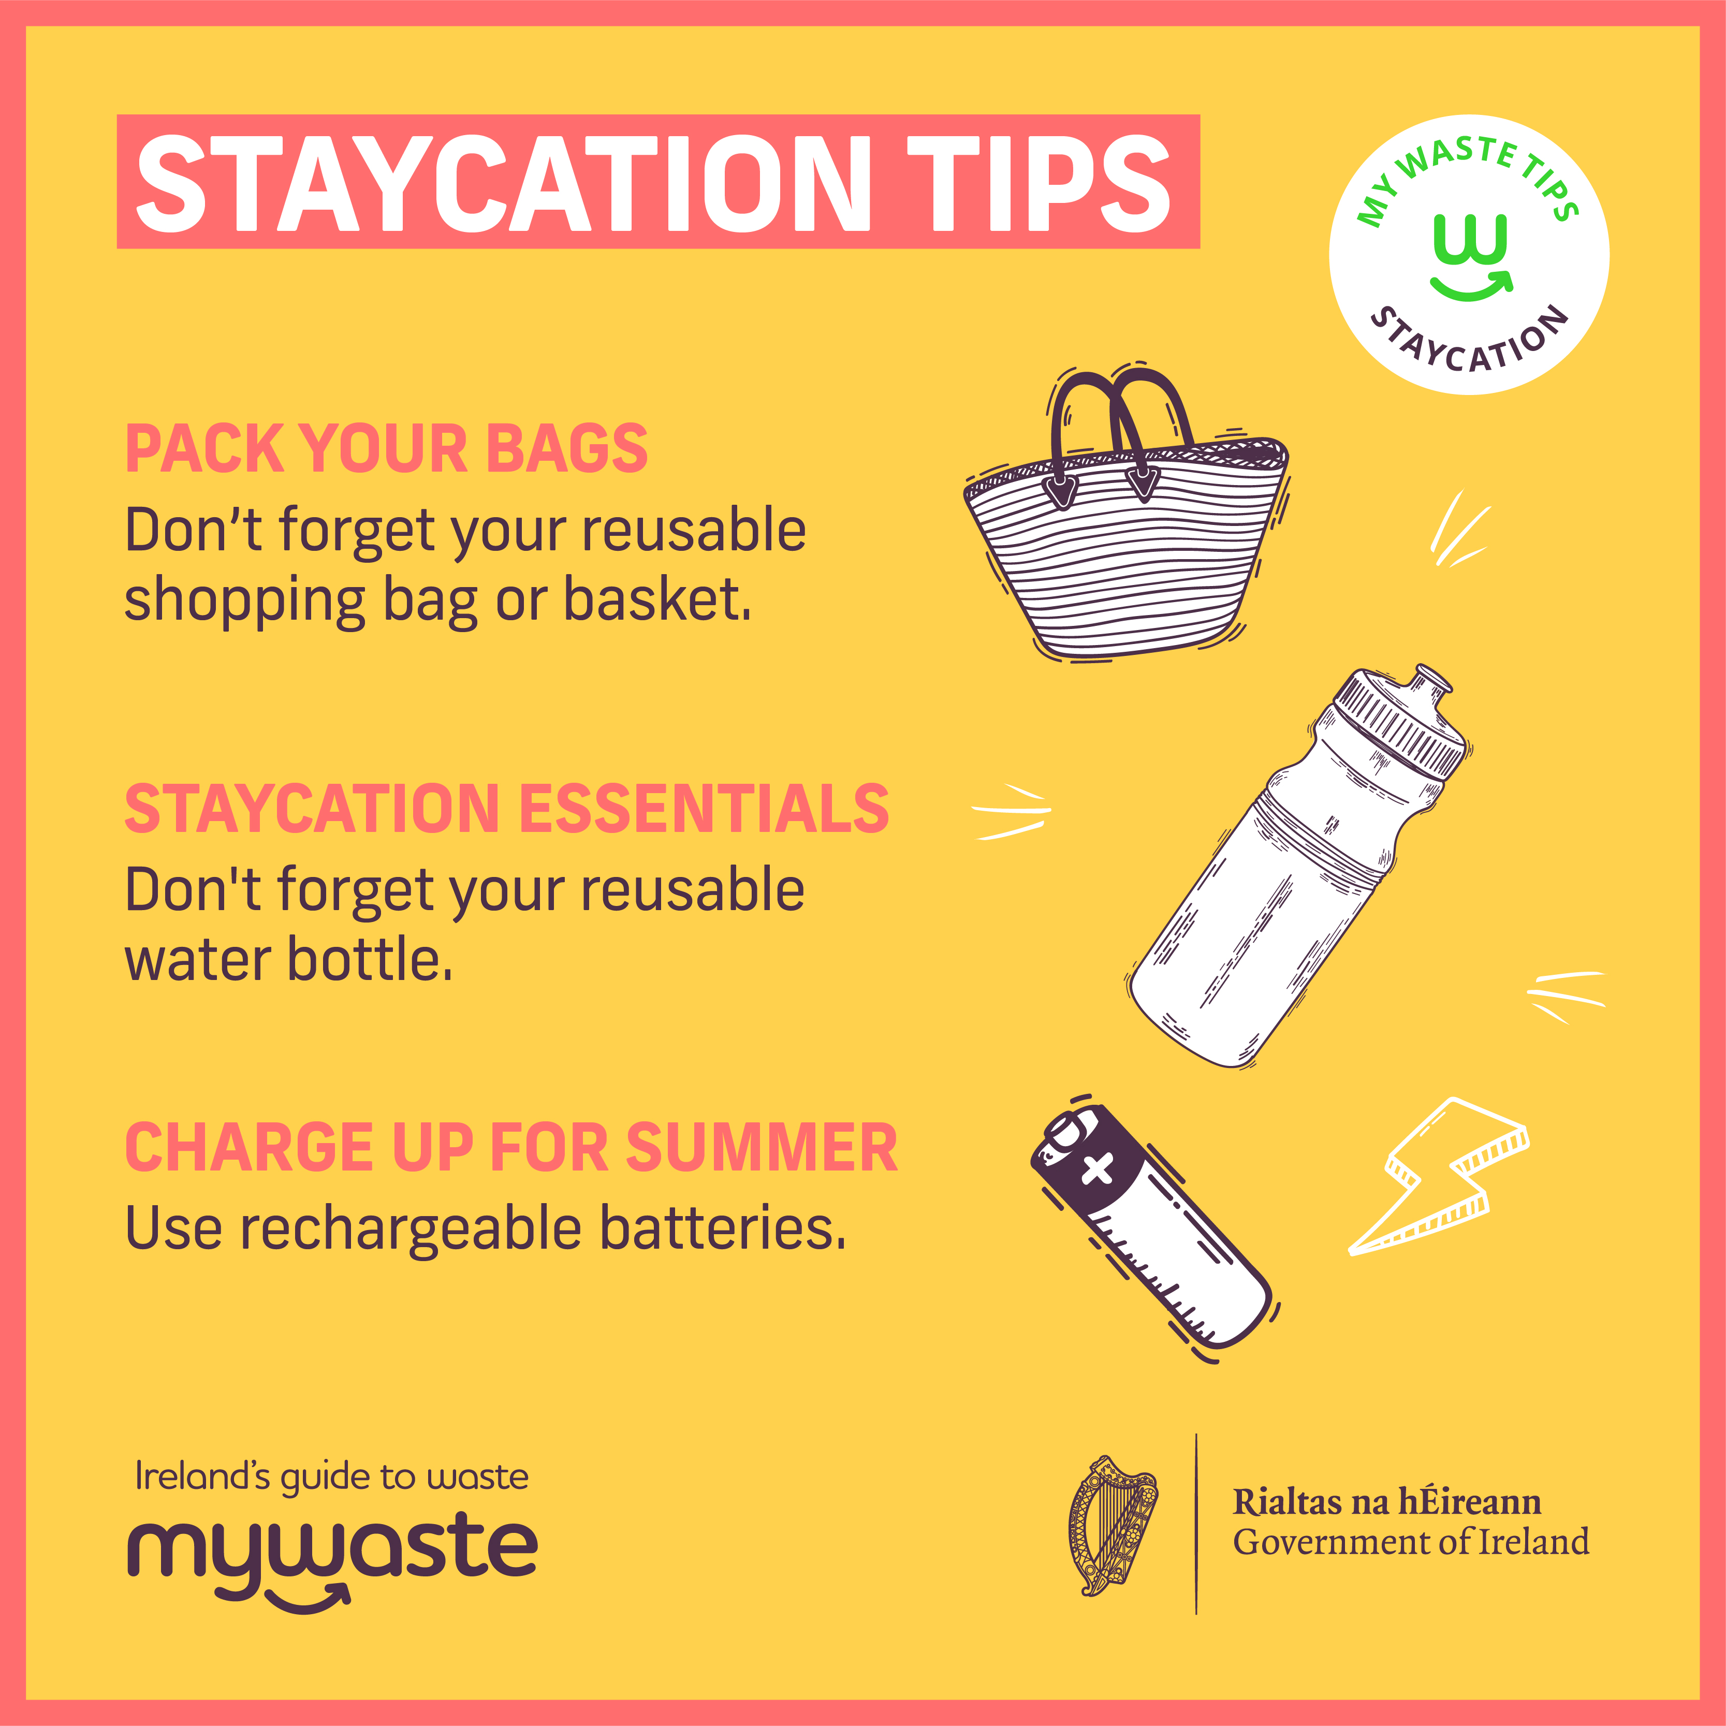
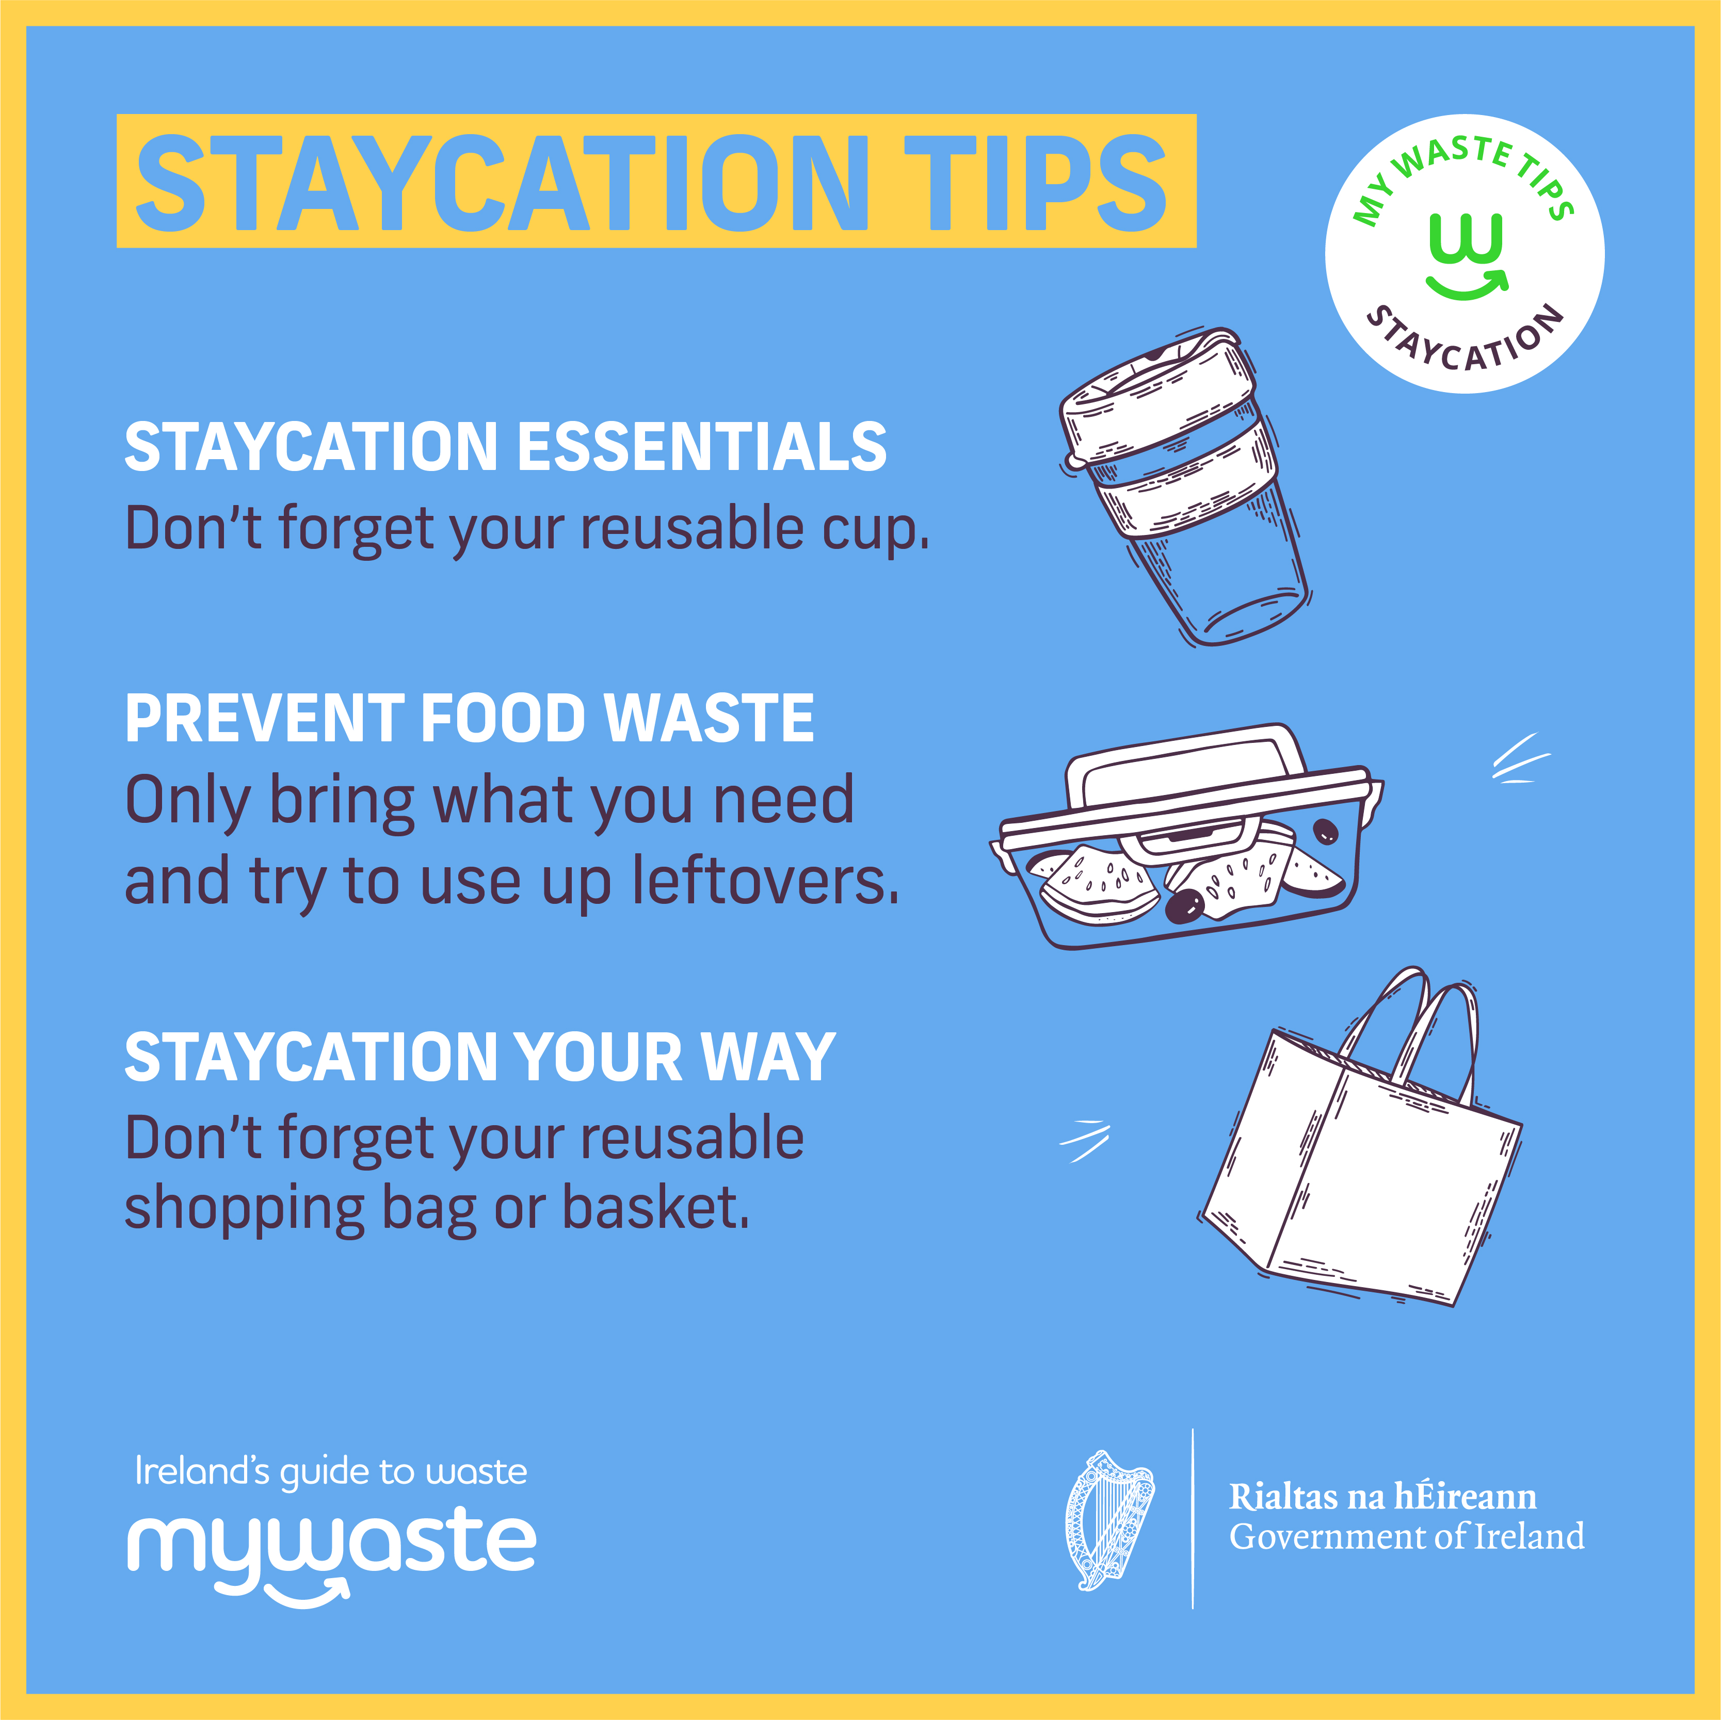
Always on advertising – Staycationing

Slide 12
Reintroduction of Soft Plastics
National Media Launch 06th September
Minister Ossian Smyth & Roz Purcell
Coverage – RTE, Virgin prime time news – Morning TV – Interviews on Major radio stations – extensive coverage in traditional and digital media
Campaign will run from September until the end of the year:
TV – RTE, Virgin, TG4 & Sky
Radio – Alternates around the country will get regional & national air time
Digital – utilise affinity targeting
Social – Facebook, Instagram, Twitter & YouTube

Slide 13
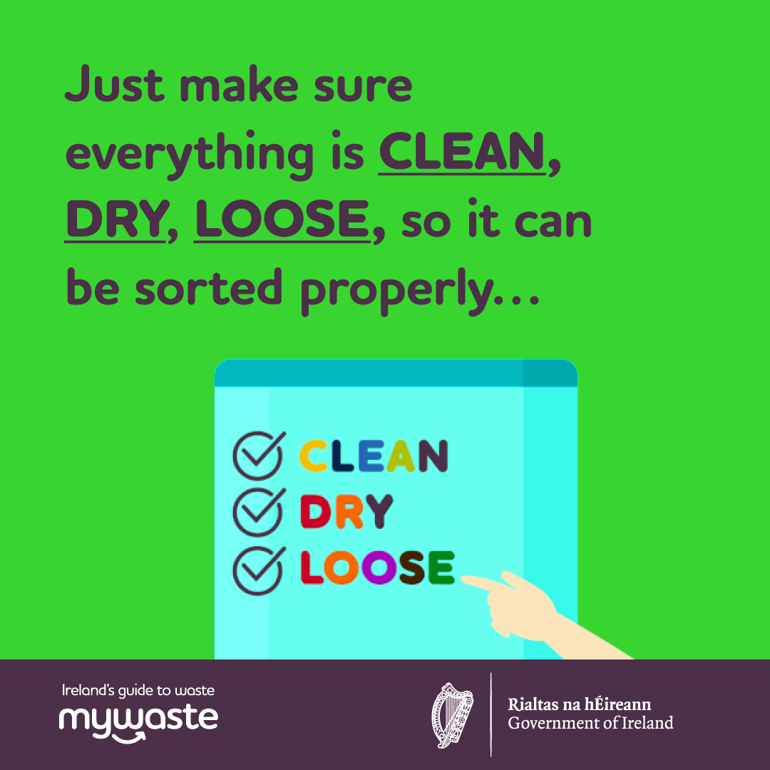
Reintroduction of Soft Plastics

Slide 14
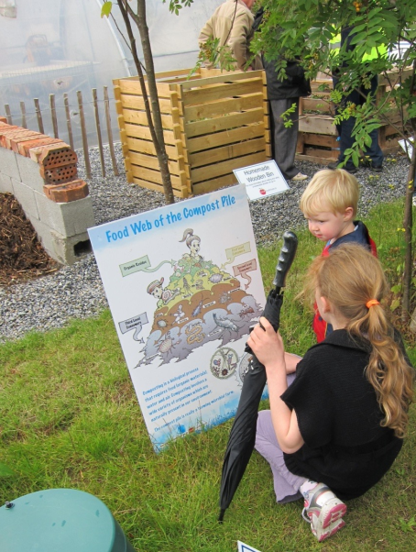
Schools Composting Project
4 Dublin Councils are involved in a large Schools Composting Project – this is a pilot and can be replicated in other areas going forward.
Project is being run over 2 years, regional office has committed €35k (plus extra for caddies) and the Dublin LAs are contributing between 10-15k each
100 schools will be involved – most have been recruited already
Each school will get a composting system including a compost area and wormery and equipment ie. caddies, liners
Project includes a suite of resources for schools including web site, video tutorials, master composter training, online repository (base camp), class room materials, school visits
Project team/steering group includes EAOs, CTC, Craig Benton (community composting expert) and the EMWRO

Slide 15
ADI - Materials
The Anti-Dumping Initiative (ADI) Campaign aims to deliver a suite of materials that can be used by both Local Authority staff and also by community groups and organisations highlighting the importance of eliminating illegal dumping activities in their functional areas and communities.
Local Authorities (LAs)
ADI Campaign materials will be
used by LAs to highlight to the
citizen, the issues associated will
illegal dumping activity:
Press (newspaper / radio)
Posters
Social Media
Local Communities
(Community Groups, Organisations,
Corporates & Schools)
Further support and enhance
LA message, targeting the citizen
at a more local level:
Local Newsletters
Posters
Social Media

Slide 16
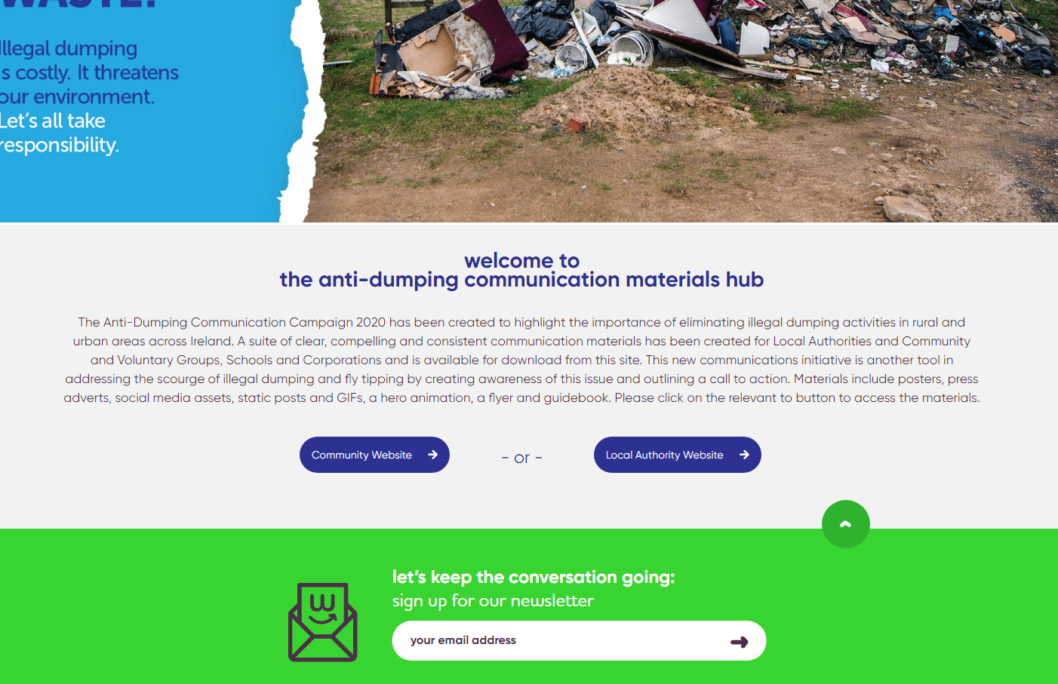
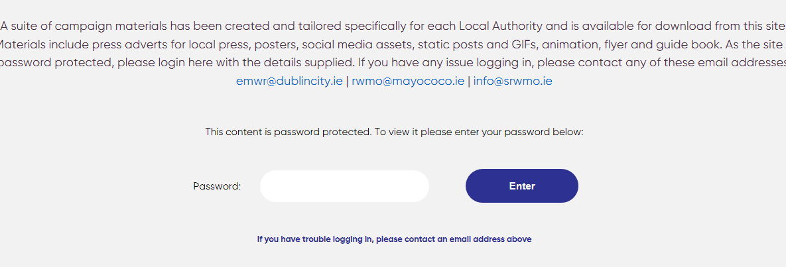
assets@adi

Slide 17
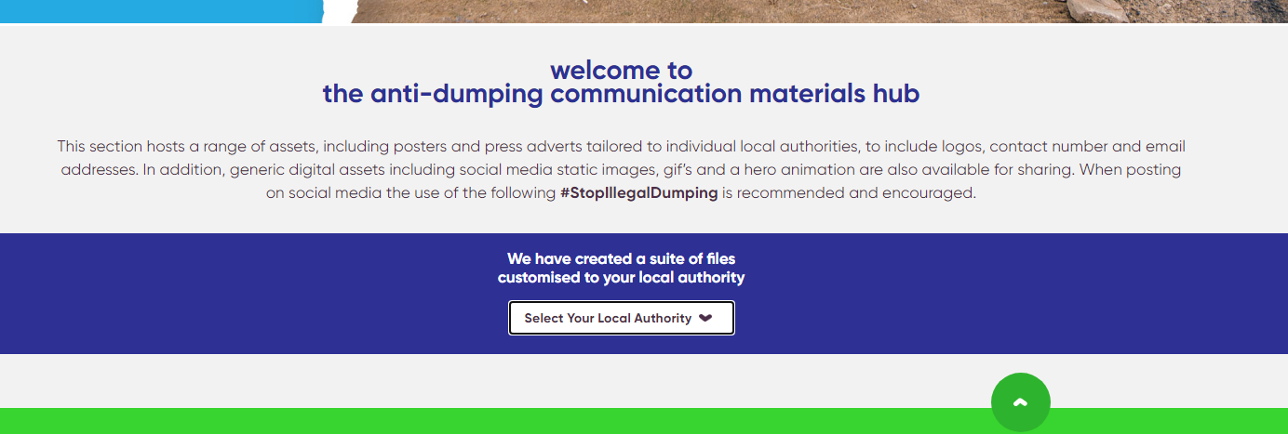
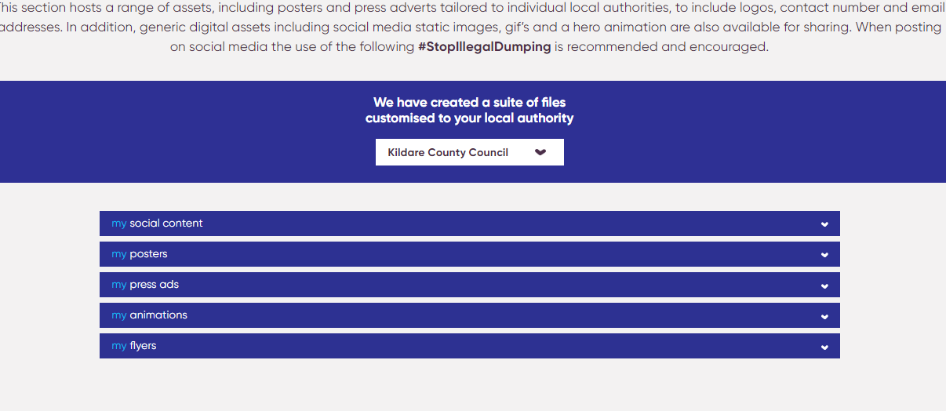

Slide 18
ADI – Additional Materials – Littering
The regions were requested to produce additional assets as a response to our outdoor Summer which lead to an increase of littering on streets and beaches.
All of these assets are also available on the ADI hub in English & Irish

Slide 19
Questions & Clarifications
hugh.coughlan@dublincity.ie

