Slide 1
Draft River Basin Management Plan for Ireland
20022 - 2027
Presentation to Environment, Public Realm and Climate Change SPC Meeting.
Date 2nd November 2021

Slide 2
Presentation Contents
About the river basin management plan
Condition of our waters, nationally and locally
Main themes in the plan
Overview of measures proposed
How to make a submission and get involved locally

Slide 3

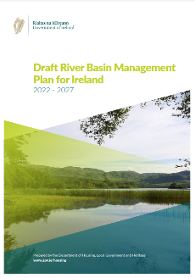
What is the river basin management plan
A national plan that aims to protect and restore good water quality in our rivers, lakes, estuaries, groundwater, and coastal waters.
For the benefit health, biodiversity, climate, communities, and jobs.
Notes:
This is a public consultation on a Plan which details how water quality in Donegal and across the country will be managed. It outlines the activities responsible for water quality declines, and the actions that are needed to correct those problems.

Slide 4
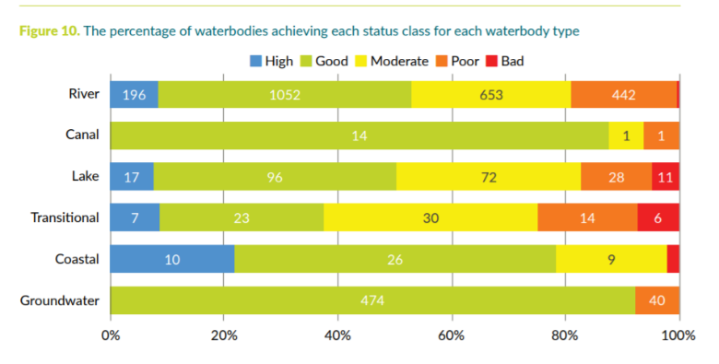
Condition of our waters - nationally
  Just over half (53%) of surface waters are in good or high ecological status.
  Overall water quality is not improving at a fast enough rate.
Notes:
Key Message: water quality is not improving fast enough.
Groundwater 92% of waterbodies are at good status.
Just over half (53%) of surface waters are in
good or high ecological status.
Summary:
Two thirds did not change in status.
One fifth declined
Just over one in ten improved.
Overall there was a 4.4% net decline in water quality mostly driven by declines in rivers.
However, assessments in 2019 and 2020 shown that the proportion of rivers improving in quality in the Priority Areas for Action at 21% is higher than the proportion improving outside of these areas at 13%, indicating that the targeting of actions is helping to improve water quality.
A large number of river waterbodies are still declining and unless this is addressed, sustained and progressive improvements in water quality will be difficult to achieve.

Slide 5
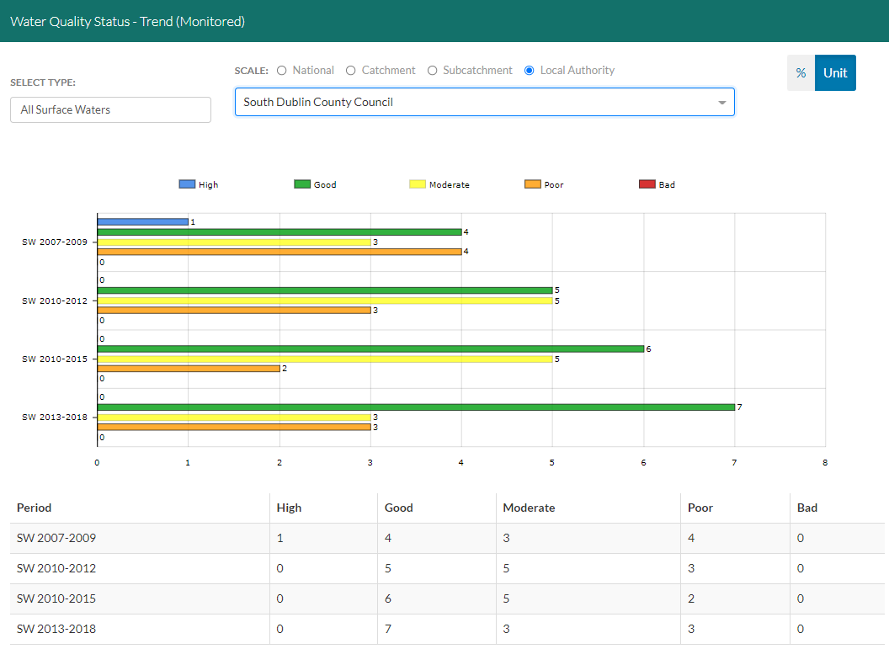
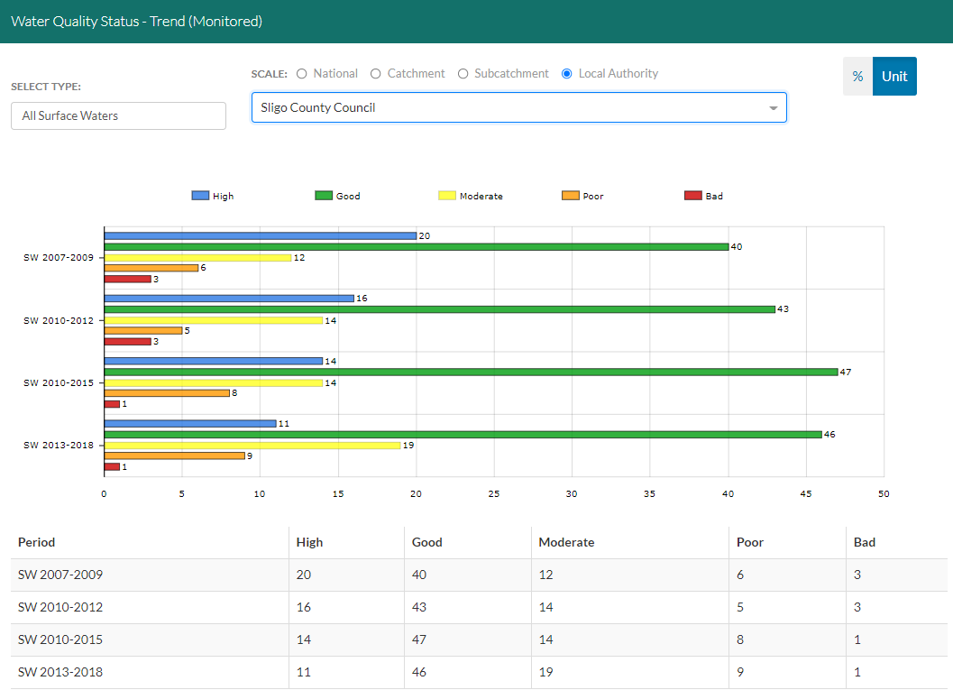
Source: catchments.ie

Slide 6
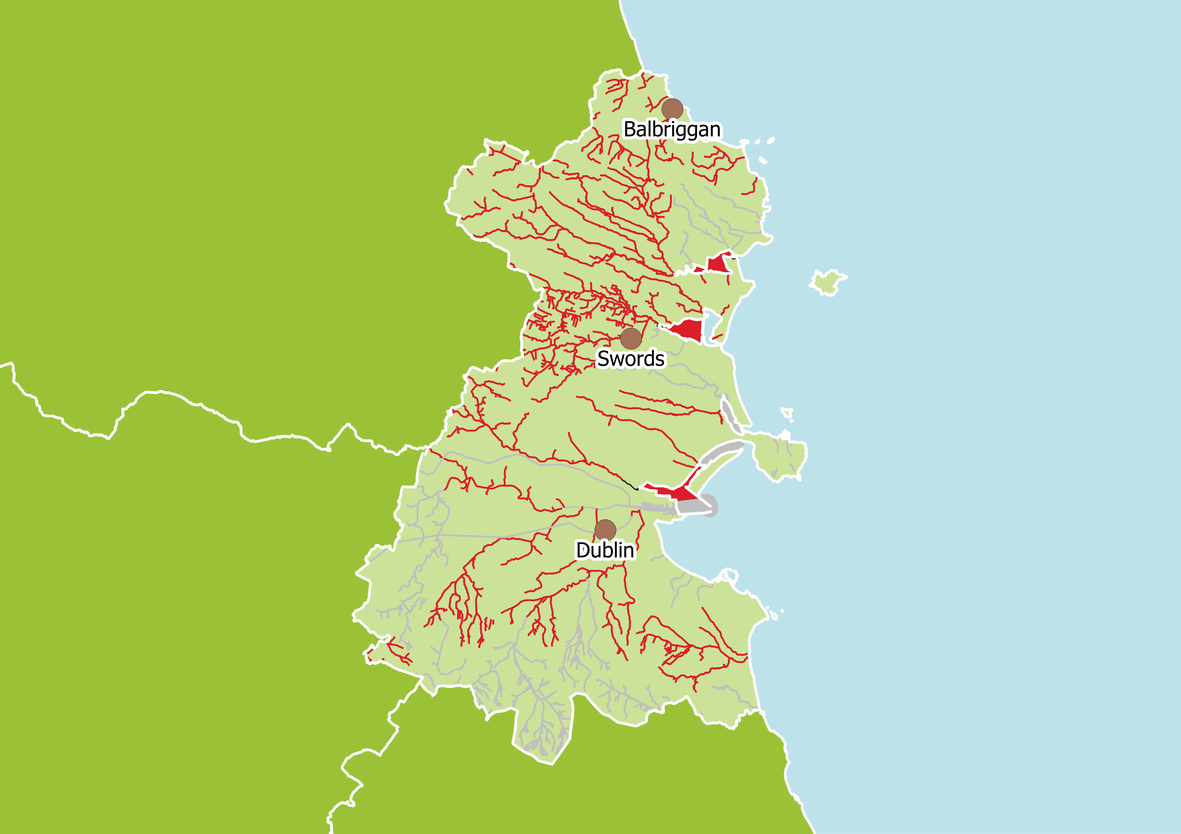
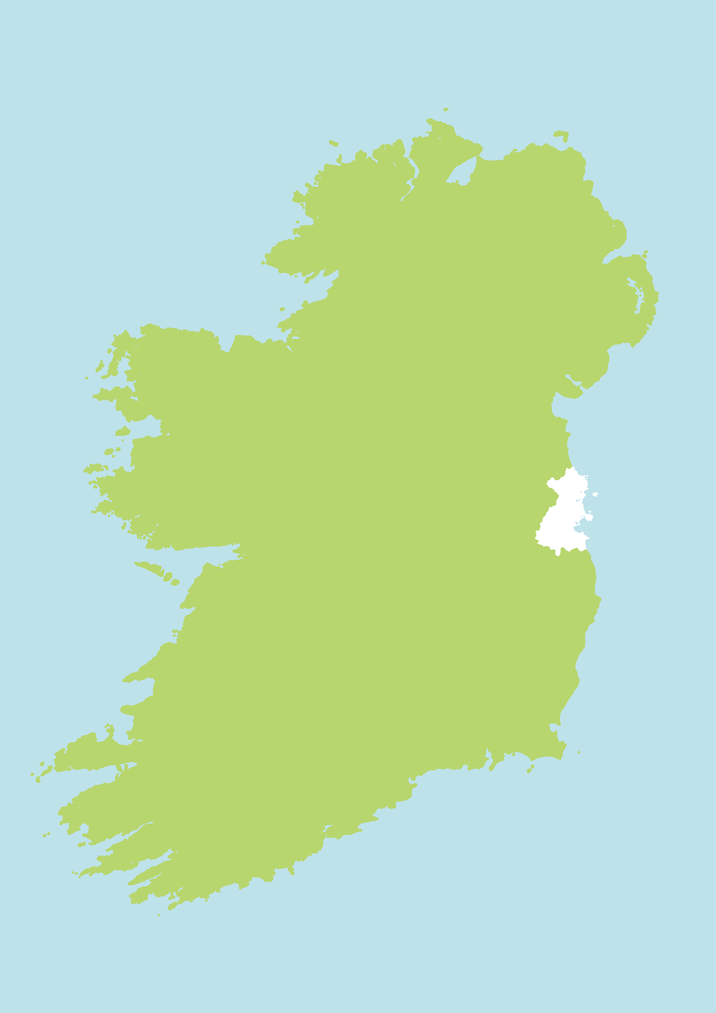
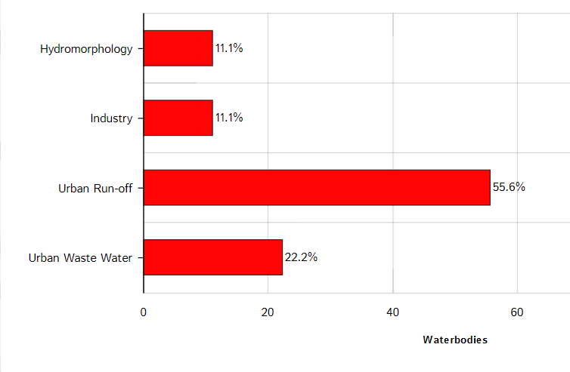

Dublin rivers ‘At Risk’ of not meeting water quality objectives
Pressures on water quality
South Dublin County Council

Slide 7
The main themes in the plan
Increased national ambition to halt the decline in water quality and reverse the damage.
Integrated Catchment Planning – a specific plan put in place for each of the 46 river catchments in the country.
Greater coordination and collaboration between State agencies, local authorities, and LAWPRO.
Delivering multiple benefits for nature, air quality, climate change, and local communities.

Slide 8
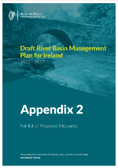
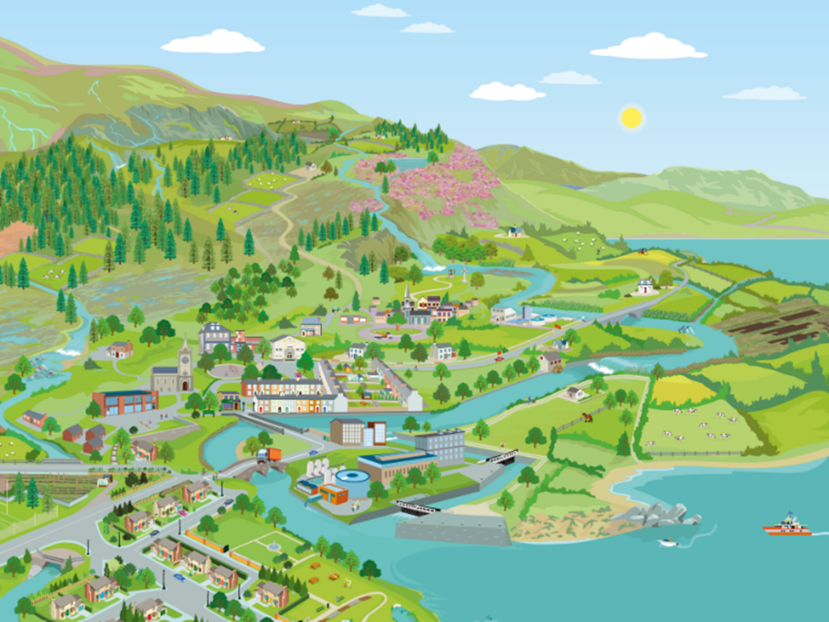

Appendix 2 contains 111 different measures. Here are some key themes:
Governance/ Implementation
Public Participation
Agriculture
Hydromorphology/ Physical changes
Forestry
Urban Wastewater
Programme of Measures
(2022 – 2027)
Business
Surface Water run-off
Land Use Planning
Septic Tanks
Peat Extraction
Drinking Water
Invasive Species
Aquaculture

Slide 9
Urban Wastewater Treatment Plants (Section 5.4.4)
12 actions focused on urban wastewater treatment plants and run-off from urban areas including
  Irish Water continued investment: €1.022bn in 83 wwtps and 10 collection networks between 2020-2024
  Investment programme for unsewered villages
  EPA to review Waste Water Discharge Licences to ensure they appropriately reflect RBMP objectives
  Promote sustainable urban drainage systems nationally
  Bathing waters – develop approach to protect bather’s health outside current bathing water season in Dublin Bay and provide discretion to LA’s to expand bathing water season

Slide 10
Agriculture
(Section 5.4.1)
Key actions focused on Agriculture include:
  New GAP Regulations to address impacts on water quality
  proposals for a stronger and more effective Nitrates Action Programme, with tighter controls on nitrogen inputs,
  Establishment of a chemical fertiliser register and improved enforcement and compliance of Nitrates Regulations by local authorities
  CAP strategic plan to be submitted to EU in January 22, aims to deliver and reward positive environmental outcomes
  Increased focus on sustainability across all advisory services
  New authorisation system for instream engineering works to strengthen controls on land drainage practices and their enforcement

Slide 11
Hydromorphology/ Physical alterations (Section 5.4.2)
Comprehensive new legislation and management system being developed: Controlled Activities for the Protection of Waters regime
DHLGH to establish a restoration programme to mitigate negative impacts of past construction
Implement actions in the Lower Shannon at the hydroelectric scheme in Parteen and Ardnacrusha

Slide 12
Domestic wastewater treatment systems (Section 5.4.6)
Grants for upgrades to septic tanks – a review of uptake of existing schemes will be undertaken
National Inspection Plan – local authorities will continue to prioritise inspections in areas of greatest environmental and public health risk

Slide 13
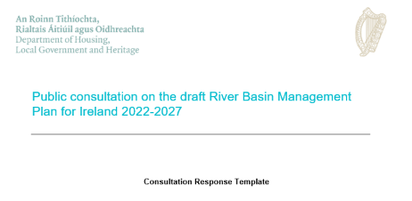
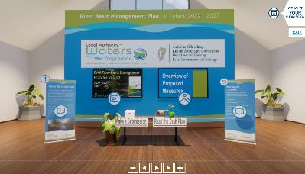
How to make a submission
Direct to Department of Housing, Local Government, and Heritage
www.gov.ie/draftRBMP
Visit the LAWPRO Virtual Consultation Room at www.lawaters.ie
Attend a LAWPRO meeting – contact your local Community Water Officer
Notes:
LAWPRO will compile all submissions and a report will be sent to the Department of Housing, Local Government, and Heritage to ensure local communities have a say in decision making for the final plan.
The issues raised will then be sent to the relevant State agency and local authority.

