Slide 1
Notes:
3 slides each x 4 people
Jagoda
Katherine + interagency
Halimat
Izzie

Slide 2
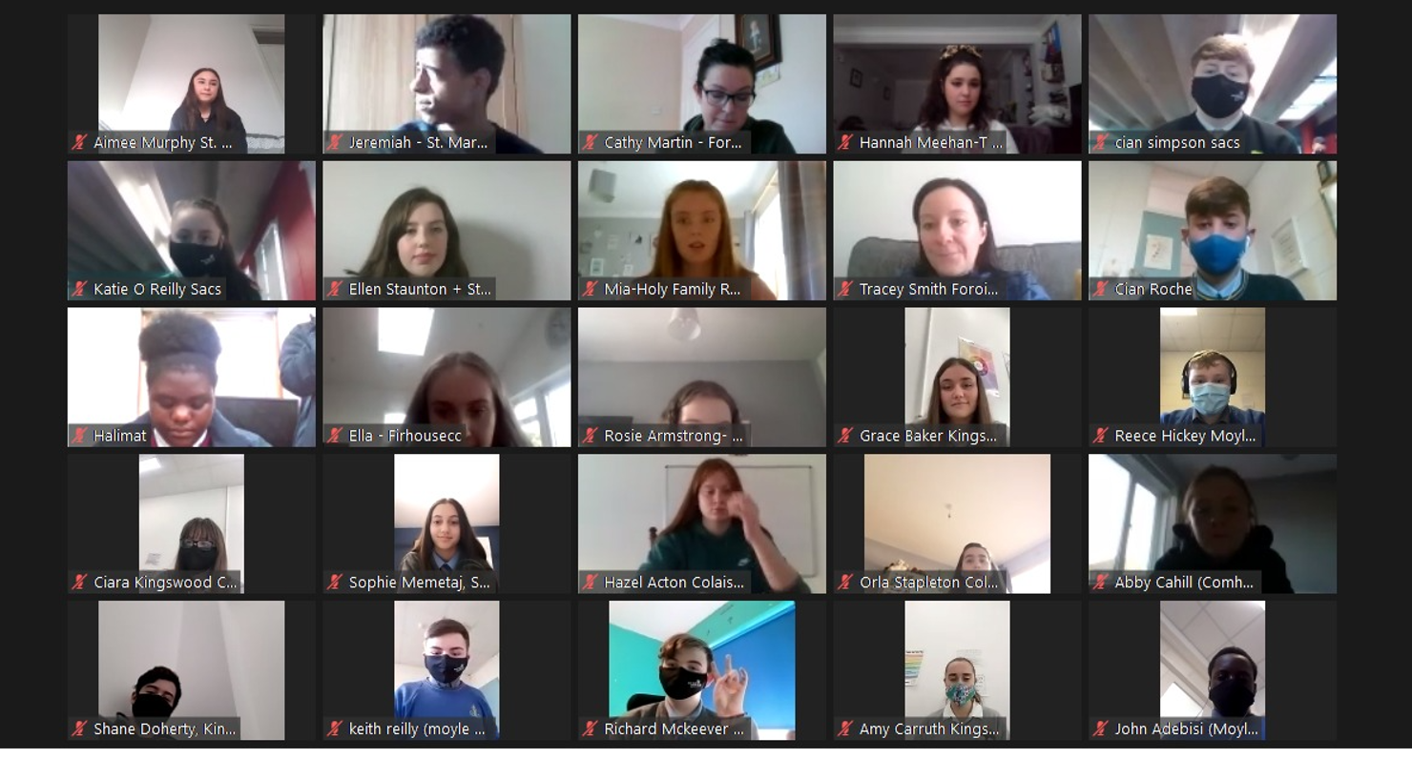
Introduction to Comhairle na nÓg
Members to present;
Jagoda, Ellen and Melissa
How a Comhairle is formed?
AGM
Membership
Topic
2 years – Climate Action Chosen at AGM

Slide 3
First 6 months (Nov- April)
Climate Conversations 2021 South Dublin with Fionnghuala, the Environmental Awareness and Climate Change Officer. We were chosen to be part of the National Dialogue. We had our opportunity to input into the Climate Action Plan.
Following our Climate Conversations with Fionnghuala, we met with her again for a Comhairle Meeting and decided on an achievable goal.
We wanted to focus on 'Waste in Schools' ; food waste, proper disposal, sufficient number of bins, signage.
Survey was developed and distributed to 38 Post Primary Schools, Youthreach & ALP. Responses returned was over 350

Slide 4
Working on our Topic – Climate Action
Sub Groups established:
Letter to Principals
Green Schools link
Media Campaign
Climate Action Week
Other work:
SDCC Climate Change Action Fund Bike Planters
Anticipate to maintain planters in working with Tidy Towns
Environmental Protection Agency Consultation – Jagoda participated

Slide 5
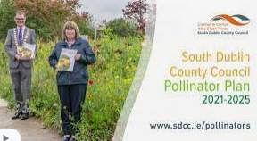
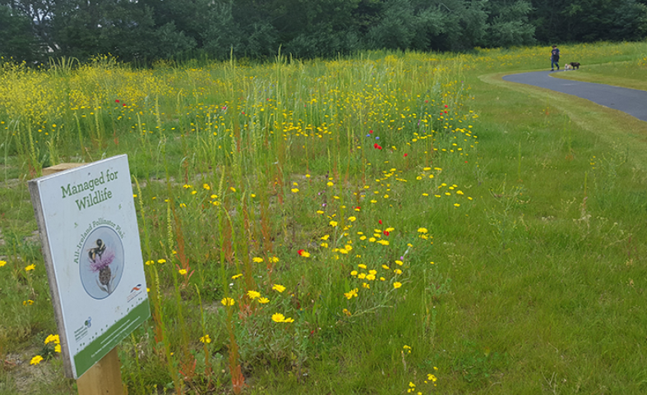
Involvement in Council Work
Richard (Vice- PRO) has added his voice to the SDCC Pollinator Video
Climate Action Week Promotional Video – Corkagh Park

Slide 6
Interagency Work
South Dublin CYPSC
Kate sits on the Economic Security & Opportunity Sub Group
focusing on homelessness
Katherine sits on the Active and Healthy Sub-group
focusing on mental health
LCDC
Bi-Annual Report given to the Local Communities
Development Committee for South Dublin
Notes:
Katherine

Slide 7
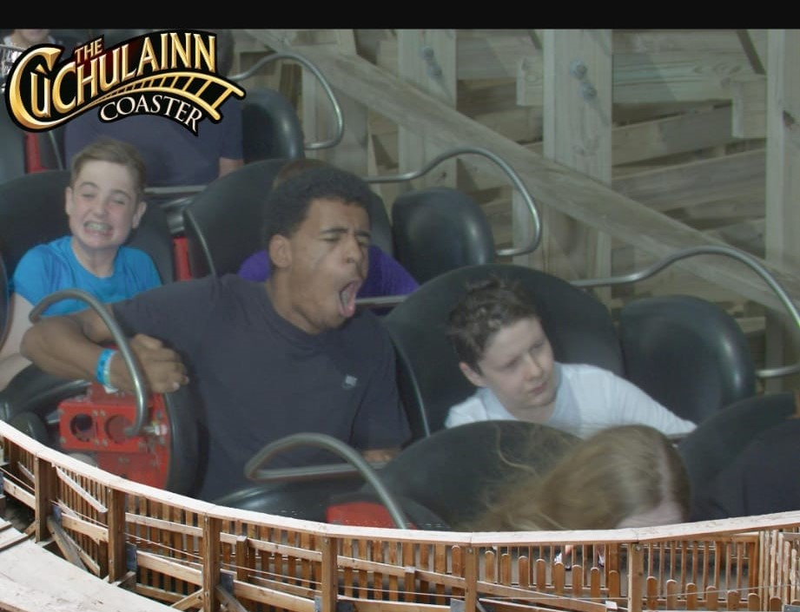
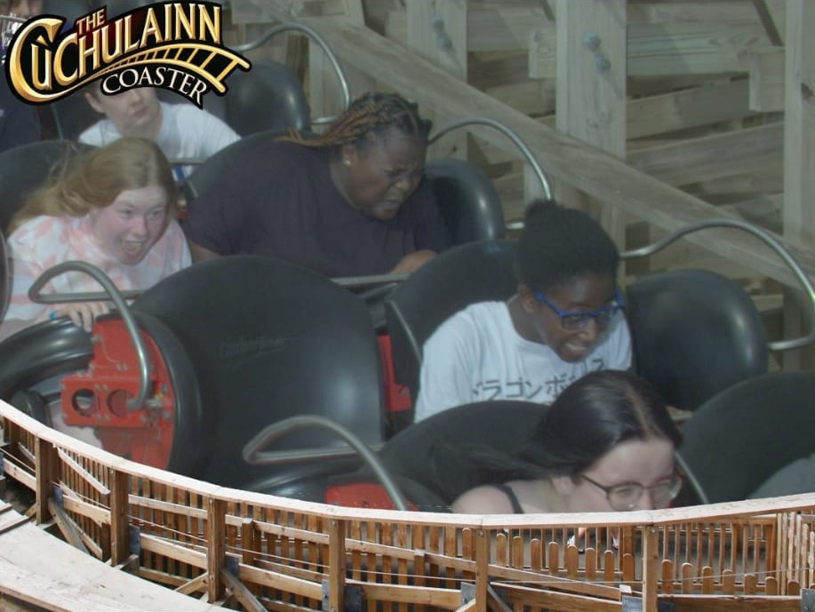
What have we done in past few months ?
July
Trip to Tayto Park
Topic sub groups working away – 4 groups
Comhairle na nÓg 5 year Development Plan Launch
Members took part in:
Department of Education Consultation – Holly
Cancer control consultation – Alix
Full Members Meeting held: 21/7/2021

Slide 8
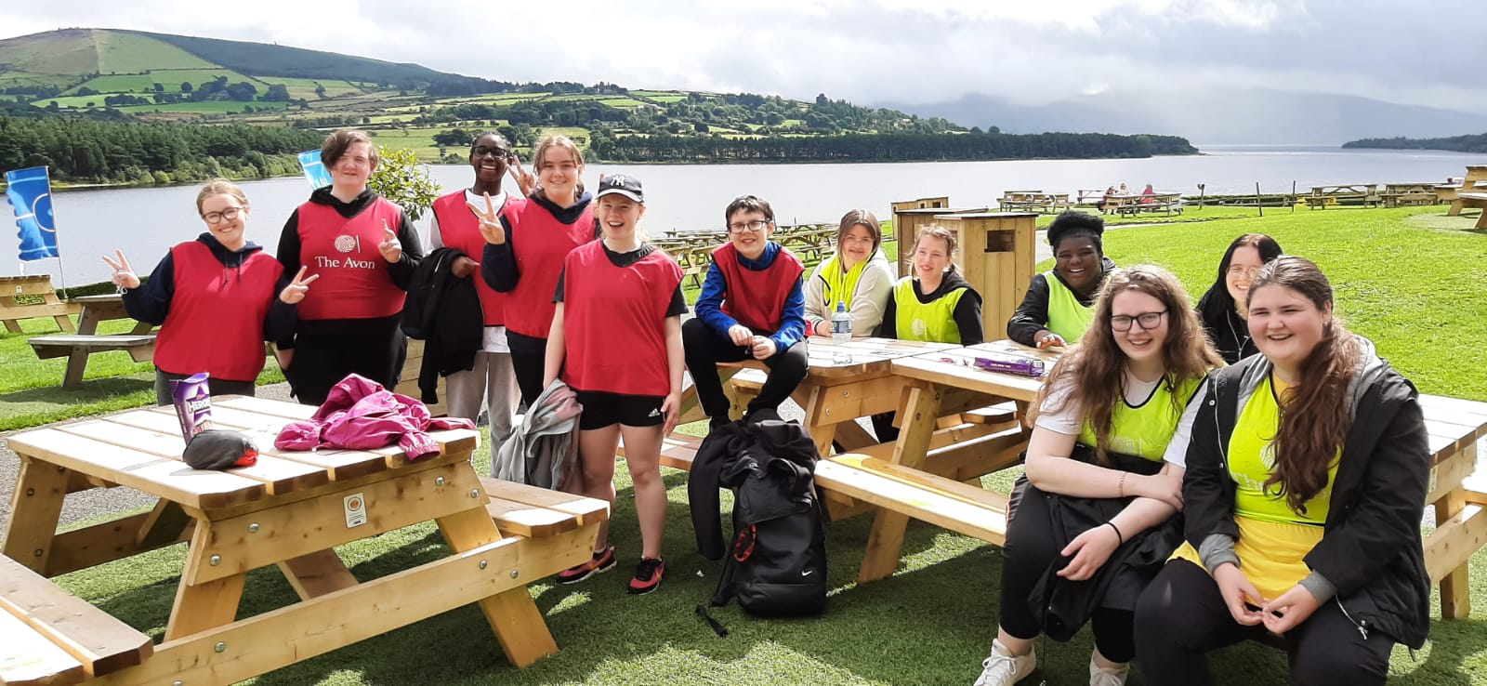
Update of our Work
August
Total Experience Team Building Day
Social media sub group met with the illustrator Feena Kavanagh, and work on the video commenced
An Taisce met with the Green Schools sub group
Principal’s letter sub group drafted their letter with data from the survey
Climate Action Week sub group got planning the launch
Full Members Meeting held: 18/8/2021

Slide 9
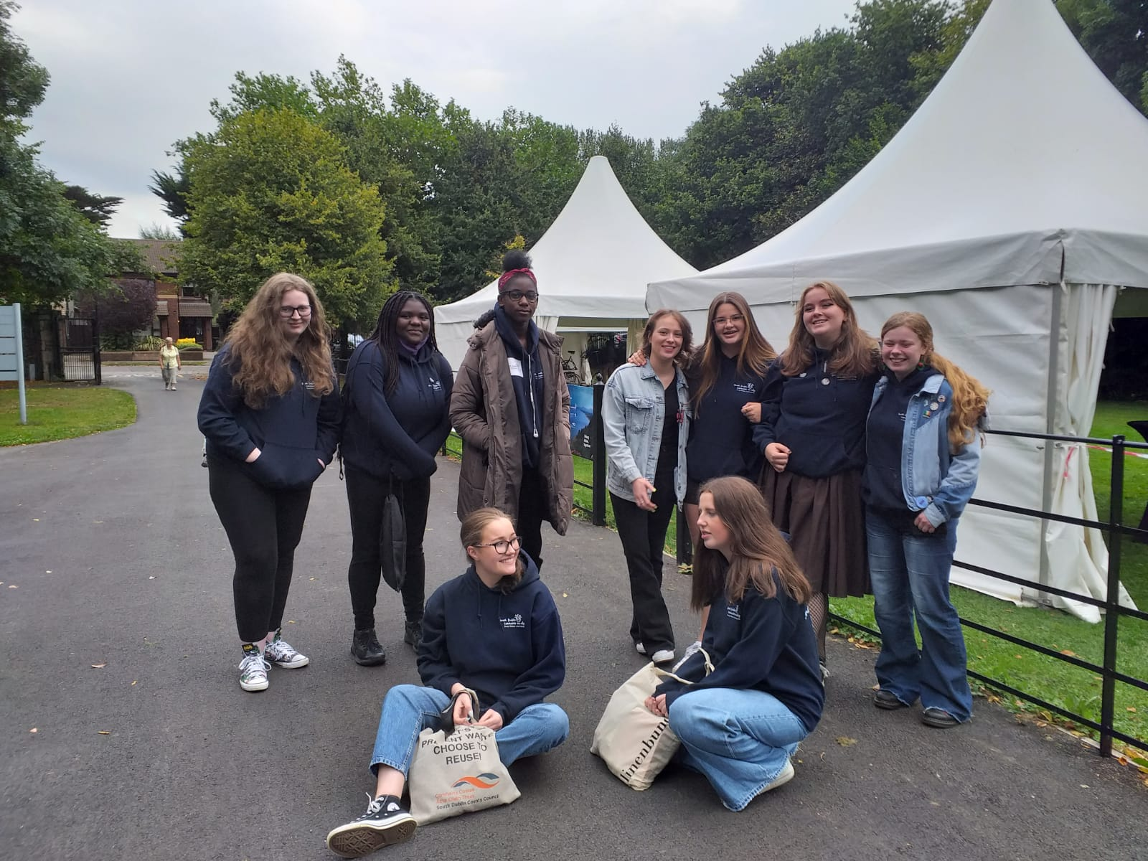
Update of our Work
September
Principal’s Letters sub group sent letter
Green Schools brochure – being developed
Members attended a workshop with
Cllr Emma Murphy on Social Media.
Consultations members attended:
Youth Advisory Group Consultation
AGM planning starts
Save the date email sent to key contacts in schools by Noeleen
Full Members Meeting held: 8/9/2021
Continued…….

Slide 10
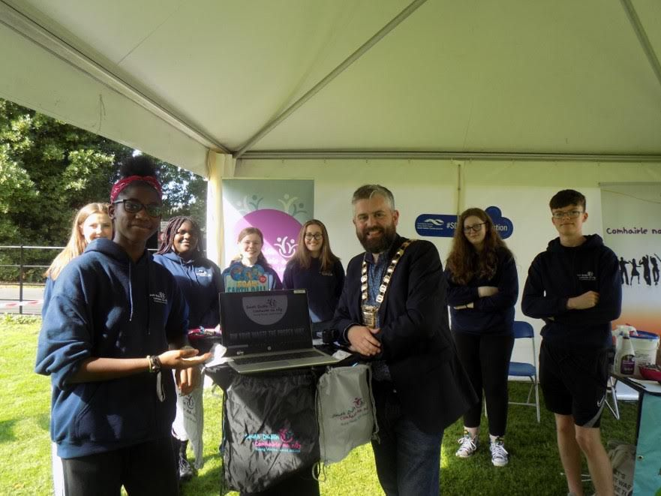
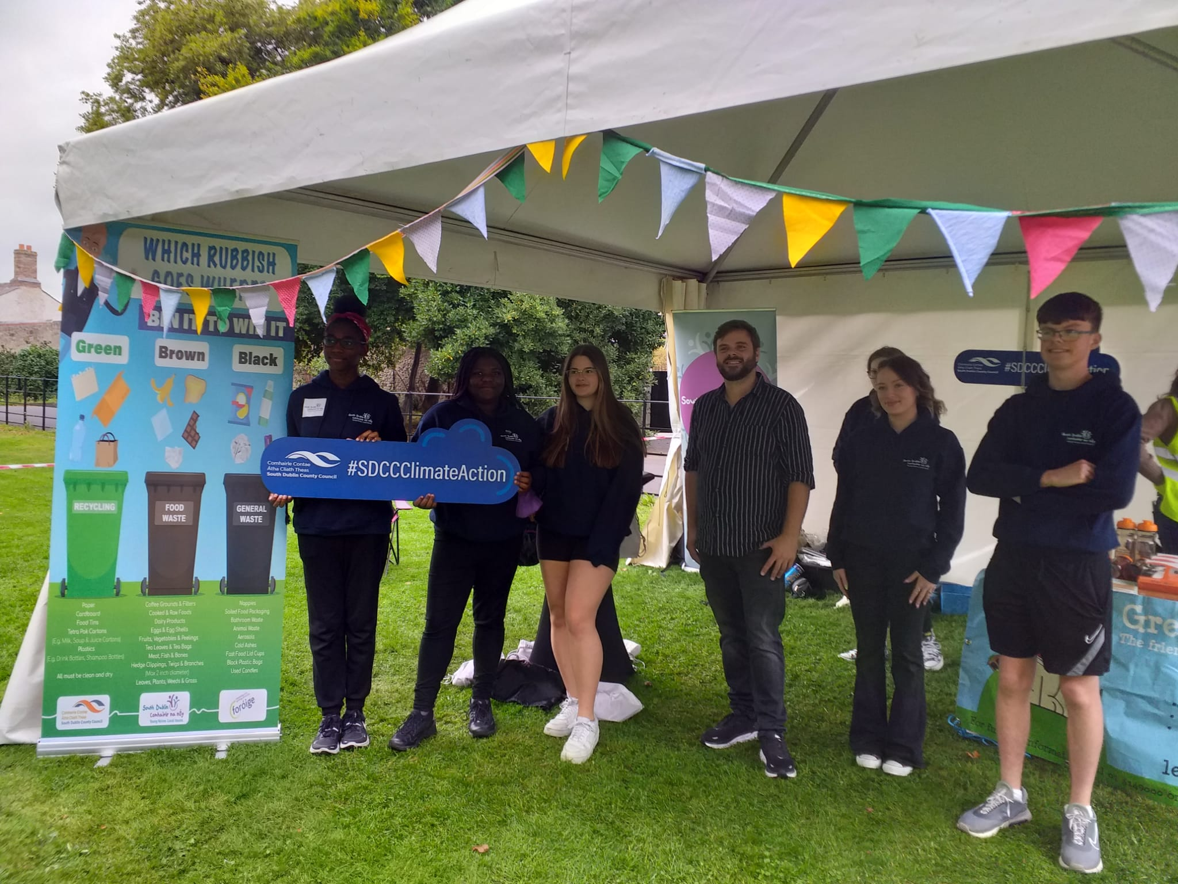
Update of our Work
September
Climate Action Week Event took place and
Mayor Peter Kavanagh launched the video of our Bin It To Win It campaign.

Slide 11
Current work…..
‘Bin It To Win It’ Posters to be sent to schools
Dail na nÓg workshops
Presentations to be made:
Presentation to Full Council 8th November – 4 members
Social Community and Equality Strategic Policy Committee
Ongoing AGM planning
All principals received an email for registration
Full Members Meeting : 6/10/2021
Please enjoy our campaign video !

Slide 13
Work plan for the rest of the year
November
AGM to be held on 4th November
Presentation to be made:
Environment, Public Realm & Climate Strategic Policy Committee
Council Meeting
Ongoing work:
2 CYPSC sub committees representation
Members Intro Meeting: Following AGM
We are also getting stickers of our campaign for bins in schools, youth services, and public bins in parks and the street encouraging people to dispose of their waste responsibly.

Slide 14
Work plan for the rest of the year
December
Dail na nÓg to be held on 4th December
Green Schools Leaflet/Brochure completed – pending funding
Social Media presence increased – Instagram page
Full Members Meeting: TBC – Team Building

Slide 15
Future Plans
Champion the idea of a Comhairle Flag for schools – pilot in south Dublin
Share our campaign video as much as possible
Seek out funding for our Green Schools Brochure
Increasing the membership to include ‘Seldom Heard’ young people

