Slide 1
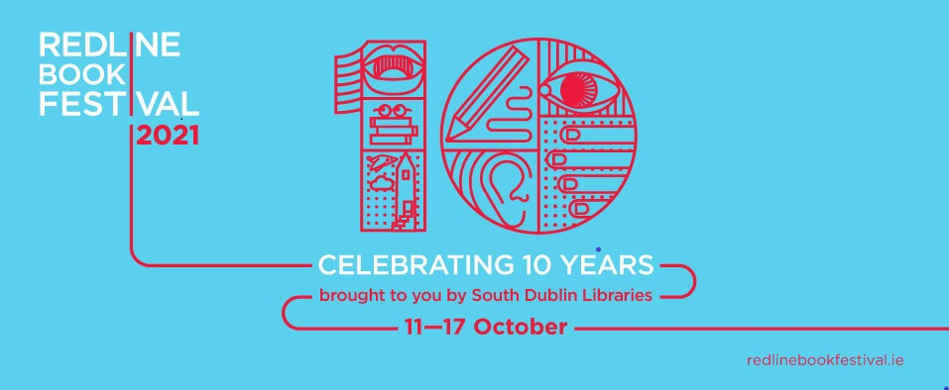
Notes:
Red Line Book Festival 2021 – The Roaring Twenties – the years after the Spanish flu.
This year was the 10th Anniversary of the Red Line Book Festival, the theme of this year’s festival was the roaring twenties. Reading groups across the county took part in the run up to festival by reading books penned or set in that period and this culminated in a discussion which took place in the Civic Theatre with broadcaster Rick O’Shea, Emily Hourican and Selina Guinness, the discussion was live streamed to book clubs across the county.
In total 69 in person and 15 online events took place across South Dublin County, venues included the Civic Theatre, Rua Red, Casement Aerodrome and all of the South Dublin Library network.
Highlights included:

Slide 2
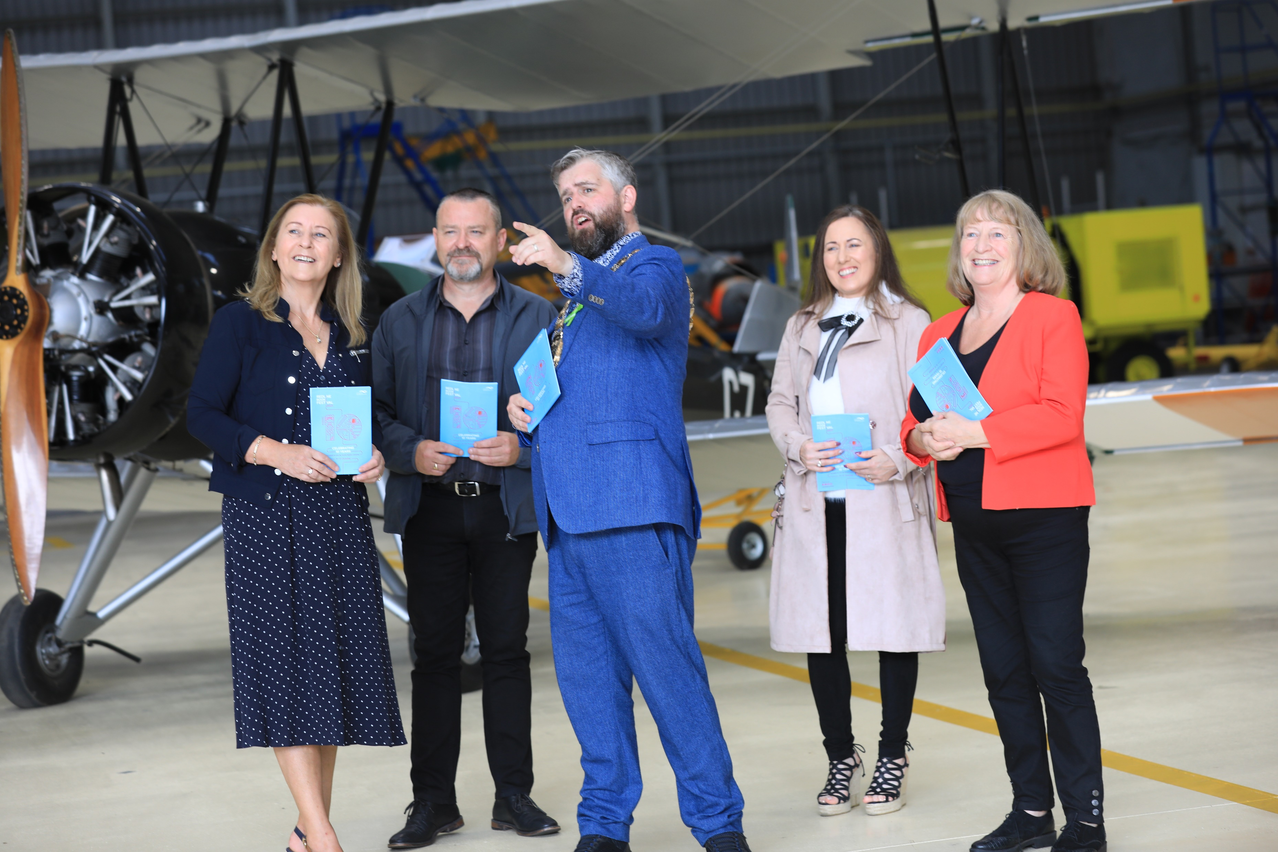
Notes:
The festival was launched at Casement Aerodrome in Baldonnell by the Mayor of South Dublin, Councillor Peter Kavanagh, with other south Dublin Councillors in attendance.

Slide 3
Notes:
Highlights included:
Pure Magic - author Colm Tóibin in conversation with Kevin Power. (Civic Theatre) It was a great coup for the festival to secure one of Ireland’s top authors Colm Tóbin who generously agreed to take part in 2 events in the Civic Theatre.
Howdie Skelp – One of the world’s most renowned poets Paul Muldoon, based in Princeton University, closed the festival with an online reading from his new works projected onto the stage in the Civic theatre.
Between Two Hells, The Irish Civil War – author Diarmaid Ferriter in conversation with Richard Crowley. (Casement Aerodrome) A very interesting discussion on the research that Diarmaid completed for his latest book. This event was booked out and it was the festival’s first visit to casement.
Professor Luke O’Neill in conversation with Dr Shubhangi Karmaker – Update on vaccines and therapies for COVID-19 (Civic Theatre). Luke O’Neill became a household name during the ongoing pandemic and this event featured a Q and A which allowed the audience to ask questions of the man himself.
Dolcáin Cellar Open Mic Poetry Event (North Clondalkin Library). This annual event historically forms part of the RedLine Book Festival, it was one of the events that was not put online last year as participants did not feel that an online version would work. We were delighted to welcome this event back and it received a capacity audience in North Clondalkin Library
Mind full – author and broadcaster Dermot Whelan in conversation with Fiona Brennan. This was a very entertaining evening with many laughs but also a very clear message from Dermot on the many benefits of meditation in today’s busy and stressful world.

Slide 4
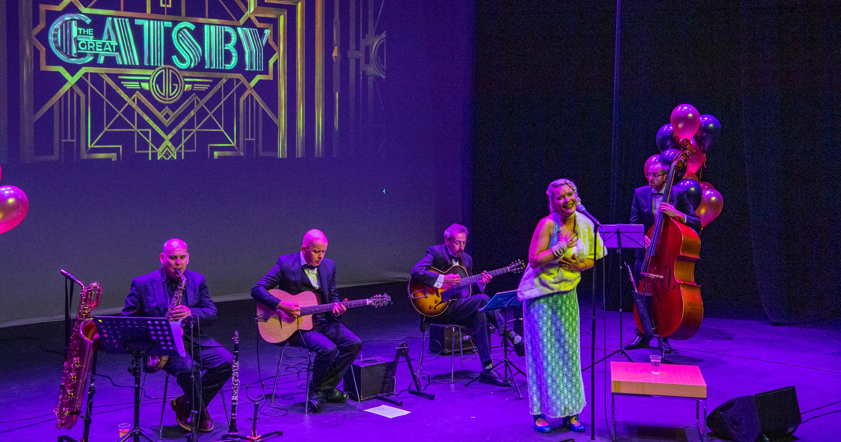
Notes:
Gatsby Night –a night of jazz with Cotton Club Quartet and singer Truly Divine. The audience were encouraged to dress for the occasion and many enjoyed doing so.

Slide 5
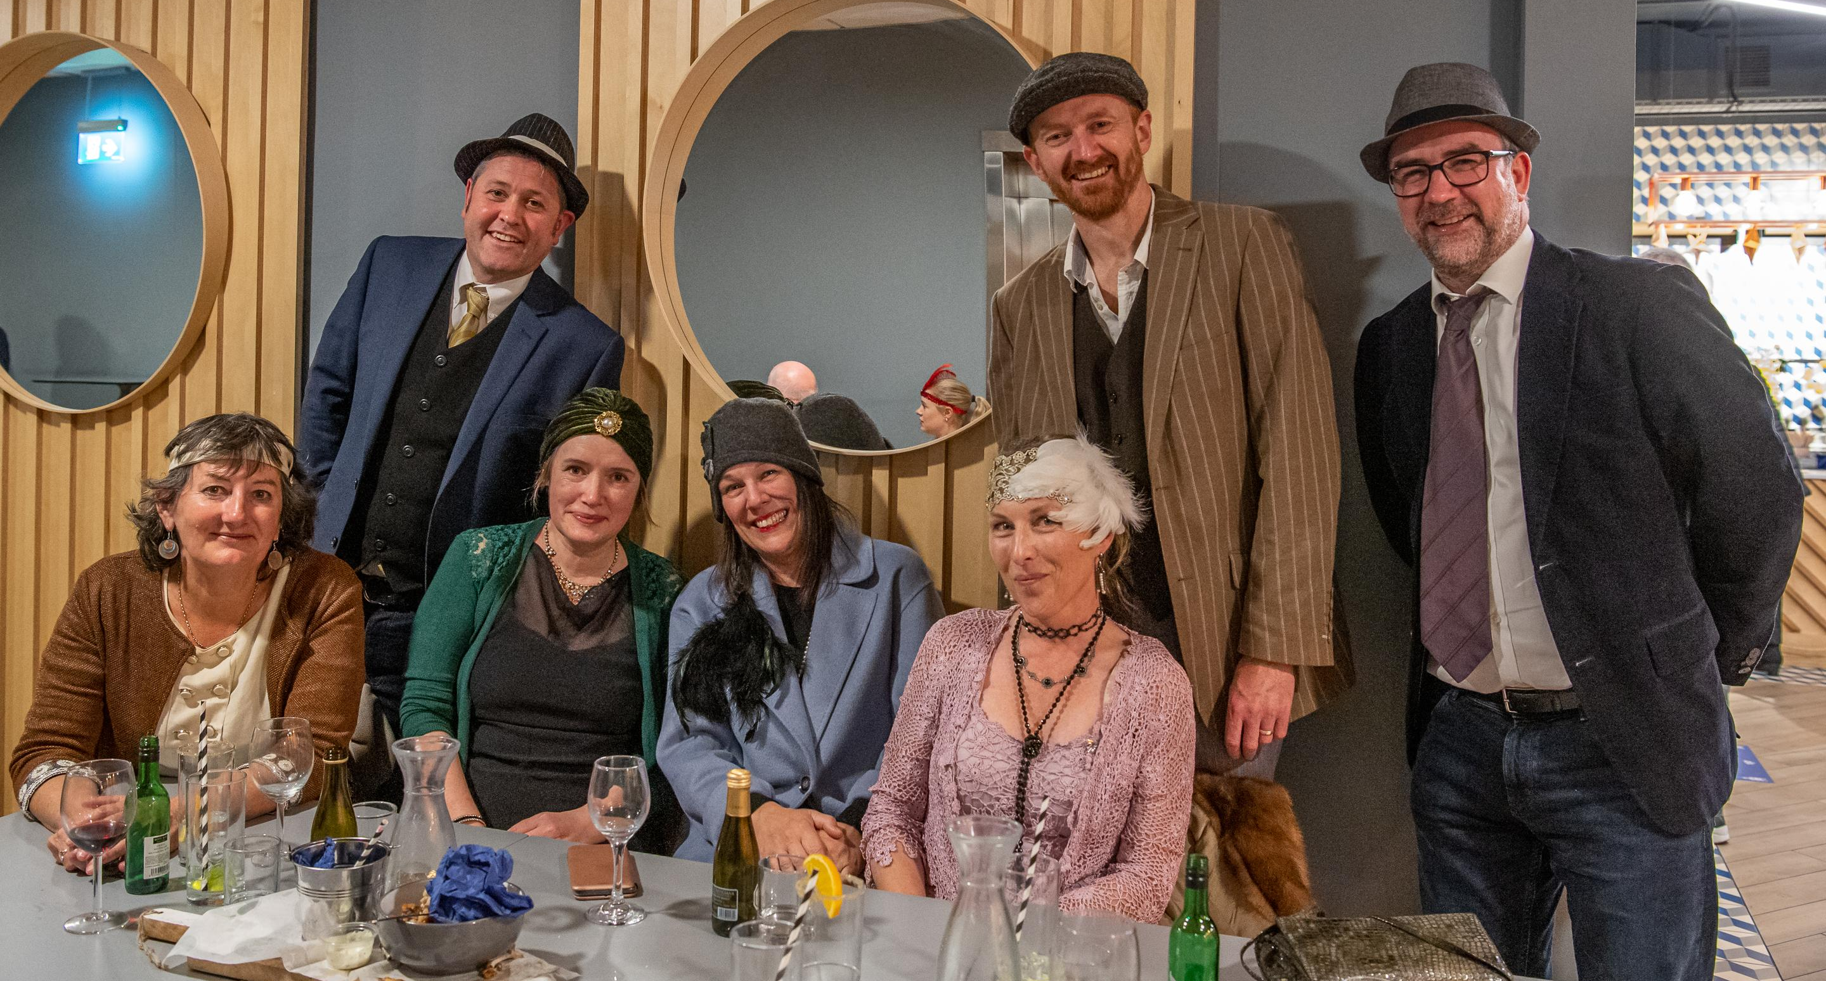
Notes:
Enjoying the RedLine Book Festival Gatsby

