Slide 1
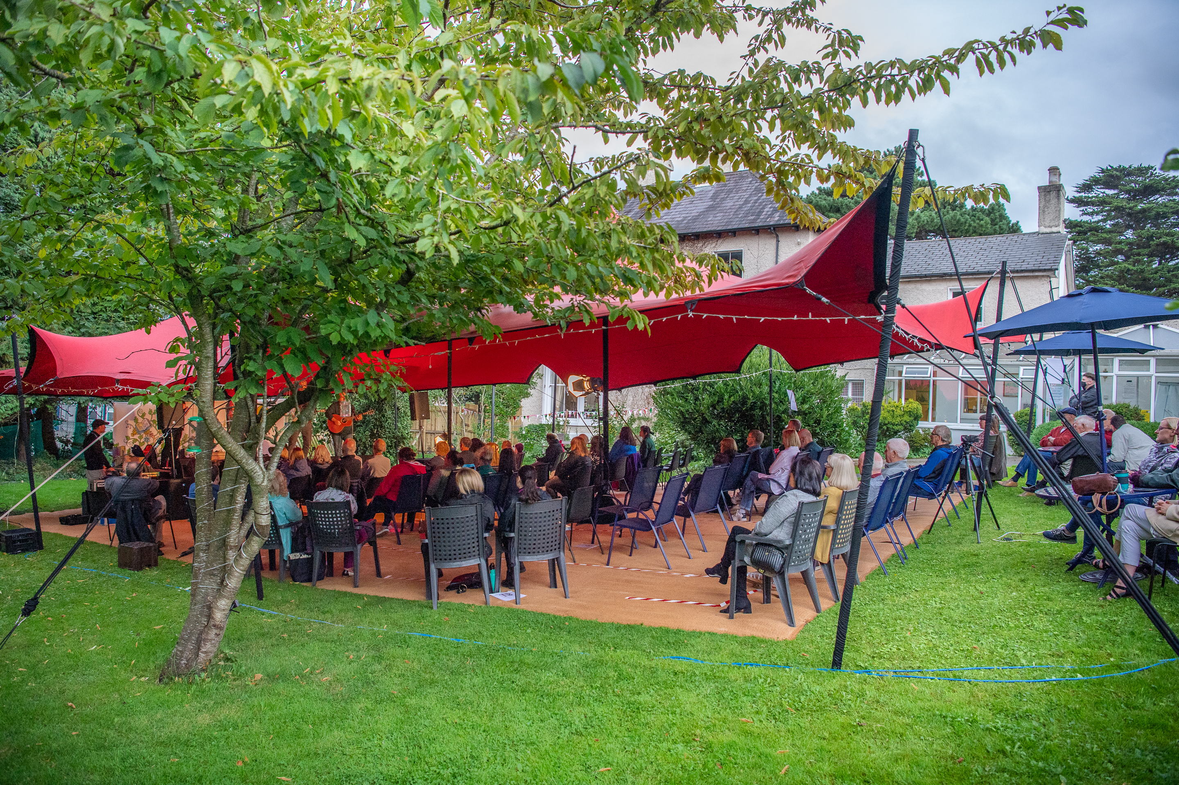

South Dublin County
Arts Development Strategy 2020-2026

Slide 2
Why an Arts Development Strategy?
Required under Arts Act 2003
To stimulate public engagement with the Arts
Describes the priorities for South Dublin County Arts Office
Makes a common ground for all arts service providers
Serves to make partnerships, networks and collaborations more likely, more sustainable and more effective.

Slide 3
Consultation and
Research
Public Survey on Public Consultation Portal
SWOT Analysis
Focus Group interviews: Cultural Diversity
Arts and Disability sectors
Review of Youth Arts Policy and Strategy

Slide 4


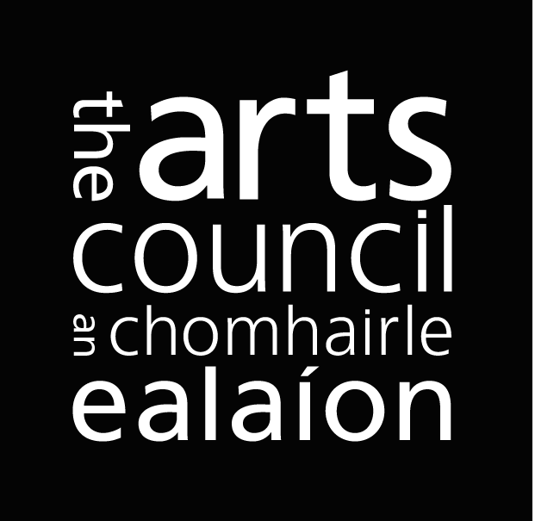


Critical success 2016-2020
Growth in partnerships national and local 
Increased investment 
Increased opportunities for participation 
Increased number of events 
Extended outreach by arts centres 
Increased Cultural Quarter and county wide collaboration 
Development of Early Years Practice
4000 children in music education service
185,614 people engaged in Creative Ireland South Dublin since 2018

Slide 5
Vision Statement 2022-2026
That the arts, in all its diversity, is deeply embedded within the lives of the people of South Dublin county, significantly contributing to every citizen’s sense of wellbeing and belonging, and appreciated and enjoyed by those visiting the county.

Slide 6
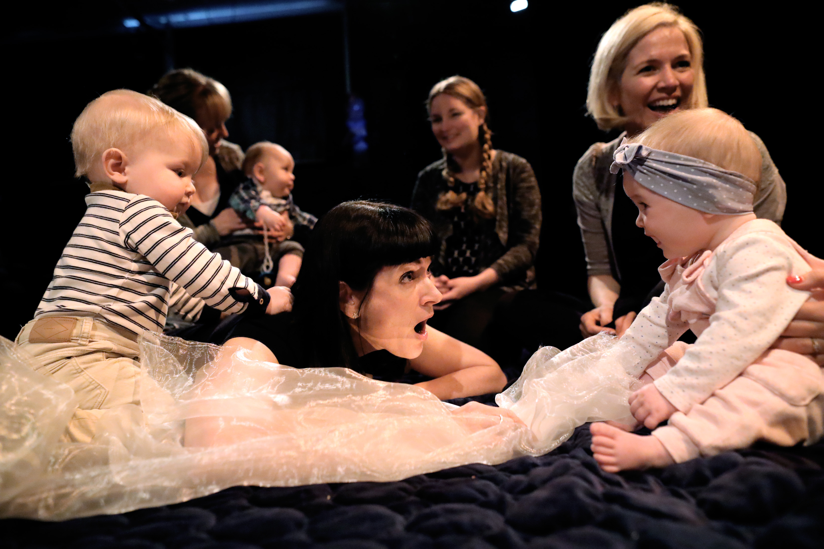
Priorities
2022-2026
[Striving for] Equity of access and opportunity
[Supporting] A vibrant and resilient arts sector
[Strengthening] Our capacity to deliver

Slide 7
Objectives and Actions
Equity of access and opportunity
A vibrant and resilient arts sector
Focus on children and young people
Focus on diversity and inclusion
Focus on arts and disability
Provide specialist input
Increase capacity for participation
Provide annual programme resources
Highlight pathways of progression
Invest time in strategic partnership
Support artistic ambition at each career stage
Extend the reach, participation and appreciation of the arts
Cultivate emerging arts practice
Explore new making, participation and audience spaces in the county
Update current support schemes against evolving practice and needs
Support festivals and programmes to reach new audiences
Work closely with key county arts organisations
Public art projects and programmes will increase significantly
Assess current infrastructure and plan for future opportunities in respect of population changes

Slide 8
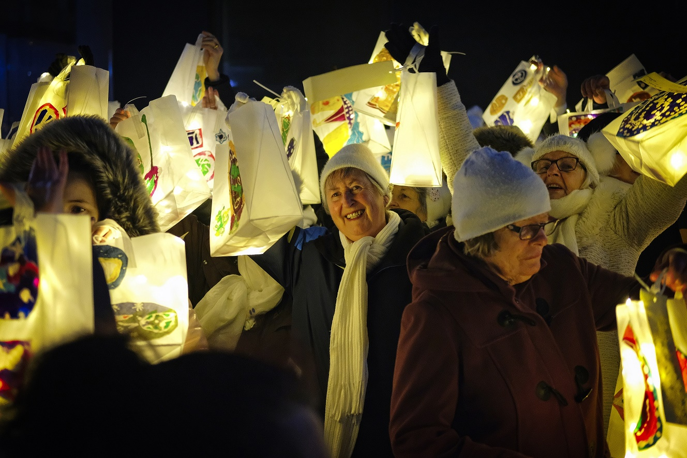
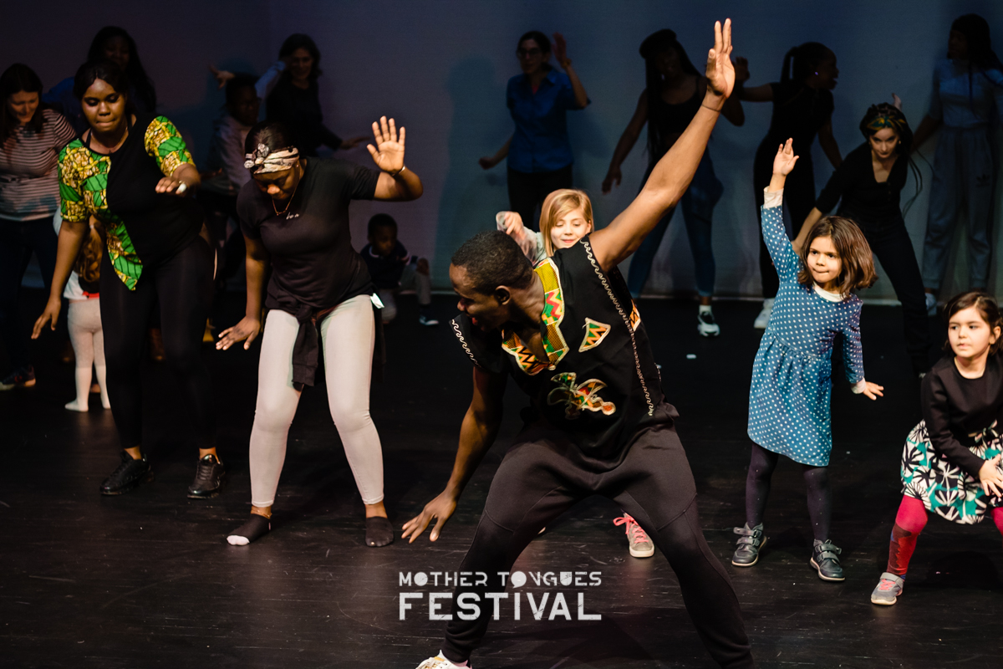
Objectives and Actions
Our capacity to deliver
Strengthen our ability to deliver a progressive, informed and relevant county arts service
Develop clear and robust communications
Ensure sustainability of the arts service
Monitor and measure social impact in line with the mission and core objectives
Establish appropriate staffing, skills and resources to deliver effectively
Provide information and advisory support services
Embed arts and culture across Council policies and cross-cutting strategies
Advance shared vision of citizenship and wellbeing through culture team
Build evidence base through mixed method research, data capture, social impact evaluation, and quality framework

Slide 9
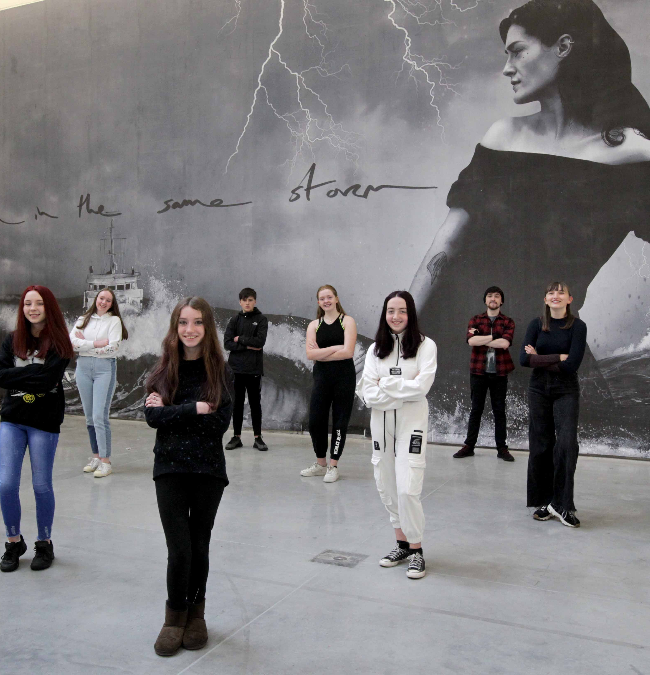
Anticipated Outcomes
Increased active participation by young people and children, of all abilities
Enhanced capacity building, access and engagement for people of all abilities, ages and backgrounds
Established community arts hubs, as local access points
A clear vision for Cultural Quarter development
Increased opportunities for artists in public art and climate change
Maintained a quality art service in accordance with the Council’s Mission “To make our county a vibrant and inclusive place for the people who live, visit, work, and do business here, now and for the future”.

Slide 10
South Dublin County
Arts Development Strategy 2020-2026

