Slide 1
STREET IMPROVEMENT MANAGEMENT GUIDE - Local Transport Interventions To Improve Safety For All Road Users
Context:
There are increased cars on our Streets - 9% increase in the years 2017-2019.
Surveys continue to demonstrate that speeding is occurring at some locations
SDCC must provide Safe and Improved facilities for all road users
All works will be delivered under S38 Powers
Aims of Guidance Document
To deliver Local Transport Safety Interventions to benefit All Road Users
Improving Safety at Junctions
Small Permeability Schemes
Pedestrian Crossings
Small Footpath Extensions
Traffic Calming Measures where vehicle speeding is happening

Slide 2
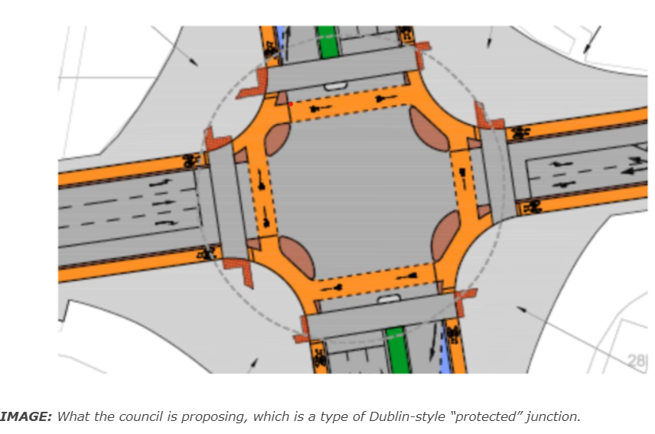
Improving Safety at Junctions:

Slide 3
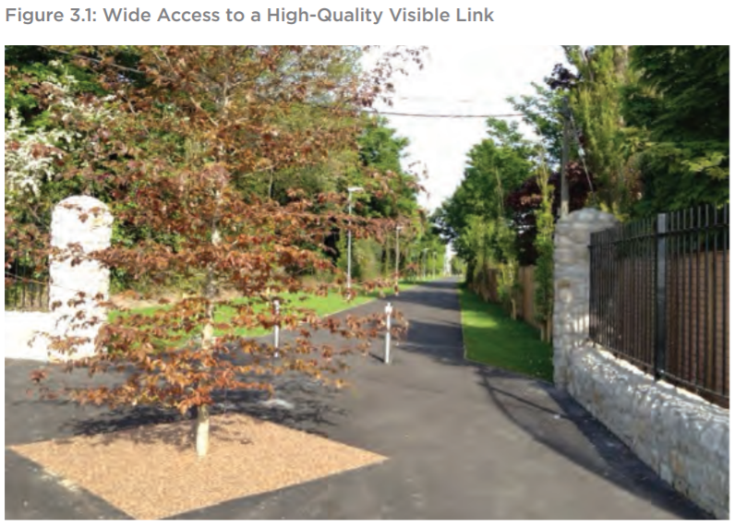
Permeability Schemes

Slide 4
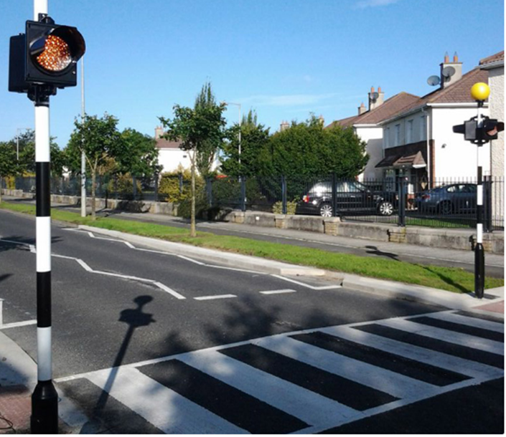
Pedestrian Crossings

Slide 5
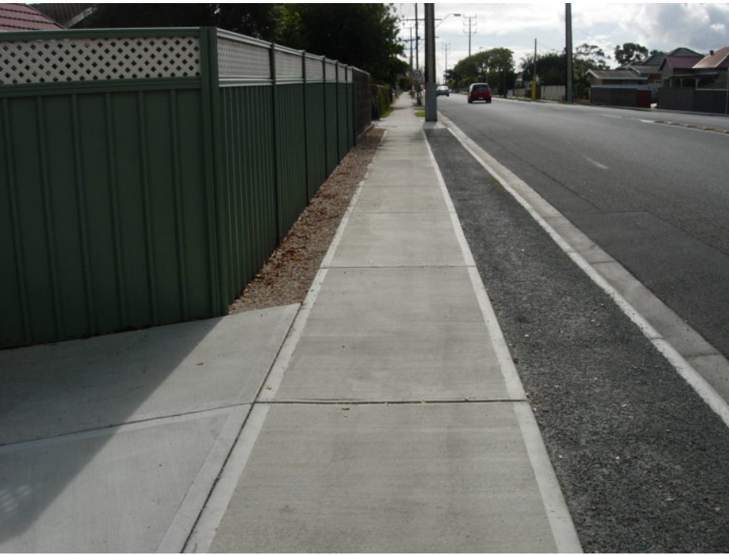
Small Footpath Extensions

Slide 6
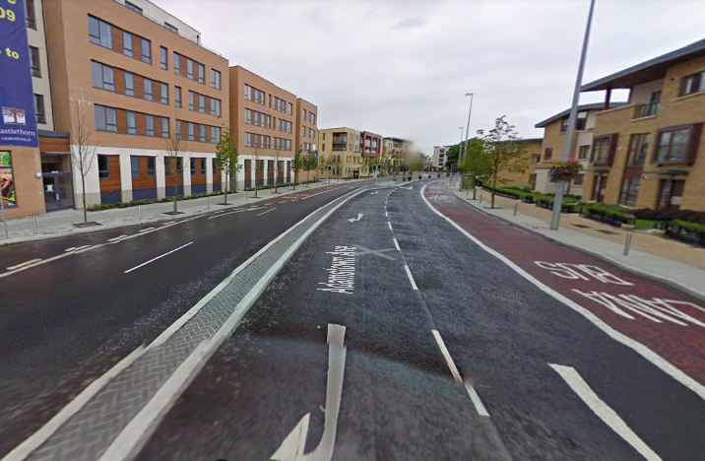
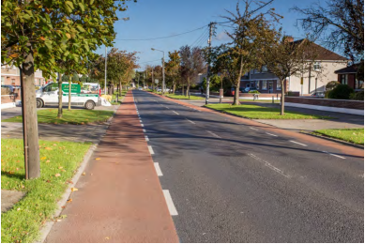
Traffic Calming Proposed – horizontal control measures
Central Reserve, tree planting and coloured asphalt- e.g. Adamstown
Shared Surfaces – e.g. Wainsfort
Road Reduction in effective Road Width

Slide 7
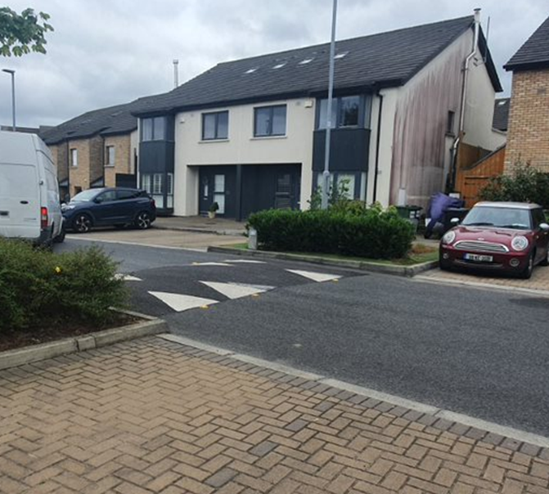
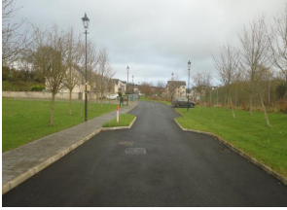
Traffic calming – horizontal control measures
Ramps
Buildout/ Chicane /Tree Planting

Slide 8
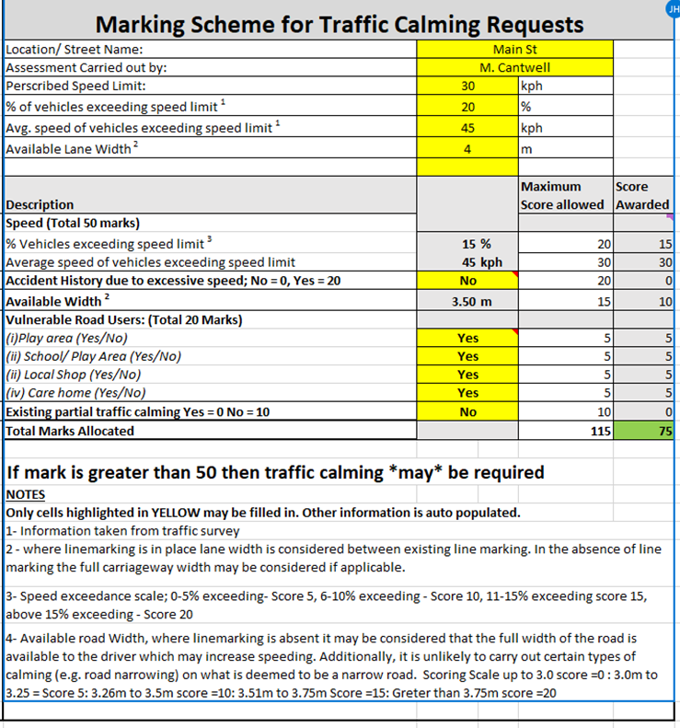
Decision Process for Scheme Selection
Assess Scheme Requests
Create a Priority List of Schemes
Public Consultation and Agreement where Appropriate
Agree a Proactive Programme of Works with the Members

Slide 9
Street Improvement Management Guide - Budget
There is approximately €600,000 per annum for “Street Improvement Works” allocated in the SDCC annual revenue budget.
The NTA have a range of funding streams available for these types of Work
It is hoped to access NTA funding to support the delivery of these measures

Slide 10
Street Improvement Management Guide
Next Steps:
Draft Guidance Document is completed.
To be Discussed in Detail at next SPC in November
Go for Council agreement in Q1 2022
SDCC will Pilot some Works Interventions in 2022
Annual Agreement of a Programme of Works

