Slide 1
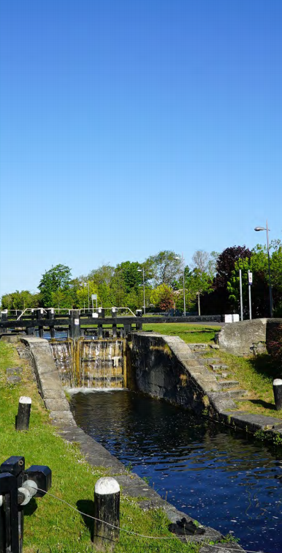


Clonburris SDZ
SDZ Elected Members Briefing
Date:
September 2021

Slide 2

Agenda
URDF Update
SDZ Updates
Infrastructure Programme
Branding Strategy
Adamstown URDF Update

Slide 3
URDF Update
8,714 Homes
€2.3bn Project
38% Affordable
23,000 People
Key Infrastructure Required to unlock delivery of housing in the SDZ
€176.6m approved in principle
Approval to Stage 2 of Public Spending Code
Ongoing meetings with DPER and Dept. of Housing
Next Stages
Public Spending Code Gateway 2
Preliminary Business Case
Request for Tenders for Stage 1 infrastructure
Later
Detailed Business Case
Ongoing Implementation and Review

Slide 4
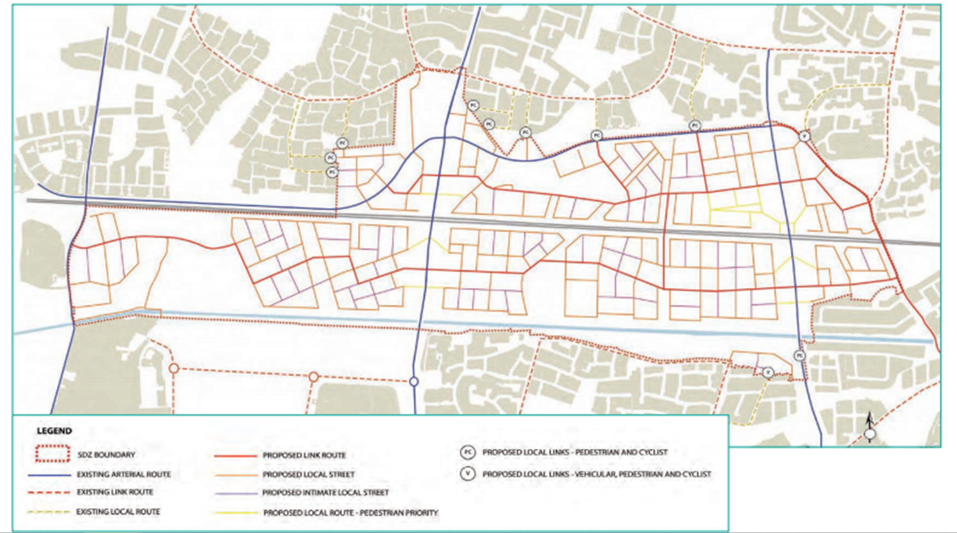
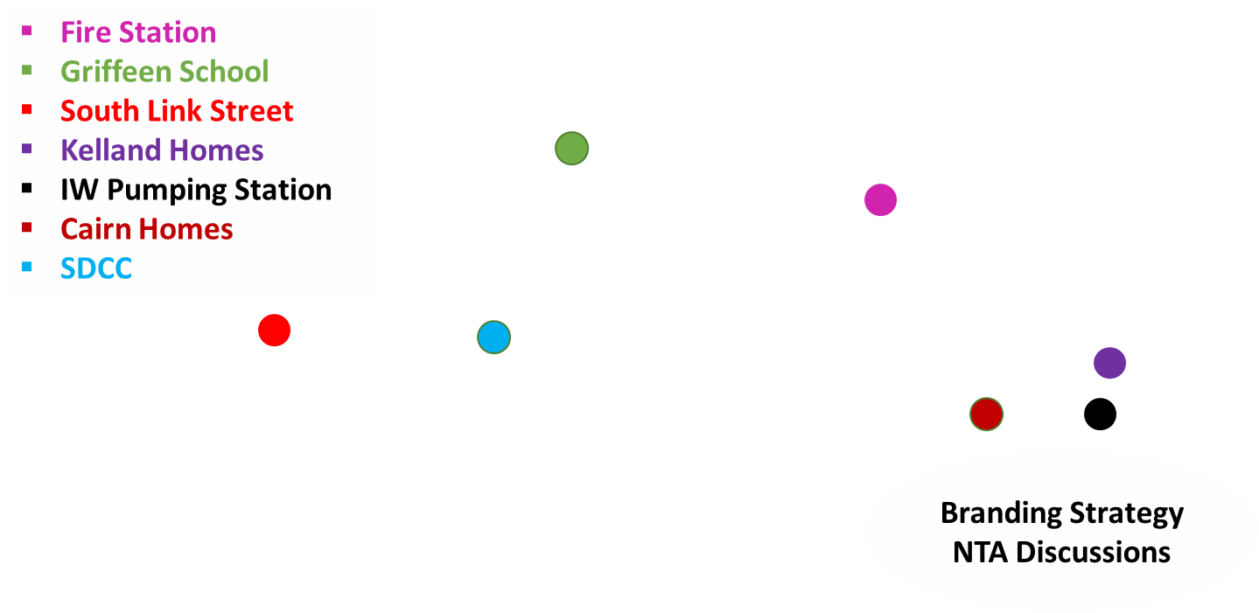
SDZ Updates
Planning
South Link Street (SDZ20A/0021) – Permission granted 12/08/21
Irish Water Pump Station (SDZ20A/0021) – FI requested 24/05/2021
Post primary school (SDZ21A/0013) – Further Information requested 29/06/2021
SDZ Requirements
Phase 0 Requirements (Surface Water and Foul Drainage) – Signed Off 14/06/21
Phase 0 Requirements (Parks and Landscape Strategy & Biodiversity Plan) – To be Submitted
Initial Survey Work - Underway on Site

Slide 5
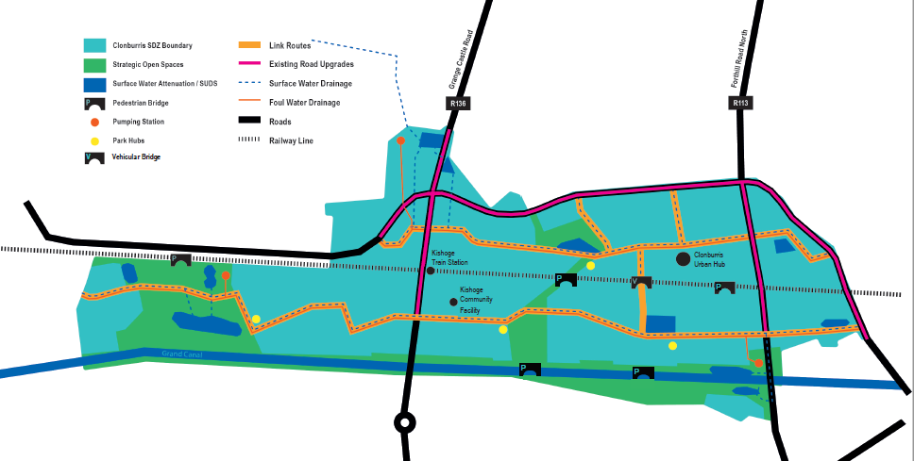
South Link Street & Utility Corridor

Slide 6

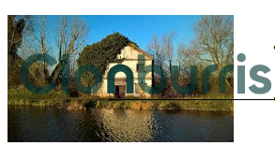
Logos & Marks
Branding Strategy

Slide 7
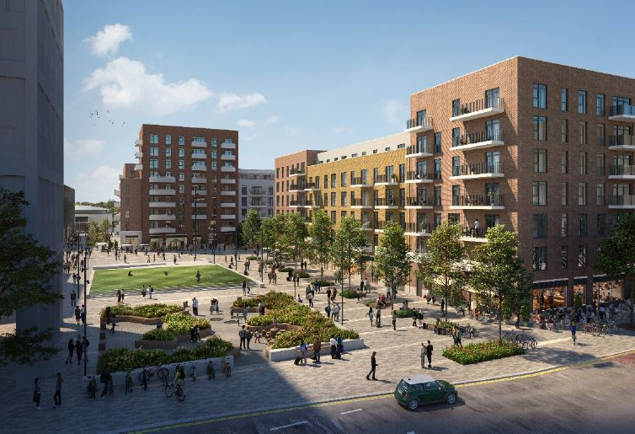
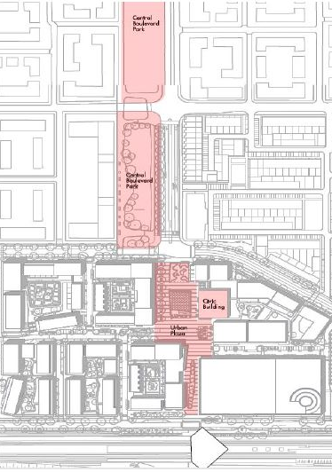
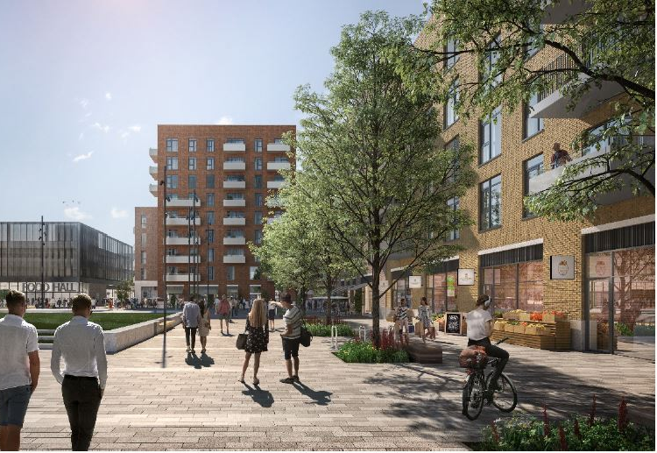

Adamstown SDZ URDF Update: Bid Successful
Priority 1 – Town Centre Projects
Plaza: €3.35m
Civic Building: €3.93m
Housing: 329 of 585 Homes
Planning: Majority Secured
Central
Boulevard
Park
Priority 2 – Central Boulevard
The Park: €5.68m
Housing: 256 of 585 Homes
Planning: Pre-planning
Civic
Building
Plaza
585 Homes by 2024
20% Social / Affordable Homes
€12m Funding Application
€220m Investment
Train station

Slide 8
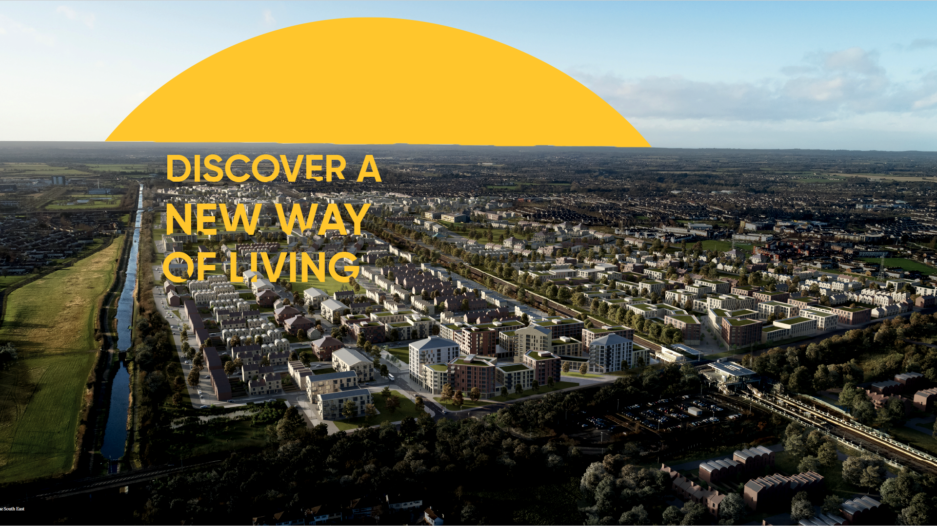
Thank you
Questions?

