Slide 1
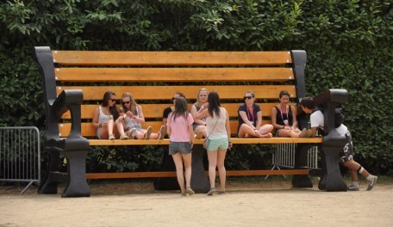
Update on Teenspace Projects in Rathfarnham/Templeogue/ Firhouse/Bohernabreena Area
Ballycragh Park and Templeogue

Slide 2
Ballycragh Park- revised location. It has been necessary to change location of the Teenspace due to an Irish Water pipe which will be laid in the area originally chosen for the Teenspace. A new location has been chosen which also benefits from good passive supervision and has sufficient space for all of the equipment and seating

Slide 3
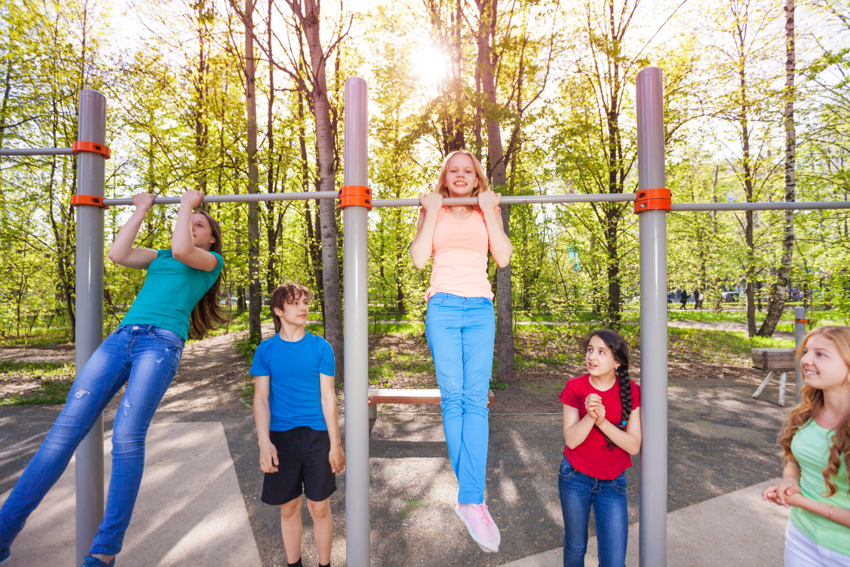
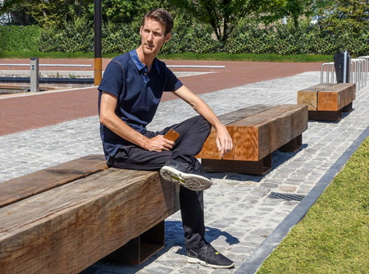
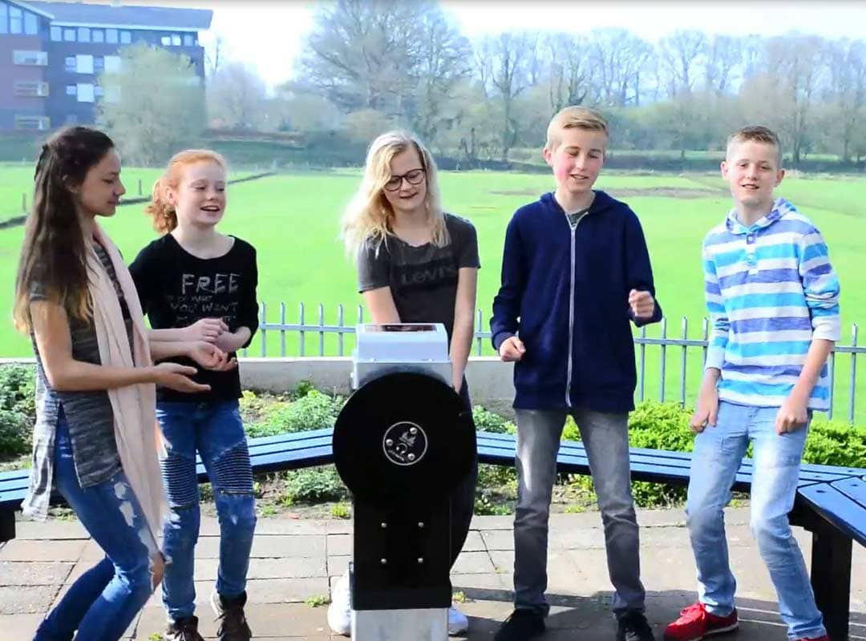
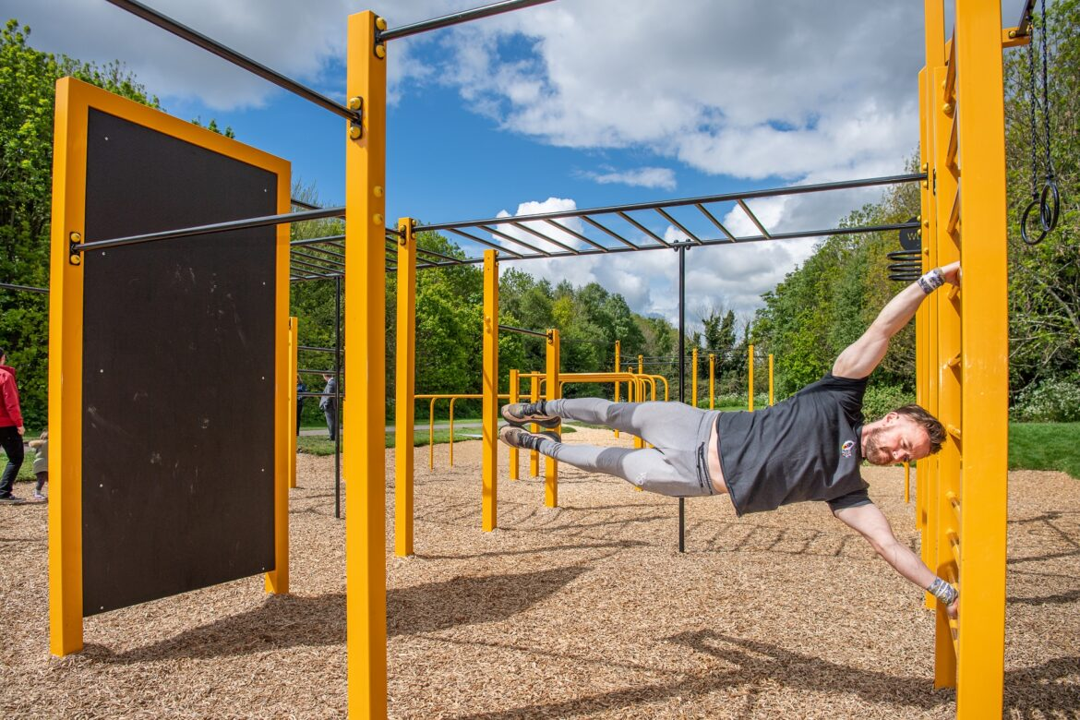
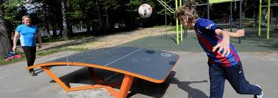
Facilities include: Calisthenics, Parkour, Teqball, wifi point, Water font, music post and seating.
Concrete pipe seating originally proposed is being replaced with long timber and concrete benches as it was not considered successful in another site where it was installed.
Layout has been organised to keep the Teqball and hangout areas away from pond. Given the additional space in this location more extensive landscaping was possible and 20 native trees will be planted through and around the teenspace.

Slide 4
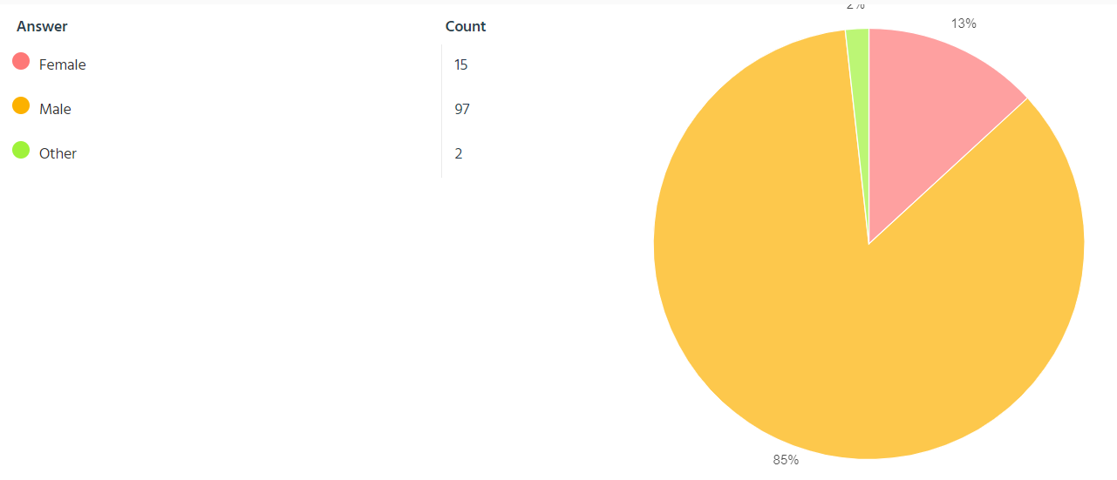
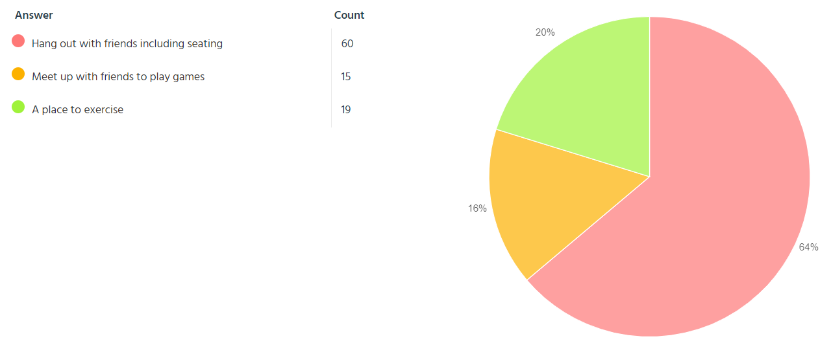
Templeogue Teenspace Survey.
SDDC Public Realm Section completed a teenspace survey in the Templeogue area in May 2021. All of the local secondary schools and sports clubs with teenage members were contacted and requested to complete the survey.
Survey Results
In total 118 responses were received. Roughly 85% were male and 13% were female.
64% of respondents selected hanging out with friends as the most important aspect of the teenspace. In addition, 54% of all survey respondents selected Wi-Fi as the most important element in of a teen space. This was followed by seating (26%), exercise area (23%), music (4%) and play (2%)
For exercise an Outdoor Gym was the most requested item with 62.2% of respondents stating this was their first preference, followed by parkour (36%) and Calisthenics (5%).
Glendown Open Space and Orwell Open space were selected as being the most popular locations for any Teenspace.
Recommendation: Public Realm found it extremely difficult to get responses to the consultation or to get engagement with schools and clubs due to Covid lockdowns at the time. We had hoped to reach several hundred teenagers and have a good representation of boys and girls. We are therefore not satisfied that the results of the consultation are an accurate representation of the needs of local teenagers especially given the low numbers of girls who responded.

Slide 5
Proposal:
The responses to the consultation, although not properly representative, are similar to consultations with teenagers in other areas in that they point to the need for meeting places. Again the main request was for seating and wifi and for the provision of exercise equipment. We are therefore proposing as an interim measure to install a wifi point and seating close to the existing Calisthenics area at Tymon Limekiln and to recommence the consultation in Templeogue later in the programme when the restrictions of COVID may allow greater access to consult with schools and Clubs.

