Slide 1
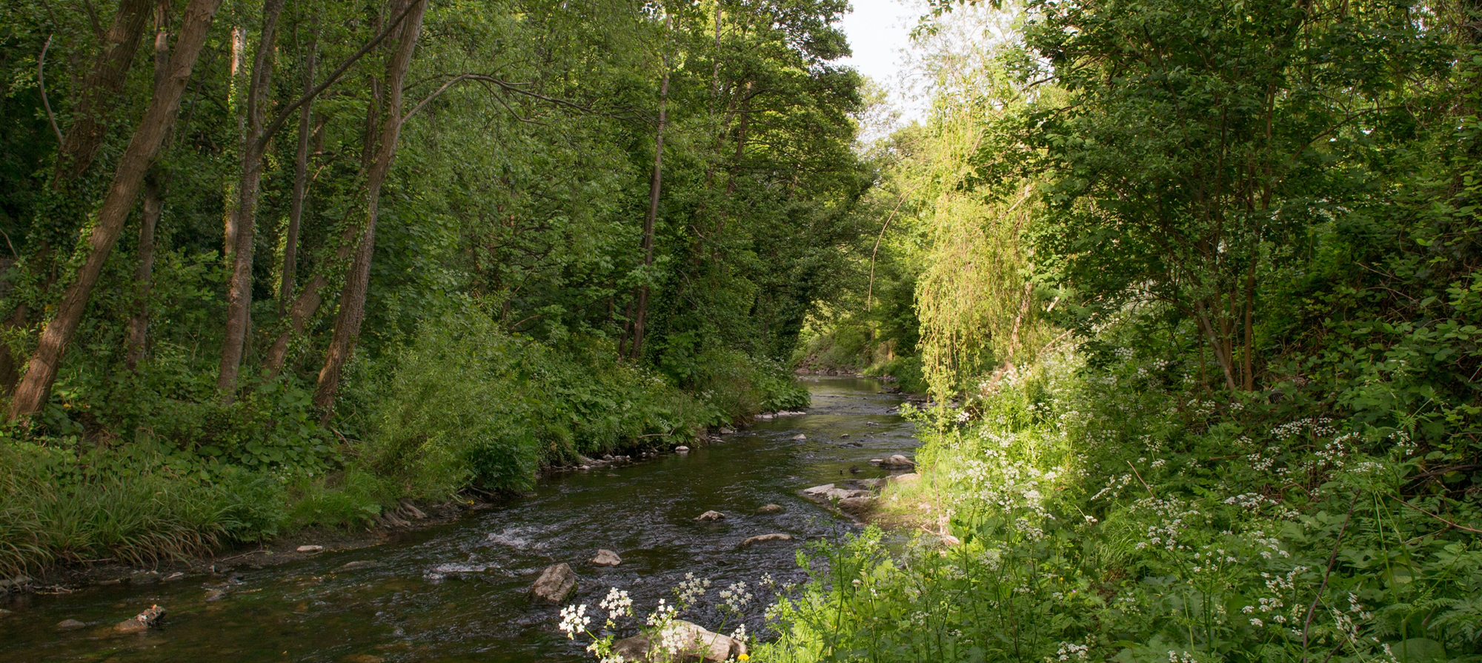
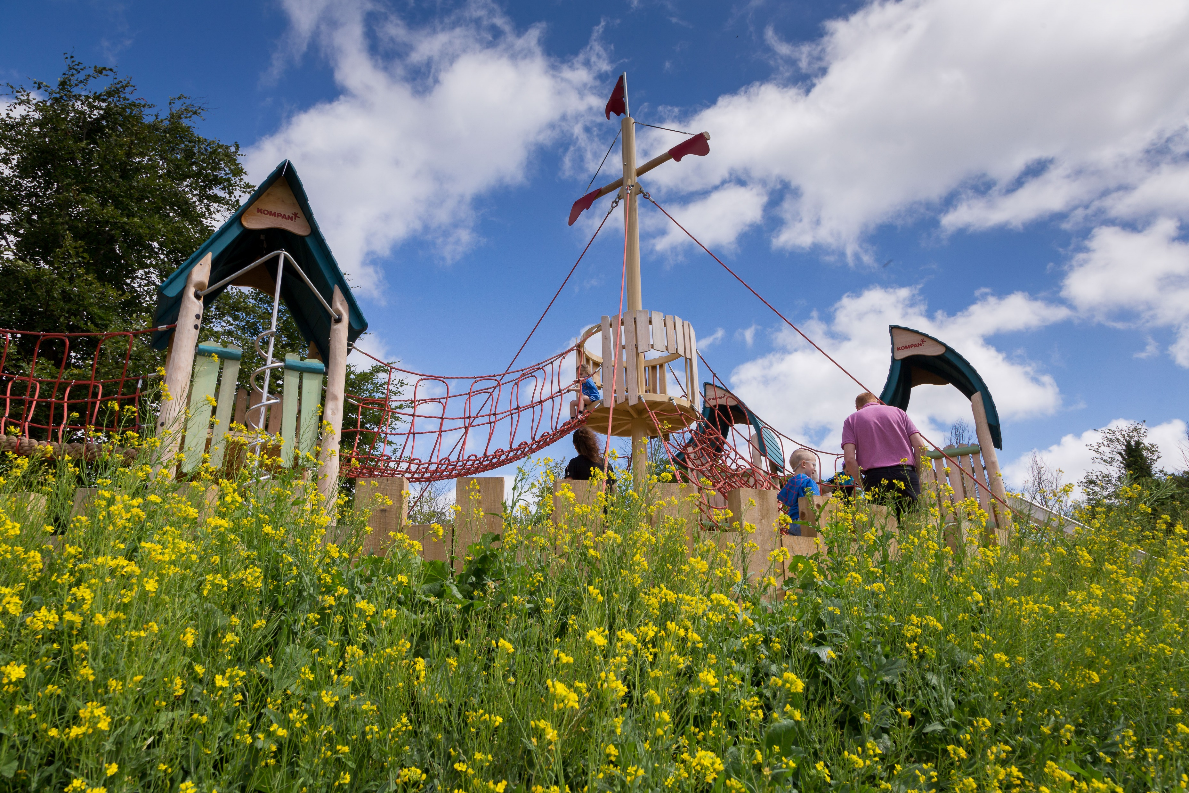
Parks and Open Space (POS) Strategy Update
Green Infrastructure (GI) Strategy Update
Update to EWCC SPC
07 09 2021

Slide 2
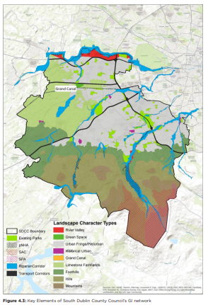
GI Strategy
Vision
Promote the development of an integrated GI network for South Dublin County working with and enhancing existing biodiversity and natural heritage, improving our resilience to climate change and enabling the role of GI in delivering
sustainable communities to provide environmental, economic and social benefits.
This chapter of the Development Plan, alongside the associated maps and appendices, sets out the Green Infrastructure Strategy for the County.

Slide 3
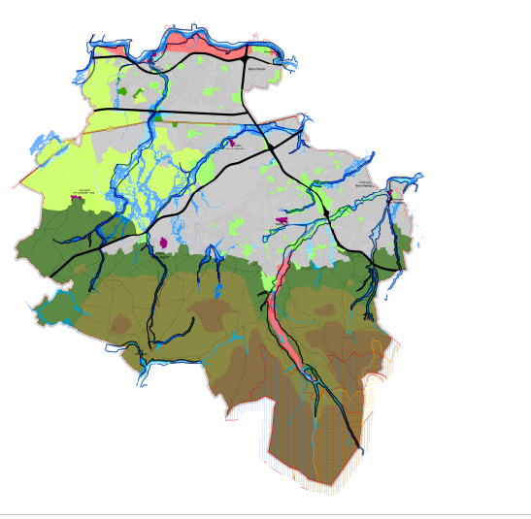
Draft CDP
The Draft Plan (Written Statement, including Appendices and maps) and associated SEA Environmental Report and AA Natura Impact Report will be on public display and available for public inspection from:
7th July to 15th September 2021
On public consultation portal:
https://www.sdcc.ie/en/devplan2022/
Green Infrastructure Strategy is contained within Chapter 4 and Appendix 4:
Chapter 4: Green Infrastructure | South Dublin County Council's Online Consultation Portal (sdublincoco.ie)
Appendix 4: Green Infrastructure: Local Objectives and Case Studies | South Dublin County Council's Online Consultation Portal (sdublincoco.ie)

Slide 4
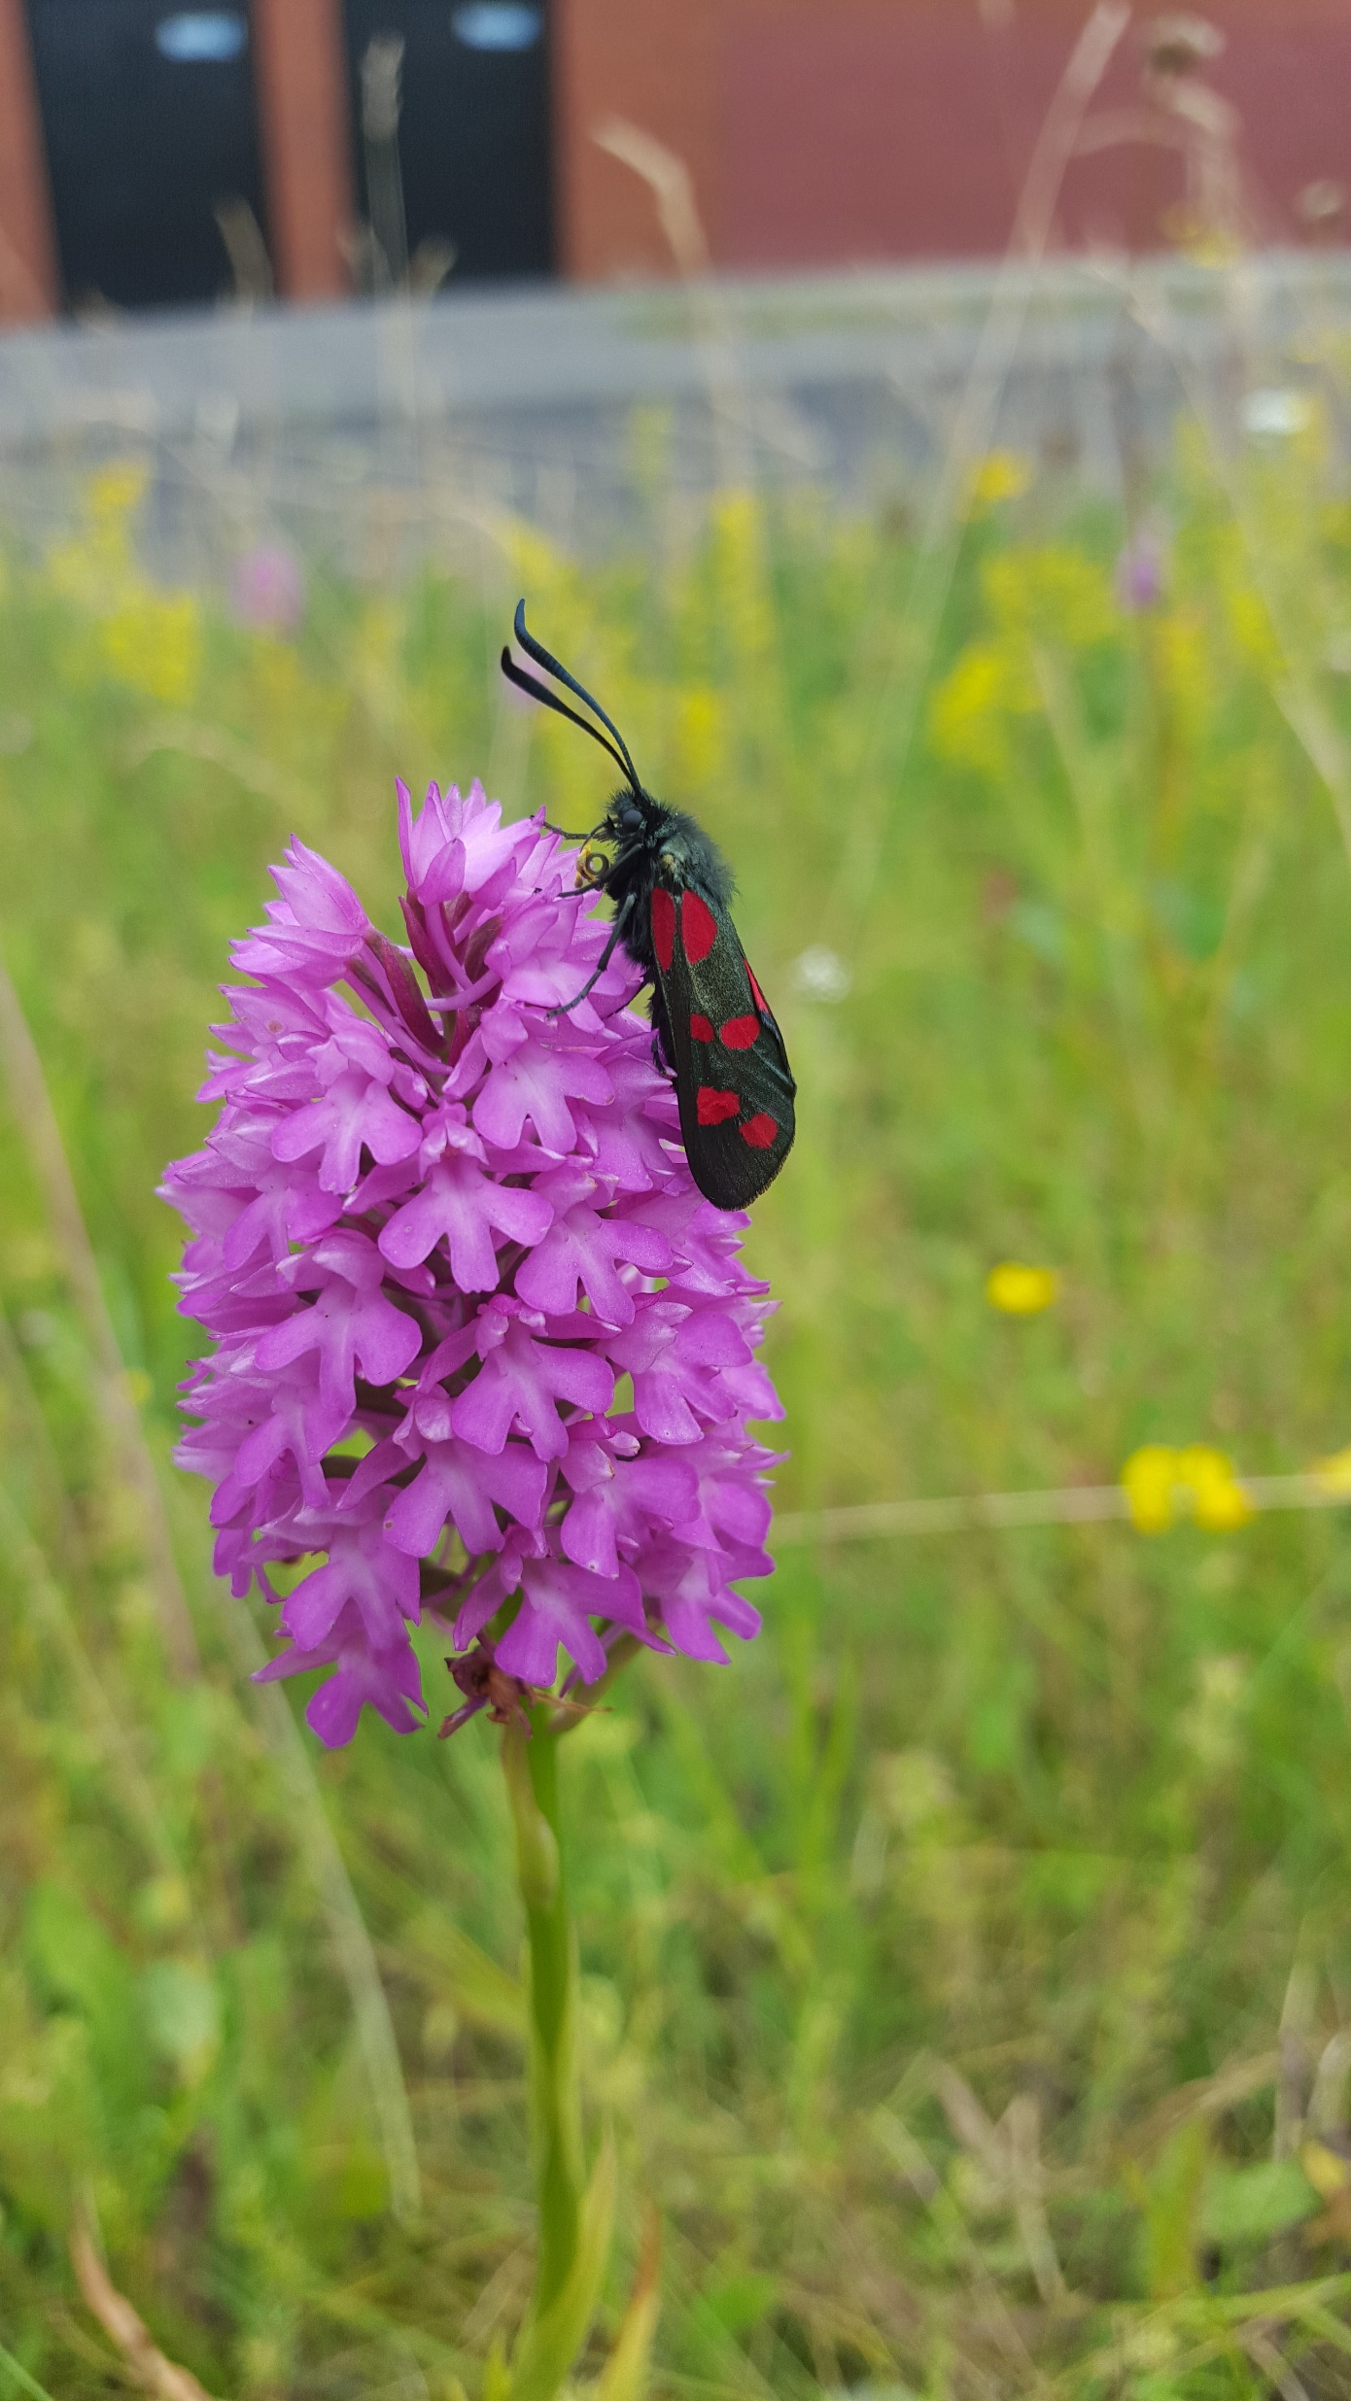
GI Strategy-Overarching
Policy GI1: Overarching
Protect, enhance and further develop a multifunctional GI network, using an ecosystem services approach, protecting, enhancing and further developing the identified interconnected network of parks, open spaces, natural features, protected areas, and rivers and streams that provide a shared space for amenity and recreation, biodiversity protection, water quality, flood management and adaptation to climate change.

Slide 5
GI Strategy Biodiversity
Policy GI2: Biodiversity
Strengthen the existing GI network and ensure all new developments contribute towards GI, in order to protect and enhance biodiversity across the County as part of South Dublin County Council’s commitment to the National Biodiversity Action Plan 2021- 2025 and the South Dublin County Council Biodiversity Action Plan, 2020-2026, the National Planning Framework (NPF)and the East Region Spatial and Economic Strategy (RSES).

Slide 6
GI Strategy-Sustainable Water Management
Policy GI3: Sustainable Water Management
Protect and enhance the natural, historical, amenity and biodiversity value of the County’s watercourses. Require the long-term management and protection of these watercourses as significant elements of the County’s and Region’s Green Infrastructure Network and liaise with relevant Prescribed Bodies where appropriate. Accommodate flood waters as far as possible during extreme flooding events and enhance biodiversity and amenity through the designation of riparian corridors and the application of appropriate restrictions to development within these corridors.

Slide 7
GI Strategy-SuDS
Policy GI4: Sustainable Urban Drainage Systems
Require the provision of Sustainable urban Drainage Systems (SUDS) in the County and maximise the amenity and biodiversity value of these systems.

Slide 8
GI Strategy-Climate Resilience
Policy GI5: Climate Resilience
Strengthen the County’s GI in both urban and rural areas to improve resilience against future shocks and disruptions arising from a changing climate.

Slide 9
GI Strategy-Recreation& Amenity
Policy GI6: Human Health and Wellbeing
Improve the accessibility and recreational amenity of the County’s GI in order to enhance human health and wellbeing while protecting the natural environment within which the recreation occurs.

Slide 10
GI Strategy-Landscape, Natural, Cultural and Built Heritage
Policy GI7: Landscape, Natural, Cultural and Built Heritage
Protect, conserve and enhance landscape, natural, cultural and built heritage features, and support the objectives and actions of the County Heritage Plan.

Slide 11
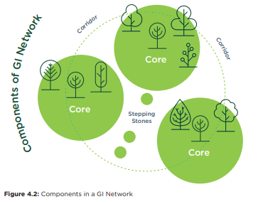
Components of GI:
GI Cores serve as anchors within the network.
They are ecological resources of regional / national importance, and / or high levels of outstanding amenity and act as points of origin / destination for wildlife at which essential ecological processes occur.
Dublin Mountains, Liffey Valley, Grand Canal, Regional Parks.
GI Corridors are physical links that tie the network together.
They provide for movement of flora and fauna between GI Cores. Primary GI Corridors operate at the regional level; linking GI Cores within and beyond our own county. Local GI Corridors link Cores or Corridors within our county at a more local level.
Primary GI Corridors: Camac Valley, Dodder Valley, Rural Fringe
Local GI Corridors: Griffeen River Valley, tributaries of the Dodder River.
GI Stepping Stones are smaller areas of green space; important at the local level.
They are discrete pieces of GI Infrastructure that are not linked to a wider network as yet but can act as alternative ecological routes, as refuges for ecology or small zones of biodiversity and amenity within an urban or hard landscape area or an area of monoculture. GI stepping stones can be improved on or linked-up over time to become local or even primary GI Corridors.
Small open space areas proximal to GI Cores and Corridors, private gardens, hedge and ditch combinations.

Slide 12
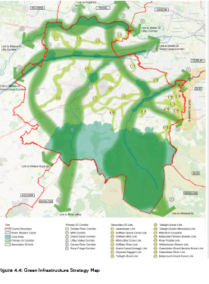
GI Strategy Map

Slide 13
Parks and Open Space (POS) Strategy Update

Slide 14
PARKS AND OPEN SPACES: Are fundamental in contributing to a high quality of life for those living, working and visiting the County. They provide habitats for ecological processes, a focal point for active and passive recreation, promote community interaction and help mitigate the impacts of climate change.
Define Open Space standards
Quantity
Access
Quality
Benchmarking of Standards
Application of Standards to South Dublin neighbourhoods (as per county development plan)
Policies and Objectives incorporated as part of Draft CDP.

Slide 15
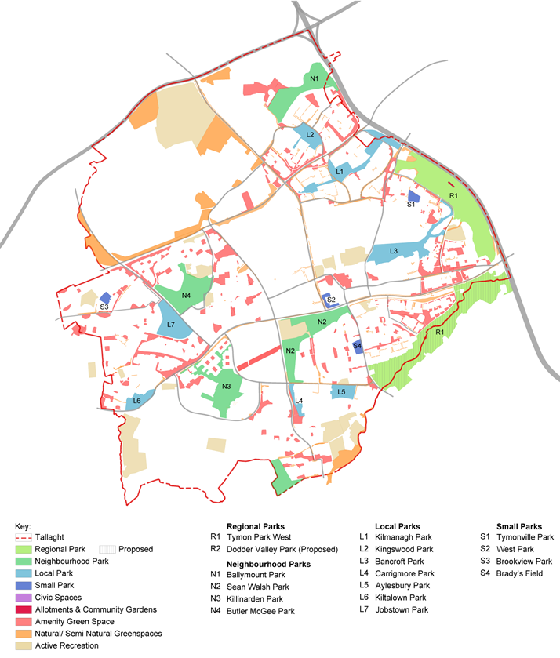
Parks and Open Spaces Strategy
Type | Park | Area (ha)
Regional Parks | Tymon Park West | 128.83
 | Dodder Valley (Proposed) | 118.31
 | Totals | 247.14
Neighbourhood Parks | Ballymount Park | 21.15
 | Sean Walsh Park | 21.86
 | Killinarden Park | 20.81
 | Butler McGee Park | 20.67
 | Totals | 84.49
Local Parks | Kilnamanagh Park | 15.52
 | Kingswood Park | 6.71
 | Bancroft Park | 18.00
 | Carrigmore Park | 2.38
 | Aylesbury Park | 5.15
 | Kiltalown Park | 5.49
 | Jobstown Park | 13.34
 | Totals | 66.59
Small Parks | Tymonville Park | 1.73
 | West Park | 1.42
 | Brookview Park | 1.40
 | Brady’s Field | 1.91
 | Totals | 6.46
Amenity Green Space | Various | 118.72
Natural/semi-natural | Various | 92.90
Applying the Standards: Tallaght
Quantity

Slide 16
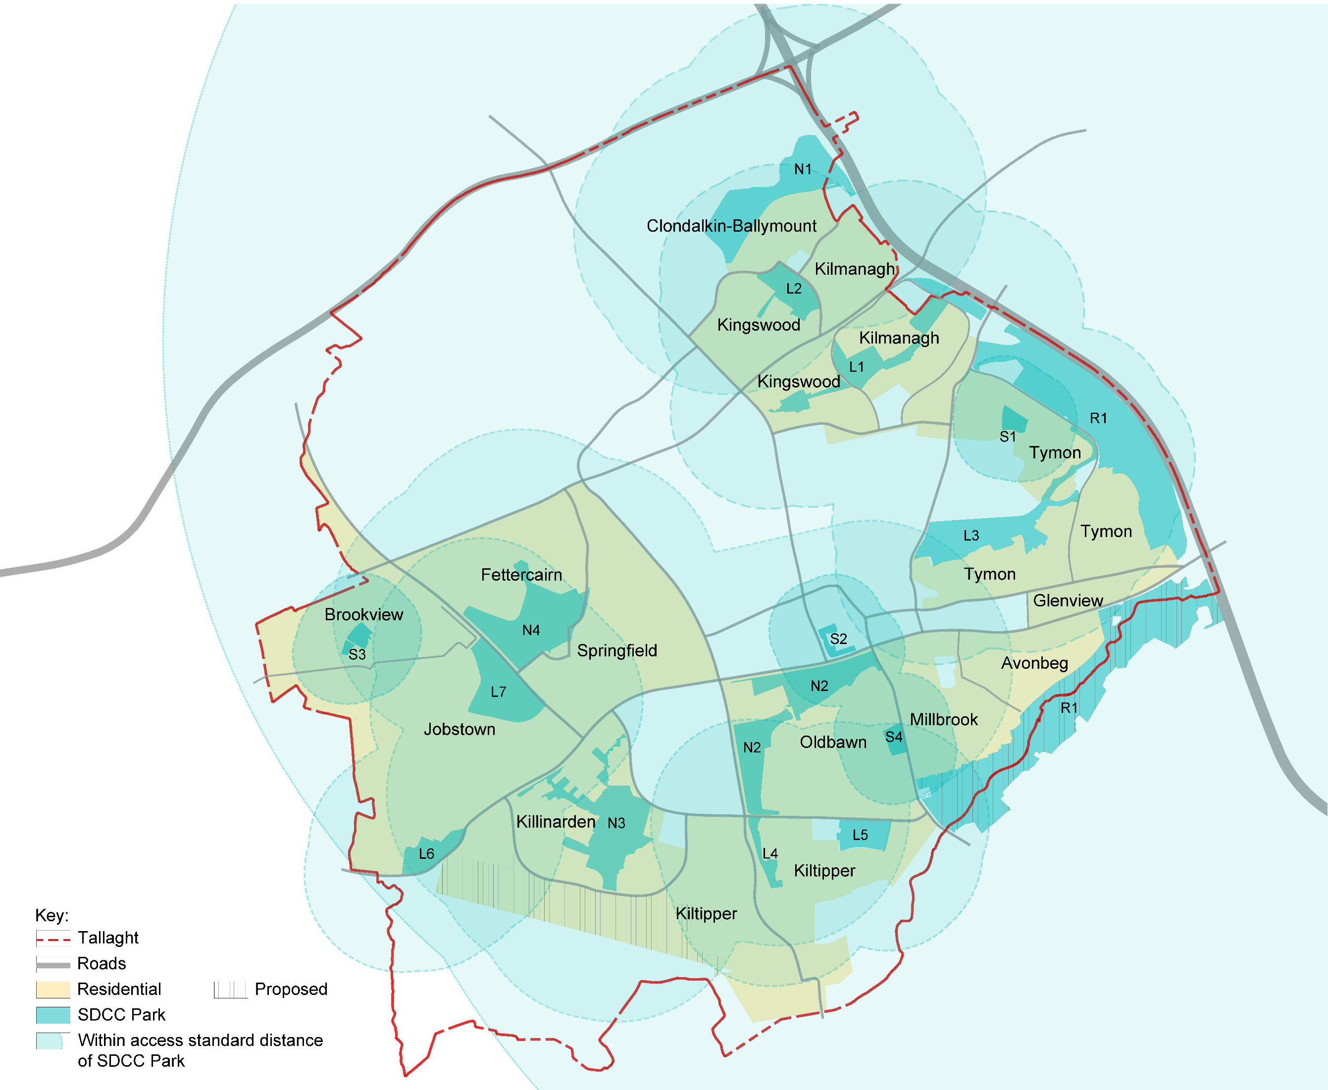
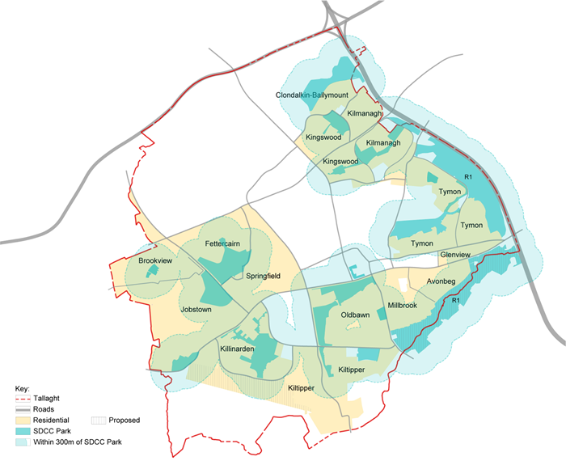
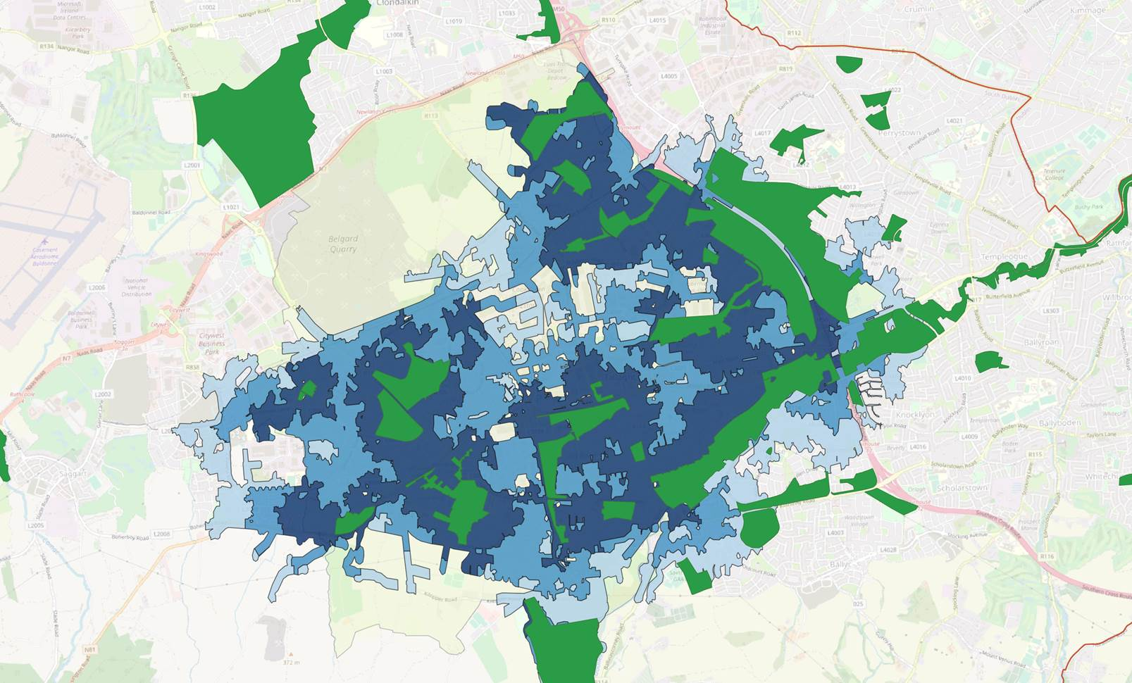
Parks and Open Spaces Strategy
Applying the Standards: Tallaght
Accessibility
Within prescribed walking thresholds of all SDCC Parks
Within 300m band of all SDCC Parks
Information is being refined
Applying the Access Standards: Public Parks
Within the Tallaght neighbourhood there is an existing well-distributed network of public parks.
There are no residential areas in the neighbourhood that do not have access to a park within the prescribed walking thresholds.
Note:
Initial access thresholds and assessments are being up-dated in line with walkability bands created by SDCC using 'Open Street Maps' to give truer walking routes and catchments.
Adding a 300m band (to existing public parks only)

Slide 17
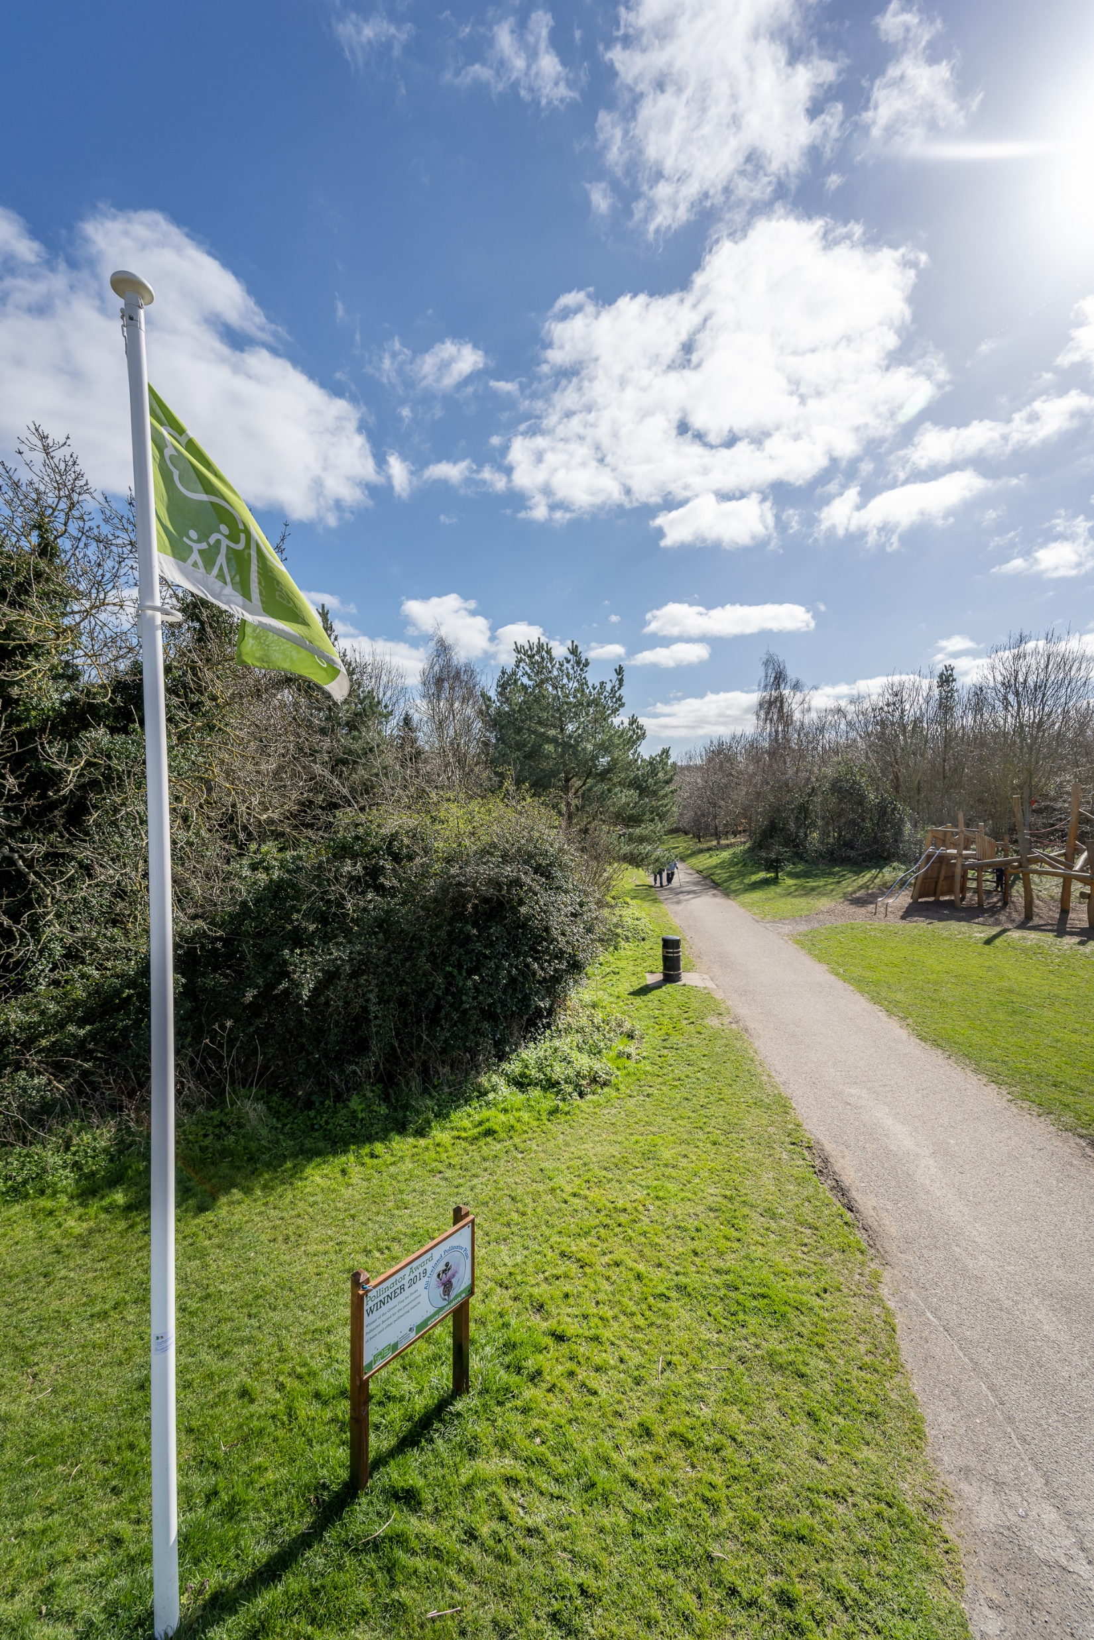
Parks and Open Spaces Strategy
Quality Standards – Green flag standard with developed biodiversity section.
A locally set quality assessment is being undertaken for each area of open space. Scores are given against a basic expected level of quality/maintenance, potential for biodiversity and community value, as shown.
A Welcoming Place
1. Welcoming entrances
2. Good and safe access
3. Signage
4. Equal access for all
Healthy, Safe and Secure
5. Safe and accessible equipment and facilities
6. Personal security
7. Appropriate provision of facilities
8. Quality of places
Management
9. Clean and well-maintained
10. Litter and waste management
11. Grounds maintenance and horticulture
12. Building and infrastructure maintenance
Potential for Biodiversity
13. Linkages to GI network
14. Native tree and shrub planting
15. Hedgerows
16. SuDS features (incl. integrated wetlands)
17. Natural water features (including stream re-profiling)

Slide 18
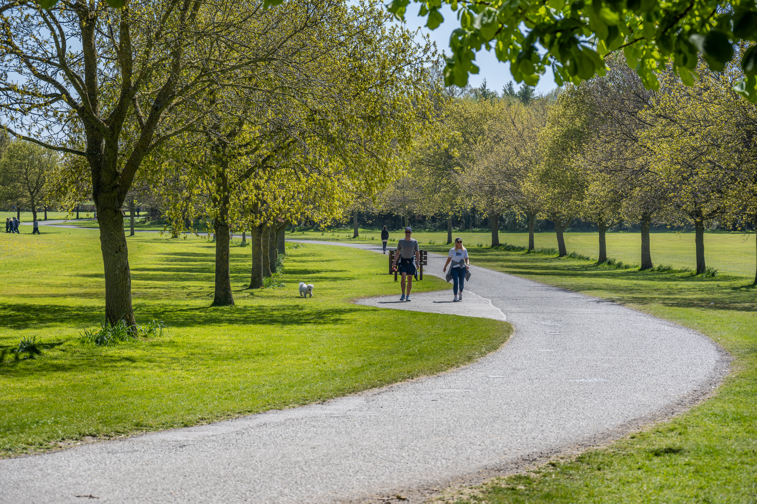
Parks and Open Spaces Strategy
Parks and Open Space Survey & Review
Strategic level assessment carried out for Parks and Open Spaces.
Related policies and objectives included in Draft County Development Plan
Public Survey:
https://consult.sdublincoco.ie/
A video promoting SDCC parks and requesting feedback accompanied the survey.
4274 submissions received that are currently being assessed.
Review of existing facilities within parks and open spaces underway to allow more local assessment.

Slide 19
Parks and Open Space (POS) Strategy Update
Thank you
Green Infrastructure (GI) Strategy Update

