Slide 1
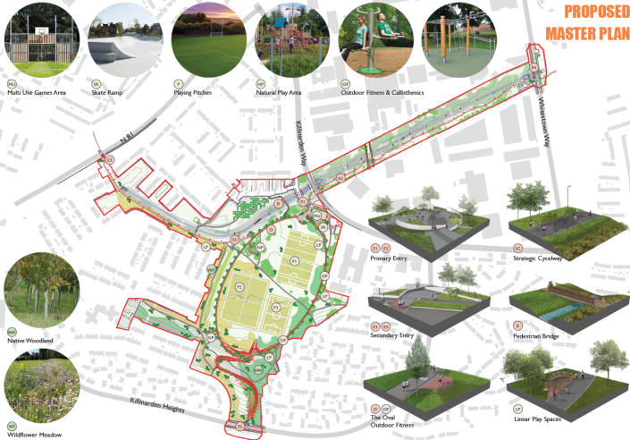
Notes:
The attached gives an overview of the design for the park and greenway. The design includes facilities and enhancements to the park including the Oval a 3m footpath at the heart of the park with fitness and play spaces located around it, upgraded playing pitches, MUGA – including a skate ramp, natural play areas, upgraded and enhanced primary and secondary entrances, enhanced boundary treatments, strategic cycleway, outdoor fitness & calisthethics, landscaping including orchard and wildflower meadow. The introduction of these positive features will attract people to use the park – currently only features in the park are the playing fields.

