Slide 1
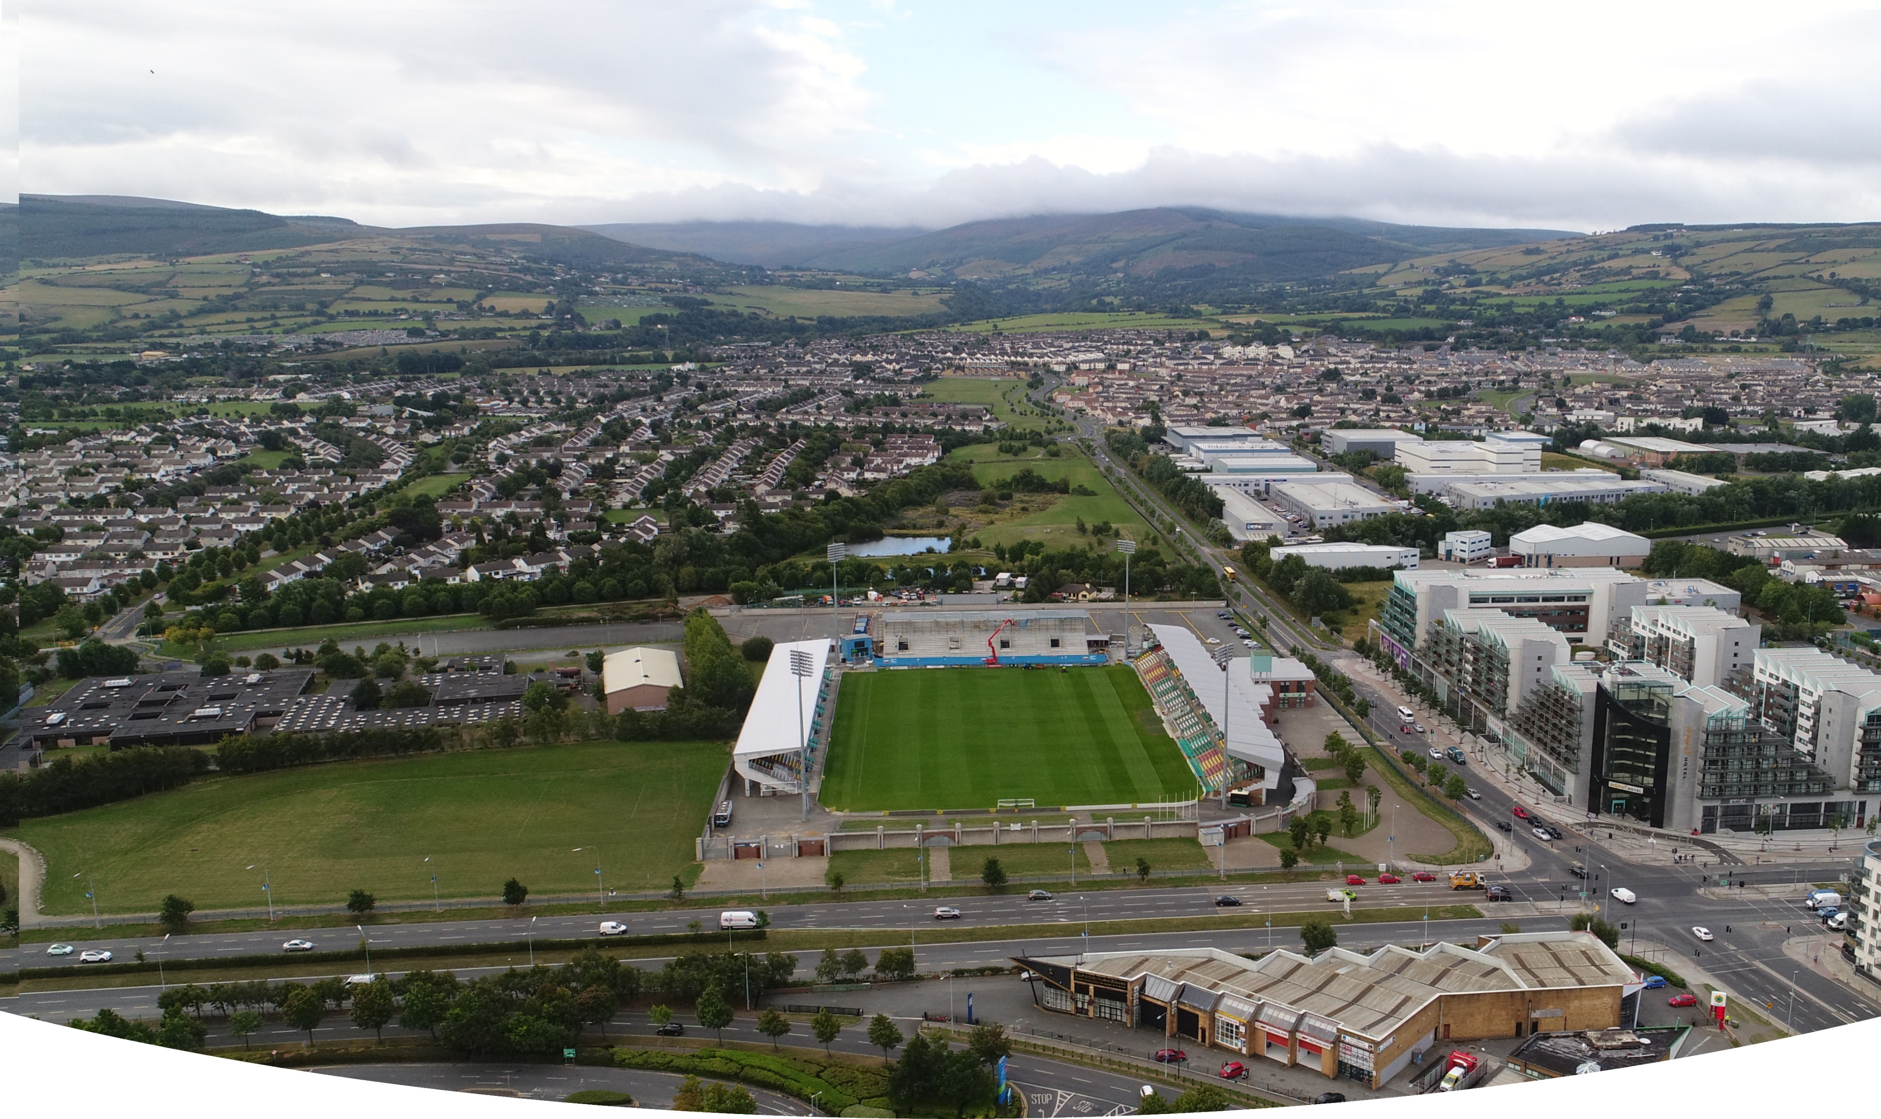
COUNCIL MEETING July 2021
Part 8 Report Sean Walsh Park
Synthetic Grass Sports Pitch
Context for the Project
National plans, including National Development Plan, Project 2040 Building Irelands Future, National Planning Framework, SDCC Development Plan, Tallaght Local Area Plan.
November 2018, Government launched Urban Regeneration and Development Fund a flagship element of Project 2040
SDCC’s application successful in receiving funding for projects in Tallaght’s Core Urban Centre
Delivery of these projects will raise the profile of Tallaght and create a sense of pride and place for Tallaght and enhance the liveability and revitalisation of the town centre.
URDF Funded Projects:
New Innovation Square,
Innovation Centre,
Upgrade and regeneration of Chamber Square and associated pedestrian link
Tallaght Stadium 4th Stand,
Tallaght Mobility Hub,
Belgard Link Roads
Astro Pitch for Sean Walsh Park.

Slide 2
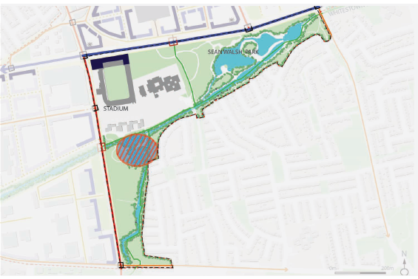
Sean Walsh Park Synthetic Grass Pitch LAP context
Policy for Recreational Facilites in Tallaght LAP 2020
It is policy of the Council to support and facilitate the expansion of Tallaght Stadium and encourage a wide range of uses and events including the development of all-weather playing facilities and expansion of recreational facilities in Tallaght Town Centre (Objective CF 7).
Playing pitches constitute a major proportion of the facilities available. However, increased levels of rainfall and future predicted rainfall means that grass based pitches are unusable for an increasing amount of time each year. This situation has affected Tallaght, where many pitches have been unplayable for almost 6 months at a time. The development of all-weather facilities with floodlighting for year round and night time use would be a valuable addition to the amenities available in the area. The location of such facilities should take into account the impact of floodlighting on wildlife and residential amenities.
Objectives of Tallaght Local Area Plan 2020
Town Park:
Enhanced, multi-purpose high quality urban park with high levels of accessibility to surrounding areas and strong connections with the larger green infrastructure of the Plan area.
TP1: Consolidate and enhance amenity function of Sean Walsh Park.
TP2: Balanced provision of active and passive recreation.
TP6: Provision of all-weather playing pitches.
TP10: That any consideration of the siting of astro-pitches in Seán Walsh Park shall be subject to an Ecological Impact Assessment having regard, in particular, to the wetland area in the west of the park.
Map of Town park taken from Tallaght LAP 2020.

Slide 3
Sean Walsh Park Synthetic Grass Pitch sports pitch strategy context
Recommendations from Sports Pitch Strategy
Provide Artificial Grass Pitches (AGPs) to increase provision, usage and provide for training need
AGP’s provide increased pitch capacity to meet increased population growth in higher density/ urban locations
Position at Strategic locations, particularly at new planned development and high population areas; to facilitate high use, late evening use and flood lighting.
Provide all weather, year-round facilites:
meet demand for increased match play
meet demand for training provision which is not currently being met.
remove training pressure from grass pitches with resultant higher standard of grass pitches.
The multi-use nature of AGP pitches should lead to efficiencies in use; GAA, Soccer and Rugby High capital outlay required; need to ensure value for money
Provision to be made for replacement / repair over lifetime of the facility
.

Slide 4
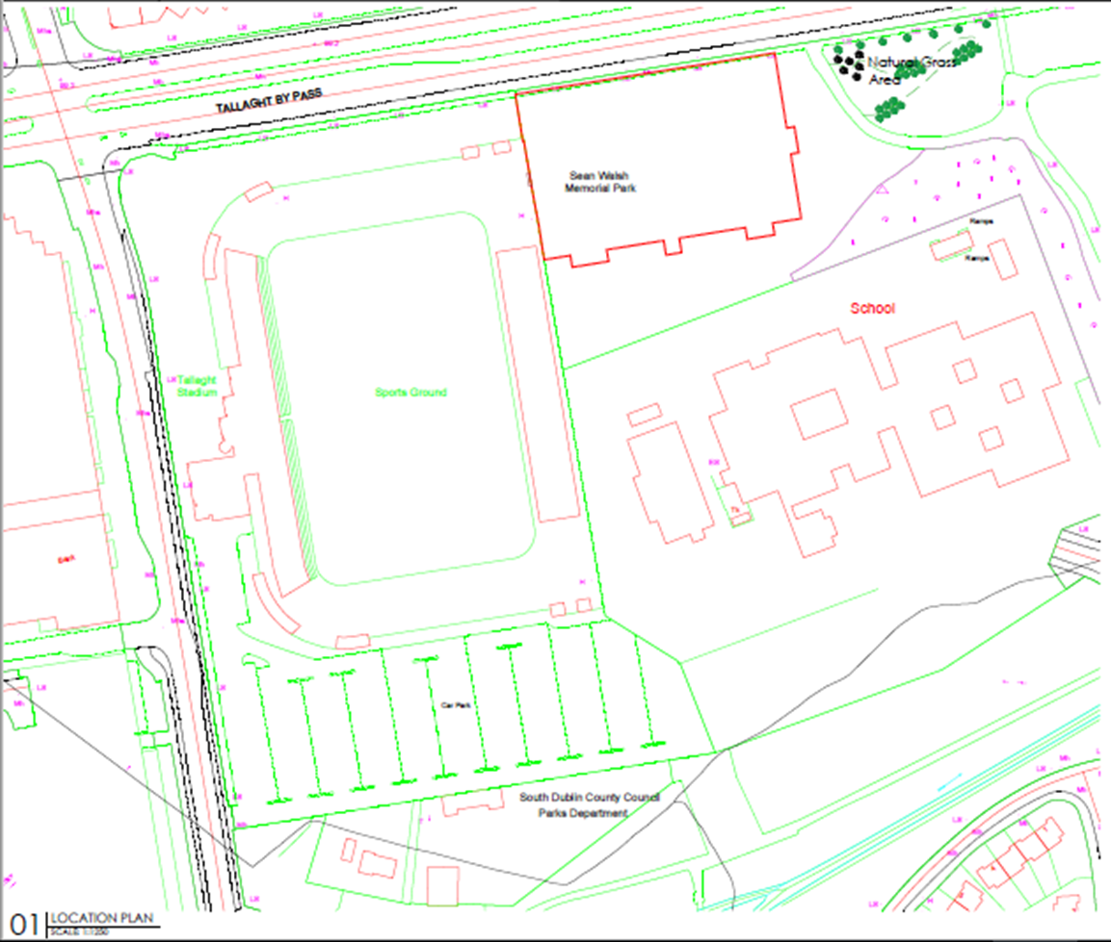
Sean Walsh Park Synthetic Grass Pitch location plan
Proposed Location:
Located in one of SDCC’s larger neighbourhood parks
Close to Tallaght town centre and its facilities (shops, restaurants, adjacent parking, public transport routes and stops, walking and cycling routes.)
Adjacent to high capacity access roads.
Adjacent to areas already subject to high levels of artificial lighting (Tallaght Stadium, N81)
Adjacent to areas already subject to elevated noise levels (N81, Tallaght Stadium)
Adjacent to Tallaght Stadium ‘Sports Hub’ location
Central location; high profile and easy access, adjacent to school.
Over 30 clubs using council facilites within 5km of the proposed location.
Passive surveillance ensured at this location.
Other options considered Southwards into Sean Walsh Park:
Increased ecological concerns.
Further from supporting facilites
Increased likelihood of adverse impact on adjacent residential estates. (Lighting, Noise)

Slide 5
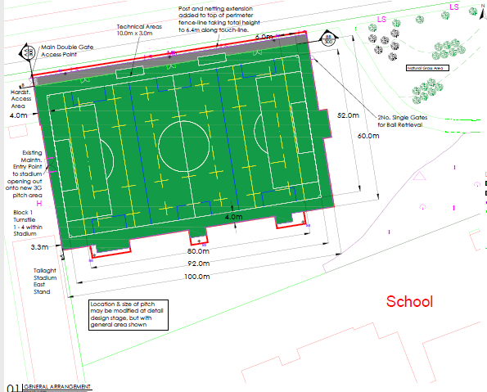
Sean Walsh Park Synthetic Grass Pitch proposal
Development of a Synthetic Grass Sports Pitch at Sean Walsh Park, Tallaght, Dublin 24 as set out below:
The construction of a synthetic grass 3G all-weather sports pitch, approx. 92m X 52m
To be surrounded with a 5-metre-high weldmesh type fence with an additional 1.4m ball-stop fence on the northern side.
6 floodlighting columns to allow evening use.
Installation of CCTV Cameras for monitoring by An Garda Siochána and South Dublin County Council.
The planting of new trees in Sean Walsh Park.
All necessary landscape works including storage areas, footpaths and planting.
All ancillary works.

Slide 6
Sean Walsh Park Synthetic Grass Pitch part 8 process
The proposal has undergone Appropriate Assessment Screening under the Habitats Directive (92/43/EEC) and screening for Environmental Impact Assessment under the EIA Directive 2014/52/EU.
Due to Covid-19 restrictions, plans and particulars of the proposed development were available for inspection or purchase at a fee not exceeding the reasonable cost of making a copy only by appointment at County Hall, Tallaght, Dublin 24 during normal working hours during the period of 4 weeks from the 20th of May 2021.
The plans are available online on the Council’s Public Consultation Portal website: http://consult.sdublincoco.ie
Consultation Period:
20th May 2021 to 5pm on the 2nd July 2021

Slide 7
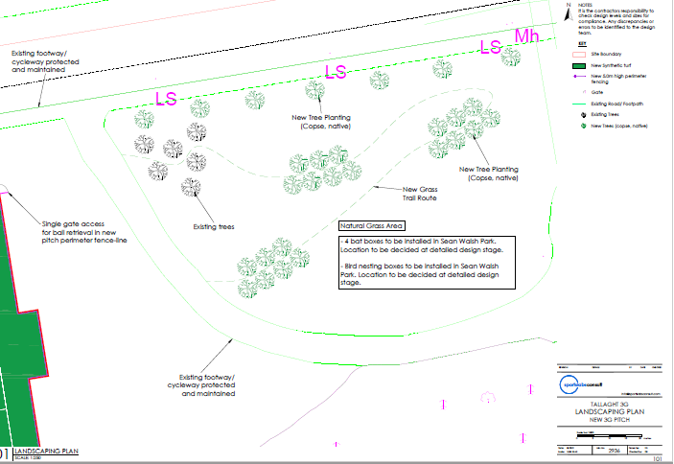
Sean Walsh Park Synthetic Grass Pitch part 8 process
Submissions and observations with respect to the proposed development dealing with the proper planning and sustainable development of the area in which the proposed development will be situated, could be made in writing up to 5pm on the 2nd July 2021 and were to be submitted either on line or by post.
By the closing date 3 No. submissions were received. These have been summarised and responded to in the Chief Executive's Report.
Landscape Plan:

Slide 8
Sean Walsh Park Astro Pitch part 8
Recommendation:
Following consideration of the submissions received the Chief Executive is of the view that the issues raised by way of the submissions can be satisfactorily addressed during the detailed design stage, and the operational and management stage and as outlined in the Chief Executive's report.
It is recommended that, as the proposal is in conformity with proper planning and sustainable development the Council proceed with the Part 8 proposal to construct the proposed synthetic grass 3G all-weather sports pitch in Sean Walsh Park, Tallaght, Dublin 24.

