Slide 1
Annual Report
2020

Slide 2
LCDC Annual Report 2020
“Co-ordination, planning and overseeing local and community development funding and bringing a more joined-up approach to the running of local and community development programmes and interventions in the South Dublin County”
Professor Mary P. Corcoran, Chairperson,
South Dublin Local Community Development Committee
14th, June 2021

Slide 3
LCDC Annual Report 2020 Overview
Overview & Membership
Meetings & Subcommittees
Funding Report
LEADER Programme
Local Economic & Community Plan
The “lowdown on the LCDC”

Slide 4
LCDC Annual Report 2020 -Funding
SICAP funding from DRCD
€2,169,313
Healthy Ireland Round 3
€246,050*
Community Enhancement Programme 1
€81,967
Community Enhancement Programme 2
€279,944

Slide 5
LCDC Annual Report 2020 -SICAP Third year of current contract
Local Community Development Committee
KPI 1 - Local Community Groups assisted - achieved 111% (83 of 75)
KPI 2 - Total number of individuals engaged on a one-to-one basis achieved 101% (897of 890)
For KPI 2 there is a target to reach 41% of those living in disadvantaged areas. The actual reach of 34% was below target but considerably affected by COVID 19. More challenging to work online due to deficits in access, space and skill sets.
SICAP Oversight Subcommittee
South Dublin County Partnership
Programme Implementor (PI)

Slide 6
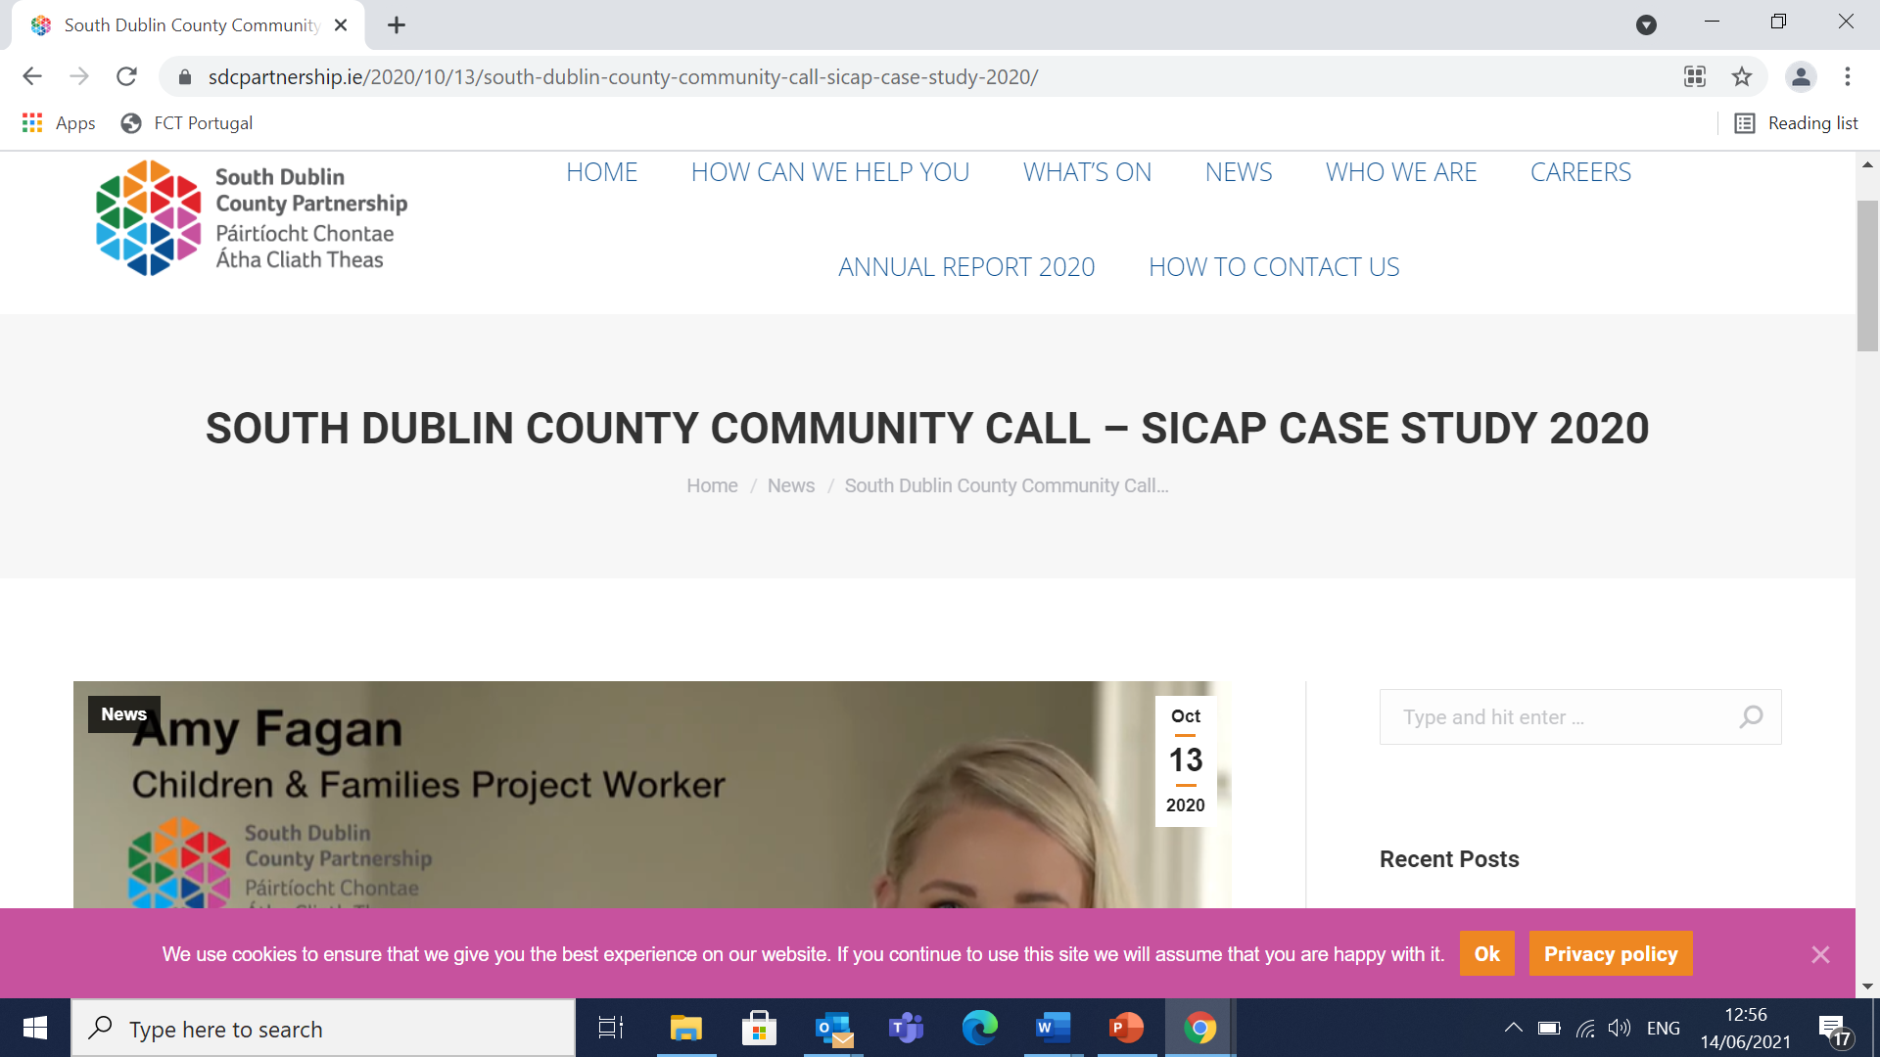
Through Community Call and in conjunction with SDCC, the SDC partnership fielded 2,500 emergency calls in 2020. https://sdcpartnership.ie/2020/10/13/south-dublin-county-community-call-sicap-case-study-2020

Slide 7
LCDC Annual Report 2020: Community Enhancement Programme
LCDC responsible for monitoring and administration of CEP
CEP Round 1 funding for 42 community groups totalling €81,018.
CEP Round 2 funding for 37 community groups totalling €279,944
List of successful applicants will be included in Appendix 3 of Annual Report

Slide 8
LCDC Annual Report 2020: Audits of the SICAP and Community Enhancement Programme
The Local Government Audit Service (LGAS) carried out an audit in two parts on: the SICAP programme and the South Dublin Community Enhancement Programme 2018
The outcome of both audits was communicated in May 2020, considered by the SICAP Oversight Committee and reported at the LCDC June 2020 meeting. All of the 12 recommendations suggested have been responded to by SDCC Management.

Slide 9
LCDC Annual Report 2020: LEADER Programme
Dublin Rural LEADER Programme 2014-2020
The LCDC is represented by 5 members on the Local Area Group which oversees the allocation of funding:
Most projects approved are under economic development or social inclusion. Environmental projects are under-represented and efforts will be made going forward by the Implementation company to address this imbalance.
Interim funding has been received from DRCD pending the next LEADER programme

Slide 10
Dublin Rural Leader 2014-2020 *Approved projects in 2020 will be listed in Appendix 4 of Annual Report

Slide 11
LCDC Annual Report 2020: LECP
•
Local Economic & Community Plan:
monitoring progress & addressing key issues and themes
Responsibility for Community elements of LECP
Current plan, 2016-2021 expires this year
DRCD developing new guidelines due to issue in June 2021 for the next LECP

Slide 12
LCDC Annual Report 2020: LECP Focus group facilitated by DRCD March 24, 2021
A dis-connect between high level planning and what happens on the ground
SPC element of LECP seen as having higher status.
• Need to avoid duplication with other plans and a need for greater alignment.
•The LECP should create an enabling environment for pursuing objectives and the guidelines need to make that happen.
•Key issues that need to be addressed are:
Climate Action Plan, Digital Inclusion, address areas of high unemployment particularly in the aftermath of the pandemic

Slide 13
LCDC Annual Report 2020: Low down on the LCDC , Nov 18, 2020 Social Inclusion Festival

Slide 14
LCDC Annual Report 2020: Low down on the LCDC , Nov 18, 2020 Social Inclusion Festival
•
Launch of 2019 Annual Report
Presentation by Paula Donovan on “interim findings on Community Development in South County Dublin”
Presentation from Paula Haverty and Noreen Byrne on “The impact of social exclusion” in people’s everyday lives.
Some materials available on SDCC website.

