Slide 1
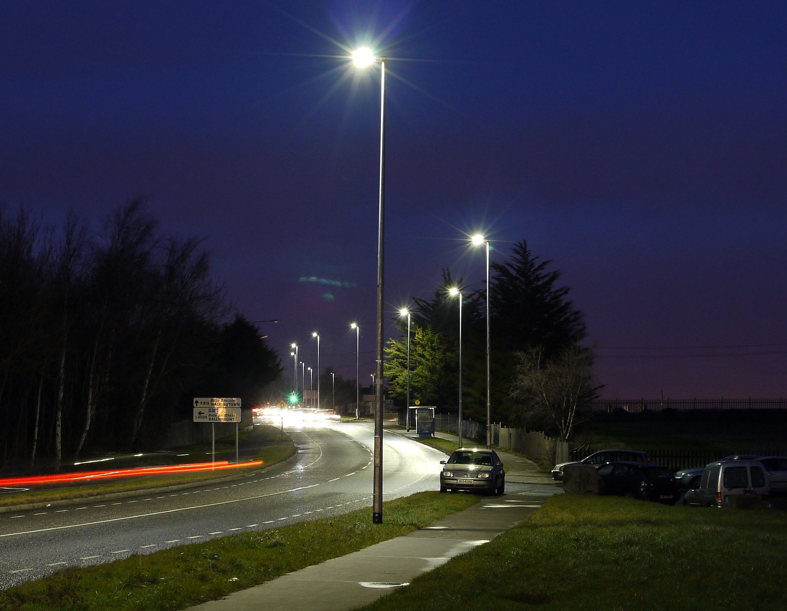
Energy Efficiency LED Upgrade June – Dec 2021
Land Use Planning and Transportation
June 2021

Slide 2
Current status June 2021
12, 000 Lanterns upgraded to LED throughout the County
Electrical surveys are ongoing to identify suitable upgrade candidate locations
Over 600 lanterns upgraded to date this year
900 further lanterns programmed over the remainder of the year

Slide 3
Upgrade Programme Jun-Dec 2021
Electoral Area | Location | Electoral Area | Location
Rathfarnham | Beverly | Templeogue | Priory Walk & Way
Rathfarnham | Cremorne | Templeogue | Cypress Drive
Rathfarnham | Hermitage Rathfarnham | Templeogue | Templeogue Woods
Rathfarnham | Castlefield Manor | Templeogue | Domville
Rathfarnham | Knockfield Manor | Templeogue | Grosvenor Court
Rathfarnham | Idrone | Templeogue | Greenpark
Rathfarnham | Brookvale | Templeogue | Ballymount Drive
Rathfarnham | The Priory Rathfarnham | Templeogue | Ballymount Road
Rathfarnham | Coolamber Park | Templeogue | ballymount Cross
Rathfarnham | Coolamber Court | Firhouse | Delaford
Rathfarnham | Knocklyon Road | Firhouse | Ballycullen Avenue
Rathfarnham | Westbourne Lodge | Firhouse | Ballycullen Drive
 |  | Firhouse | Bohernabreena Road

Slide 4
Upgrade Programme Jun-Dec 2021
Tallaght | Hazelbrook | Clondalkin | Glenfield
Tallaght | Seskin View Road | Clondalkin | Pinewoods
Tallaght | Millbrook Lawns | Clondalkin | St Ronan's
Tallaght | Sean Walsh Park | Clondalkin | St. John’s Estate
Tallaght | Cois na hAbhainn | Clondalkin | St John's Wood
Tallaght | Watermeadow | Clondalkin | Lealand
Tallaght | Watergate | Lucan | Hermitage Lucan
Tallaght | Old Bawn | Lucan | Brookvale lucan
Tallaght | Dun an Oir | Lucan | Esker Lawns
Tallaght | Belgard road | Lucan | Esker Park

Slide 5
Estate Selection Criteria
These estates have been prioritised based on the following criteria;
ESBN interaction is minimal (we do not need to wait on ratification of forthcoming ESBN Supplementary Agreement)
The columns are generally in good condition
They are currently fitted with SOX lanterns which are the highest energy consumer and most urgently require replacement.

Slide 6
Upgrade Programme Jun-Dec 2021
Now targeting our pre 90’s or “Legacy” stock
This will lead to certain columns within an estate being unsuitable for upgrade at this time, without ESBN Supplementary Agreement in place.
Ongoing discussions with ESBN to resolve this
Until final agreement with ESBN/regulatory bodies is reached, some estates will have columns not suitable for immediate upgrade
SDCC will revisit these columns once these issues have been resolved.

