Slide 1
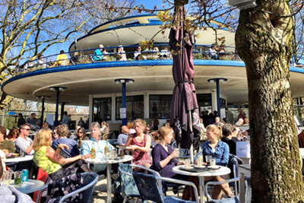
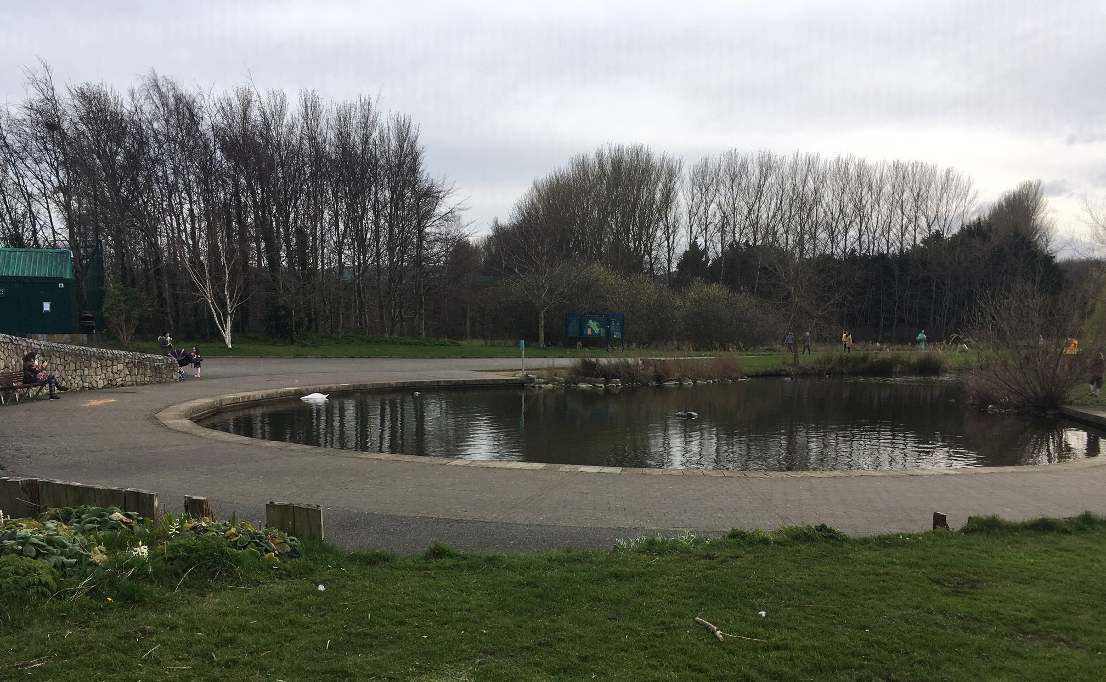
TYMON PARK INTER-GENERATIONAL CENTRE
ARCHITECTURAL SERVICES, PUBLIC REALM & COMMUNITY– 14 06 2021
Part 8 Report Presentation
Presented by Aidan McNamara
Architectural Services. SDCC

Slide 2
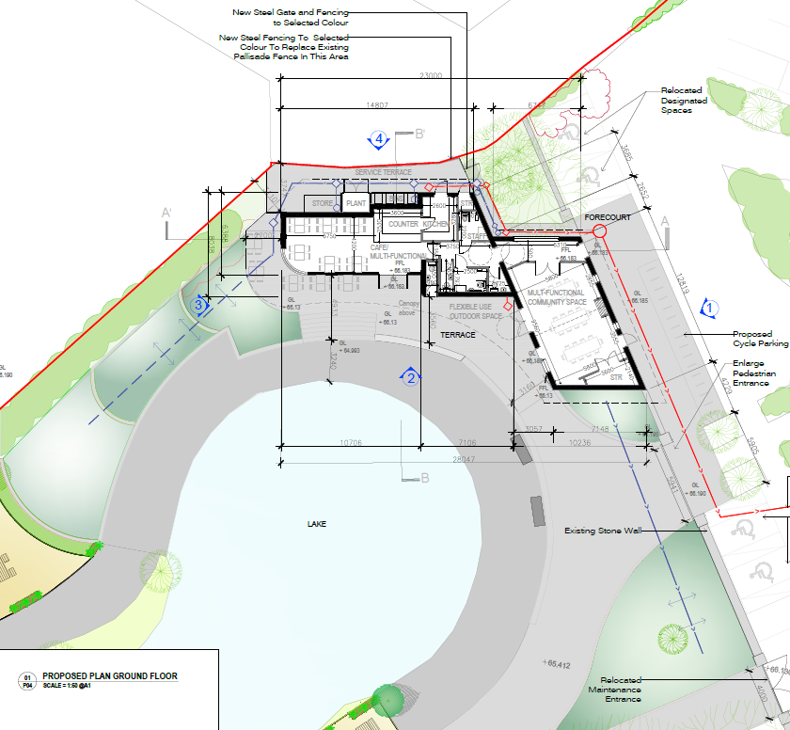
N
SITE LOCATION
Adjacent to Car Park and Pedestrian Entrance
South Facing
Overlooking the Lake

Slide 3
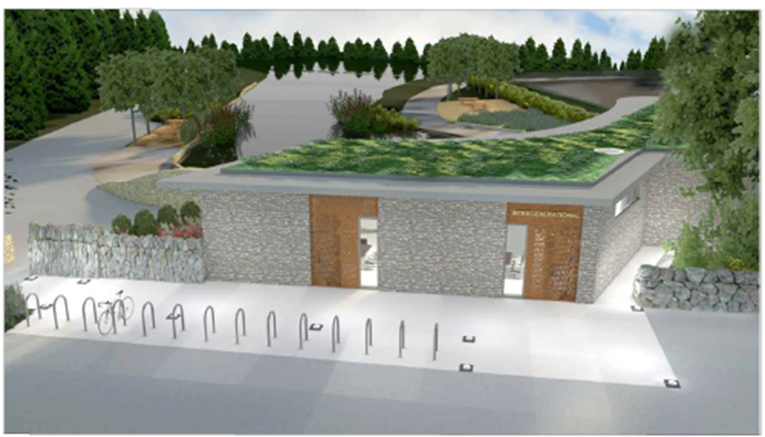
3D IMAGES – CAR PARK/ ENTRANCE VIEW
The multi-function space of the building faces the car park and entrance.
The new stone wall of the building forms part of the parks stone wall.
It is a solid and secure face with feature entrance openings.

Slide 4
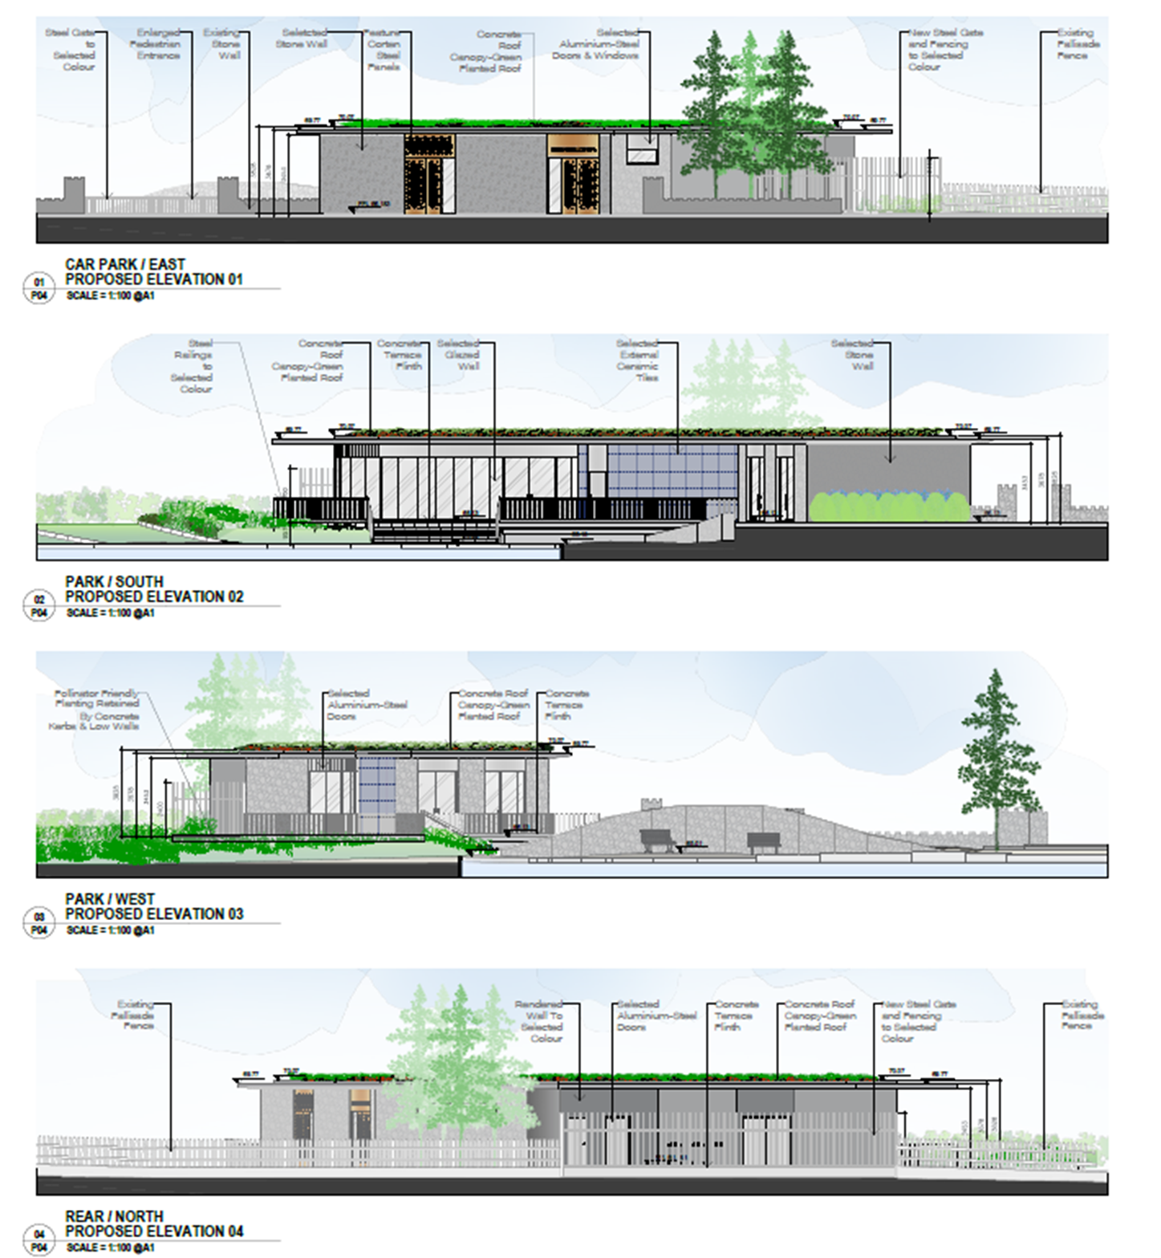

Slide 5
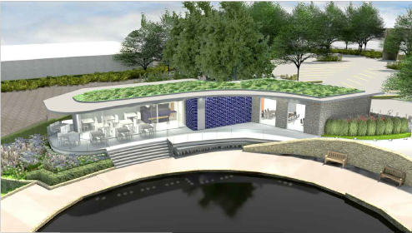
3D IMAGES – PARK VIEW
The Café element opens onto a substantial terrace and the park
with the feature roof canopy allowing sheltered outdoor seating and activities.

Slide 6
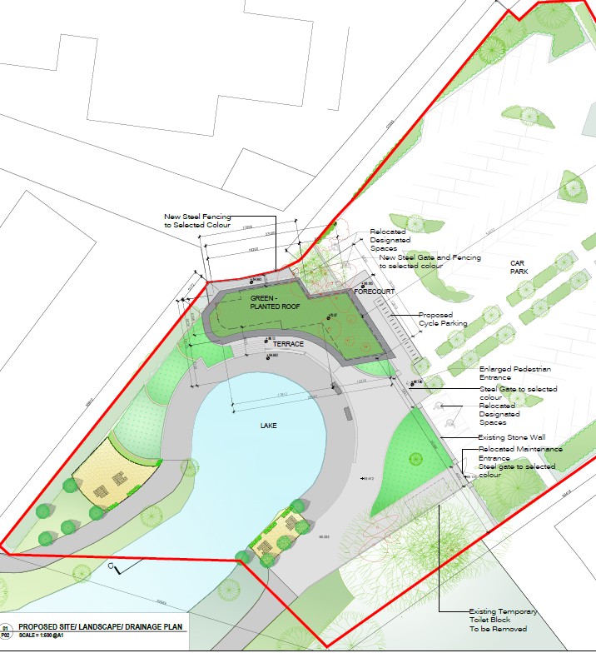
N
PROPOSED SITE PLAN & LANDSCAPE
The centre opens onto a substantial south facing sheltered terrace which overlooks the lake.

Slide 7
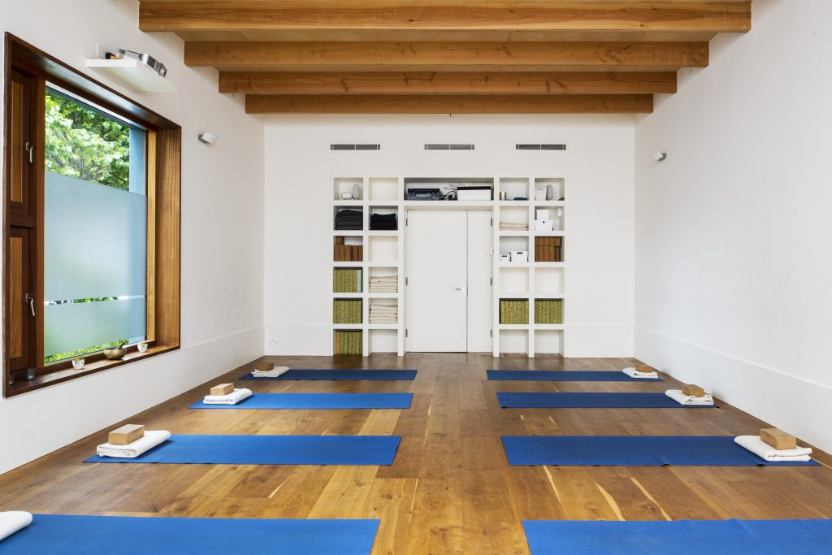
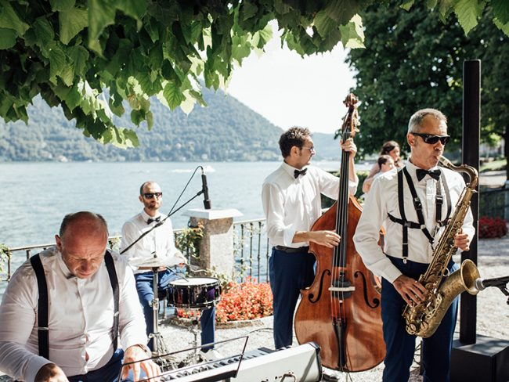
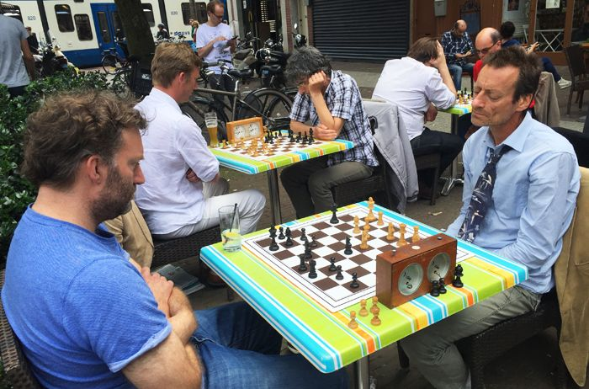
USE REFERENCES- FLEXIBLE MULTI-USE ACTIVITIES
Café/ Tearooms
Yoga Studio
Music Events
Board Games
Notes:
The intergenerational concept develops the idea of a multi-use facility that is adaptable to a variety of purposes.
This facility is designed for use by active age, age friendly and other groups of a small to medium size that require a flexible space for community-type use.
The management of the community space and its programming is to rest with the Community Dept of the Council and/or its agents.

Slide 8
Submissions and Recommendation
5 submissions were received by the closing date and these are summarised and recommendations are made in the Chief Executive’s Report.
Following consideration of the submissions received the Chief Executive is of the view that the issues raised can be satisfactorily addressed during the detailed design stage and the operational and management stage as summarised below:
1. Cycle Parking and Cycling
Cycle parking has been increased as part of this scheme. The cycle parking has been located at an optimal location by the entrance of the Intergenerational building and the park. Cycle parking will be designed to the required standards with adequate spacing and allowance for cargo bikes etc.
2. Accessibility and WCs
The toilet facilities will serve the Intergenerational Centre but will also serve the park. To serve the Centre in the evenings, in particular when the park is closed, the WCs and accessible WC need to be accessed from the building. The WCs are located close to the café entrance for park use with one outward facing WC. To facilitate universal access and enable access directly from the park, a door from the terrace to the Accessible WC will be added
3. Community Space
An assessment was undertaken and it was established that there are a number of larger function rooms in the surrounding area that cater for the demand for larger gatherings.
So this facility is designed for use of small to medium sized groups that require a flexible space for community-type use.
It is recommended that, as the proposal is in conformity with proper planning and sustainable development the Council proceed with the Part 8 proposal.

Slide 9
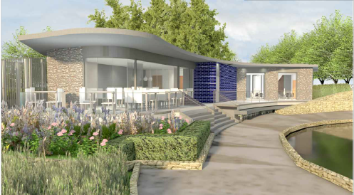
THANK YOU

