Slide 1
Section 183
Disposal of 56 Acres at Grange Castle West to Lens Media Ltd.

Slide 2
Lens Media - Development Proposal for Site
Full Service Media Park
1st in Ireland
Film, TV & Digital Content Production Studio Campus
Cater for International Markets
185,000 sq. ft Production Space
100,000 sq. ft Workshop Space
1000 sq. ft Production Offices
12 Sound Stages
9 to be constructed initially

Slide 3
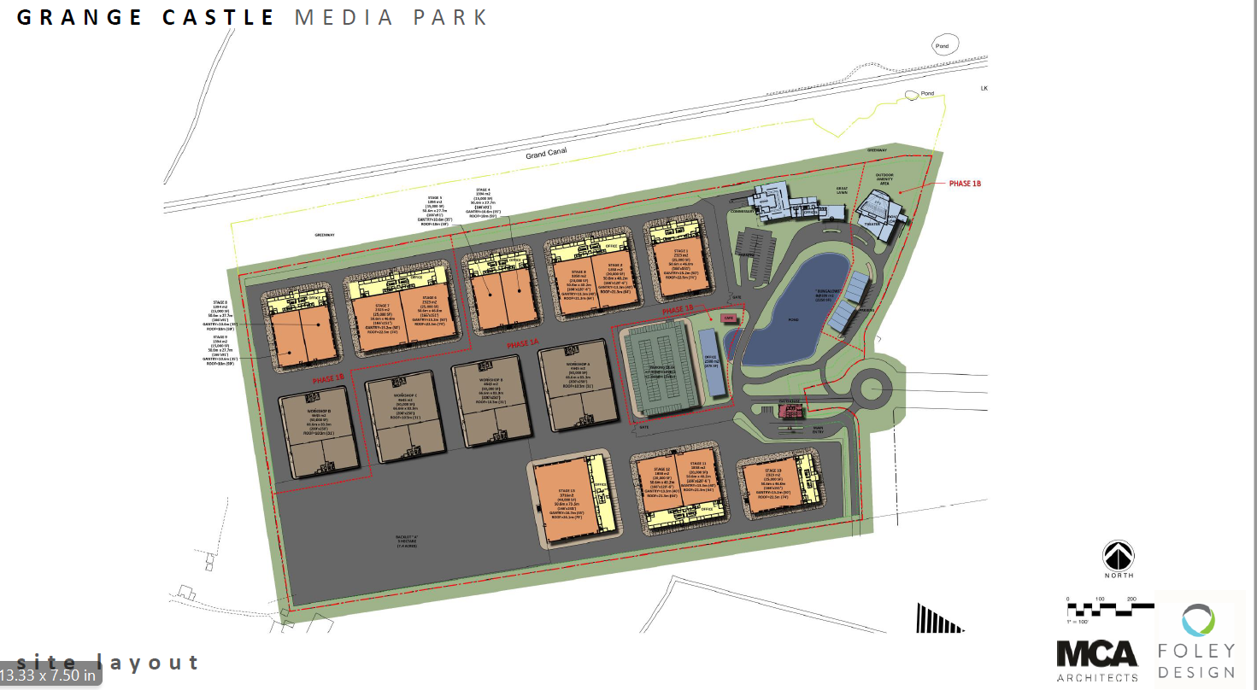
Proposed Site Layout

Slide 4
Economic Development of the County
€125 million investment in Development of the Media Park
1800 New Jobs
Plus c. 1800 Ancillary jobs
Ratio typical of similar facilities elsewhere
At Construction stage 1200 -1500 jobs
c. 150 Consultants /Advisers on the project

Slide 5
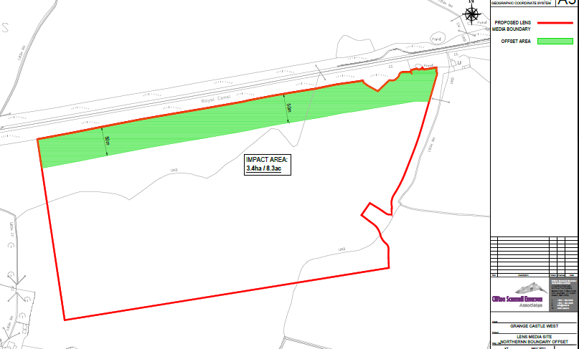
Disposal Terms
c. 56 Acres in total
c. 48 acres at €550,000 per acre.
c. 8 acres at €137,500 per acre [undevelopable portion of site]
Subject to Terms & Conditions as listed in Headed Item Report.

Slide 6
