Slide 1
H.14 Update on Major Council-Led Housing Developments
Meeting of South Dublin County Council
14th June 2021

Slide 3
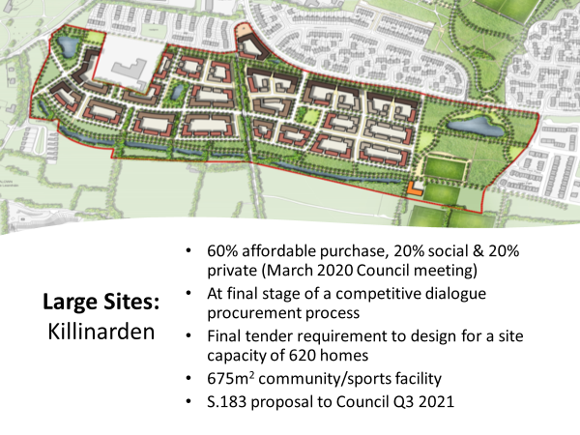

Slide 5
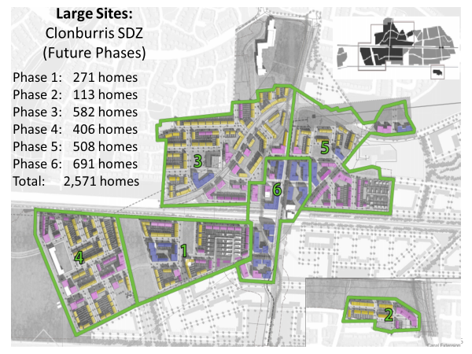

Slide 8
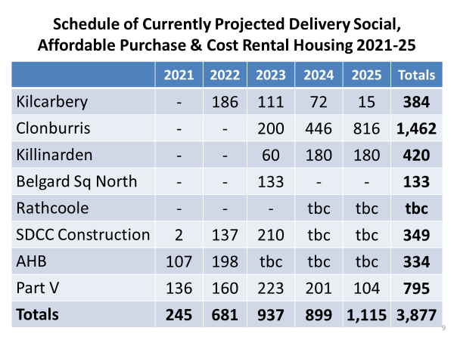

Slide 13
