Slide 1
SHAPE – EXPLORE – EXPERIENCE
SOUTH DUBLIN’S FUTURE
Sustainable Movement and the County Development Plan
Land-Use Planning and Transportation SPC
27th May 2021

Slide 2
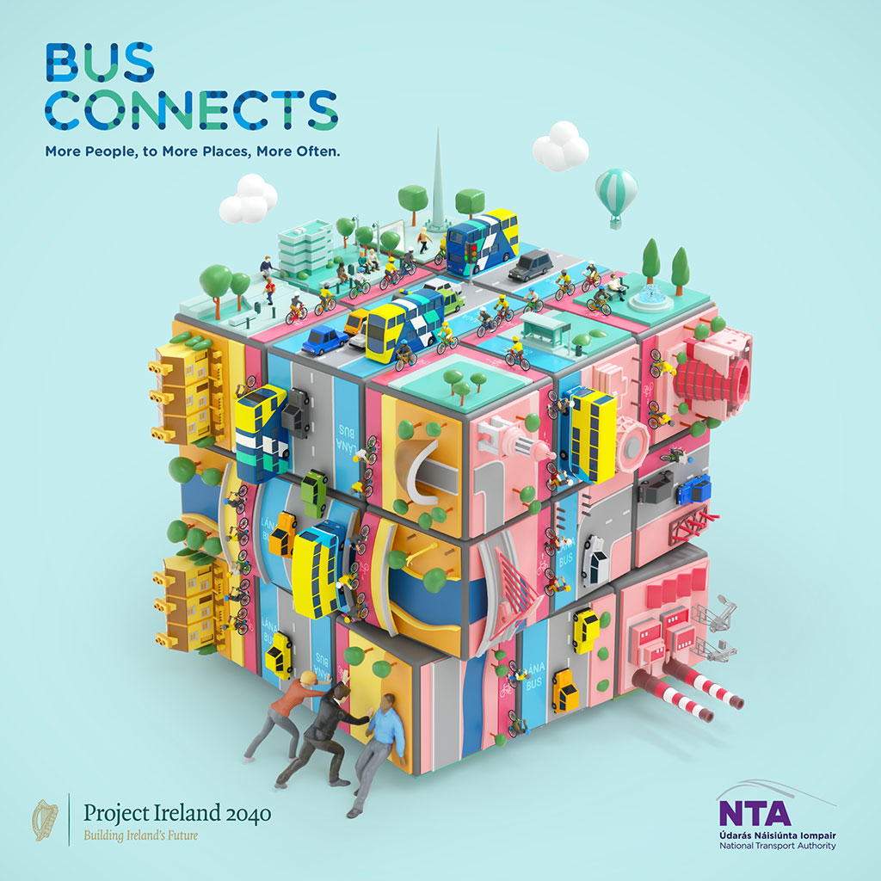
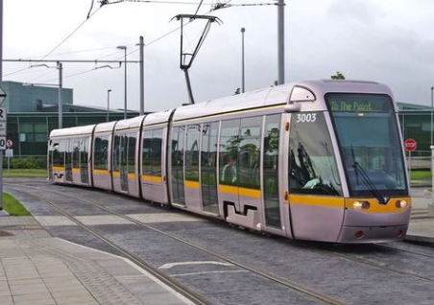
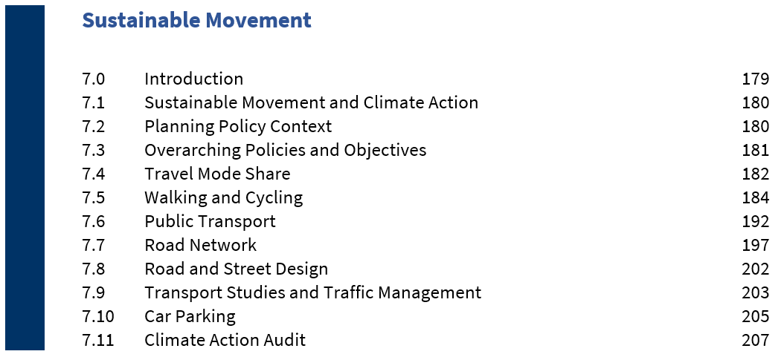
Chapter 7
Sustainable Movement
Vision
To increase the number of people walking, cycling and using public transport and to reduce the need for car journeys, resulting in a more active and healthy community, a more attractive public realm, safer streets, less congestion, reduced carbon emissions, better air quality, and a positive climate impact.

Slide 3
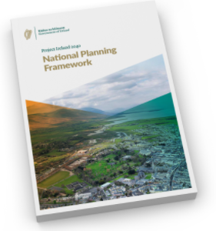
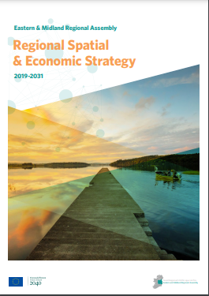
National and Regional Planning Policy
Development Plan policies and objectives must be consistent with national and regional planning policy – NPF and RSES
NSO 4 of the NPF is Sustainable Mobility.
NPO 64 of the NPF seeks ‘……integrated land use and spatial planning that supports public transport, walking and cycling as more favourable modes of transport to the private car……..’
RPO 5.2 of the RSES/MASP is to ‘Support the delivery of key sustainable transport projects including Metrolink, DART and LUAS expansion programmes, Bus Connects and the Greater Dublin Metropolitan Cycle Network………….’
RPO 5.3 of the RSES/MASP requires that ‘Future development in the Dublin Metropolitan area shall be planned and designed in a manner that facilitates sustainable travel patterns, with a particular focus on increasing the share of active modes (walking and cycling) and public transport use and creating a safe attractive street environment for pedestrians and cyclists’.

Slide 4
Positive Outcomes of Sustainable Movement

Slide 5
NTA Data: Mode Share ‘Traffic Light’ Table
Data Source: Census 2016 POWSCAR data (Place of Work, School or College: Census of Anonymised Records)
Trip Mode Categories: Walk, Cycle, Bus, Train, Private
Trip Purpose Categories: Education; Work; Education and Work Combined
Trip Destination Categories:
Internal Neighbourhood – trips within neighbourhood area (7 NAs)
External Neighbourhood, Internal County – trips to and from neighbourhood area to other neighbourhood areas within County
External County – trips between neighbourhood area and GDA
Trip length: 0-3km; 3-6km; and 6km plus

Slide 6
Travel in South Dublin County: Existing Situation

Slide 7
County Targets for Travel Mode Share

Slide 8
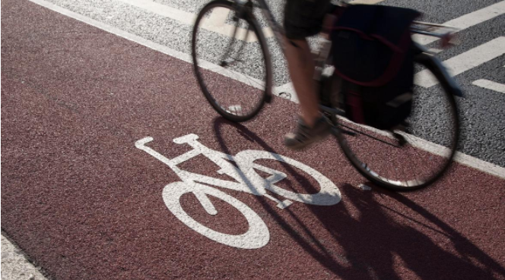
Cycle South Dublin
260 km of cycle routes are proposed as part of the Cycle SD network to be delivered over the next 10 years
Mainly funded by the NTA.
‘Now’, ‘Soon’ and ‘Later’ proposals
Also includes improvements to the existing network and a further separate phase of works to facilitate cycling associated with the BusConnects project.
The objectives of Cycle South Dublin are to:
Provide a comprehensive and connected cycle network across South Dublin County;
Increase participation and make cycling a more achievable mode of transport for people of all ages and abilities; and
Improve the cycling identity of the County.

Slide 9
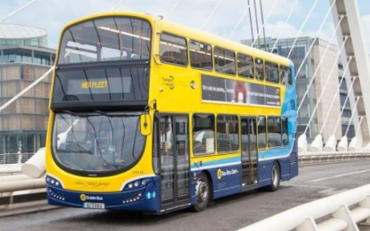
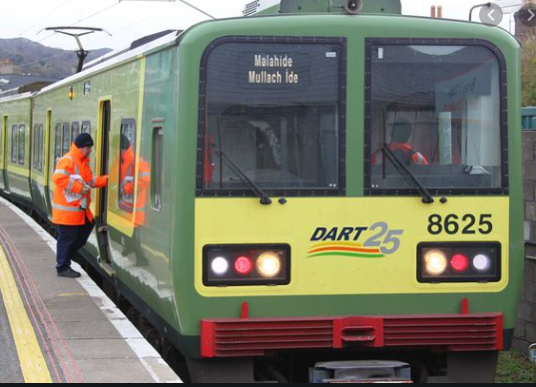
Public Transport
Approximately one fifth (20%) of trips originating in South Dublin County are by public transport.
There are a number of strategic projects in the GDA Strategy 2016-2035 relevant to South Dublin County:
BusConnects
DART+ along the Kildare Line from Heuston to Hazelhatch
Luas to Lucan
Transport interchanges at Tallaght and Liffey Valley.
The GDA Strategy is under review and the feasibility of a further light rail to the south-west of the County is being examined as part of this work.

Slide 10
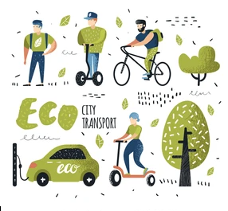
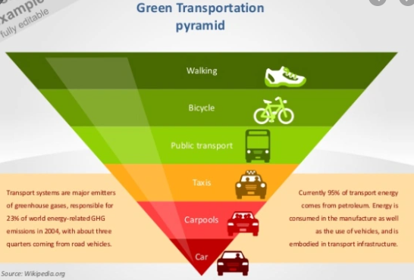
Sustainable Movement Studies
Sustainable Movements Studies were undertaken for each of the seven Neighbourhood Areas with the support of the NTA. The purpose of the studies was to:
Paint a picture of movement issues within each area; and
Identify measures to increase active transport modes (walking and cycling) and public transport to help achieve target mode share and reduce dependency on the car.
The outcomes of these studies have informed the policies and objectives on sustainable movement within the Development Plan.
Summaries of the issues identified within each Neighbourhood Area are set out in Chapter 12 Our Neighbourhoods.

Slide 11
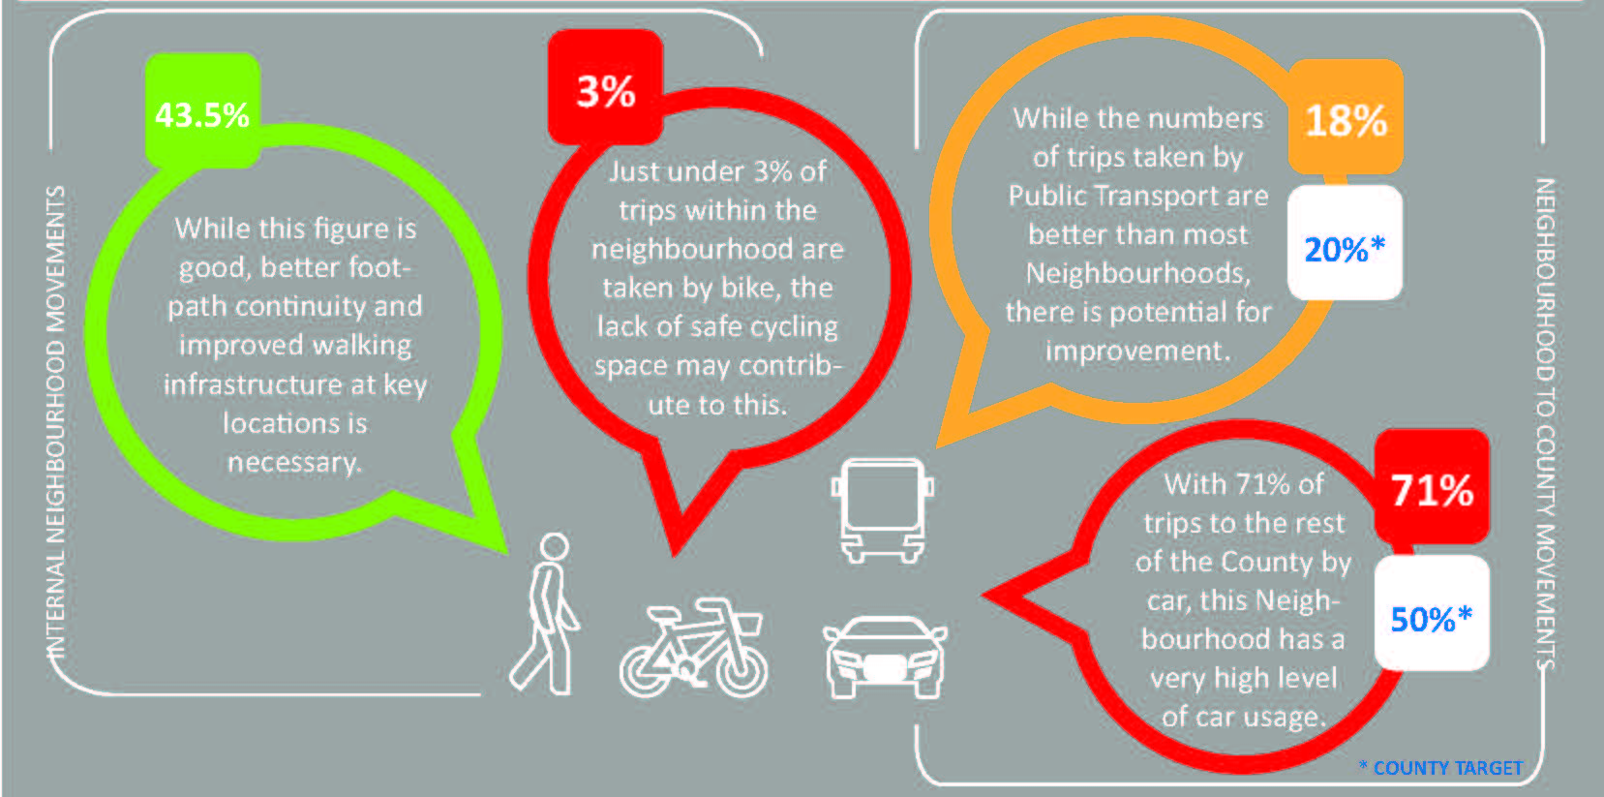
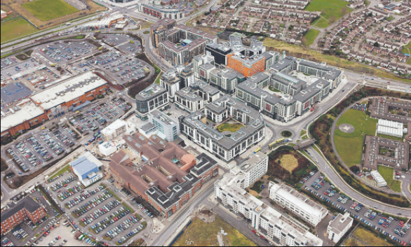
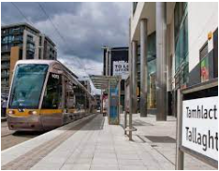
Example: Tallaght Sustainable Movement Study

Slide 12
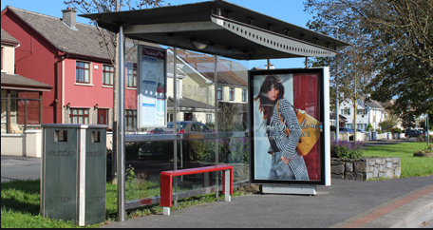
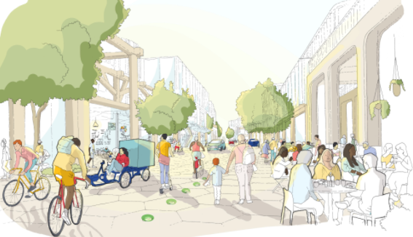
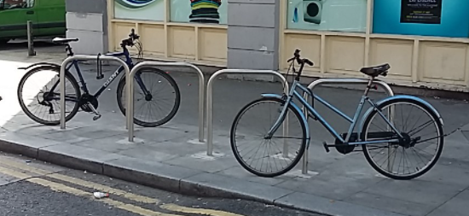
Measures Identified in Sustainable Movement Studies
The Studies identified various measures that would help generate a shift towards active travel and public transport including:
Creating more permeable connections for walking and cycling and access to public transport routes
Improvements to public transport waiting facilities
Traffic calming measures
Footpath widening and surface enhancement
Improvements to cycle lane and cycle parking provision.
Scope for some of these projects to be funded by NTA.

Slide 13
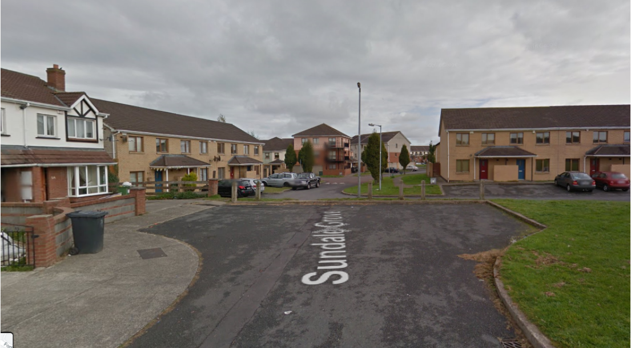

Slide 14
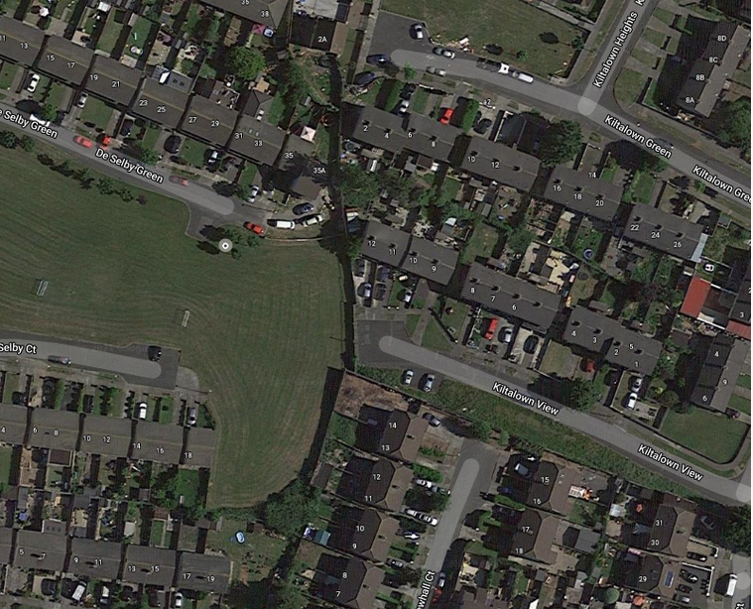

Slide 15
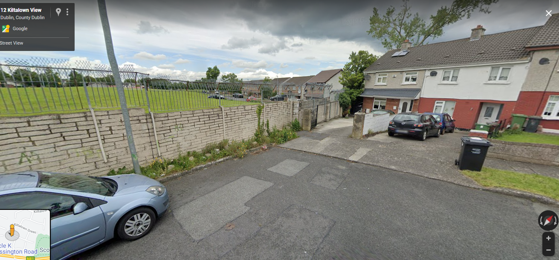

Slide 16
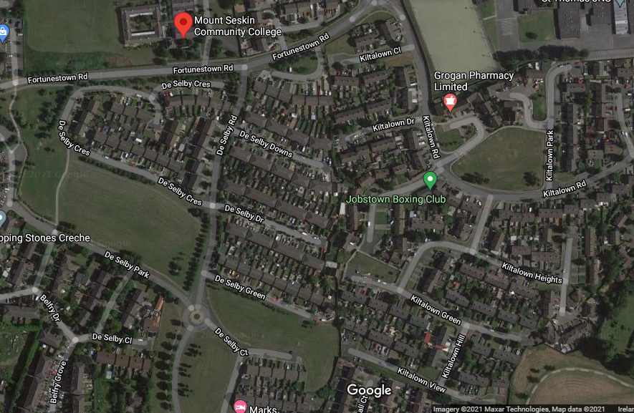

Slide 17
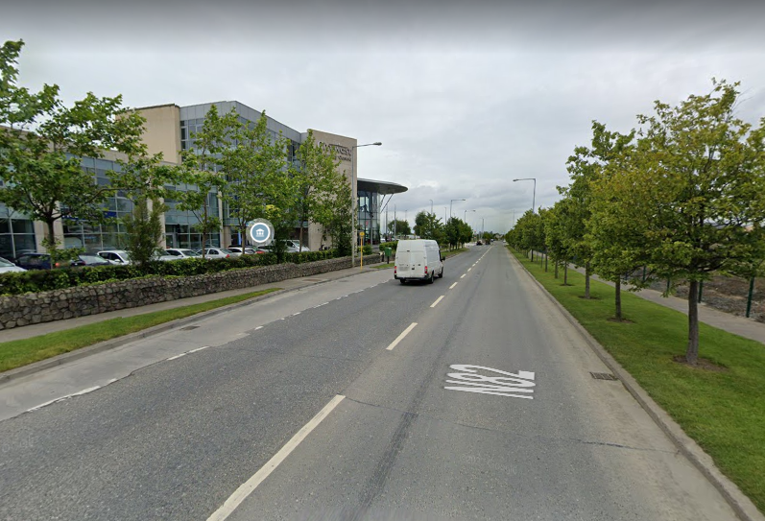

Slide 18
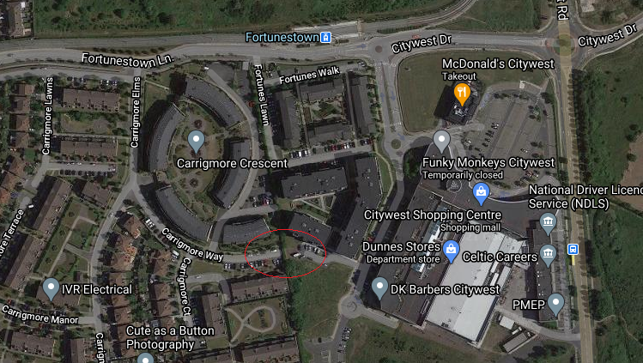

Slide 19
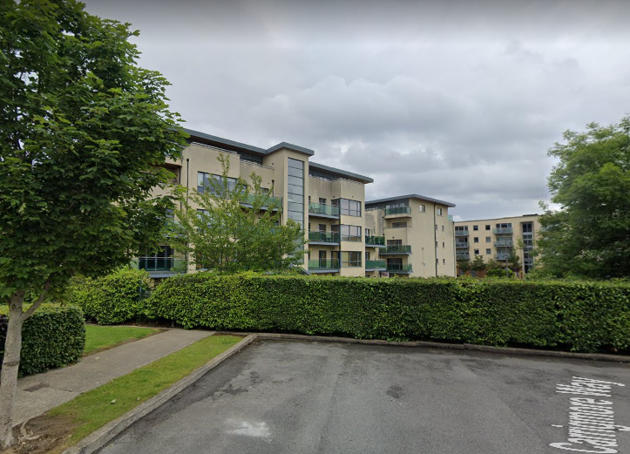

Slide 20
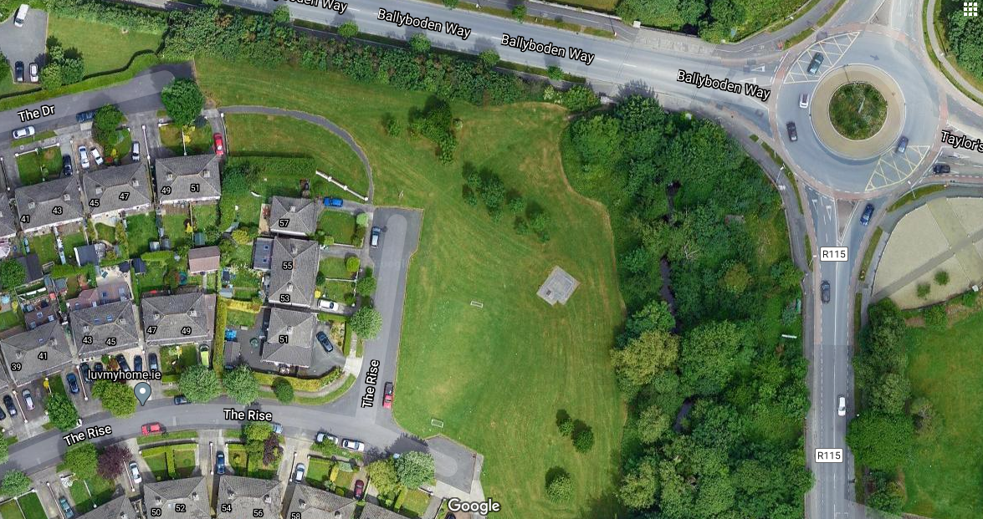

Slide 21
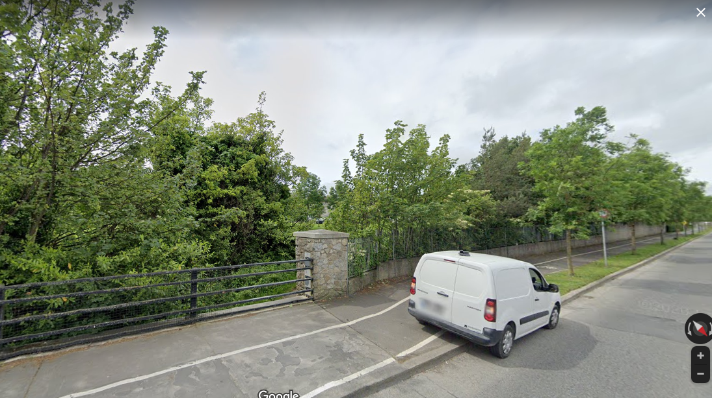

Slide 22
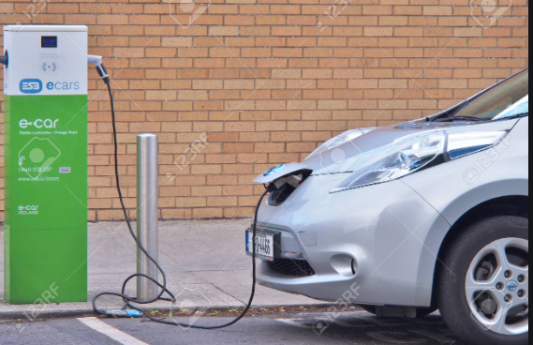
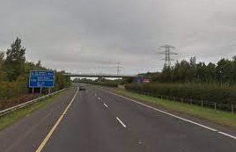
Other Objectives within the Chapter….
Support for the NTA GDA transport strategy
Promoting compact growth and design of safe, permeable and attractive street environments to facilitate sustainable modes
An increase in EV charging facilities to facilitate a switch to EVs.
Car parking – we will continue to apply maximum rates taking account of location – with lower parking requirements in urban areas well served by public transport.
Still a place for Roads – still need to be considered as an essential part of the transport equation, particularly for goods transport, and for access to new development areas, etc. Plan contains list of 6 year and long term Roads objectives.
Promoting active travel to school – School Streets, Green Schools Initiatives.

Slide 23
Climate Action Audit
Implementing compact growth, sustainable movement and placemaking concepts in the planning and design of new development areas;
Planning, design and implementation of major walking and cycling networks (Cycle South Dublin, Grand Canal and Dodder Greenways, etc);
Implementation of permeability projects to facilitate active travel and connectivity to public transport;
Active support for public transport projects;
Design of streets and roads to prioritise active travel;
Parking policies tailored to reflect land-use, location and public transport accessibility;
Demand management measures such as car park charging regimes linked to public transport accessibility;
Requiring mobility management plans for major developments;
Promoting an increase in EV charging facilities.
Ensuring that transport corridors perform a function as green infrastructure links through tree planting and landscaping and incorporation of SuDS features;
Ensuring that design of car parking incorporates planting, permeable surfaces (where appropriate) and SuDs features.

