Slide 1
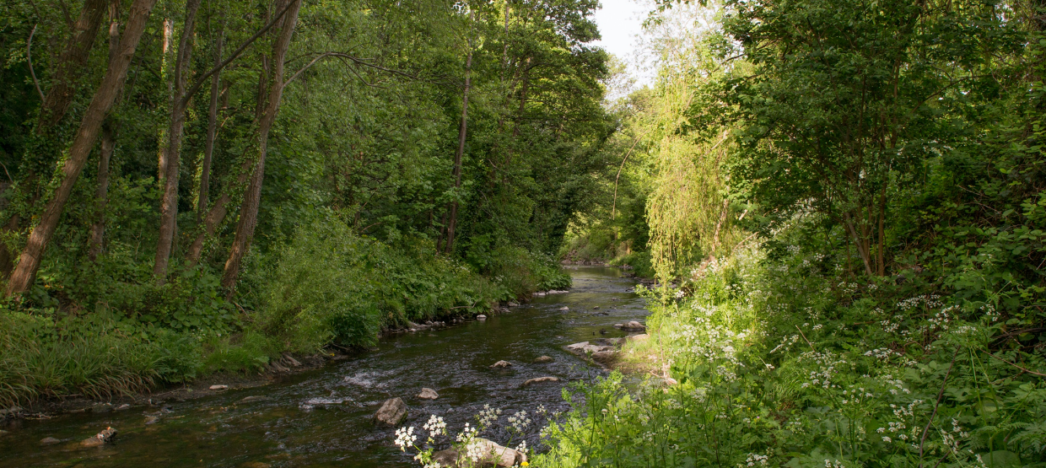
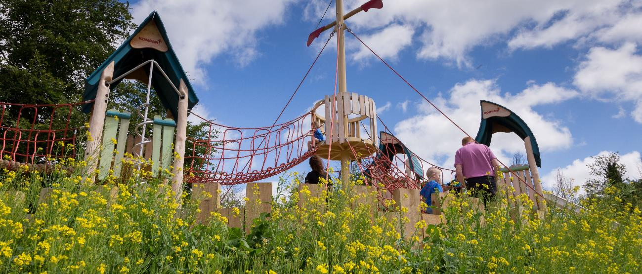
Update to LUPT SPC 27-05-21
Green Infrastructure (GI) Strategy Update

Slide 2
GREEN INFRASTRUCTURE ……“a strategically planned network of natural and semi-natural areas with other environmental features designed and managed to deliver a wide range of ecosystem services such as water purification, air quality, space for recreation and climate mitigation and adaptation.”……. A GI STRATEGY WILL: “form the basis for the identification, protection, enhancement and management of the Green Infrastructure network within the County.”
CONTEXT FOR ACTION
Climate Action & Biodiversity loss
Policy Context:
National Planning Framework
Regional Spatial & Economic Strategy

Slide 3
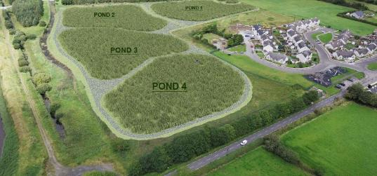
GI Strategy Development
These 5 Key Themes, are identified which reflect the broad range of eco-system services and benefits GI provides. These frame the policies and objectives within the County Development Plan and allow us to identify opportunities to improve the GI network:
Biodiversity
Sustainable Water Management
Climate Resilience
Recreation and Amenity (Human health and wellbeing)
Landscape (Natural and Cultural Heritage)
Case Studies carried out to inform policy development. 5 areas representing different Green Infrastructure Network Characteristics will assist in generating relevant policies for similar areas.

Slide 4
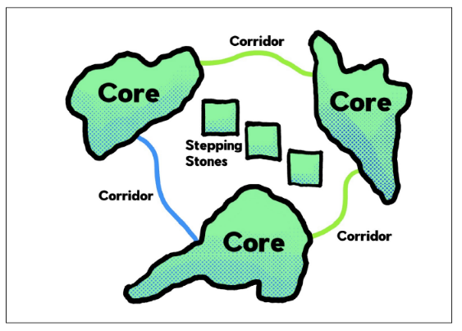
GI Strategy Development
Components of GI:
GI Cores serve as ANCHORS WITHIN THE NETWORK.
They are ecological resources of regional / national importance, and / or high levels of outstanding amenity and act as points of origin / destination for wildlife at which essential ecological processes occur.
e.g. Dublin Mountains, Liffey Valley, Grand Canal, Regional Parks.
GI Corridors are PHYSICAL LINKS THAT TIE THE NETWORK TOGETHER.
They provide for movement of flora and fauna between GI Cores. Primary GI Corridors operate at the regional level; linking GI Cores within and beyond our own county. Local GI Corridors link Cores or Corridors within our county at a more local level.
e.g. Primary GI Corridors: Camac Valley, Dodder Valley, Rural Fringe
Local GI Corridors: Griffeen River Valley, tributaries of the Dodder River.
GI Stepping Stones are smaller areas of green space; important at the local level.
They are discrete pieces of GI Infrastructure that may not be linked to a wider network as yet but can act as alternative ecological routes, as refuges for ecology or small zones of biodiversity and amenity within an urban or hard landscape area or an area of monoculture. GI stepping stones can be improved on or linked-up over time to become local or even primary GI Corridors.
e.g. Small open space areas proximal to GI Cores and Corridors, private gardens, hedge and ditch combinations.
Spatial Framework

Slide 5
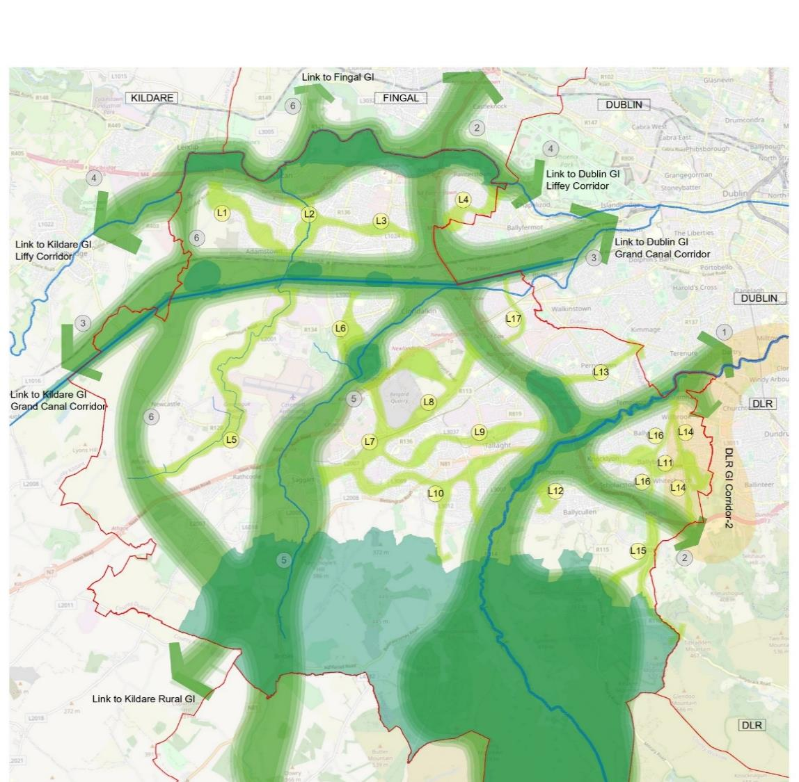
GI Strategic Corridors
Dodder River
M50
Grand Canal Corridor
Liffey Valley Corridor
Camac River
Rural Fringe
17 Secondary Corridors l

Slide 6
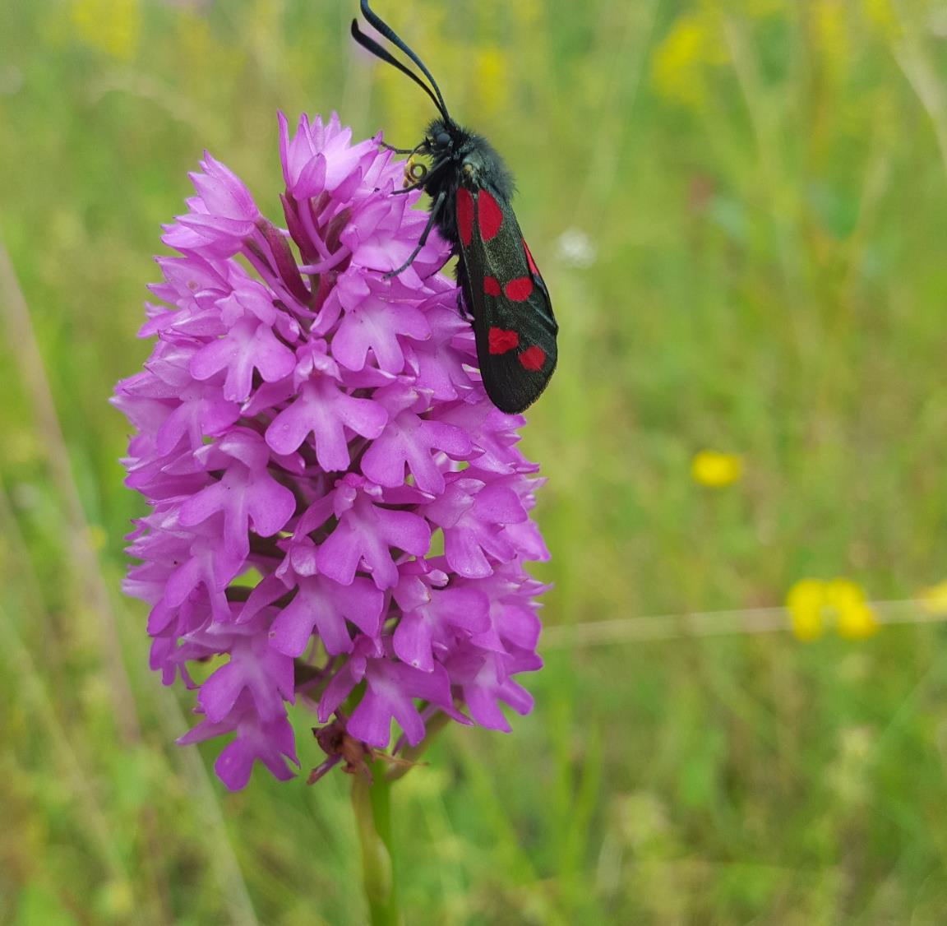
GI Strategy Implementation
Implementation:
Policies and Objectives in the Development Plan tailored to the GI network that protect, restore or enhance the GI assets and support sustainable development:
Derived from:
5 themes
Cores, corridors and stepping-stone locations
Case Studies

Slide 7
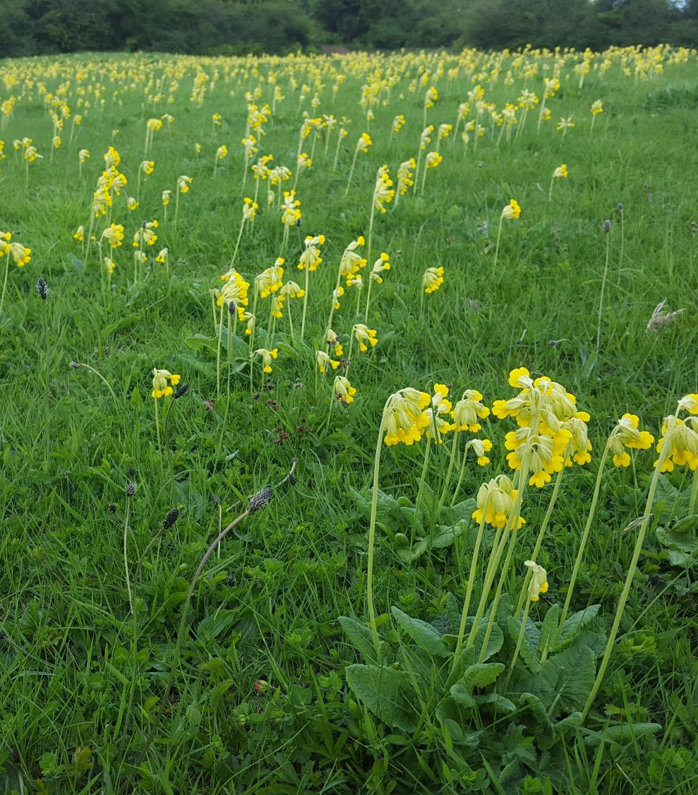
GI Strategy Implementation
The Planning Application
Implementation:
All development shall be accompanied by a GI Infrastructure Plan as follows:
Site location plan showing site in context of wider GI in the county
Site Survey and analysis; identifying existing GI Infrastructure within the site.
GI protection, enhancement and restoration proposals as part of the landscape plan for the site; including proposed linkages to wider GI network.

Slide 8
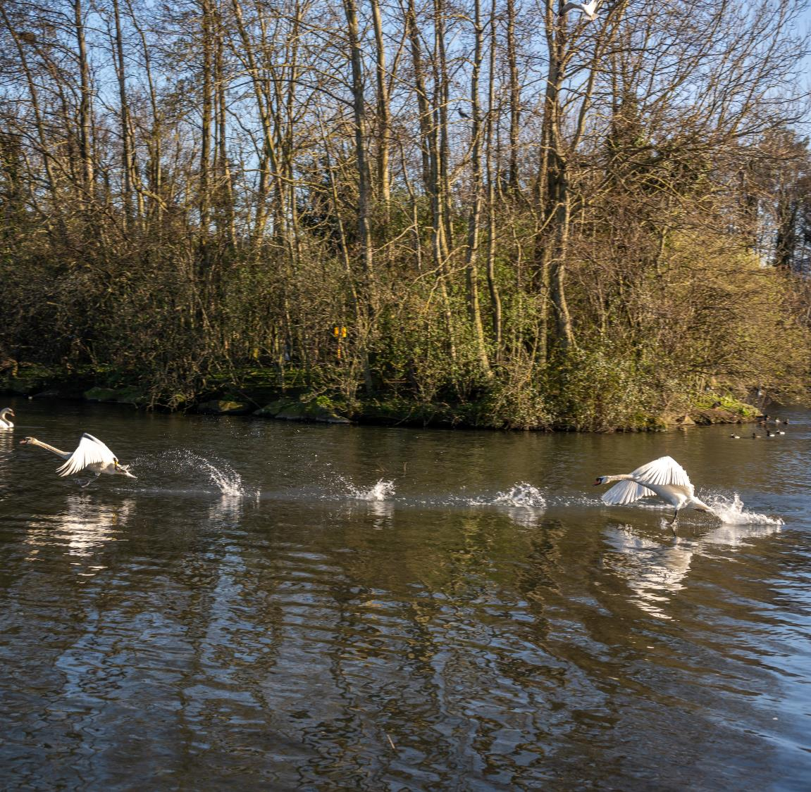
GI Implementation
Assessing Proposals
Implementation:
GI Proposals will be assessed against the policies and objectives contained within the County Development Plan for GI and the Greening Factor outlined below.
Greening Factor:
“An urban greening factor is a ratio between the amount of built areas and non-built areas within an urban area. The urban greening factor tool is used to assess and quantify the amount and quality of urban greening that a scheme provides”.
An urban greening factor will be applied to submitted GI Infrastructure Plans.
The appropriate scoring mechanism for greening urban areas based on best international practice and its application to local circumstances in South Dublin County will be developed and applied during the lifetime of the plan.

Slide 9
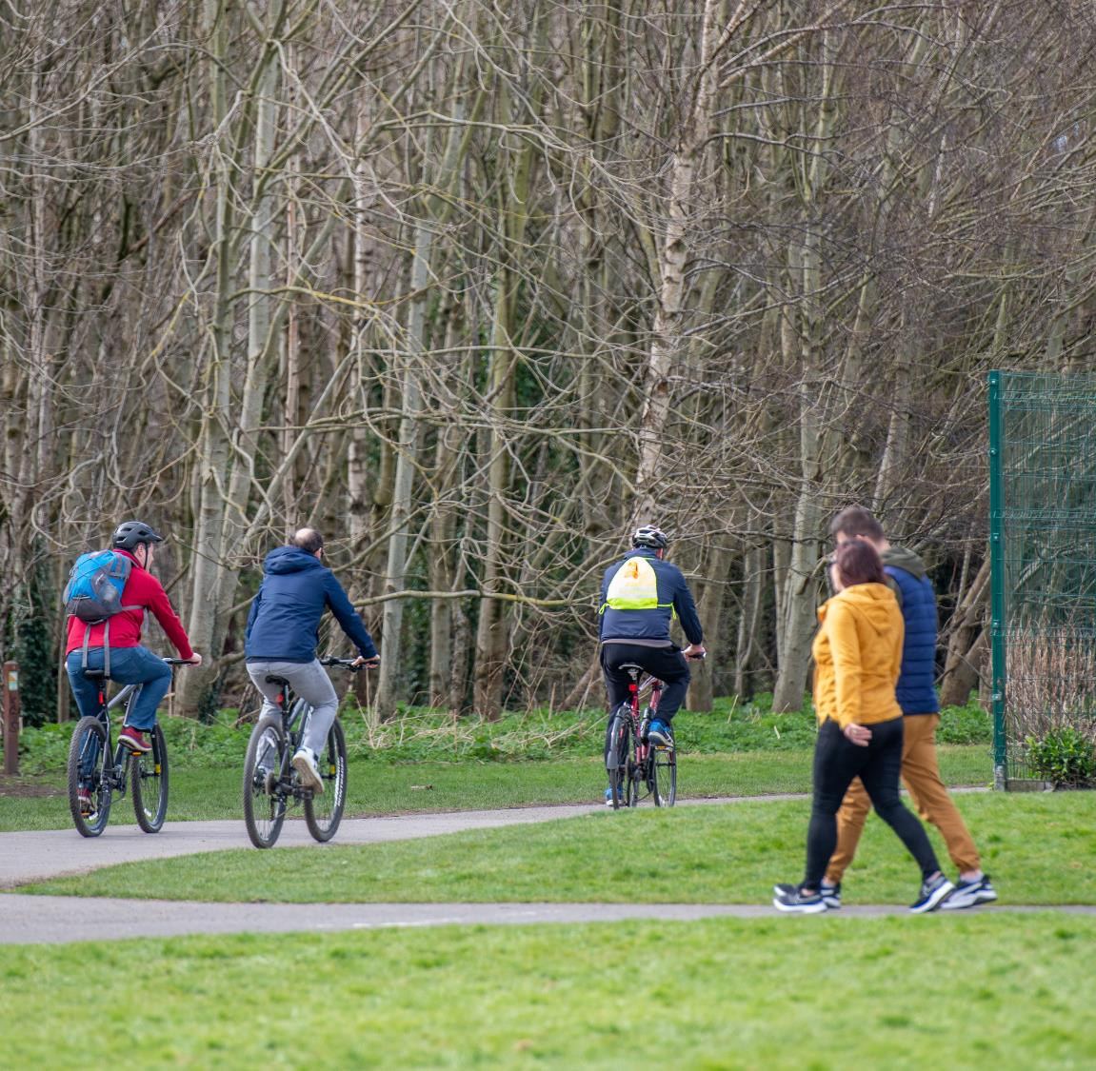
GI Strategy: Going Forward Implementation and Monitoring
Monitoring:
Implementation and monitoring the GI Strategy through the further development of a GI scoring approach which will support ongoing identification, protection, enhancement and management of GI in the County and which will enable the assessment and monitoring of GI interventions.
GI Scoring:
A methodology for GI scoring is being developed based on:
Level 3 detailed habitat mapping of the county which broadly assesses the ability of different types of land cover to deliver different ecosystem services.
Ecosystem services are the direct and indirect contributions of ecosystems to human wellbeing. There are four main types; provisioning, regulating, supporting and cultural services.
Each habitat type will be assigned a score based on its capacity to provide ecosystem services.
Scoring enables comprehensive analysis and calculation of GI value across the county as well as allowing for repeat monitoring over time.

Slide 10
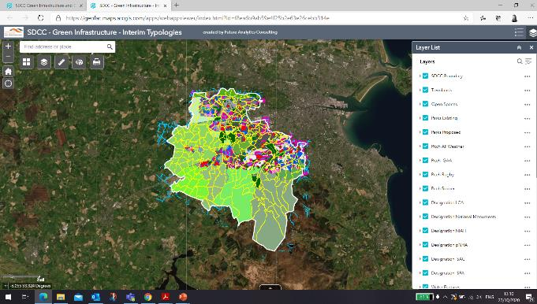
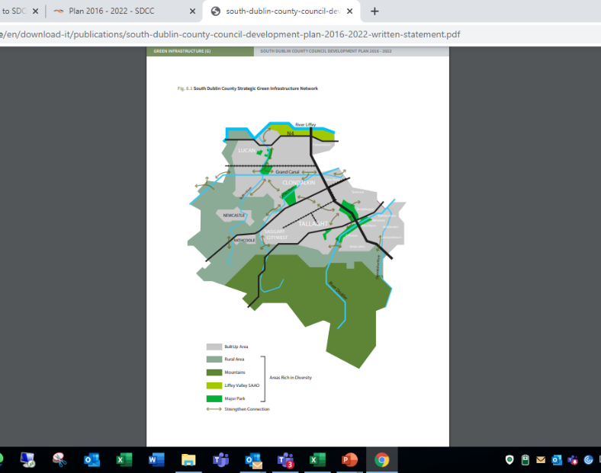
Mapping Framework
The GI Strategy will have accompanying mapping:
Maps adopted with the County Development Plan showing layers of Green Infrastructure and how they relate to the Plan.
This will be represented in the CDP document diagrammatically.
It will also be supported by the background GIS mapping that SDCC can keep updated to monitor changes and improvements to GI networks over time.

