Slide 1
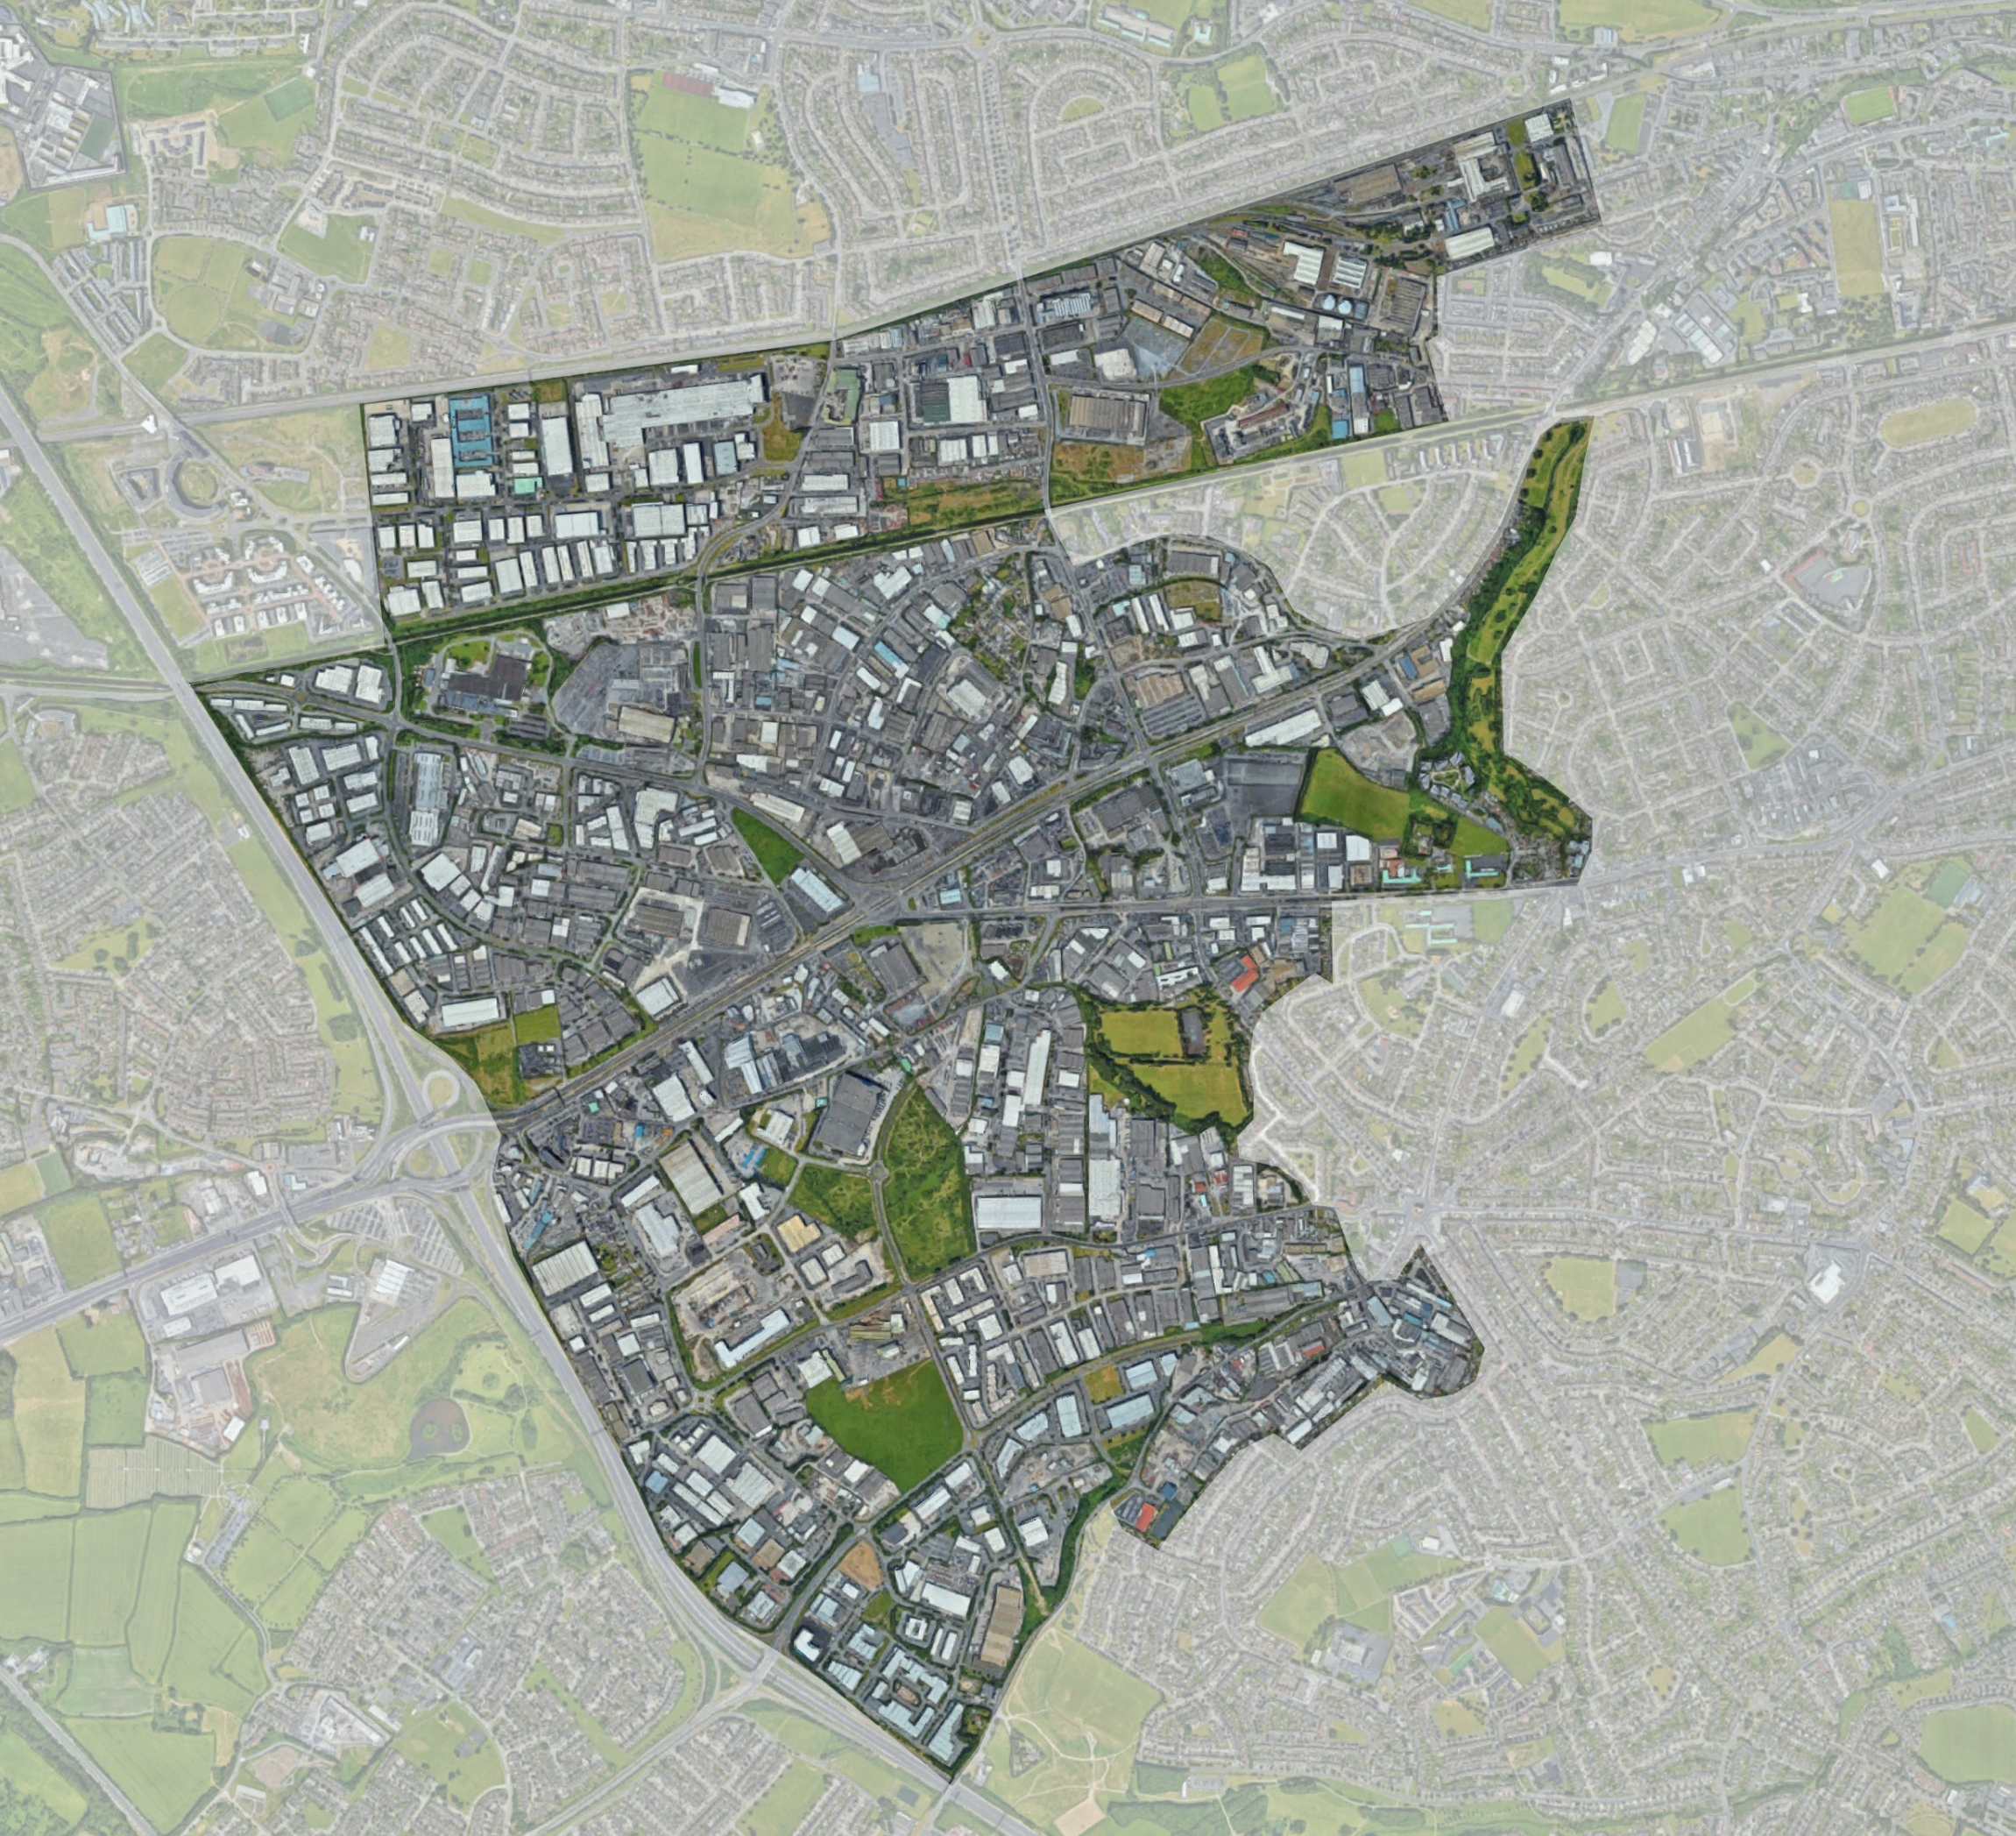
Naas Road
Masterplan
May 2021
Strategic Policy Committee

Slide 2
Agenda Items
Programme
Project Overview
Structuring Components
Development Scenarios
Movement
Green Infrastructure
Next Steps

Slide 3
Project Overview
Agenda Items
Programme
Structuring Components
Strategic Briefs
NTA GDA Strategy Review
Next Steps

Slide 4
Project Timeline
Agenda Items
Programme
3 Scenarios
Big Moves
Branding & Website
Next Steps

Slide 5
Structuring Components
Draft Examples
Tymon to Phoenix Park
Orbital Public Transport
Kylemore Heavy Rail Station
Luas Station
Naas Road/Nangor Road/Longmile Road Intersection
Flagship Park
Camac Naturalisation
Management of Pylons
Grand Canal
Energy
SUDs
Strategic Framework
Landuse & Nodes
Structuring Components

Slide 6
Structuring Components
Draft

Slide 7
3 Scenarios

Slide 8
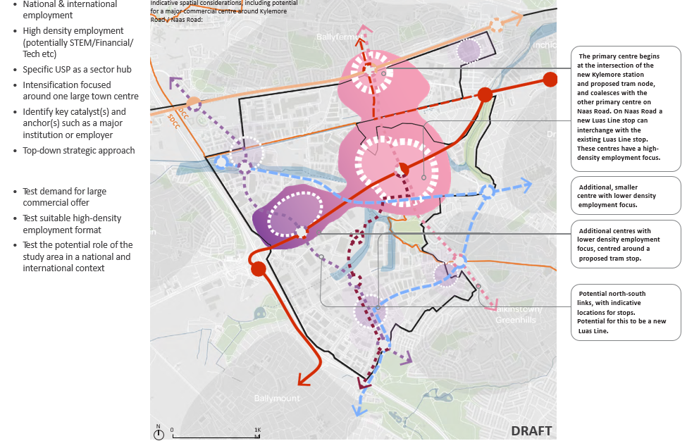
3 Scenarios
1. Commercial Centre

Slide 9
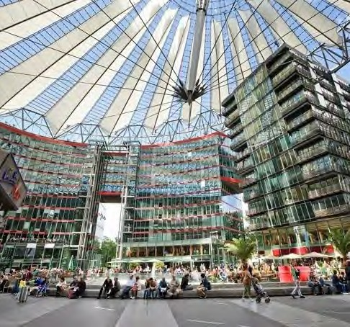
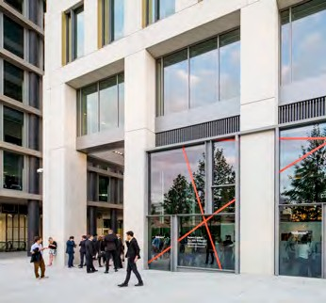
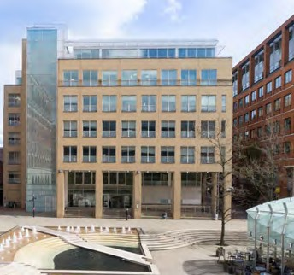
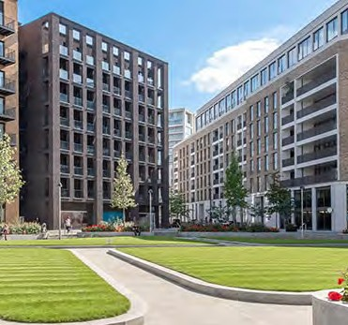
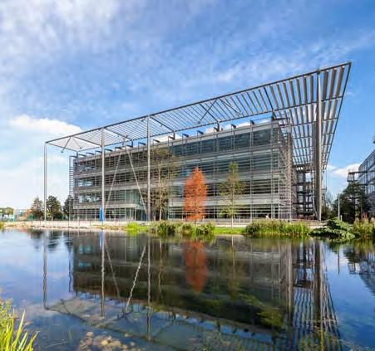
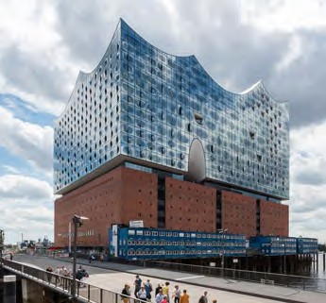
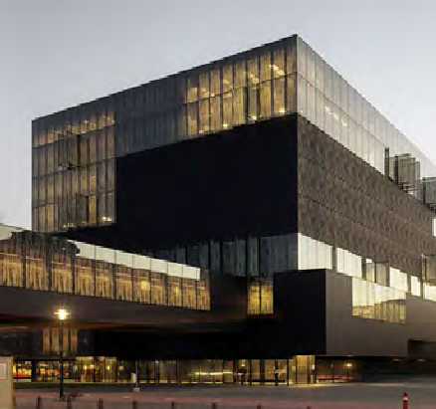
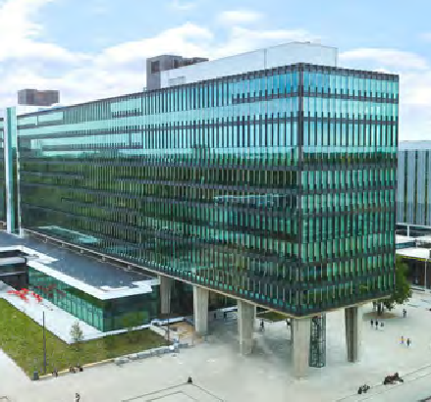
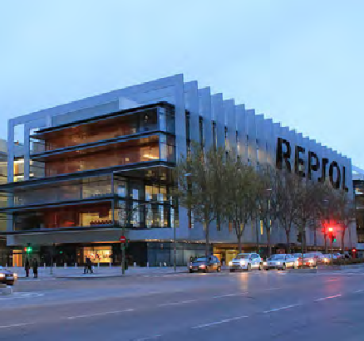
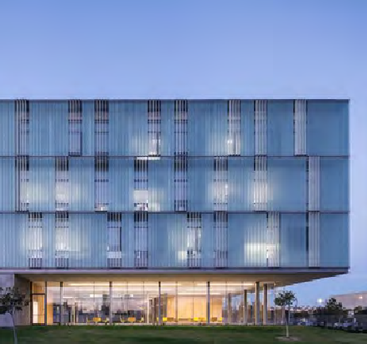
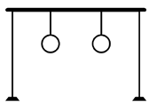
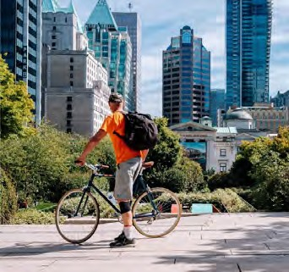
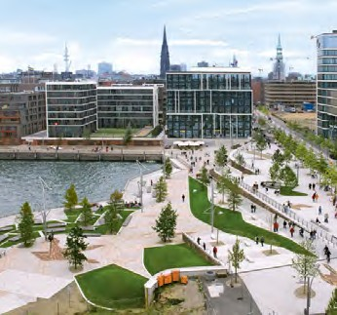
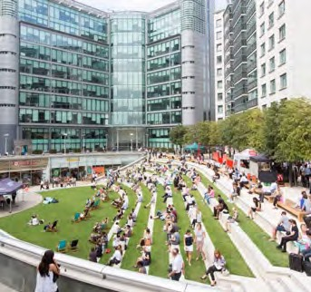
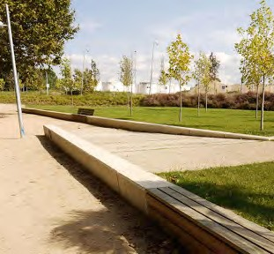
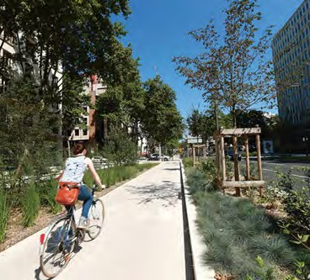
1. Commercial Centre
As part of Scenario 1, a focus on high density office and employment buildings and public space. Some examples are shown here:
Employment spaces
High density office spaces, catalytic projects, and supporting uses.
High-density office + commercial Potsdamer Platz, Berlin
High-density office + commercial Kings Cross, London
Mid-density office
Brindley Place, Birmingham
High-density mixed-use residential Royal Wharf, London
Mid-density office Chiswick Park, London
Anchors
Catalytic anchor spaces and uses to support and attract local and global visitors and investment.
Cultural institution
Elbphilharmonie, HafenCity, Hamburg
Academic institution Utrecht University Library
STEM / technical institution Eindhoven University
Green Enterprise
Repsol Hydrogen Production HQ, Madrid
Research and development / bio-tech National Institute of Biotechnology, Israel
Legacy for the public realm
The creation of pieces of public infrastructure that are of a high quality and a mix of hard and soft spaces.
These are urban elements that aim to reconnect character of the place with its social dimension.
Active travel focus East Vancouver
Space as an attractor HafenCity, Hamburg
Flexible space for events Urban Room Folkestone
Space as an attractor Perello Park, Girona
Streets as public spaces Rue Garibaldi, Lyon

Slide 10
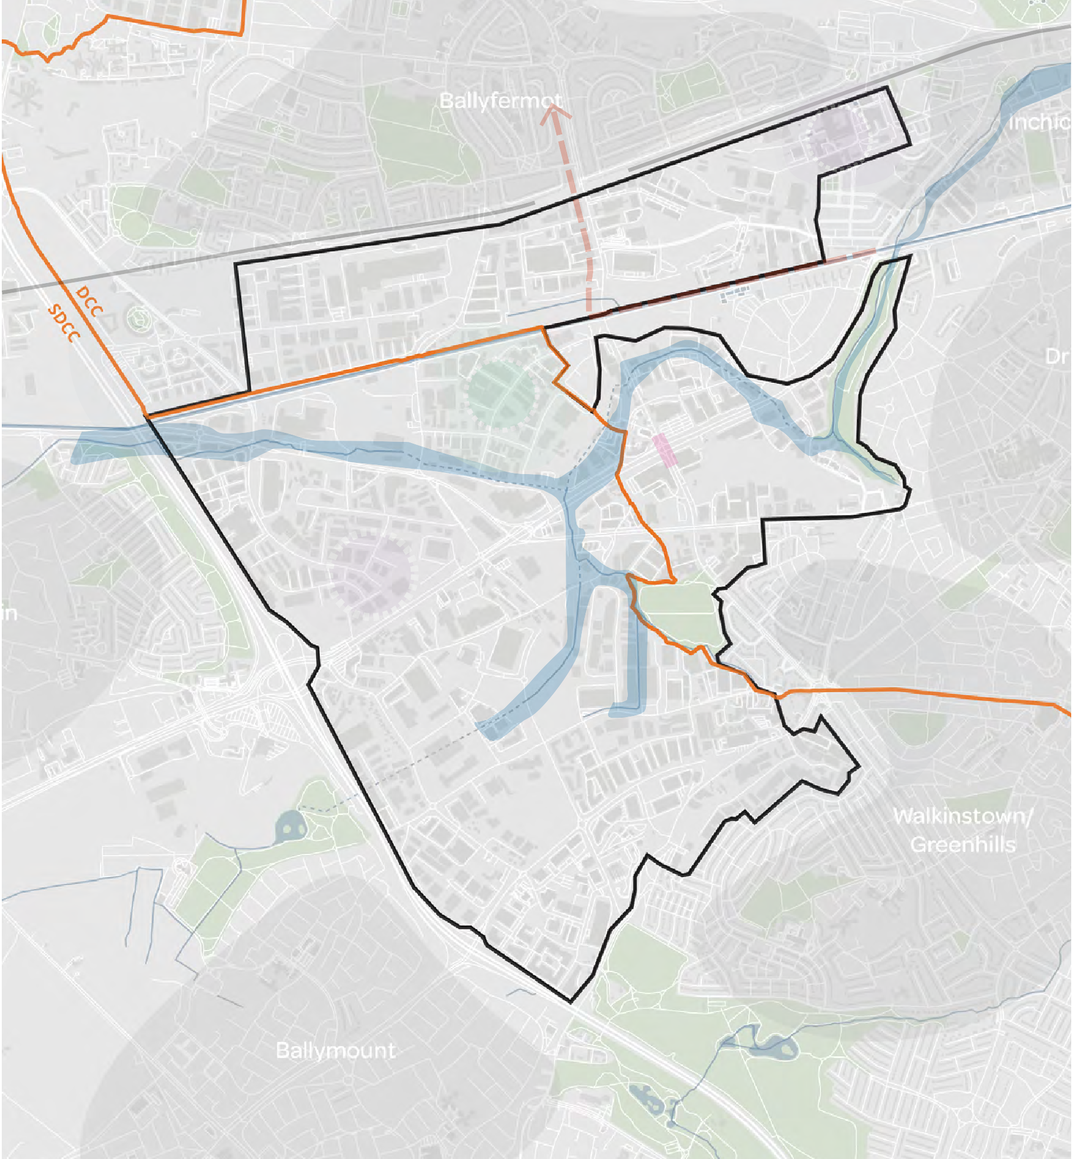
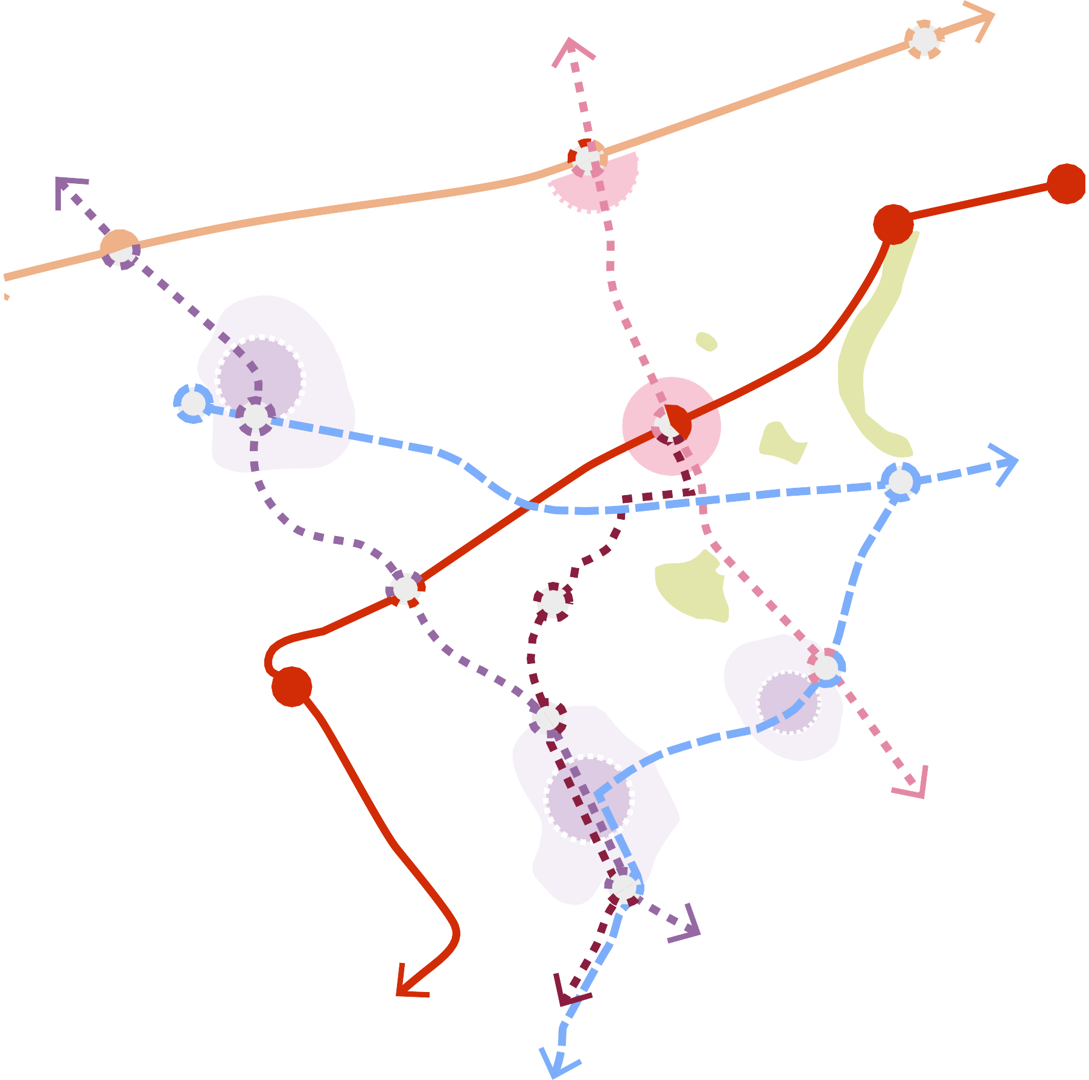
2. Enterprise & Urban Industry
Complementing existing employment with high-end/ advanced manufacturing, future of urban logistics and industry in the city
Building on the area’s current successes
Retaining and promoting the successful current industrial uses and locations
Focus on strategic surgical interventions or small scale interventions
Potential green enterprise hub
Meanwhile uses and urban servicing
Multiple centres of varying scales with residential supporting the employment focus
Bottom-up interventions and supporting a fertile environment for economic growth
Indicative spatial considerations, including potential for a series of neighbourhood centres defined by individual employment types and characteristics:
Potential for a green enterprise zone
Mid-density employment focus around Kylemore
station
Primary large centre focused around the
intersection of the Naas Road and Kylemore Road. Mid-density employment focus.
Additional, smaller centres with low-mid density
industrial employment focus.
Additional centre with industrial employment focus, centred around a
proposed Luas line tram stop.
Additional centre with
industrial employment focus, centred around a
proposed north-south tram stop.
Test which current industry is suitable and successful, where is it and if it should be retained
Test how to support strategic relocations
Test suitability of sector hubs such as green enterprises
N
0 1KM
DRAFT
0
1KM

Slide 11
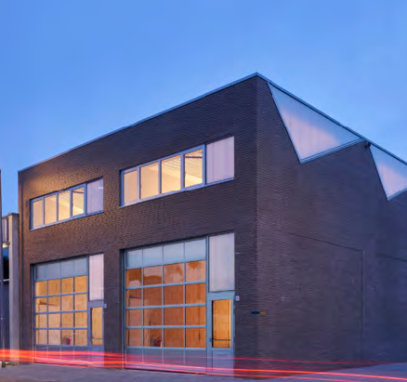
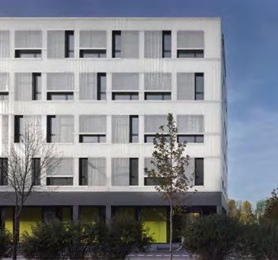
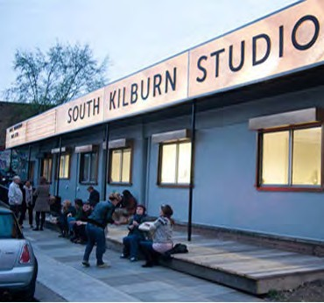
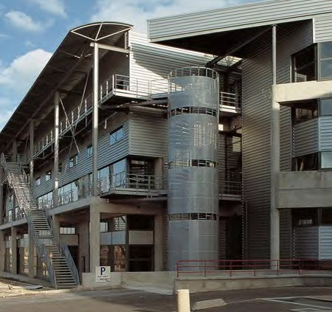
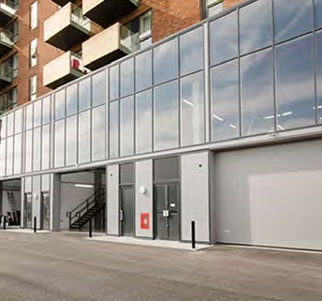
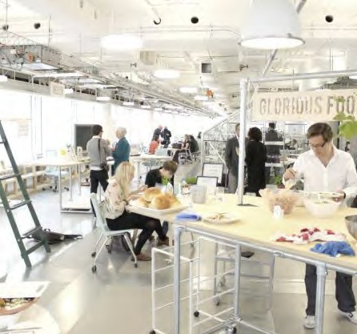
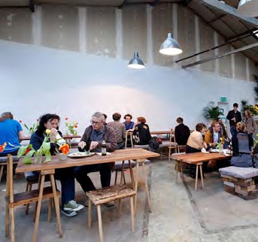
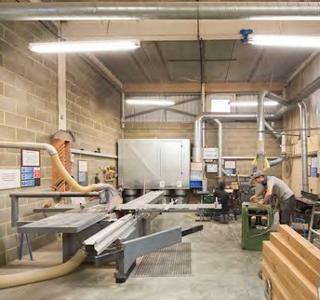
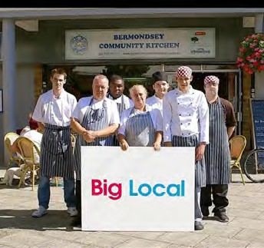
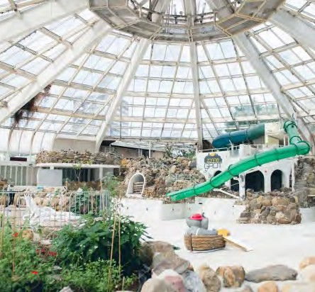
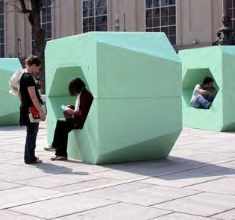
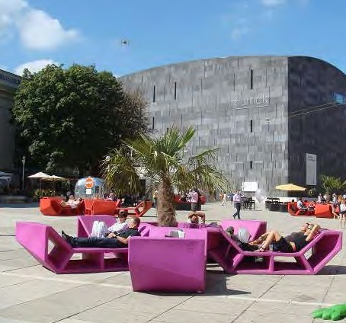
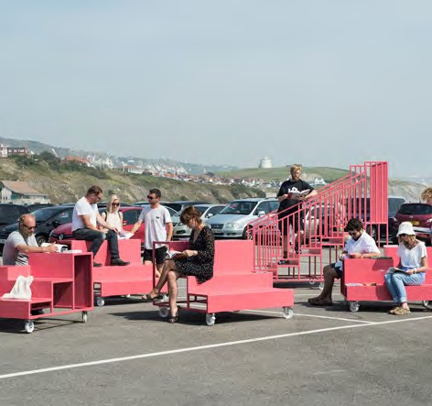
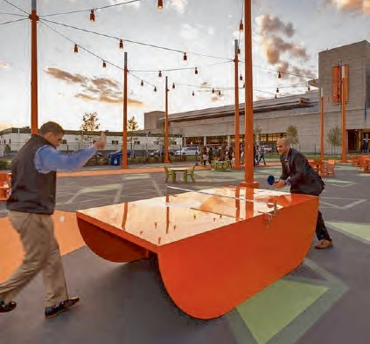
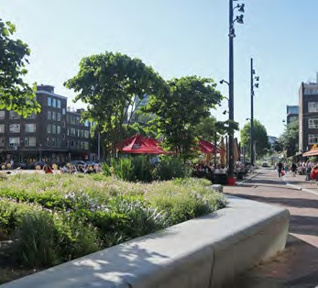
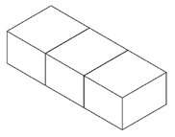
2. Enterprise & Urban Industry
As part of Scenario 2, meanwhile uses and re-use of existing buildings and infrastructure will play a part alongside redevelopment opportunities. Some examples are shown here:
Contemporary Urban Industry Various scales of industry that are appropriate for use within an urban area. Uses range from packing, logistics, high-end manufacturing to studios and workspaces.
Intensified industrial use Rozenburg, Rotterdam
Stacked industrial space Gewerbehof Laim, Munich
Light intervention South Kilburn Studio
Mixed industry / hi-tech / office Hôtel industriel, Paris
Industrial + residential mixed-use Bow Enterprise Park, London
Re-use and Meanwhile spaces
On demand spaces and building re-use such as: co-working hubs, a community kitchen, bike repair workshop, an open workshop, library of things.
Co-working hub
The HUB, Westminster
Interim cultural re-use Sugarhouse Studios, Hackney
Community workshop spaces Blackhorse Workshop
Community initiatives Bermondsey Community Kitchen
Adaptive re-use BlueCity Rotterdam
Legacy for the public realm Lighter-touch enhancements, and the creation of pieces of public infrastructure that are used during
the ‘meanwhile’ phase and later could mature for future developments. These can be flexible spaces for events that aim to reconnect character of the place with its social dimension.
Temporary furniture and events Vienna Cultural Quarter, Vienna
Temporary furniture and events Vienna Cultural Quarter, Vienna
Temporary furniture and events Urban Room Folkestone
Temporary furniture and events The Lawn on D
Adaptive space
City Market, Rotterdam

Slide 12
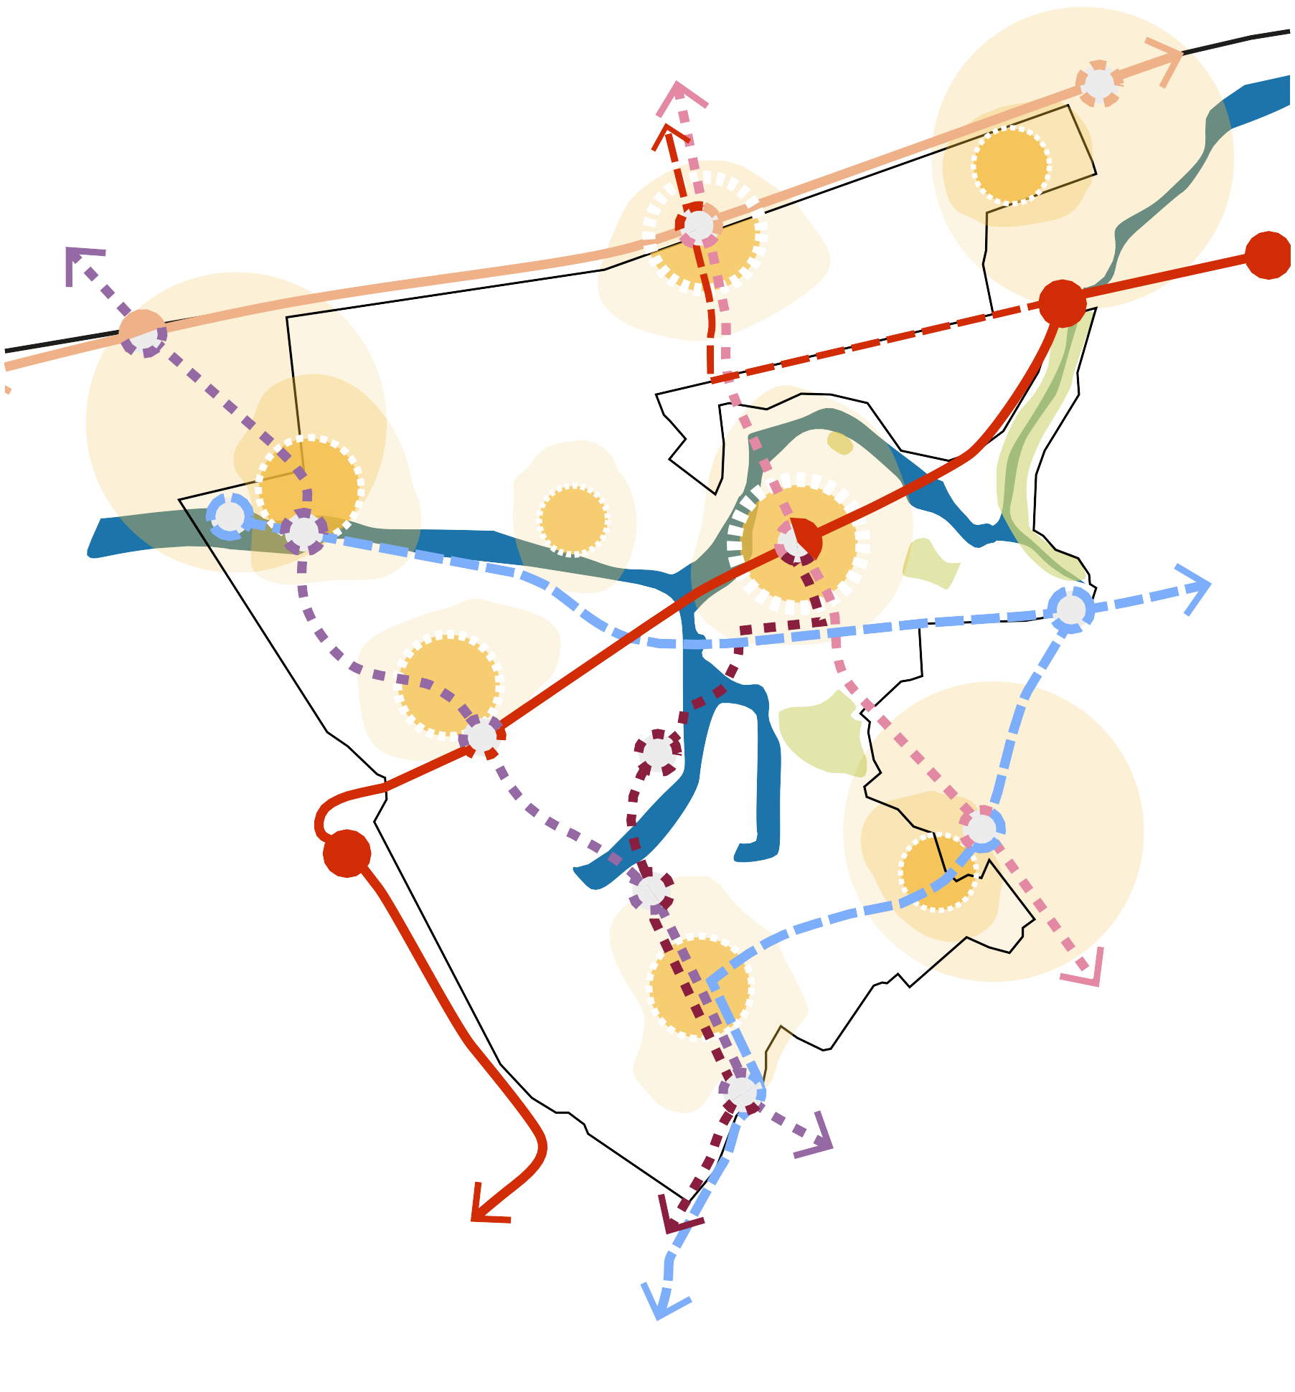
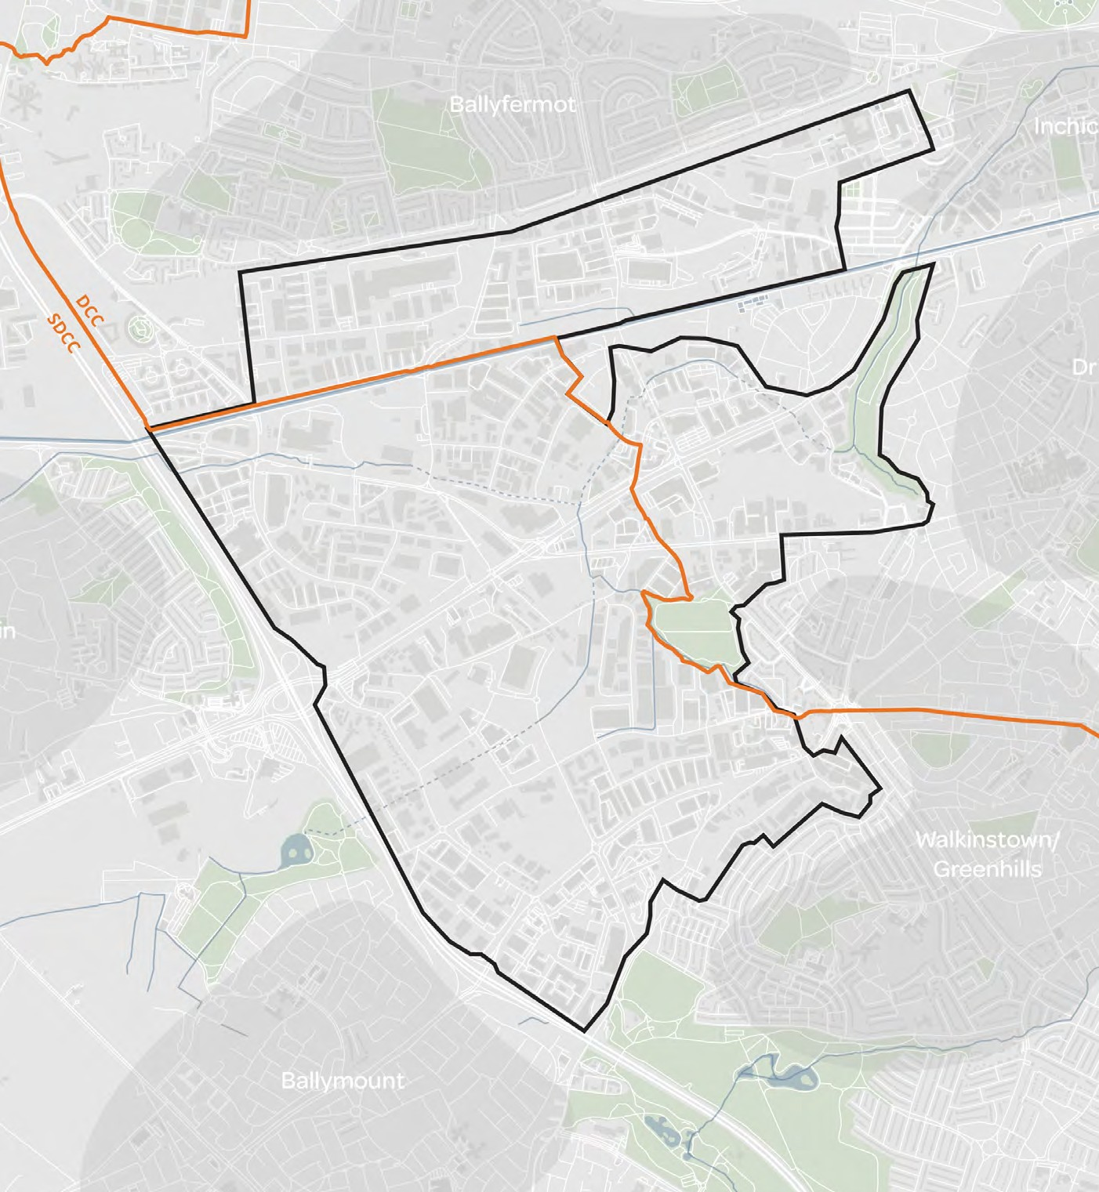
3. Residential Led Mixed Use
Regional / Dublin level of employment
Residential-led mixed-use development approach
Dispersed growth across multiple centres
Accommodating projected jobs growth to 2040
Reviewing and acknowledging existing pipelines schemes
Accommodating and promoting supporting resources and social infrastructure
Indicative spatial considerations, including potential for a series of neighbourhood centres focused around high streets and centres with complementary employment:
Centre focused around
a north-south high street
condition along Kylemore
Road, linking through to Naas Road
Primary, larger centre that extends upwards towards Kylemore station. Centred at the intersection of the
Naas Road Kylemore Luas tram stop and proposed north south tram stop.
Integration with existing centres whose influence
bleeds into the study area
Test suitable housing quantum
Test appropriate complementary employment offer
Additional centre with
greater focus on industrial employment, centred
around a proposed Luas line tram stop.
Additional centre with
lower density employment alongside a new small
domestic centre, centred around a proposed north- south tram stop.
DRAFT

Slide 13
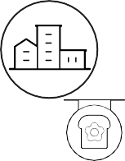
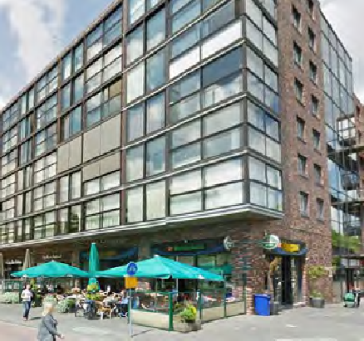
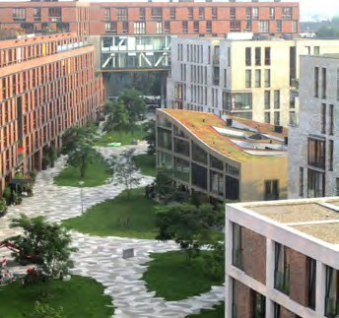
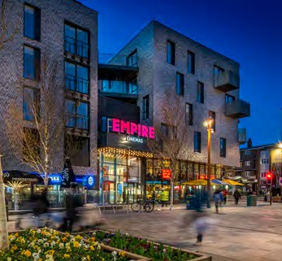
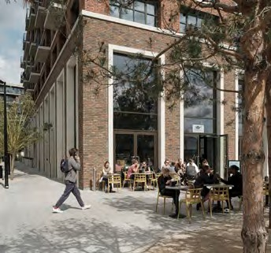
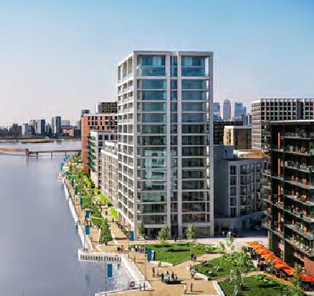
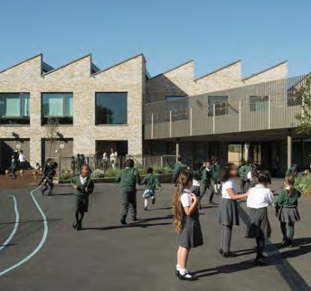
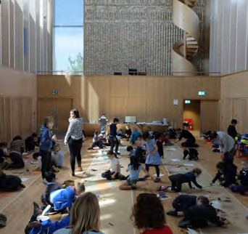
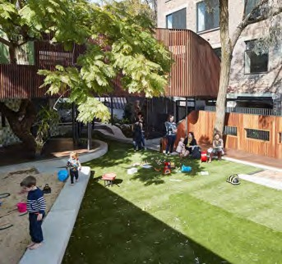
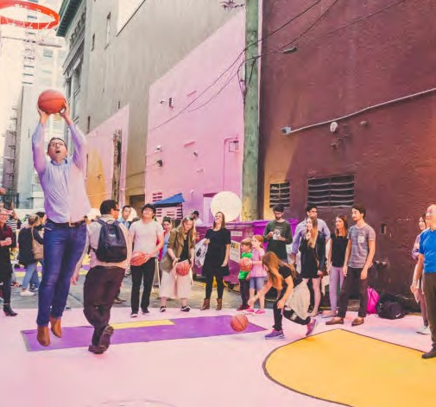
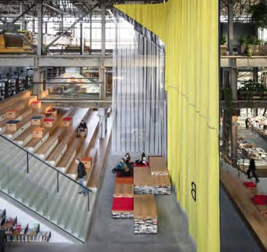
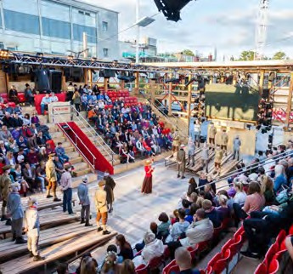
3. Residential Led Mixed Use
As part of Scenario 3, a focus on residential needs will require a variety of social and quality public spaces. Some examples are shown here:
Mixed Use Residential Buildings and public spaces that responds to the needs of a high
intensity of residents. This is expressed through new residential buildings and supporting infrastructure catering to the new residents as well as creating an attractor for visitors
Residential above high street uses Stadstuinen, Rotterdam
Mid-density residential neighbourhood Het Funen, Amsterdam
High street uses with residential above The Scene, Walthastow
Residential above active ground floors Canada Water, London
Residential neighbourhood with supporting infrastructure
Royal Wharf, London
Robust social amenity space Building and public spaces that responds to the needs of a high intensity of residents. This is expressed through new building catering to the new residents, new public spaces and existing buildings re-utilised as social infrastructure.
Primary schools & social infrastructure Marlborough Primary School, Chelsea
Community infrastructure ArtScapers in the Storeys Field Centre
Local community infrastructure East Sydney Early Learning Centre
Experience retail and leisure uses DVBIA More Awesome Now alley HCMA
Cultural infrastructure Lochal Library, Tilburg
Legacy for the public realm
The creation of pieces of public infrastructure that are of a high quality and function as event and community spaces. These are urban elements that aim to reconnect character of the place with its social dimension.
Temporary performance space The Playing Field, Southampton
Riverside public spaces Seigen Riverfront, Germany
Playspace & commercial uses in parks Queen Elizabeth Olympic Park, London
Shared amenity
Courtyard at Elephant & Castle
Mixed-use, activated public space Canada Water, London

Slide 14
Movement
Shown here is an initial aspiration for the street network and hierarchy strategy. Primary, secondary and tertiary streets are represented, with potential new links to complete the network shown dashed. It is anticipated that a finer grain network of streets could sit within this, breaking up the plots further.
Active travel / green & blue network
Primary connections
create the access and
movement routes across the site.
Secondary connections structure the
neighbourhood scale layouts.
Tertiary connections
structure the local scale plot layouts.
Naas Road, main east-west connection across the site.
Arterial vehicular network
The aspiration is
for connections to be
completed/extended to create a more permeable network structure
Interstitial network
These aspirations are subject to further
consultation with NTA/TII and key stakeholders.
N
0
1KM
DRAFT

Slide 15
Street Typologies
Arterial
Primary (‘Boulevards’)
Secondary (‘Avenues’)
Avinguda Diagonal, Barcelona
Rue Garibaldi, Lyon
Sauchiehall Street, Glasgow

Slide 16
Green & Blue Infrastructure
Naturalise Camac Canal & River
North-South Greenway Flagship park
Urban greening
DRAFT

Slide 17
Naturalise Camac – Grand Canal – Greenway Network
17

Slide 18
Next Steps
Development Scenario Analysis
Preferred Scenario
Project Pause
Public Consultation
Stakeholder Engagement
Strategic Framework

Slide 19
Thank You
Questions

