Slide 1
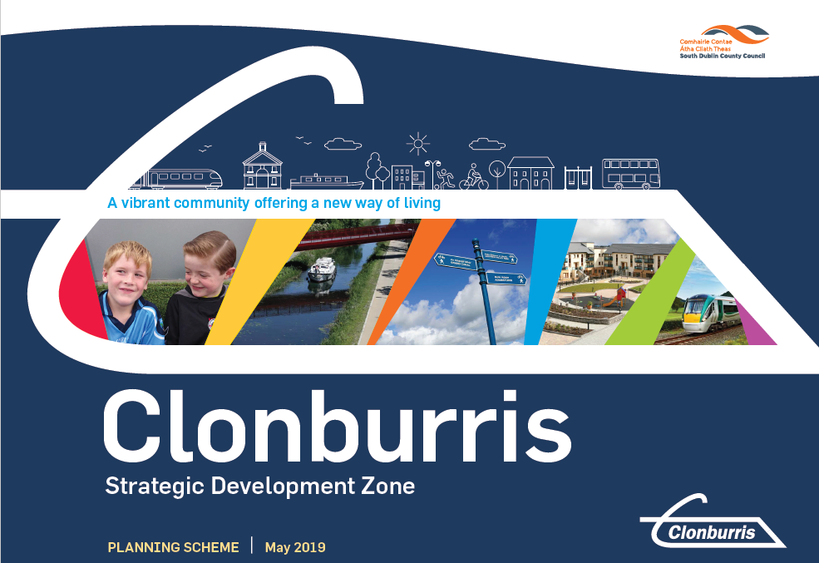

Clonburris SDZ Planning Scheme
SDZ Elected Members Briefing
May 2021

Slide 2
Agenda
URDF Update
Infrastructure Programme
Planning Activity
Phase 0 Updates
Adamstown URDF Update
SDZ Elected Members Briefing
May 2021

Slide 3
Clonburris SDZ URDF Update
URDF Approval in Principle: €176.6m (March 2021)
8,714 Homes Over 10 years
€235m Funding Application
Next Stages
Public Spending Code Gateway 2
Preliminary Business Case
Request for Tenders for Stage 1 infrastructure
Detailed Business Case
Ongoing Implementation and Review
38% Social & Affordable Homes
€2.3bn Regeneration Project

Slide 4
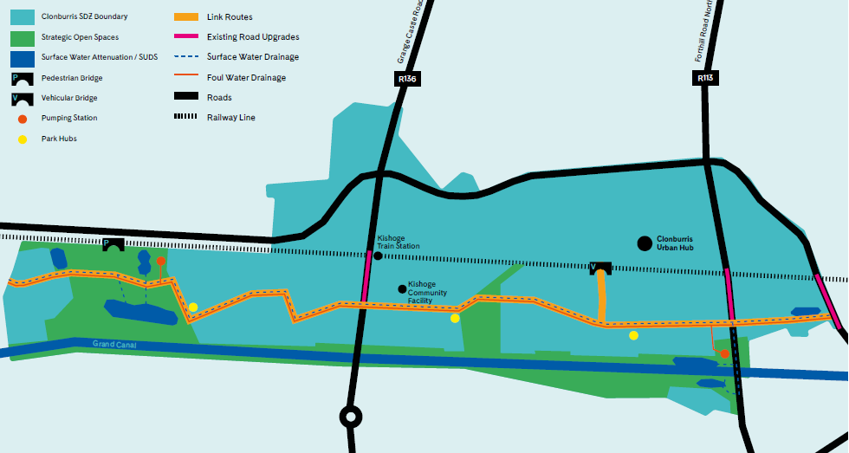
Phase 1: Infrastructure Programme South of the Railway
North
South

Slide 5
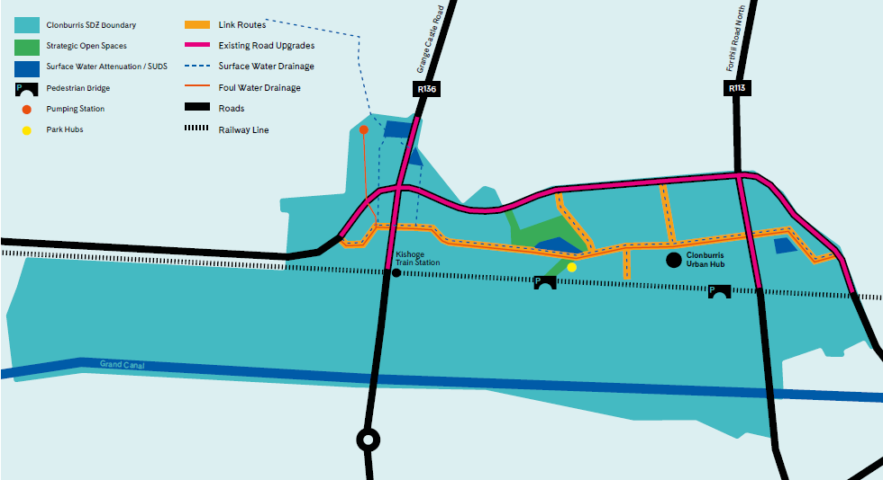
Phase 2: Infrastructure Programme North of the Railway

Slide 6
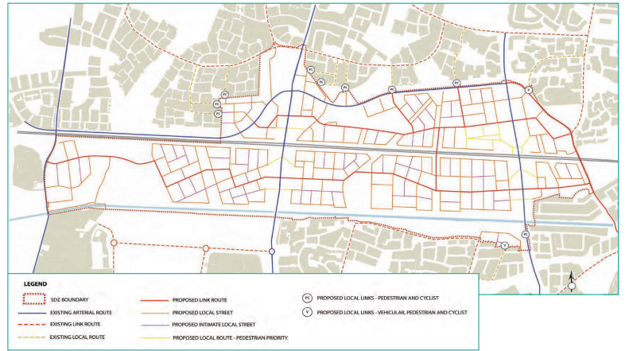
Clonburris SDZ Updates – Preliminary Discussions
Fire Station
Griffeen School
South Link Street
Kelland Homes
IW Pumping Station
Cairn Homes
SDCC
Branding Strategy
NTA Discussions

Slide 7
SDZ Phasing Requirements
Prior to Commencement of Development
Prior to the commencement of development, strategic district level measures and detailed design shall be prepared by the developer(s) and agreed with South Dublin County Council through a Surface Water Management Plan to implement the prepared Surface Water Strategy.
Prior to the commencement of development, a strategic level Parks and Landscape Strategy (incorporating a Biodiversity Management Plan) shall be prepared by the developer(s) and agreed in writing with South Dublin County Council.
Prior to the commencement of development, detailed Water and Wastewater plans for the Planning Scheme shall be prepared by the developers and agreed with Irish Water and South Dublin County Council.

Slide 8
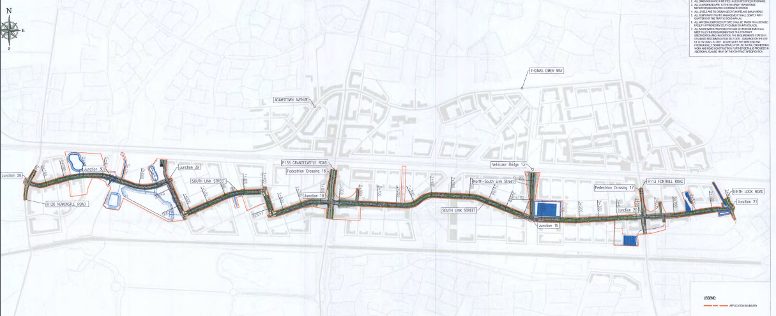
Planning Application Reference No: SDZ20A/0021
South Link Street and Utility Corridor
Decision 24th Feb 2021: Request for Further Information – 14 Items requested

Slide 9
Southern Link Road Planning Application
Further Information Request
1. Phase 0 Reports Compliance | 6. Embankments & Access to train station. | 11. Pumping Station
2. Cycle Lanes/ Pedestrian Crossings | 7. Culvert | 12. Compound/Storage Areas
3. Junction Design | 8. EIAR Update | 13. Outer Ring-Road Interface
4. Surface Water | 9. Taking in Charge | 14. Whitton Avenue
5. Landscaping & GI | 10. Demolition of Existing Structures
*Decision Issued 24/2/21
App Reference no: SDZ20A/0021

Slide 10
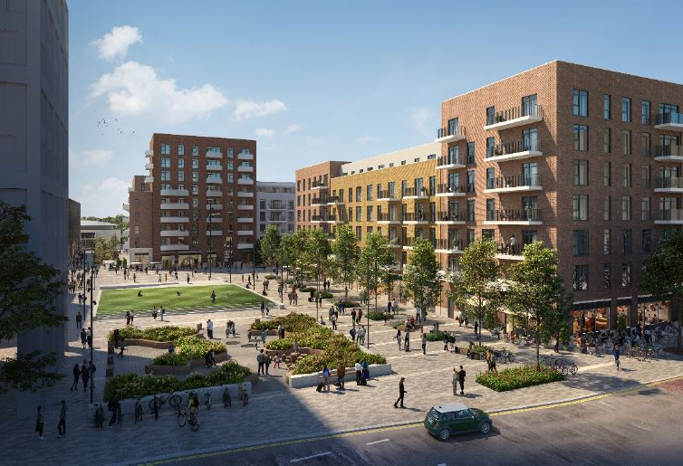
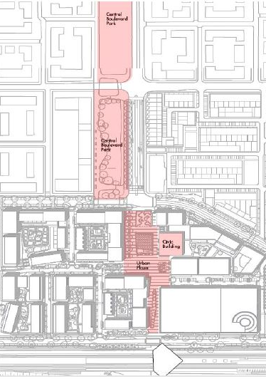
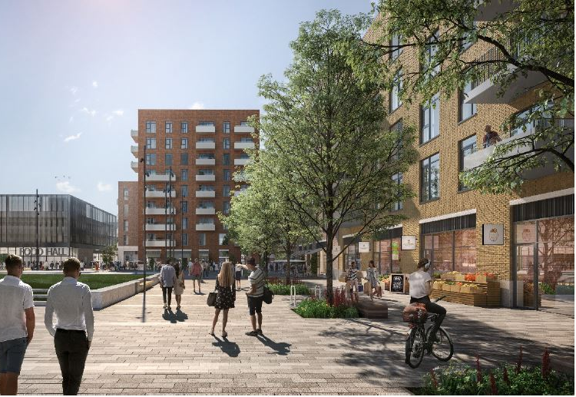
Adamstown SDZ URDF Update: Bid Successful
Priority 1 – Town Centre Projects
Plaza: €3.35m
Civic Building: €3.93m
Housing: 329 of 585 Homes
Planning: Majority Secured
Completion: 2023
Central
Boulevard
Park
Priority 2 – Central Boulevard
The Park: €5.68m
Housing: 256 of 585 Homes
Planning: Pre-planning
Completion: 2024
Civic
Building
Plaza
585 Homes by 2024
20% Social / Affordable Homes
€12m Funding Application
€220m Investment
Train station

Slide 11
Questions

