Slide 1
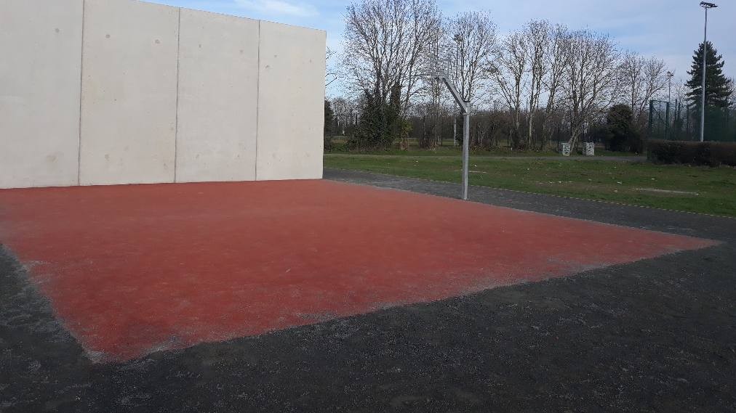
Griffeen Valley Park Teenspace

Slide 2
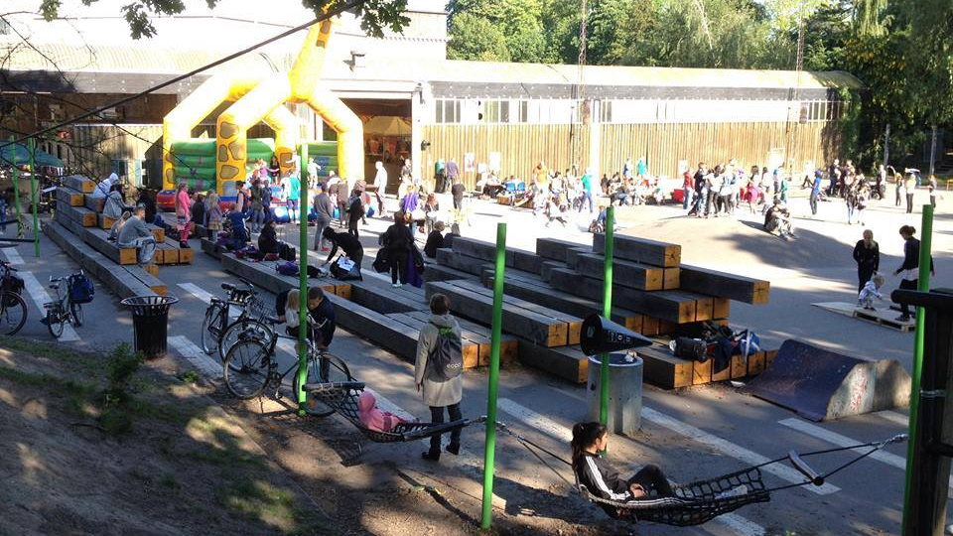
382 teenagers took part in the survey.
54% of all survey respondents selected Wi-Fi as the most important element in of a teen space. This was followed by informal seating (26%), exercise area (21.9%), play (14.7%) and music/dance area (10.8%).
For Exercise: An Outdoor Gym was the most sought-after exercise 54.3% equipment with of stating this was their first preference. This was closely followed by a Parkour area (44.6%) and Calisthenics (9.3%).
These can easily be combined into one area

Slide 3
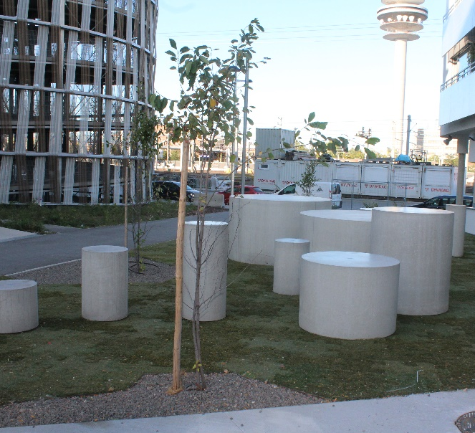
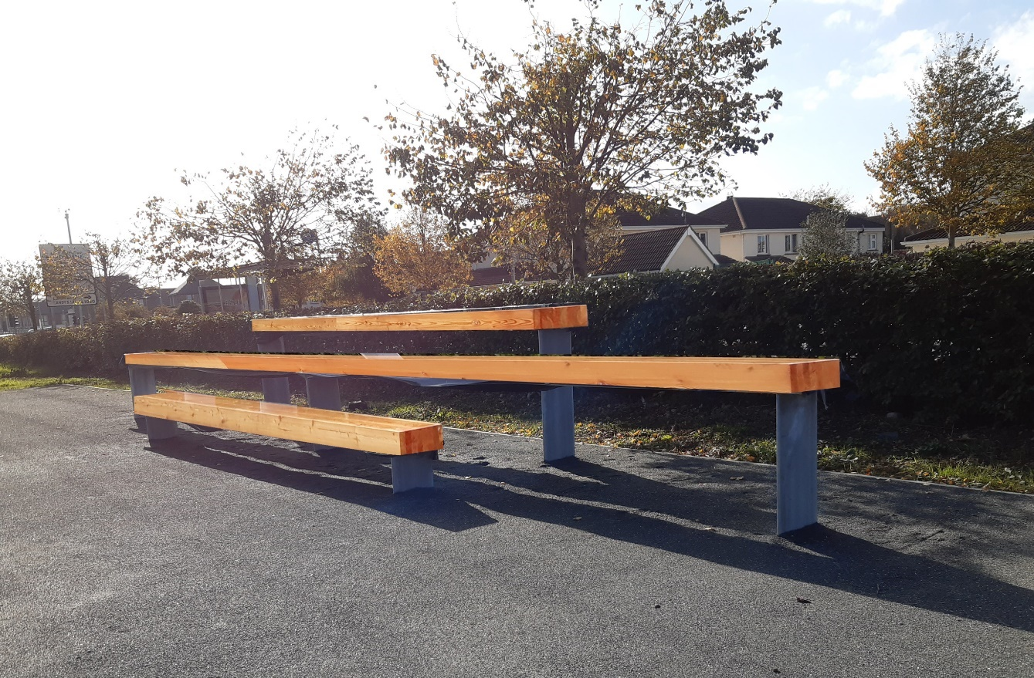
Seating This is a really important element in the teenspaces. It allow teenagers a chance to meet up outside in a place designed for their needs. They can then decide whether to engage in the activities or not.

Slide 4
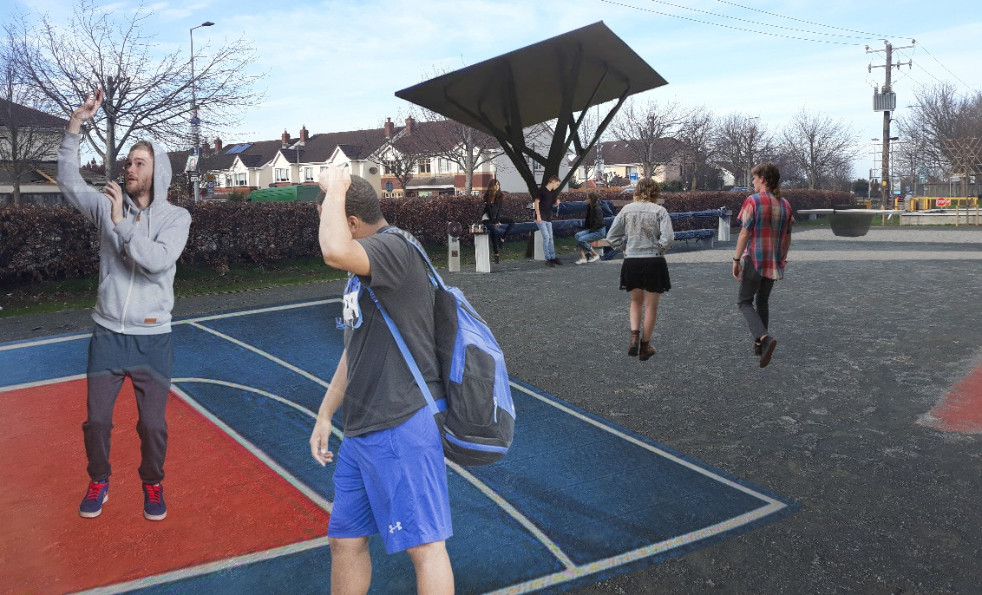
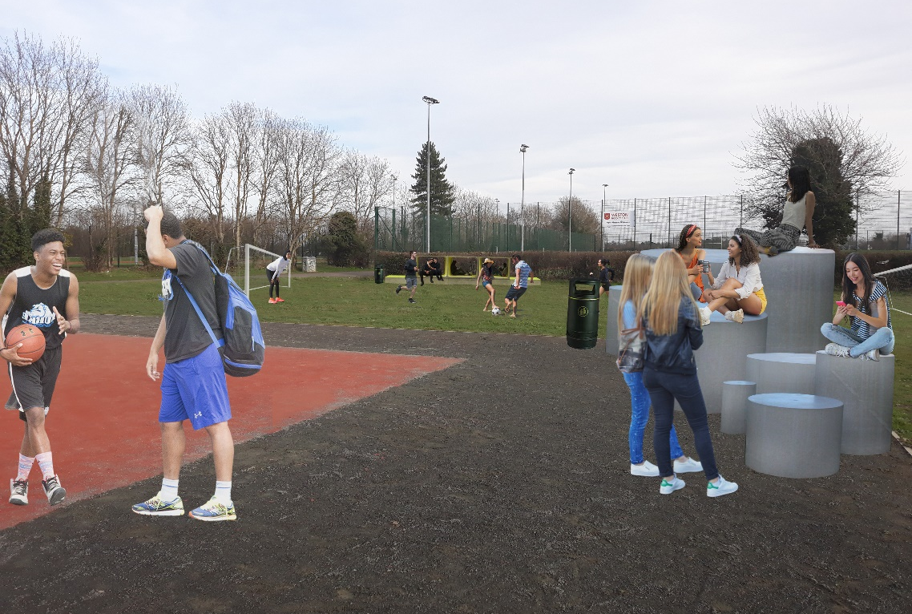
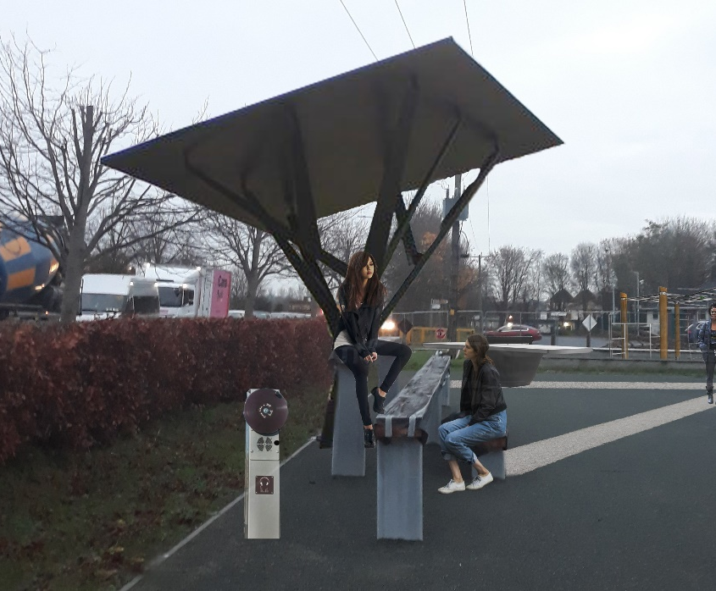
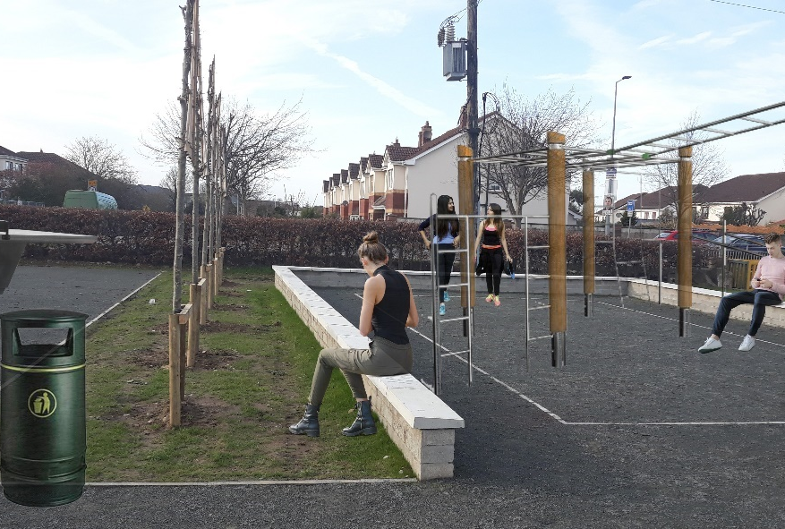
Images showing additional seating, levelled area for soccer, basketball hoops, exercise area and music post as example

