Slide 1
Balgaddy Quarter 2-Update
Lucan/Palmerstown/North Clondalkin ACM Meeting
^{25th May 2021}

Slide 2
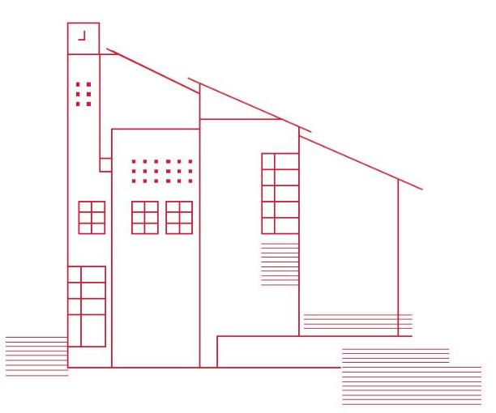
Voids Programme/Allocations/Transfers
7 Transfers in 2021 to date- Legacy Maintenance / Estate Management/Rightsizing
5 allocations to date in 2021
Breakdown and status of the 16 vacant properties currently in our housing stock at 25th May 2021 in Balgaddy Estate is as follows:
Ready for Allocation | Tender Stage | Works Pending
4 | 8 | 4

Slide 3
Costing and Finance- Planned Maintenance
Painting Programme- €750K
Safety Works- €1m
Balgaddy Specific Works €500K
Windows and Doors Programme €8.5 M

Slide 4
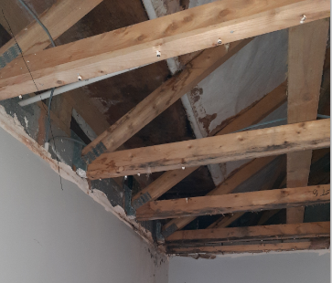
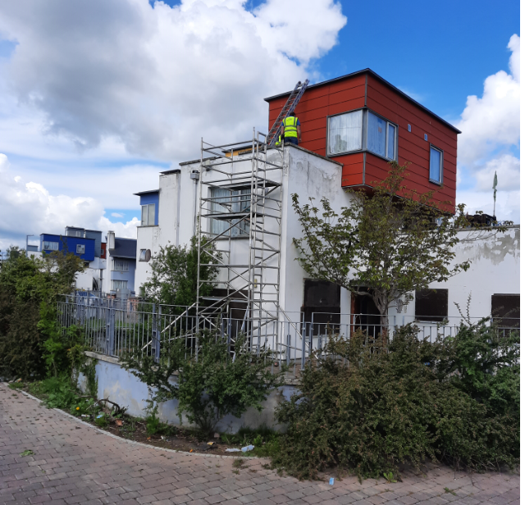
Roof Repairs and Inspections
Foxdene Avenue - Roof inspection was carried out 7th May 2021. The inspection included inspection of the roof space, wall construction and external inspection of the valley of the roof. Specification and bill of quantities for the works required is currently being prepared for tendering. Tender process to commence week of 28th June 2021
Tor an Rí Lane – Roof and terrace inspection to take place on 24th May 2021. Following the inspection specification and bill of quantities for the works required will be prepared. Commencement of the tender process to be confirmed.
Meile and Rí – Roof inspections to be carried out. Date for the inspection to be confirmed in the coming week.

Slide 5
Painting of Communal Areas Indoor/Outdoor
Painting contractor has completed painting works, week ending 21st May 2021 in the communal areas of 31-39 Meil an Rí Road.
Tendering for painting of the following communal areas is under way in the following areas:
Foxdene Avenue between 32 and 134
Meile and Rí Road between 11 and 63
Meile and Rí View between 11 and 17
Meile and Rí Drive between 2 and 47
Meile and Rí Green between 3 and 16
Closing date for tenders week ending 11th June 2021
External areas are currently being assessed and a works program will be confirmed for 2021. Subject to findings from roof inspections, this may lead to delays in the painting of some external areas.

Slide 6
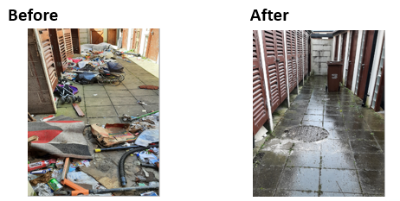
Cleaning of Communal Areas Indoor/Outdoor
On Saturdays 24th April and 15th May, housing maintenance crews carried out extensive cleaning and removal of waste in communal areas of properties in Balgaddy.

Slide 7
Communal Doors
Roofing and Door Contractor has been appointed and will be on site week commencing 24th May 2021.
A number of doors and locks have been replaced but have subsequently been damaged due to vandalism.
Contractor will be tasked to look at an alternate design solution to provide a robust entrance door whilst ensuring tenants safety and where possible aesthetics are is maintained.
Once design established a price for the works will sought in order to carry out works on a phased basis.

Slide 8
Replacement of Utility Box Covers
Tendering for the provision and installation of steel utility boxes is broken up into two lots. Tendering for Lot 1 is under way in the following areas:
Communal areas at Foxdene Avenue between 90 and 134
Communal areas at Meile and Rí Road between 11 and 63
Own door properties at Meile and Rí Park between 3 and 13
Closing date for tenders week ending 11th June 2021.
Tendering for the provision and installation of steel utility boxes for the remaining properties will commence once Lot 1 tender is complete
Meile and Rí Road between 1 and 65
Meile and Rí View between 3 and 25

Slide 9
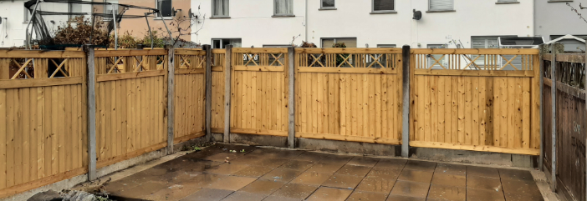
Replacement of Fire
Damaged Fencing
Replacement of Glass Windows
Tender document has been prepared and tendering process commenced for the replacement of various broken glazing units in the Balgaddy area. A total 20 glazing units to individual properties will be replaced as part of the works. Installation date is to be confirmed in the coming week

Slide 10
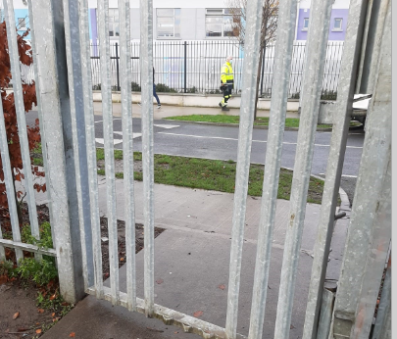
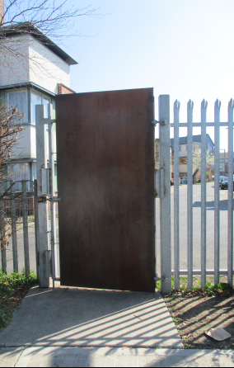
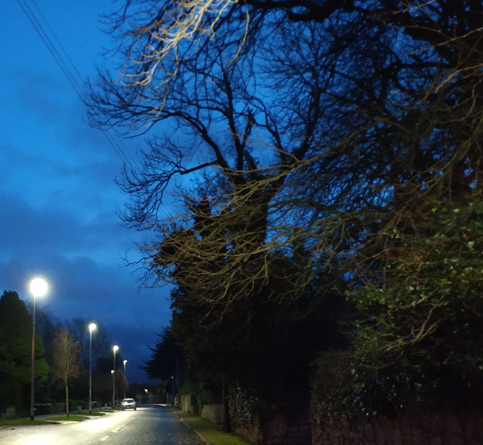
Estate Management Initiatives
2 new Public Lighting Collum’s to installed in the coming weeks in the public park.
Gateway linking Buirg An Ri Glen and Lucan Community National School was welded shut to alleviate ASB and illegal activities which proved to alleviate the problem for Buirg An Ri Residents, the school and residents in Rosscourt.

Slide 11
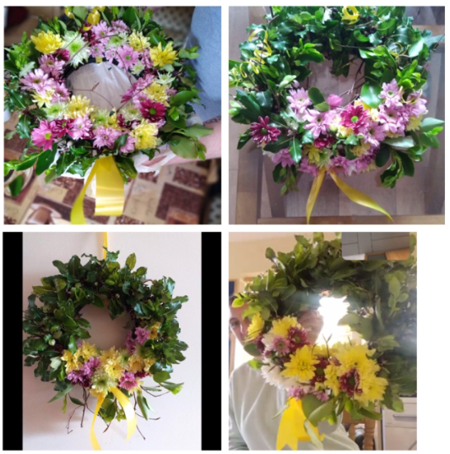
Estate Management Initiatives
Feb 2021 - Communal Bin Area cleared at Block 31-39 Meile An Ri Road
April 2021 - Virtual Spring Planting Workshop with a group of 10 Residents, this will also take place in May as part of the Bealtaine Programme
April 2021 – Virtual Easter Hunt. Photos emailed of each clue and Easter eggs presented to families as prizes.
April 2021 – Estate Clean-up organised with the Balgaddy Residents Association. All materials provided by the Estate Management Unit.
April 2021 – Estate Management Unit are working closely with the Ronanstown Gardai and local agencies on a new initiative to target and address specific anti-social issues within the area.

Slide 12
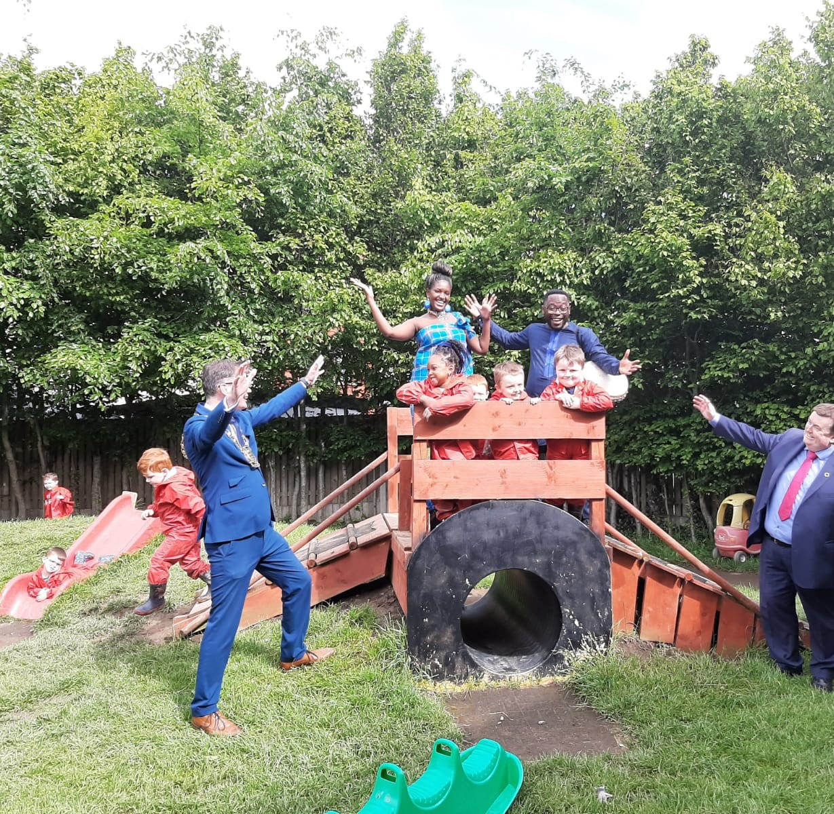
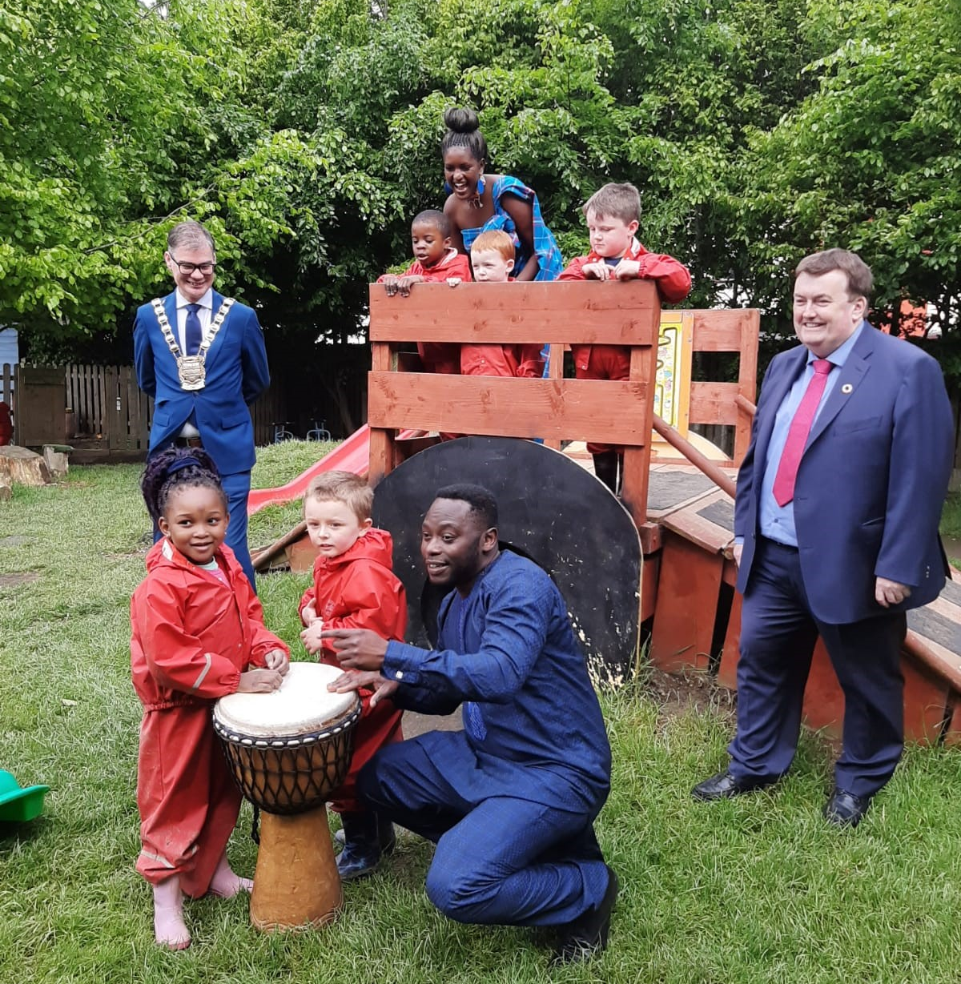
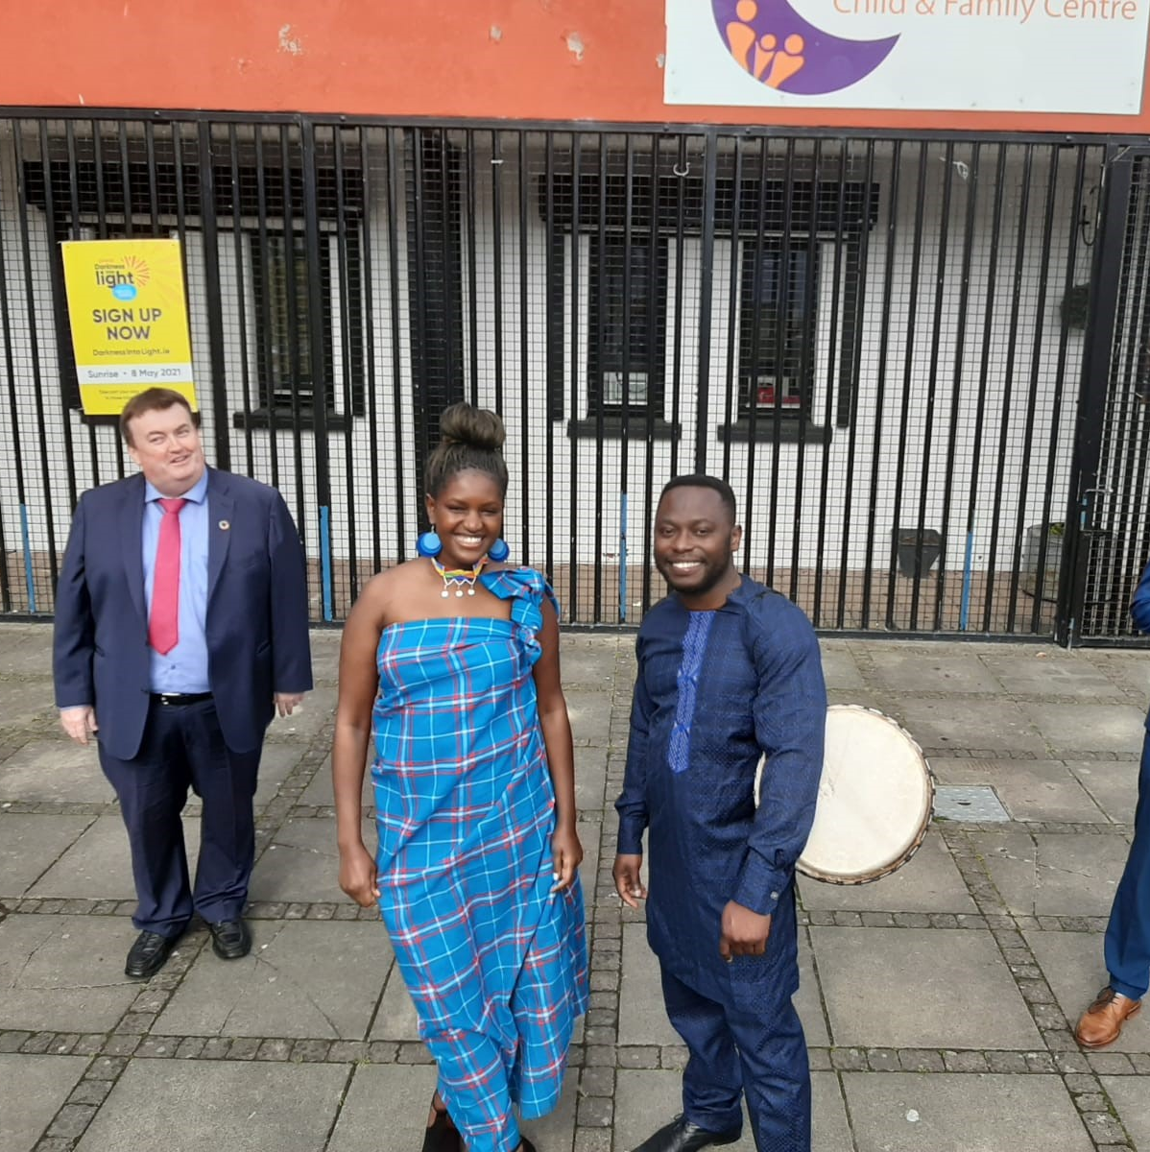
Africa Day Event- 24th May 2021
The Social Inclusion Unit and Estate Management Team have teamed up with Gomba Educare to provide an interactive storytelling session for a group of young children in the Balgaddy Child and Family Centre, Meile An Ri Road.

