Slide 1
Meeting of the Tallaght Area Committee on 24 May ‘21. Proposals to counteract anti-social behaviour at the Whitestown Stream through Jobstown.

Slide 2
Background and purpose of report
Background
The issues of illegal dumping and burning of waste, the illegal operation of scramblers and the driving of stolen cars in the green spaces adjacent to the Whitestown Stream in Jobstown have been raised many times over the years by local elected members.
The matter was placed on the agenda of both the January and February ‘21 meetings of the Tallaght area committee, the members of the committee requested that the matter be dealt with by way of a headed item report at the March meeting and that it would remain on the agenda of the ACM as a headed item until such time as a set of measures to resolve these problems are agreed.
A report outlining the issues in the area requiring attention was presented to the March area committee meeting. The report being presented today is intended to identify measures to be taken in response to the variety of issues outlined in the first report.
As outlined in the March report there is currently no provision either in the revenue or capital budgets for a programme of works to address these issues. It is intended that this process will lead to agreement on a set of measures which can be costed and proposed for inclusion in the budget for 2022.

Slide 3
Summary of proposed actions
The main issue to be tackled is the lack of a secure boundary around the green area which adjoins the Whitestown Stream on both sides. This provision of a 1.2m high railing on top of the existing low wall is intended to prevent entry by stolen cars and scrambler motorbikes and it is hoped will remove this aspect of the anti-social behaviour from the area.
In addition to this an investment in other aspects of hard landscaping as well as soft landscaping will result in a major improvement to the area which will increase legitimate use of the area, increase passive supervision in the area and thereby counteract the other main aspect of anti-social behaviour in the area which is the illegal dumping and burning of waste.

Slide 4
Summary of proposed actions (continued).
Secure 1.01km of boundary.
Install access control at 20 entry points.
Provide new footpath at Cloonmore to complete footpath loop around the area and overlay existing footpaths which have been damaged by vandalism.
Remove existing bridge linking Bawnlea Avenue and Cloonmore Road and replace with 2 new bridges one at either end of the stream (as shown on the hard landscaping plan).
Remove graffiti as required from boundary walls and other locations.
Realign boundaries of properties to remove hidden corners which currently facilitate dumping and burning of waste.
Audit of public lighting is being carried out to identify any improvements necessary.
Planting of 130 mature trees in an avenue formation along the pathway and at the new boundary railing.
Planting of 1,000 square metres of wildflowers at locations as shown on the soft landscaping plan.

Slide 5
Summary of issues referred to the Housing Dept
The following issues have been referred to the Housing Dept for consideration :
Proposed realignment of boundary walls at Bawnlea Drive and Crescent and at Cloonmore Park and Green (to eliminate hidden corners which currently facilitate illegal dumping),
Proposed closure of access to the Whitestown Stream at Bawnlea Drive (this is one of the 2 main sites of illegal dumping and burning of waste),
Proposed removal of the pedestrian bridge linking Bawnlea Avenue to Cloonmore Road (this is the second site, it seems to be regularly used by scramblers and is the location of a lot of the illegal burning of waste and burning of stolen vehicles).

Slide 6
Summary of locations and lengths of low boundary wall that can be easily crossed.
Bawnlea Dr to Jobstown Rd to Cloonmore Pk 150m
Bawnlea Crescent 63m
Bawnlea Avenue 160m
Dromcarra Grove 160m
Cloonmore Green 128m
Cloonmore Road 120m
Cloonmore Gardens 100m
Cloonmore Close 15m
Cloonmore Avenue 15m
Cloonmore Avenue to Dromcarra Avenue 100m Total 1.01 km

Slide 7
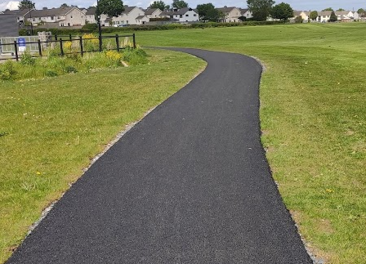
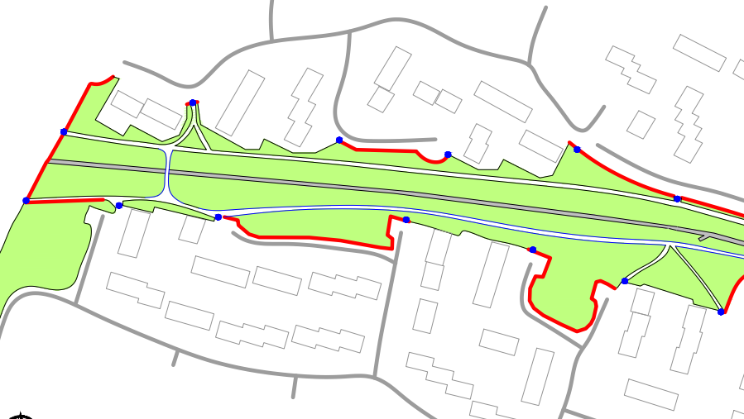
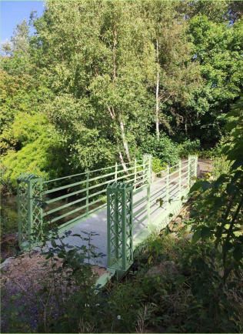
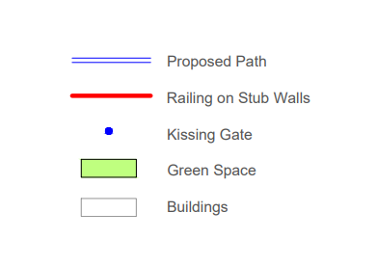
Hard Landscaping Plan

Slide 8
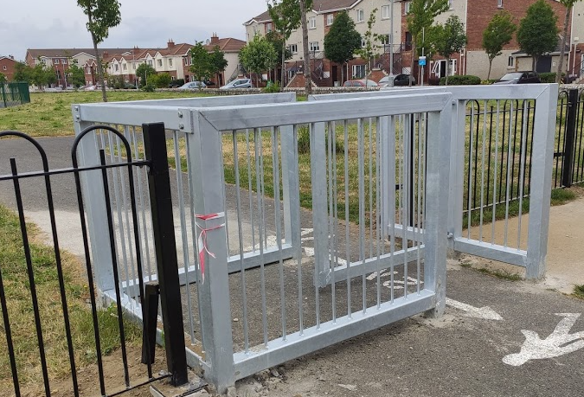
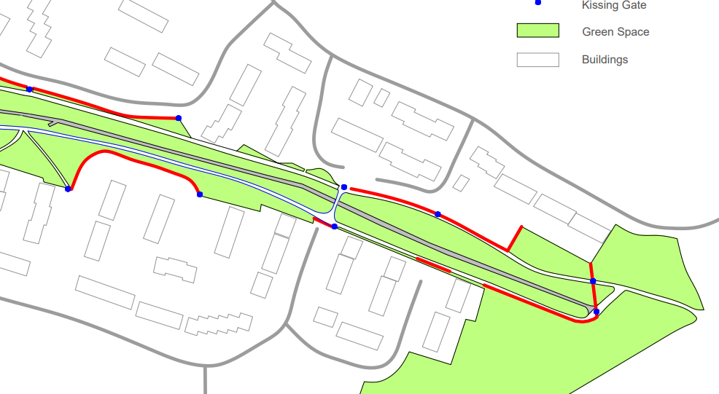
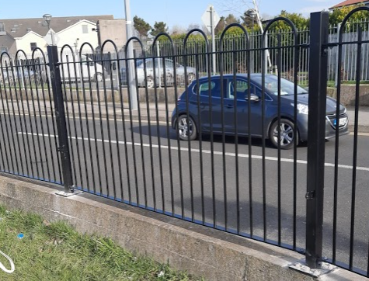
Hard Landscaping Plan

Slide 9
Costings to address access issues.
Total length of exposed boundary around the Whitestown Stream area is 1.01km. It is proposed to secure these areas and to install controlled access at all entry points to the Whitestown Stream area.
Cost to secure the low boundaries by the provision of a 1.2m high railing on top of existing stub walls, and similarly on top of the new stone wall at Gort Lar, is approximately €210,000.
Cost to install access control such as a heavy duty kissing gate at all 20 access points to the Whitestown Stream area is approximately €80,000.
The cost to secure the area around the stream using these two features is therefore estimated to be in the region of €290,000.
The railings proposed are decorative and have a bow top, such as those installed at Butler McGee Park. The steel sections to be used will be substantial in size so as to be vandal resistant, fixings will be vandal proof and each railing/fence post will be supported from the ground by a backing strut or support.

Slide 10
Other infrastructure and hard landscape issues and costings.
It is proposed that the existing footpaths along the stream will be repaired and overlaid and that the footpath will be completed between Cloonmore Green and Cloonmore Close. Estimated cost of footpath works is €80,000.
It is proposed that the existing bridge at the crossing between Cloonmore Road and Bawlea Avenue be removed as it currently appears to facilitate anti-social behaviour. It is proposed that two new decorative cast iron pedestrian bridges be installed at the crossing from Cloonmore Crescent to Bawnlea Crescent and from Cloonmore Close to Gort Lar. Estimated cost of these bridge works is €75,000.
The public lighting section has been asked to examine the existing lighting on the Bawnlea/Dromcarra side of the stream and the need for lighting on the proposed new path at the Cloonmore side. A proposal and costing is awaited.
In order to close off ‘hidden corners’ and incorporate the land into existing gardens it will require approximately 150 linear metres of 2.4m high block wall to be built. Estimated cost of this is €35,000. Note - confirmation is awaited from the Housing Dept that this is feasible in their view.
Total cost of above which excludes public lighting improvements is €190,000.

Slide 11
Soft landscaping.
In order to soften the effect of the proposed new railings it is proposed to plant 130 trees both along the pathways and also behind the proposed new railings. Estimated cost to plant 130 mature trees is €50,000.
Other planting proposed is the planting of wildflower bulbs and seeds. Approximately 1,000 sqm proposed at an estimated cost of €20,000.
Work to repair soft landscaping such as grass areas extensively damaged by burning over the years will be carried out at an estimated cost of €20,000.
Also to provide a sum of €10,000 for the provision of street furniture such as seating.
Estimated cost of tree planting, wildflower planting, repairs to grass areas and street furniture is €100,000.

Slide 12
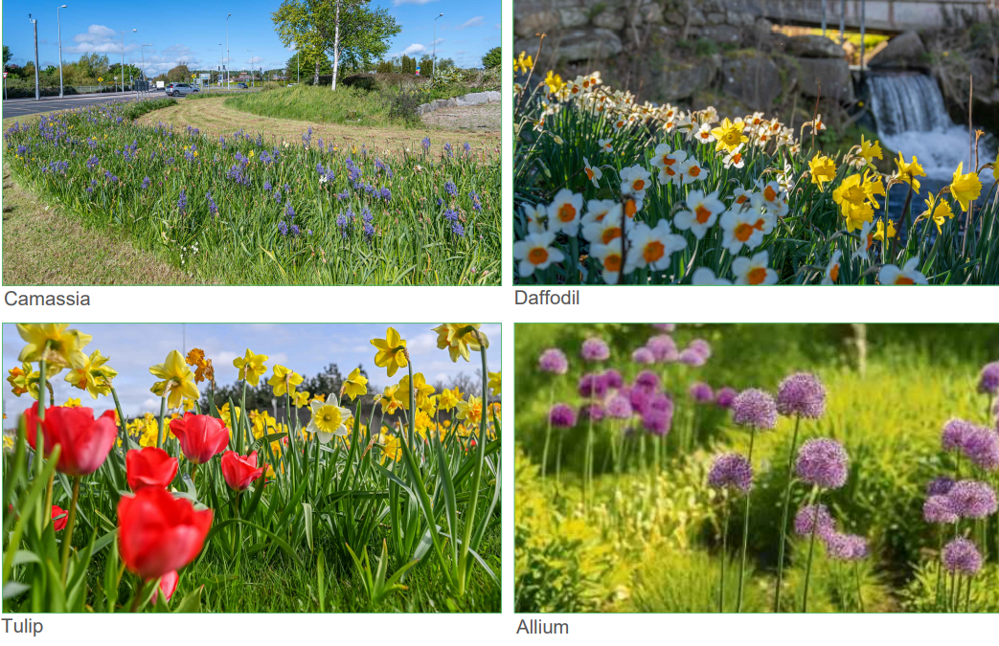
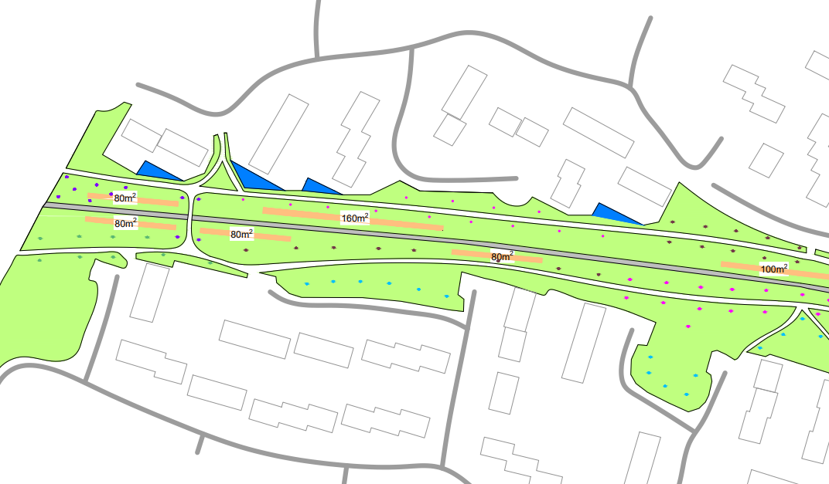
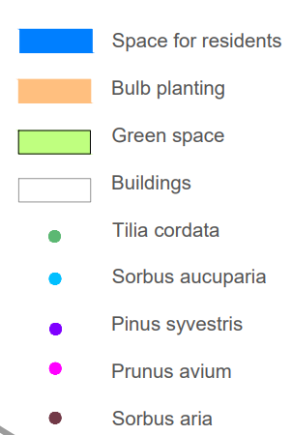
Soft Landscaping Plan

Slide 13
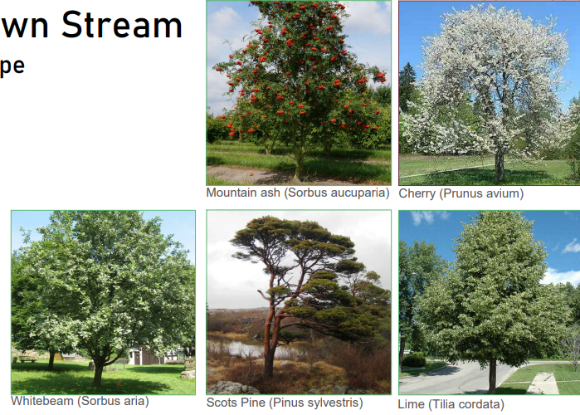
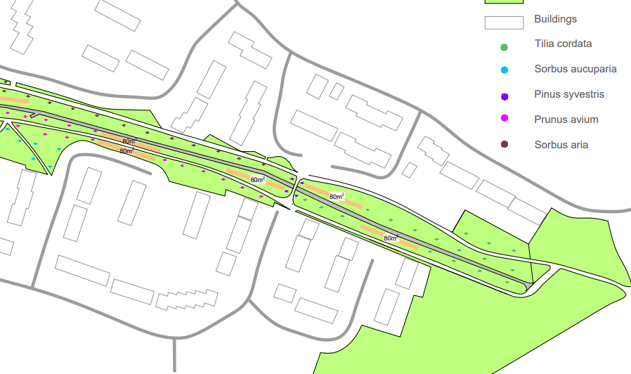
Soft Landscaping Plan

Slide 14
Other issues to be costed
Removal of graffiti
Closure of access from Bawnlea Drive
Measures required at adjoining boundary walls to secure those areas
Modifications to swing barriers which allow access for grass cutting machinery, to prevent scramblers from gaining access under these
Improvements to public lighting system
Provisional sum of €100,000 for all of the above to be included.

Slide 15
Total costs
Boundary railings and access control €290,000
Other hard landscaping €190,000
Trees and Soft landscaping €100,000
Other costs as outlined €100,000
Total for the proposed scheme €680,000

