Slide 1
SHD Application Ref: SHD3ABP-309916-21
Applicant: Square Foot Property Services Ltd.
Location: Glen Abbey Complex, Belgard Rd
Presentation to: Tallaght ACM 24th May 2021
Jim Johnston
Senior Executive Planner

Slide 2
Timelines
SHD Lodged with ABP on 09-Apr-2021
5 Week Obs by 5.30pm on 13-May-2021
8 Wks SDCC report due to ABP 03-Jun-2021
16 Week Decision due from ABP 29-July-2021
Consultations
S.247 pre-planning meetings with SDCC as follows:
SHD1SPP004/19 on 08-03-2019
SHD1SPP009/19 on 05-05-2019
Tripartite meeting ref SHD2ABP-305535-19 held on 13-11-2019 with An Bord Pleanála, the applicant and SDCC.

Slide 3
Proposed Development
• Demolition of the existing industrial and commercial office buildings totalling c.4,628sqm;
• Construction of a Build-to-Rent Housing Development comprising 170 apartments and crèche arranged in 2 blocks across 4-7 storeys over basement car park (total gross floor area c.13,880sqm excluding basement);
• The residential development consists of: 9 no. 1 bedroom studio apartments (c.37-38sqm each); 94 no. 1 bedroom/2 person apartments (c.45-58sqm
each); 2 no. 2 bedroom/3 person apartments (c.69sqm each); 34 no. 2 bedroom/4 person apartments (c.73-83sqm each); 24 no. 2 bedroom/4 person
duplex apartments (c.93sqm each) and 7 no. 3 bedroom/5 person apartments (c.91-98sqm each) with north, south, east and west facing
terraces/balconies throughout;
• Internal communal amenity spaces at ground and fourth floor levels comprising reception, gym, lounge, cinema/tv room, events rooms and ancillary
areas (totalling c.508sqm);
• External communal open space including children’s play areas and informal amenity spaces at ground floor level between Blocks A and B. Communal
roof garden at fourth floor level. Total external communal open space c.1,005sqm;
• Public open space at ground floor level to the east and south of Block B totalling c.1095sqm;
• 1 no. creche (c.163sqm) with associated outdoor play area at ground floor level (c.75sqm);

Slide 4
Proposed Development (continued)
• 73 no. car parking spaces comprising 64 no. basement spaces, 4 no. accessible parking spaces and 5 no. visitor spaces at surface level;
• 354 no. bicycle spaces comprising 264 no. resident spaces at basement level and 90 no. visitor spaces at ground floor level;
• Reconfiguration/removal of existing car parking to the north of the site and access road resulting in a total of 28 no. car spaces serving the adjoining site;
• All associated plant including heating centres, gas room, water storage room, break tank room, comms room and bin storage at basement level, ESB
substation and switch room at ground level and circulation spaces and stair and lift cores throughout;
• Vehicular/pedestrian access to the east from Belgard Road. All existing vehicular entrances serving adjoining sites maintained.
• Fire/emergency and refuse vehicle access and pedestrian access to the south from Colbert’s Fort;
• All associated site development and infrastructural works, services provision, foul and surface water drainage, extension to the foul network, access
roads/footpaths, lighting, landscaping and boundary treatment works.

Slide 5
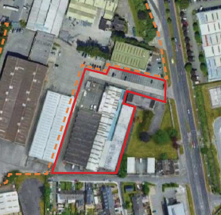

Slide 6
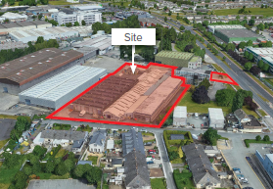

Slide 7
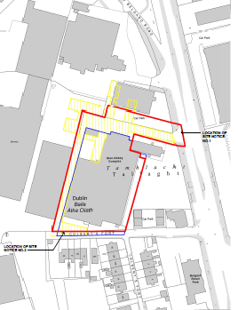

Slide 8
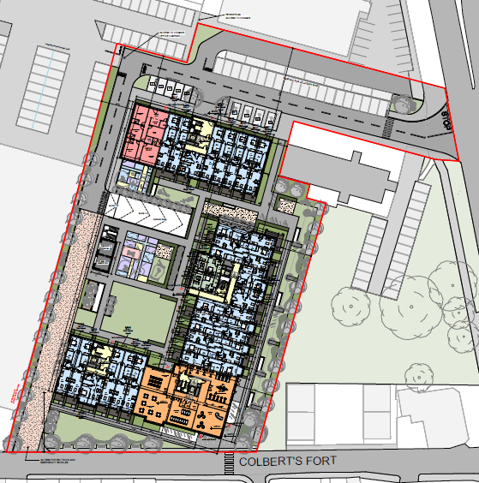

Slide 9
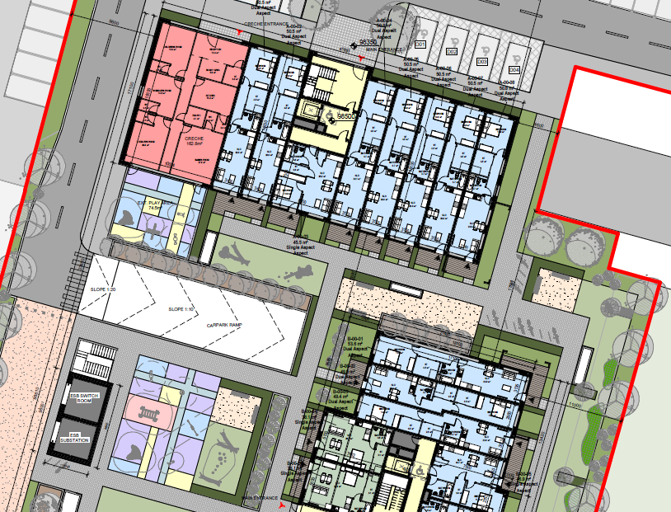

Slide 10
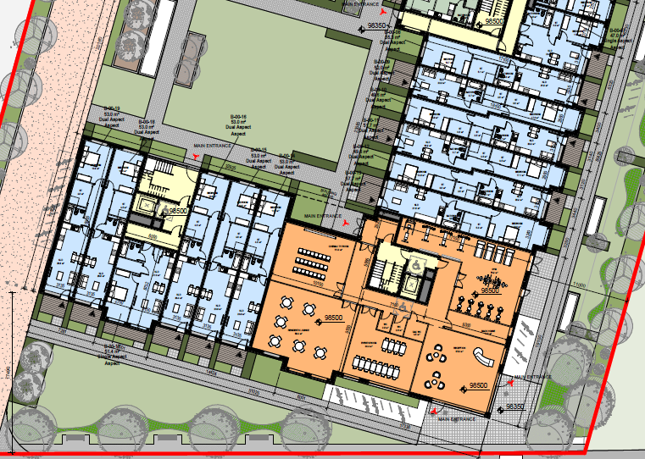

Slide 11
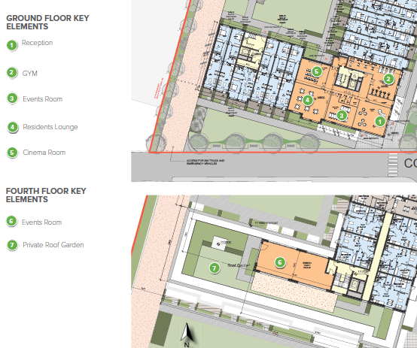

Slide 12
ABP comments – the Bord requested that the following issues be addressed
Applicant should satisfy themselves that the proposed development is not premature pending the adoption of a LAP for the area.
Demonstrate how the proposed development provides a scheme of appropriate residential amenity given the proximity to, and interface with, existing light industrial/commercial development on adjoining lands.
height in relation to South Dublin Development Plan 2016-2022, specifically objective UC6 Objective 3.
Number of north facing units and consideration of Section 28 Ministerial Guidelines Sustainable Urban Housing: Design Standards for New Apartments (2018).
requirement for a creche in light of Section 28 Ministerial Guidelines on childcare facilities.
Demonstrate that the external finishes, materials and detailing of the proposed buildings, together with the landscaping and surface/boundary treatments of the outdoor spaces would be of a sufficient quality to ensure that the proposed development makes a positive contribution to the character of the area over the long term.”

Slide 13
ABP comments (continued):
daylight/sunlight analysis to ensure adequate amenity for future residents
visual impact assessment in relation to impact of height of development, with specific reference to dwellings on Colbert's Fort
Site layout plan to be considered in the context of DMURS and pedestrian movement from the proposed apartment blocks to the entrance of the site
Certainty to be demonstrated over future of shared access road with neighbouring industrial development to the west and redesign of this road as a street
Noise impact assessment to be undertaken given context of site adjoining an industrial warehouse unit
issues raised in the reports from Roads Department and Environmental Services Department
a life cycle report which includes: management and maintenance - proposed materials and finishes which seek to create a distinctive character for the development

Slide 14
ABP comments (continued):
Mobility Management Plan.
Construction and Demolition Waste Management Plan
A schedule of accommodation indicating compliance with relevant standards in the Sustainable Urban Housing: Design Standards for New Apartments, Guidelines for Planning Authorities' 2018
legal agreement to ensure that the development remains Build-to-Rent
that the development remains owned and operated by an institutional entity for a minimum of
15 years and no apartments are sold or rented separately for that period

Slide 15
Statistics for Proposed Development
Proposal - 170 apartments comprising:
9 1bedroom studio apartments (c.37-38sqm each)
94 1bedroom/2 person apartments (c.45-58sqm each)
2 2bedroom/3 person apartments (c.69sqm each)
34 2bedroom/4 person apartments (c.73-83sqm each)
24 2bedroom/4 person duplex apartments (c.93sqm each)
7 3bedroom/5 person apartments
Site area – 0.9 ha
Density – 256 units per ha
Plot Ratio – 1.52
Creche
Height – 2 blocks ranging from 4 to 7 storeys.
Dual Aspect apartments – 51%
Public - 1095sqm. Communal open space – 1,513sqm
Car parking – 73 Cycle parking - 354

Slide 17
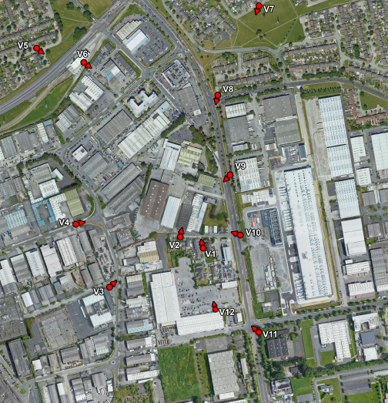

Slide 18
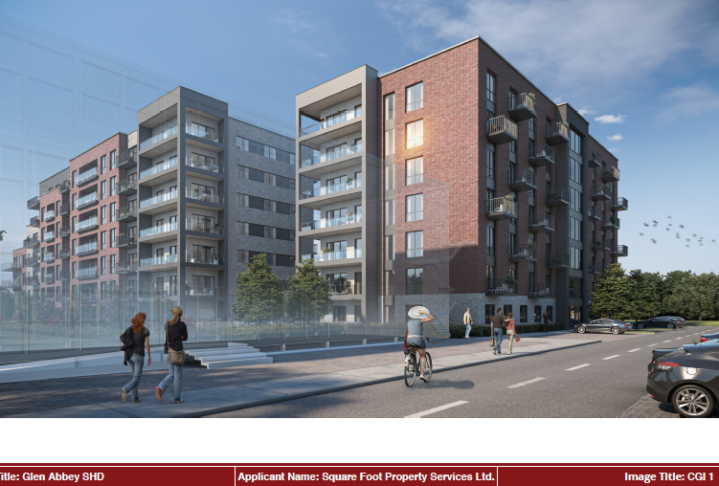

Slide 19
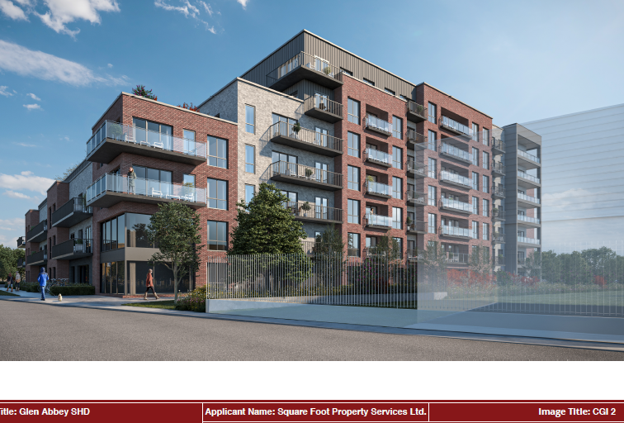

Slide 20
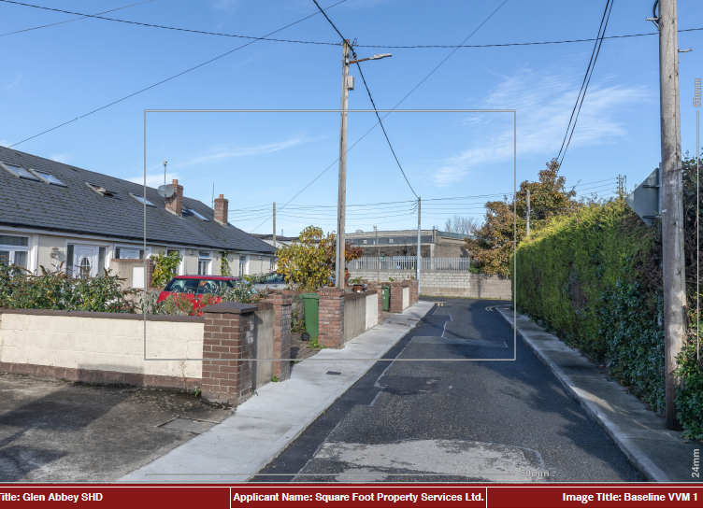

Slide 21
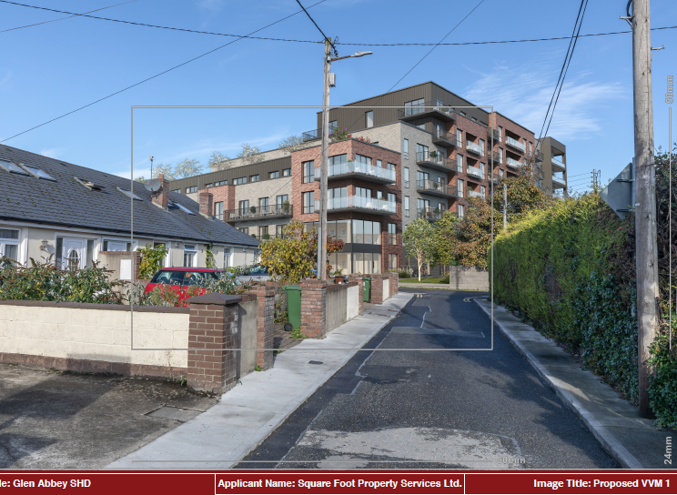

Slide 22
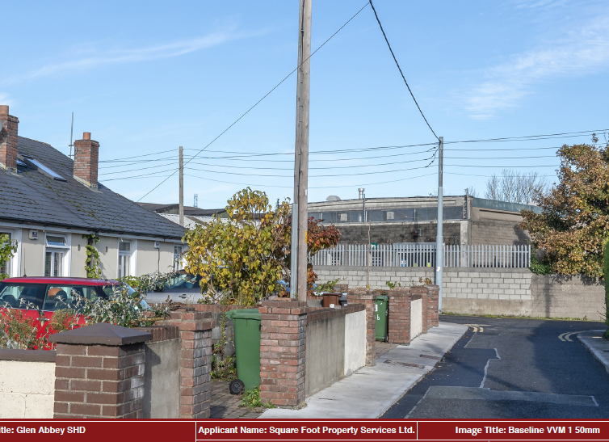

Slide 23
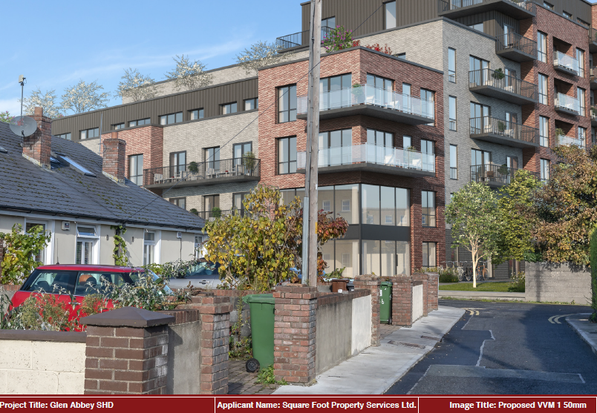

Slide 24
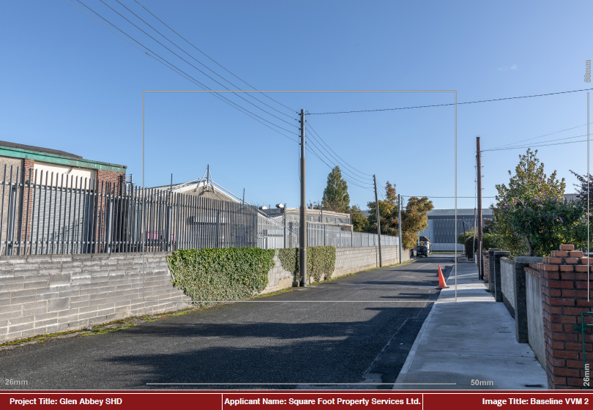

Slide 25
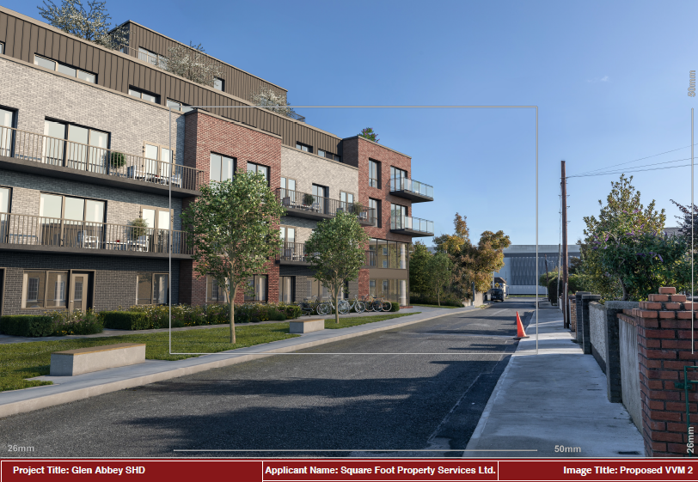

Slide 26
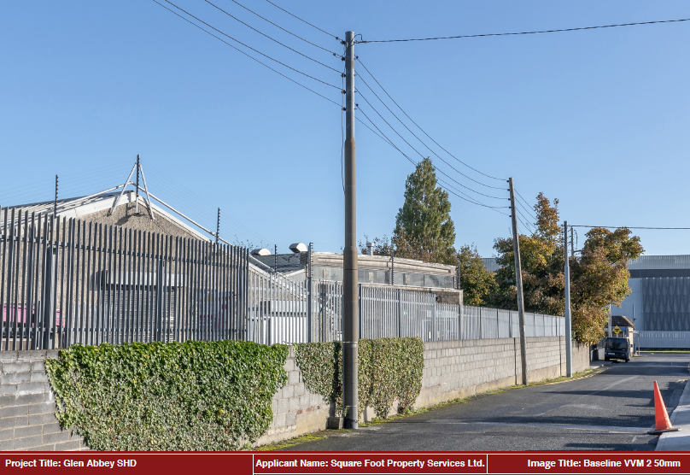

Slide 27
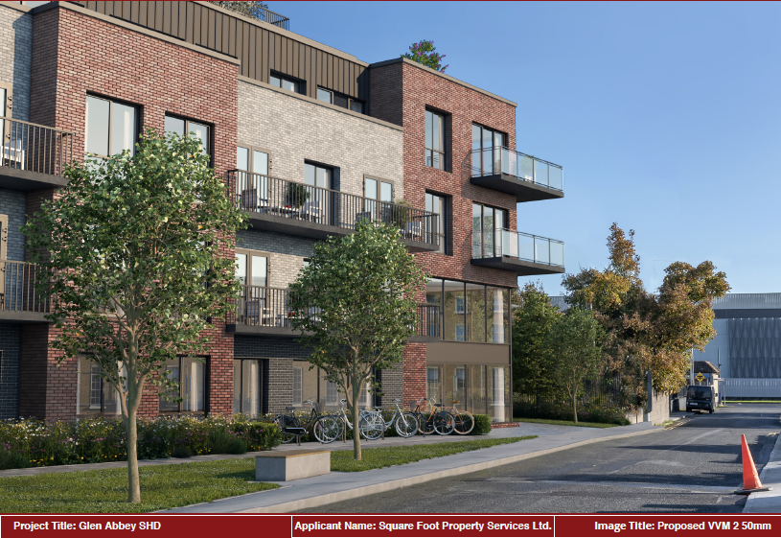

Slide 28
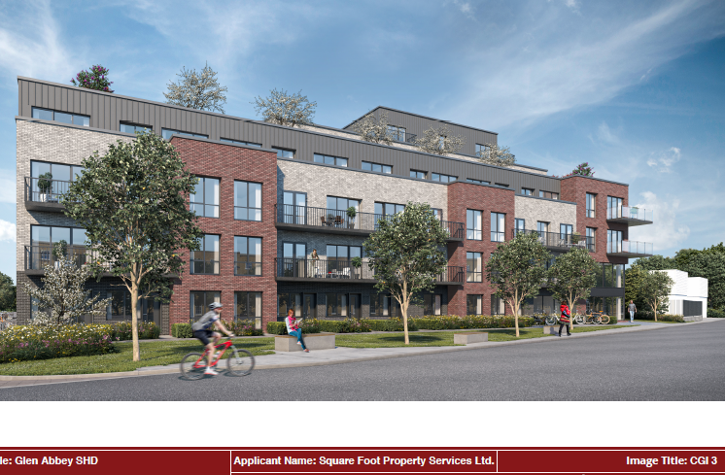

Slide 29
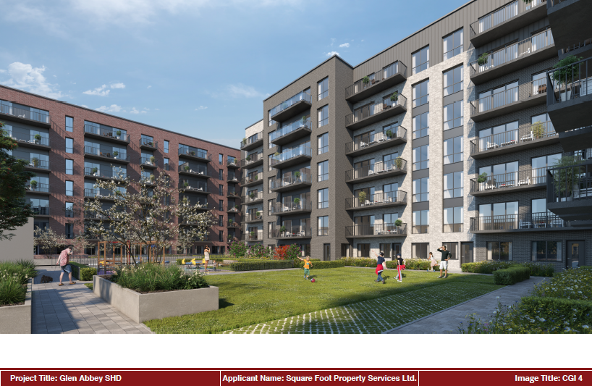

Slide 30
Eight submissions have been received from the following:
Belgard Area Residents Association
Colbert’s Fort Residents
Health Service Executive
Irish Aviation Authority
Irish Water
Gravis Planning (Acting for Print and Display Ltd. – Owners of Unit 80 Cookstown Industrial Estate, Downtree Investments Ltd. – Owners of Unit 79 Cookstown Industrial Estate, PD Visual Ltd. (trading as P&D Visual) and Westside Press Ltd. – each operating out of units 79 and 80, Cookstown Industrial Estate)
Tallaght Community Council
Transport Infrastructure Ireland

Slide 31
Belgard Area Residents Association
welcome new residential and enterprise development; have concerns regarding overdevelopment in Tallaght Town Centre. Will change the character of Tallaght and downgrade it from its intended status as a county town, to a suburb of the city, i.e. an extension of Dublin sprawl.
does not comply with LAP policy on unit.
does not provide for 30% of 3-bedrooms as required by Objective RE2.
Ignores demographics of the local area.
Families contribute greatly to the creation of community spirit, social cohesion and pride of place, and are not catered for.
Housing density of 511 residents per hectare. If this were applied to only 25% of the LAP lands, it would cater for 48,545 new residents.
Other developments have been permitted at higher densities. Housing densities in the Tallaght LAP area need to be looked at again.
No planning framework that would determine the layout of streets and spaces in the immediate vicinity – reason for refusal at Fourth Avenue
Build-to-Rent development will be for bulk purchase by a vulture fund, resulting in sky high rents and shutting out first-time buyers.
Detrimental to prospects of a settled and stable community in Tallaght.

Slide 32
Colbert’s Fort Residents
Developer shows blatant disregard for community and SDCC guidance on development. Proposed development will be a rent rip off depriving young people of the opportunity to own their own property.
Wrong address: Development is not part of Cookstown Road Industrial Estate. This is Belgard Road and Colbert’s Fort.
Who benefits from this development? No-one locally, and no future occupants.
Why remove boundary wall with Colbert’s Fort? Why not replace it with modern decorative railings?
Why is this crowded onto Colbert’s Fort?
Impact on the oldest housing estate in Tallaght will be disastrous. There should be a reasonable blend of old and new, rather than this risk to safety and peace of mind.
Long history of illegal parking on Colbert’s Fort by commercial vehicles.
Access road currently problematic for larger vehicles, i.e. bin lorries and ambulances.
Access road will not be large enough to cope with additional traffic, let alone emergency vehicles and refuse vehicles.
Not enough room for ambulances to make turning manoeuvres.

Slide 33
Colberts Fort residents continued
Proposal for Colbert’s Fort to be used for emergency and service access is at odds with reality on that street.
Commercial traffic that currently uses the road is required to do dangerous 3-point turns and has damaged garden walls in the past.
Can residents be assured that building traffic will not access the site through Colbert’s Fort?
Car parking provision is too low. Illegal parking likely, causing further obstruction to access on Colbert’s Fort.
4-7 storey building will block out any view from adjacent single-storey dwellings.
Excessive height is far too close to houses on Colbert’s Fort and will negatively impact homeowners there.
Planning permission has been granted for 7 units at the end of this street.
Thousands of Build-to-Rent units permitted in Tallaght Town Centre already.
Densities in the area are excessive for the sustainable development of Tallaght.
Infrastructure and amenities are not there to support this development.
Concerns re: capacity of local schools.

Slide 34
Health Service Executive
The HSE owns the lands to the east of the development.
The HSE has provided map extracts which show:
A folio map showing their land holding on the adjacent site to the east
Conflict/overlap between HSE ownership (outlined in green) and application site (outlined in red), all in a yellow circle.
Area outside of HSE ownership (outlined in green), not included in the applicant’s blue line, but which appears to be in their ownership.
Part of the red line application site is shown to be within the lands in HSE ownership. It appears to be an area across which pedestrian access is assumed in the Site Layout Plan.
There is a strip of land between the applicant’s red line area and the HSE’s land. The HSE believes this is in the applicant’s ownership and should’ve been included in a red line or a blue line on the submitted plans.
The HSE suggests that the application therefore does not accord with the Planning and Development Regulations minimum requirements for the submission of a valid planning application.

Slide 35
Irish Aviation Authority
Include condition to notify the following bodies of intention to commence crane operations at least 30 days prior to their erection:
IAA, Casement Aerodrome, the Property Management branch of the Department of Defence, and the HSE (with respect to Tallaght helipad).
Irish Water
Previous Confirmation of Feasibility is no longer valid.
Irish Water has undertaken detailed scoping exercise since last advice issued.
Previously advised upgrades required now impacted by additional downstream constraints.
Necessary upgrades to service this development will be identified in the next model, which is planned to be due in May 2021 (subject to changes).
Until such a time, Irish Water cannot identify the nature and scope of the upgrades and works that will be required to facilitate connections for this proposed development.

Slide 36
Gravis Planning
No consultation has taken place with our clients.
Lack of detail regarding the delivery of ‘Cookstown Urban Square’ objective, which is shown indicatively as affecting our clients’ land in the LAP.
LAP states that the square should be developed in tandem with development, and that proposals in parcel CT-G are to “provide for the delivery of the Cookstown Urban Square in tandem with development, unless otherwise agreed with the Planning Authority”.
Our clients have not been engaged by the applicant, nor are we party to any such agreement.
There is no reference in the application as to how the development will provide for the delivery of the urban square.
This is a contravention of the Local Area Plan but is not acknowledged in the Material Contravention Statement.

Slide 37
Tallaght Community Council
9th SHD in the Tallaght Town Centre LAP area.
A glut of BTR developments have been permitted. Over-dominance of build-to-rent in the housing market in Tallaght is preventing people from purchasing their own homes.
The Tallaght LAP is based on inaccurate population growth target and breaks with the National Planning Framework.
Fails to meet the LAP’s justification test for Build-To-Rent.
Does not meet the requirements for higher density.
Proposed density is unsustainable, and is higher than central London boroughs.
7 flaws in the applicant’s justification report.
Breached several specific objectives of the LAP:
Apartment mix (Objective RE2)
Housing type mix (Objective RE2)
Family size apartments (p 90 of LAP describes proportion of 4+ person families in local area as 39%)
LAP complies with SPPR 1 (mix of units) as a HNDA has effecitvely taken place.
No consideration of cumulative impact of this and other SHD developments, and BTR developments (including those built prior to 2008 which have been converted).

Slide 38
Transport Infrastructure Ireland
No objection.
As proposed development is located near a Luas line, the applicant should ensure there is no impact on Luas operation and safety.
Development shall comply with TII’s “Code Of Engineering Practice For Works On, Near, Or Adjacent To The Luas Light Rail System”.

Slide 39
Thank You
Questions

