Slide 1
Templeogue Village Initiative
Due to Covid restrictions commencement of works had been delayed.
Works have commenced on site this week
Works shall kick off with the new car park on the Piggery Site
this is to minimise delays to the new housing development on the existing car park
Works on the Main Street are anticipated to commence in June/July on the North side working from East to West, followed by the South side again working from East to West

Slide 2
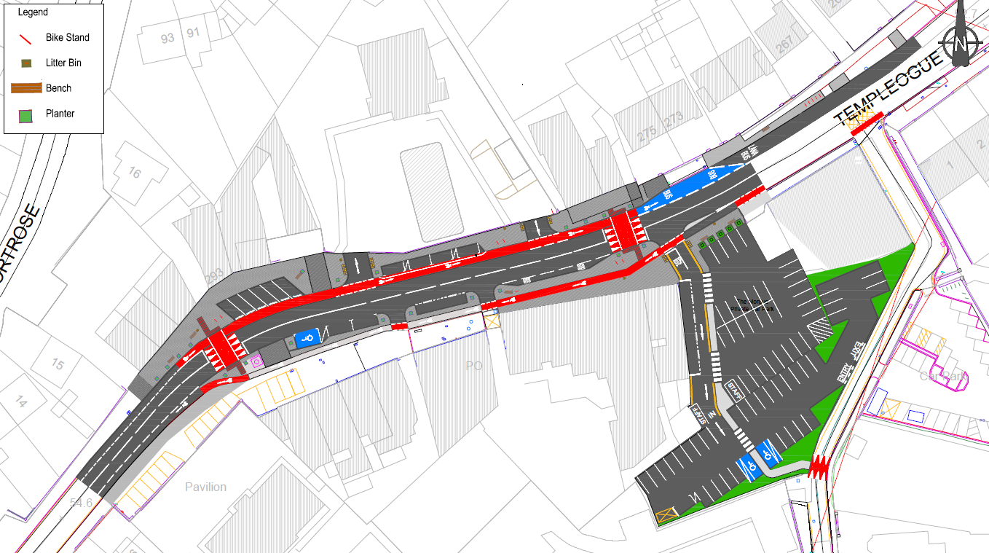
Maxol
Atlas
Hollingsworth
Diep
The Morgue Inn
O’Briens
Massey
Bros

Slide 3
SDCC Parklet Scheme
Due to Covid restrictions there is a drive to create outdoor amenities.
This includes additional seating, dining / picnic tables, bicycle parking, etc
Templeogue currently has a lack of outdoor amenity space. As part of the scheme we will be placing benches, but there is limited space in the village centre to facilitate this.
SDCC would like to propose the placement of a Parklet on 4 of the parking spaces in the village.
The proposed location is in front of the Maxol Petrol Station. This would help with greening the village and improving the biodiversity.

Slide 4
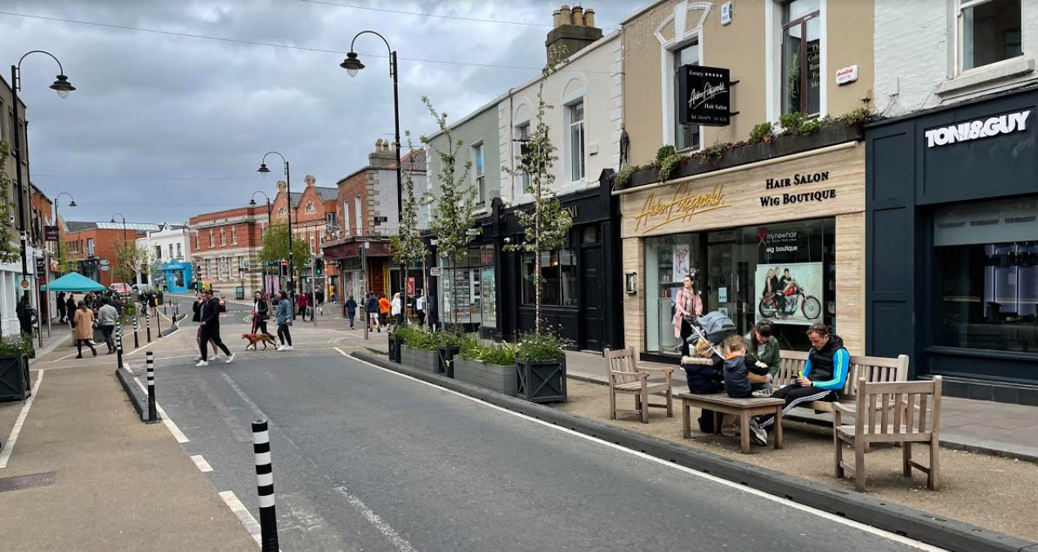
Parklets
Neighbouring Local Authorities have undertaken similar works in village and town centres to create more outdoor space for sitting and dining.
These parklet schemes are proving to be very successful and have high usage.

Slide 5
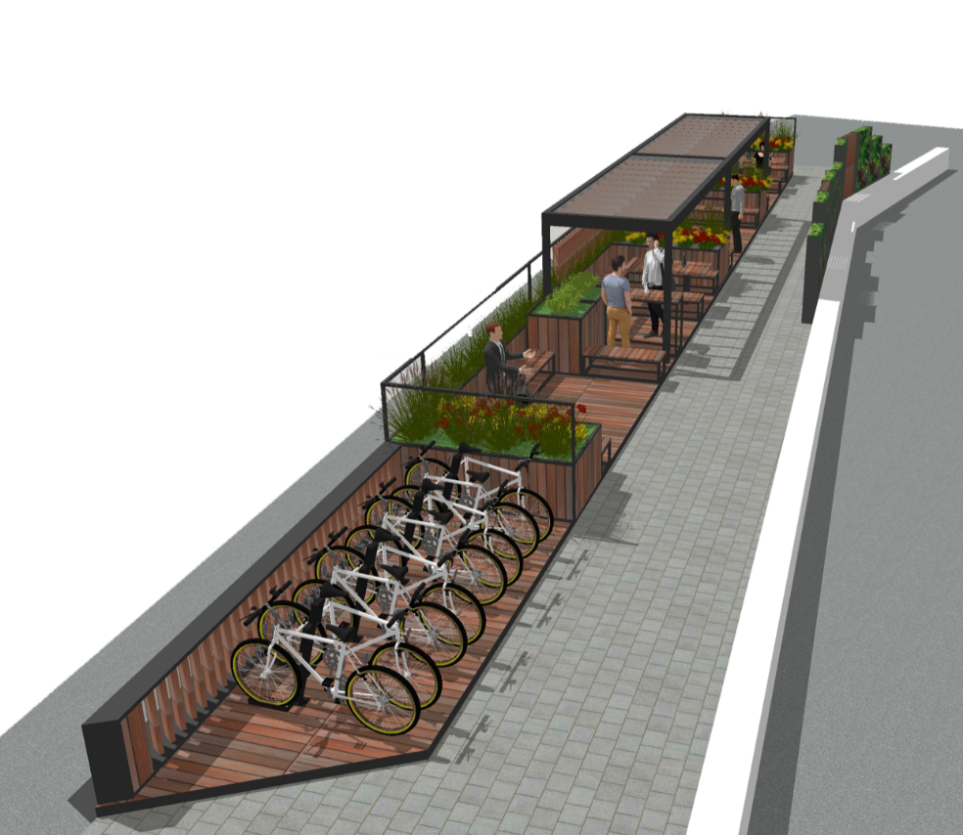
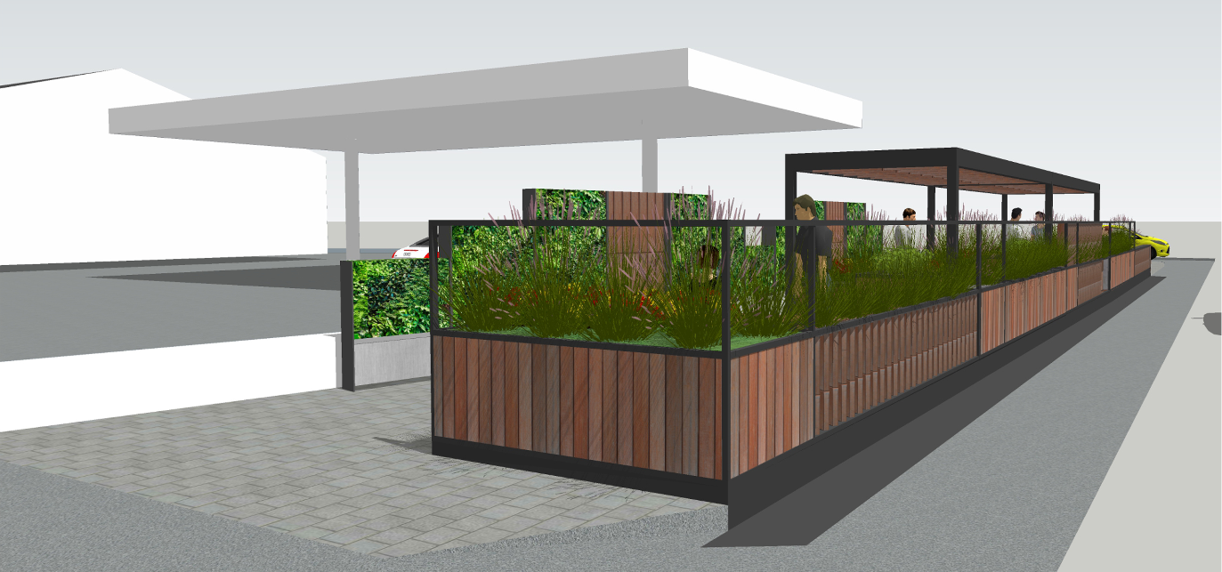
Concept Proposal for Templeogue
This is a concept image of the type of modular parklet which we could place in Templeogue

Slide 6
Proposed Location Considerations
Central location
Equal benefit to all businesses
No loss of parking outside any individual business (Maxol has its own parking)
Reduces conflicts along the cycle lane
Creates an amenity in the village centre which can attract customers
Aid greening and biodiversity in the village centre

Slide 7
