Slide 1
SHD Application Ref: SHD3ABP-309836-21
Applicant: Ardstone Homes Limited.
Location: White Pines East, Stocking Avenue.
Presentation to: R/T/F/B ACM 11th May 2021
Jim Johnston
Senior Executive Planner

Slide 2
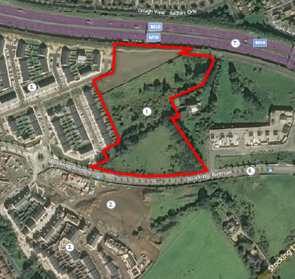

Slide 3
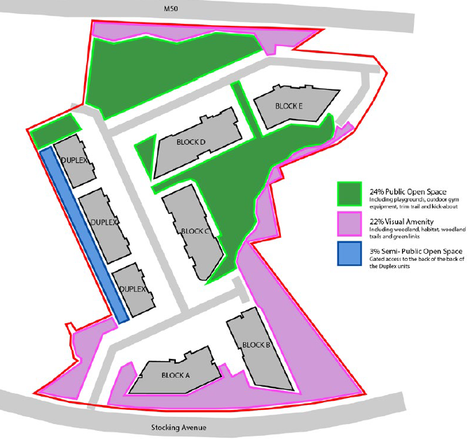

Slide 4
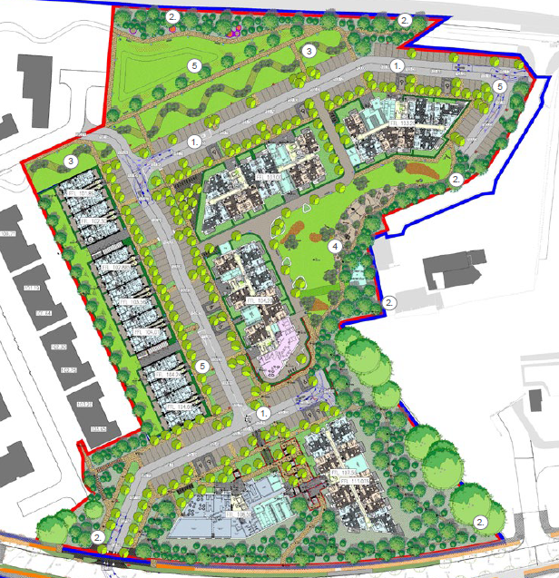

Slide 5
Timelines
SHD Lodged with ABP on 30/03/2021.
5 Week Obs by 5.30pm on 04/05/2021.
8 Wks SDCC report due to ABP 25/05/2021.
16 Week Decision due from ABP 19/07/2021.
Consultations
S.247 pre-planning meetings with SDCC as follows:
SHD1SPP003/20- on 06/03/2020.
Tripartite meeting ref SHD2ABP-307307-20 held on 09/09/2020 with An Bord Pleanála, the applicant and SDCC.

Slide 6
Proposed Development
241 apartments: in 5 apartment blocks, ranging in height from 4 - 6 storeys; 3 three storey duplex blocks; and, a dedicated community building space (c.552 sqm).
The development will provide 93 no. 1 bed and 148 no. 2 bed units, as follows:
Block A (5 storey) comprising 40 units (20 no. 1 bed units; and 20 no. 2 bed units). Balconies on southern, northern and western elevations. A dedicated community building space comprising c.552 sqm will also be provided on ground floor of Block A.
Block B (part 2 storey, part 4 storey) comprising 34 units (18 no. 1 bed units; and 16 no. 2 bed units). Balconies on southern, western and eastern elevations.
Block C (part 4 storey, part 5 storey) comprising 43 units (21 no. 1 bed units; and 22 no. 2 bed units) Balconies on southern, eastern and western elevations. Residential Tenant Amenities comprising c.171 sqm ground floor level of Block C to serve all residential units, comprising; a reception area, games space, residents lounge and gym space.
Block D (5 storey) comprising 49 no units (21 no. 1 bed units; and 28 no. 2 bed units). Block D includes balconies on southern, western and eastern elevations.
Block E (6 storey) comprising 47 no units (13 no. 1 bed units; and 34 no. 2 bed units). Balconies on southern, western, eastern and northern elevations.
3 no. 3 storey duplex blocks are provided to the western boundary of the site, comprising 28 no. 2 bed units. Balconies/terrace space on the eastern elevation.

Slide 7
Proposed Development (continued)
204 car parking spaces and 401 cycle parking spaces.
The main vehicular access to the scheme will be from Stocking Avenue. A second new vehicular access is proposed from White Pines North to the east.
Permission is also sought for the omission of a creche measuring c.364.8 sqm as approved under South Dublin County Council File Ref. SD14A/0222.
All other ancillary site development works to facilitate construction, etc.
An Environmental Impact Assessment Report (EIAR) has been prepared in respect of the proposed development.

Slide 8
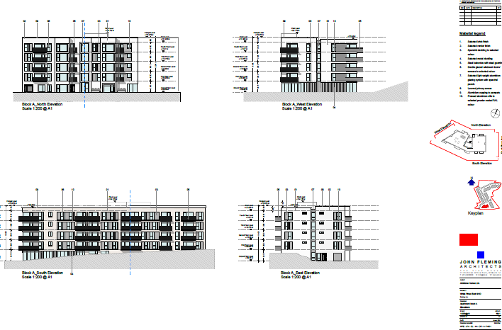

Slide 9
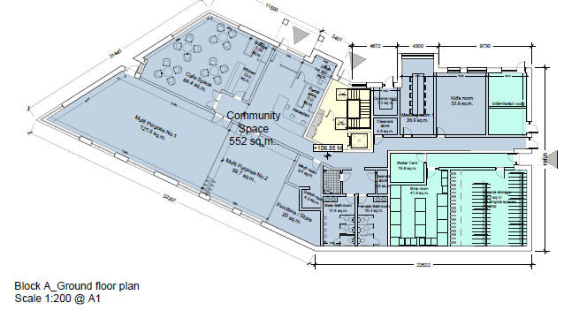

Slide 10
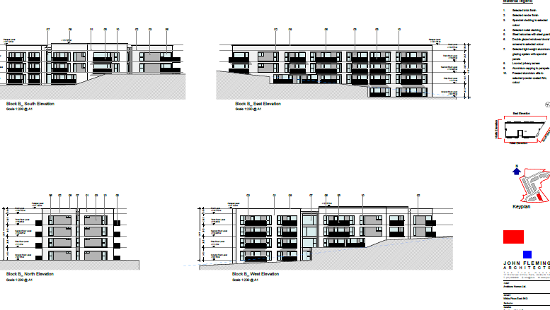

Slide 11
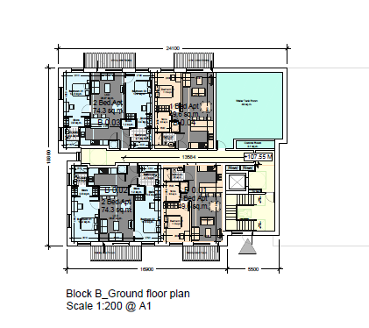

Slide 12
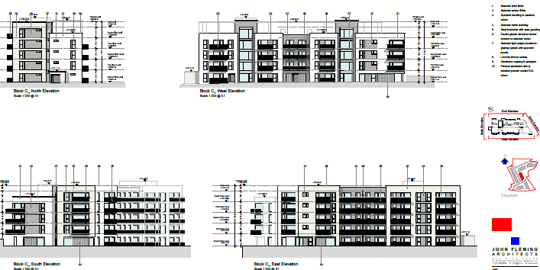

Slide 13
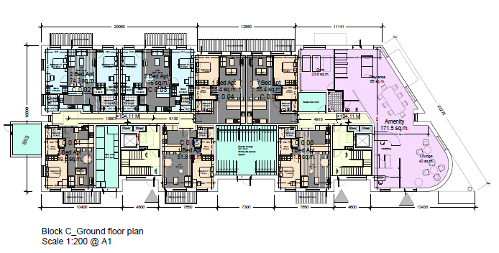

Slide 14
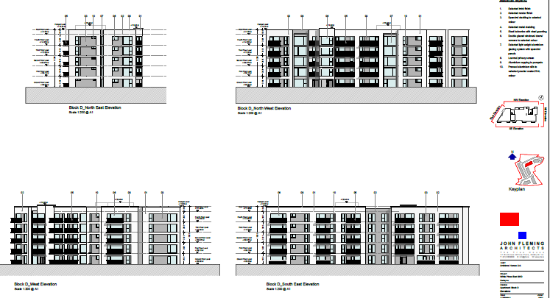

Slide 15
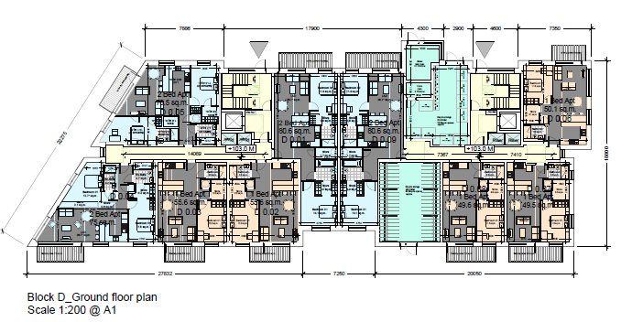

Slide 16
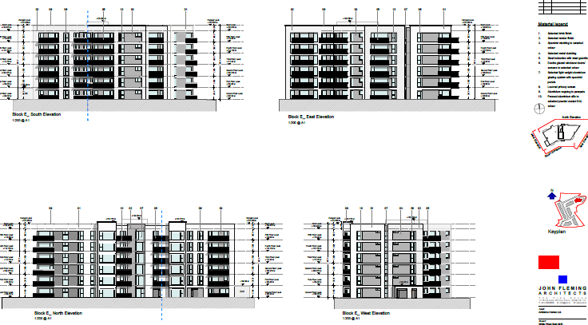

Slide 17
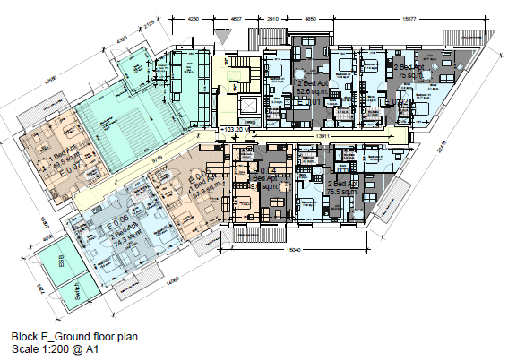

Slide 18
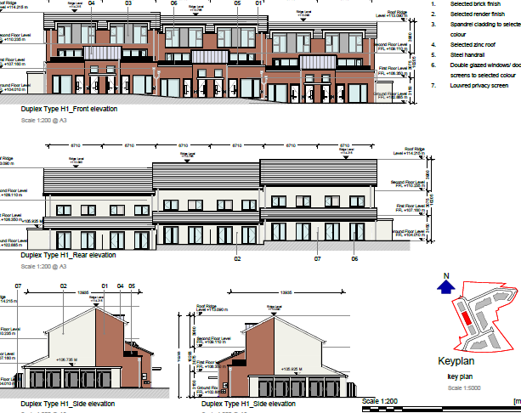

Slide 19
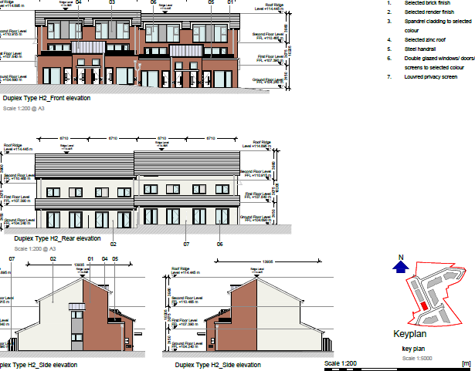

Slide 20
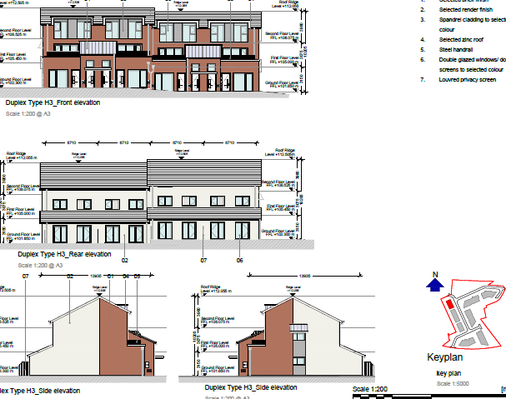

Slide 21
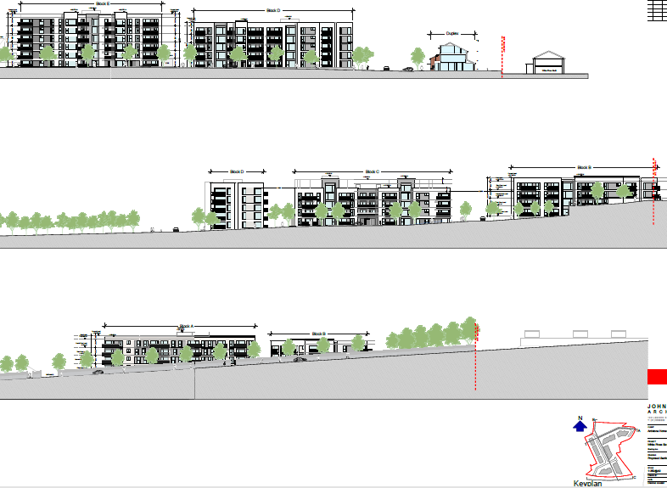

Slide 22
ABP comments – the Bord requested that the following issues be addressed
Development Strategy including Height and Density - having regard to national, regional and local policy, including ‘Guidelines for Planning Authorities on Sustainable Residential Development in Urban Areas (including the associated Urban Design Manual)’, ‘Urban Development and Building Heights - Guidelines for Planning Authorities’ and ‘Sustainable Urban Housing: Design Standards for New Apartments Guidelines for Planning Authorities’.
compliance with the Phasing Strategy of the LAP - Ballycullen – Oldcourt Local Area Plan, 2014 (as amended 2017).
A Housing Quality Assessment (HQA) which provides the specific information regarding the proposed apartments as required by the Sustainable Urban Housing: Design Standards for New Apartments Guidelines for Planning Authorities and how the proposed apartments comply with the requirements of those guidelines, including its specific planning policy requirements and dual aspect provision.
management and operation of the proposed development in accordance with SPPR7 of the Sustainable Urban Housing: Design Standards for New Apartments Guidelines for Planning Authorities, including detailed proposals for the provision and management of support facilities, services and amenities for residents.

Slide 23
ABP comments (continued):
justification for the level of car parking proposed, having regard to provisions of SPPR8 of the Sustainable Urban Housing: Design Standards for New Apartments Guidelines for Planning Authorities.
Additional details in relation to Transport issues, having regard to comments contained within the Planning Authority’s submission on this pre-application in relation to gradients, compliance with DMURS, cycleway provision, Electric Vehicle parking, fire tender and bin lorry access routes, refuse management, public lighting and the provision of a Construction Management Plan.
Additional details in relation to the proposed community centre, having regard to the quantum of floor area proposed and the viability of same, and to the concerns as raised by the Planning Authority in relation to same.
A report that addresses issues of residential amenity (both existing residents of nearby development and future occupants), specifically with regards to daylight/sunlight analysis, overlooking, overshadowing, visual impact and noise and including levels and cross-sections showing the relationship between the proposed development and nearby residential development.

Slide 24
Additional details in relation to Landscaping proposals having regard to comments contained within the Planning Authority’s submission on this pre-application in relation to green infrastructure, SuDS, protection of retained trees.
Confirmation that Irish Water can accommodate the proposed development, having regard to Irish Water’s submission on this pre-application, which states that upgrade works to the Irish Water Network are required.
Additional details in relation to surface water/flooding having regard to comments contained within the Planning Authority’s submission on this pre-application.
Additional CGIs/visualisations/3D modelling including additional views from the White Pines development to the west of the proposed development.
A report on the proposed materials and finishes of buildings, landscaped areas and any screening/boundary treatment.
A plan of the proposed open space within the site clearly delineating public, communal and private spaces.
A masterplan document outlining how this site could interact with any future proposals on the Green Acres site to the east.
Waste Management Details and Construction and Demolition Waste Management Plan.

Slide 25
Statistics for Proposed Development
Proposal - 241 apartments comprising:
93 no. 1 bed
148 no. 2 bed units
Site area – 2.98 ha
Density – 81 units per ha
Public Open Space – 23%
Height – 5 blocks varying in height from four to six storeys.
Dual Aspect apartments – 50%
Public and communal open space – 23% public open space,
Car parking – 194 Cycle parking - 401

Slide 26
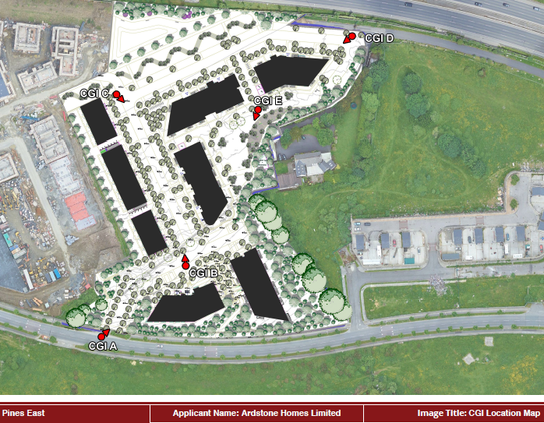

Slide 27
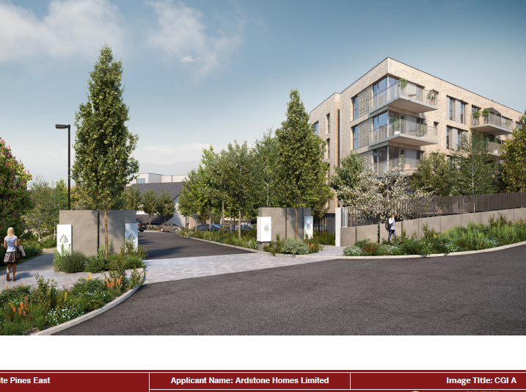

Slide 28
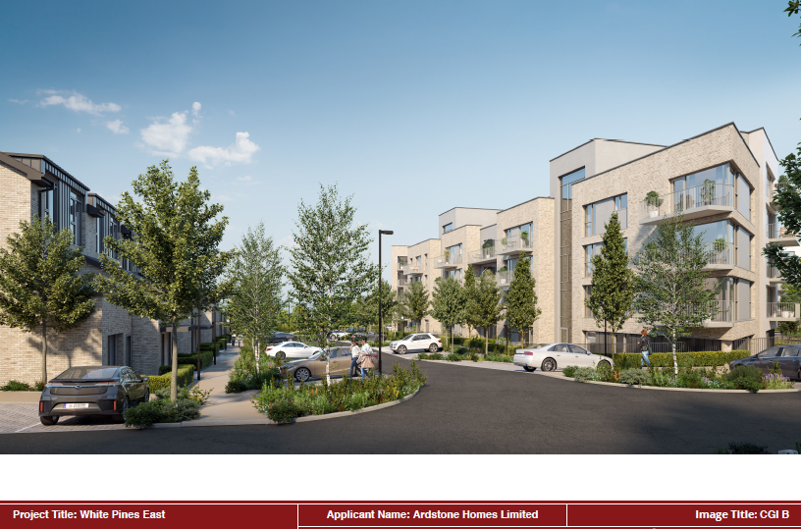

Slide 29
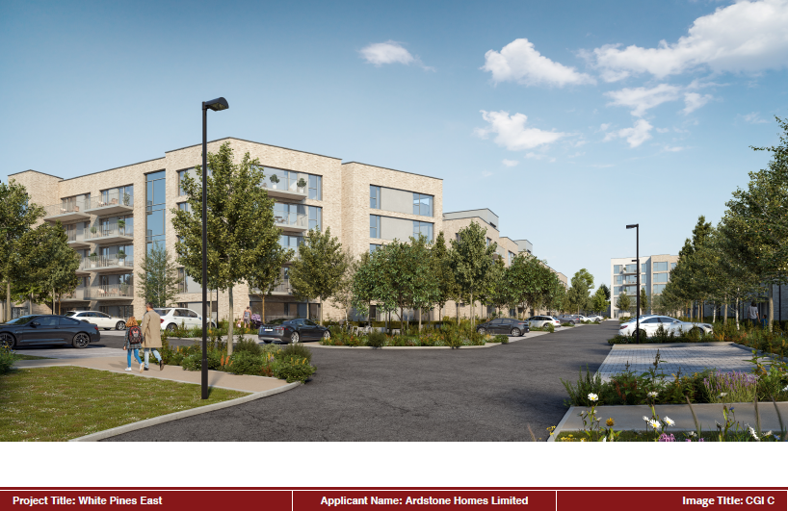

Slide 30
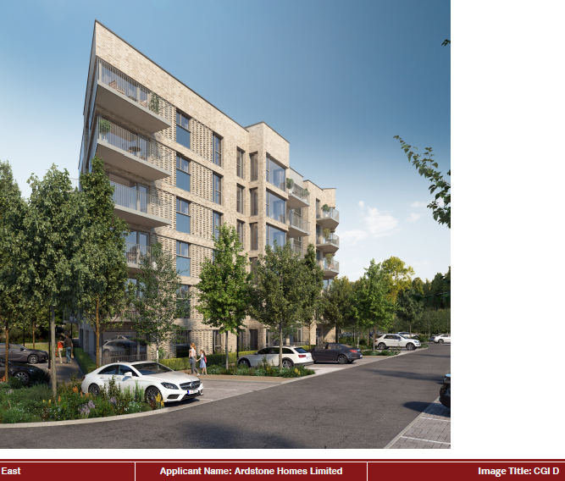

Slide 31
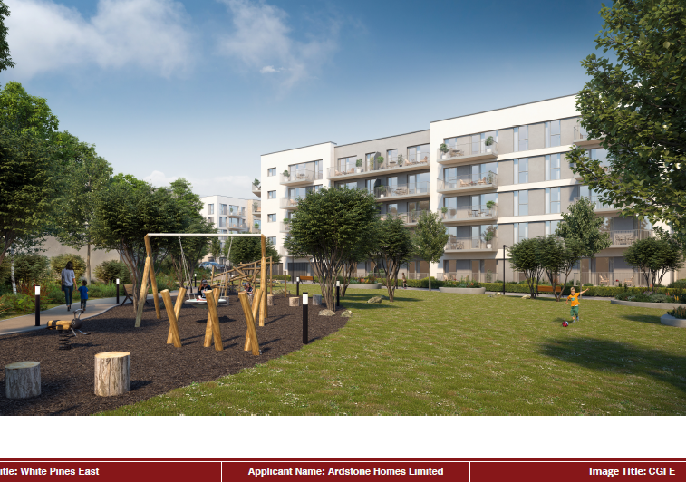

Slide 32
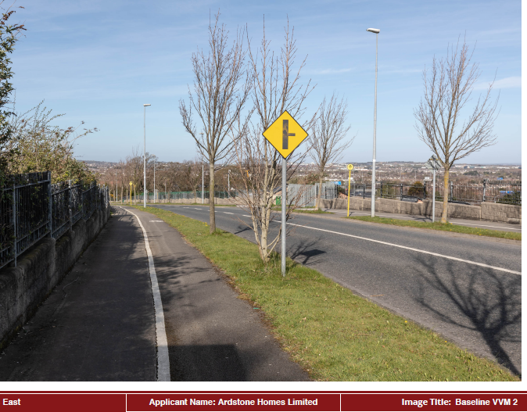

Slide 33
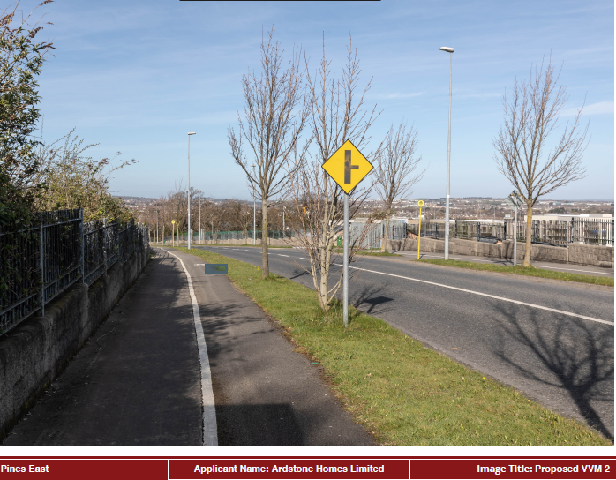

Slide 34
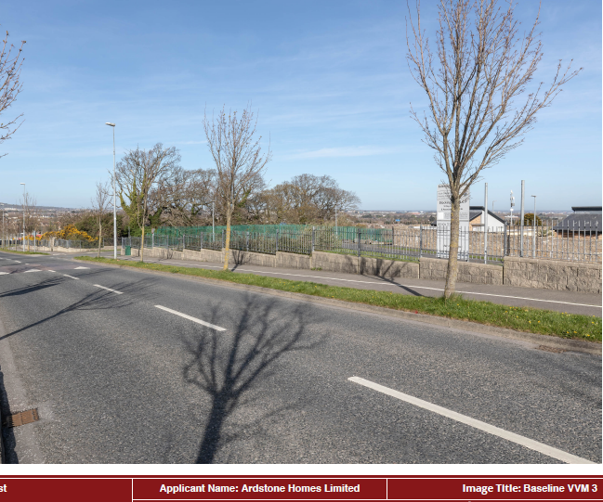

Slide 36
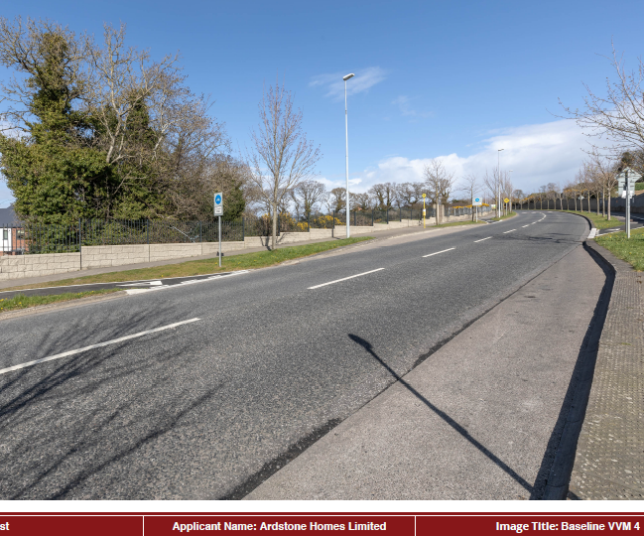

Slide 37
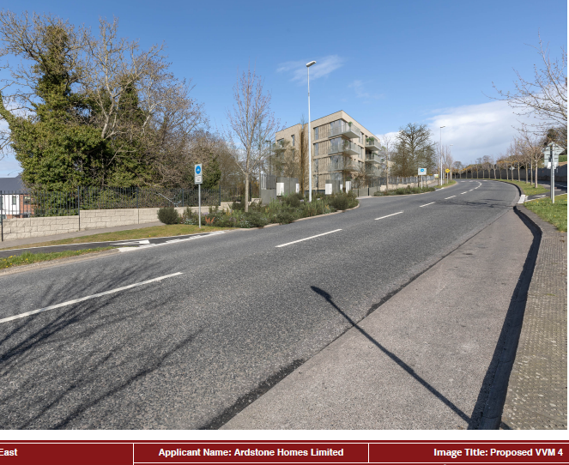

Slide 38
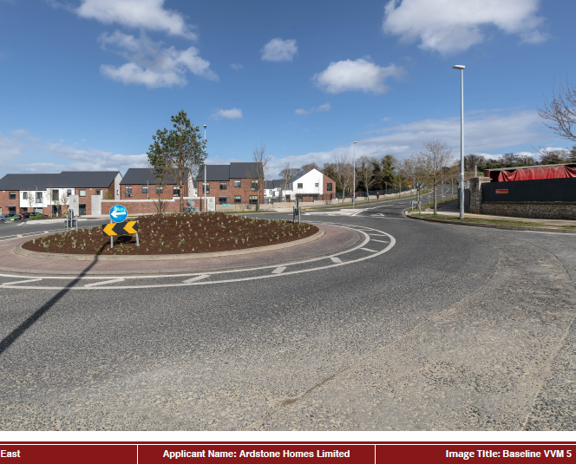

Slide 40
Objections/submissions have been received from the following:
White Pines North Residents Group (Ciaran Murray)
An Taisce
Irish Water
Transport Infrastructure Ireland
Cllr Alan Edge Independent Councillor
Sean Crowe T.D.
Ballyboden Tidy Towns Group (Marston Planning)

Slide 41
White Pines North Residents Group (Ciaran Murray)
density of the proposed development.
height of the proposed development, not in keeping with the existing area.
impact on the open spaces of White Pines North development.
environmental impact (mature trees, hedgerows, wildlife, particularly bats).
increased risk of flooding on the existing White Pines North development.
increased safety risks to the existing White Pines North development, increased traffic and parking issues.
omission of creche in White Pines North will result in reduction of childcare spaces designated to existing white pines residents and would materially contravene a condition attached to an existing permission for development and would injure the amenity of the existing white pines residents
lack of infrastructure to support such a high density development such as schools planned as part of the Local Plan Area, which have not been delivered.

Slide 42
An Taisce
Traffic
Overdevelopment – (density, building height)
Material contravention of County Development Plan and LAP
Loss of trees
Irish Water
Sets out conditions if the Bords grants permission
Transport Infrastructure Ireland - The Authority will entertain no future claims in respect of
impacts (e.g. noise and visual) on the proposed development, if approved, due to the presence of the existing road or any new road scheme, which is currently in planning
vibration impacts related to the proposed development, if approved, to the presence of the existing road or any new road scheme which is currently in planning.

Slide 43
Cllr Alan Edge Independent Councillor
Transport
Accessibility of site – lack of public transport.
Distance of site from BusConnects route and LUAS.
Narrow country roads to north and south of site, potential for congestion.
Sewage
Capacity of Dodder Valley Sewer and capacity of existing infrastructure
Existing built estates not connected to mains sewers.
Community infrastructure and Open space
Lack of school places
Assessment should be undertaken based on applications that have been granted in the area to determine demand
overlapping of open space with adjacent site – White Pines North
Developments should be examined on own merits.
Height
Six storeys are excessive and Site is not an urban location.
Protected views of surrounding landscape.
Building on slope.

Slide 44
Sean Crowe T.D.
Material contravention of the county development and LAP
Building heights
Residential Densities
Dwelling mix
Local Area Plan phasing requirement
Drainage
Flood risk
Traffic
Car parking
Removal of trees
Local school places
Biodiversity
Overshadowing
Archaeology

Slide 45
Ballyboden Tidy Towns Group (Marston Planning)
Overdevelopment/Density/Height
Excessive density in comparison to existing developments in the areaContrary to density in Ballycullen/Oldcourt LAP
Reference to net density of site and adjacent sites is misleading, should refer to gross density
Landscape buffers should be excluded from density calculation
Site should not be categorised as an ‘accessible location’
Over reliance on private cars
Argument for increased height based on accessibility.
Site is not well served by public transport.
Over reliance on one bus route – 15B.
Site not within walking distance of principle town or urban centre.
Height doesn’t respect topography of site.
Contrary to heights in LAP and CDP.
35m distance between existing and proposed dwellings not achieved.
Residential Amenity
Proximity to noise generating routes – M50 and Stocking Ave.
External balconies, single aspect units, no details of noise abating materials or finishes.
Usability of balconies on Blocks A and B and proximity to Stocking Avenue.

Slide 46
Vehicular and Pedestrian Access
Over reliance on private cars
Perpendicular parking could lead to traffic hazard.
Forward visibility on access road not demonstrated.
Width of the footpaths don’t promote pedestrian activity.
No Road Safety Audit of access or internal roads
Parking
Under provision of car parking which would lead to overspill parking.
Limited access to public transport.
No Autotrack assessment.
Impact on wider road network – additional trips not taken into account by applicant.
Insufficient bicycle parking and no justification provided.
Open space
Usability and functionality of open space.
Loss of trees and hedgerows.
Overlapping of open space between application and adjacent site.
Irish Water wayleave – ability to deliver landscaping in this area.
Usability of open space adjacent to road network, attenuation tank, no noise barriers proposed.
Tree planting proposed adjacent to plant room/generator – practicality of this.

Slide 47
Children’s Play Area
No children’s play area proposed.
Contrary to Apartment Guidelines (2018).
Flooding
No reference to local flooding/surface water issues in SSFRA.
Clarification required on whether SSFRA submitted is current or draft.
Inconsistencies in material submitted
Irish Water wayleave not identified on site location maps.
Address provided on SHD application form and statutory notices is different.
Description of development on SHD application form and statutory notices is different.
EIAR – section 7.2 does not relate to nature and extent of development and description refers to wrong number of units.
Property value
Negative impact on property value – overbearing, light, privacy, amenity, traffic and safety.
Inadequate Assessment
EIAR – cumulative impact of proposal not adequately assessed.
Bat Survey – not undertaken in optimum period.
Bird survey
Appropriate Assessment

Slide 48
Thank You
Questions

