Slide 1
Economic Enterprise & Tourism SPC 12th May 2021.
Statutory Plans Update

Slide 2
South Dublin County Development Plan 2022-2028

Slide 3
County Development Plan –Next Steps 2021
Chief Executive’s Draft of the Development Plan issued to Elected Members 5th May 2021
Motions to be submitted by 28th May 2021 to inform Draft Plan.
Draft Plan on public display from 7th July until 15th September.
10 weeks for the public and those interested to make a submission to the Plan.
September 15, 2021 Prepare Chief Executive's Report on Draft Plan Submissions
December 7, 2021 - 9th March 2022 Members consider Chief Executives Report on Submissions. Adopt or Amend

Slide 4
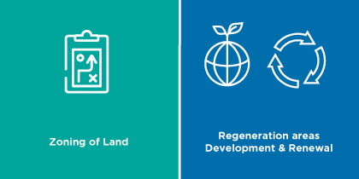
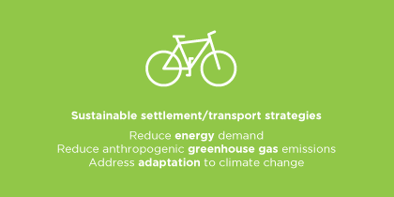
Mandatory Objectives

Slide 5
Local Economic & Community Plan
LECP 2016-2021
Evaluation of Economic Goals & Objectives currently underway
LECP 2022 – 2027
Guidelines currently being drafted and expected that they will be issued end June 2021
Timelines for work on new plan available from July 2021

