Slide 1

Eastern - Midlands Regional Waste Management Plan
South Dublin County Council
Environment SPC
4th May 2021

Slide 2
Regional Office Activities
National Issues
Prevention
Resource Efficiency
Infrastructure
Environmental Protection

Slide 3
National Issues

Slide 4
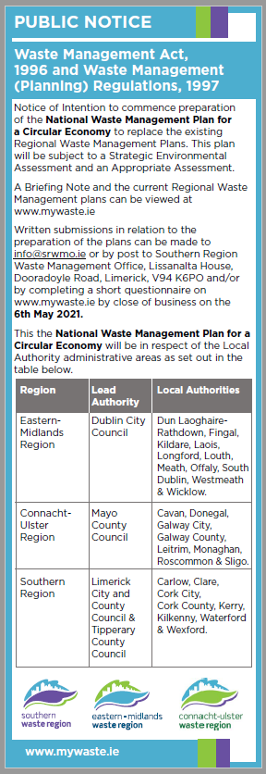
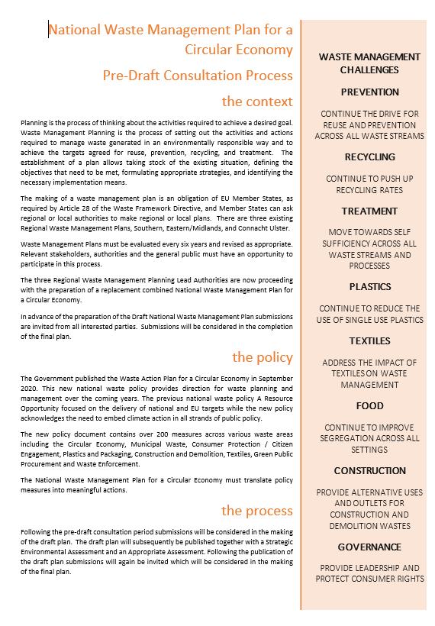
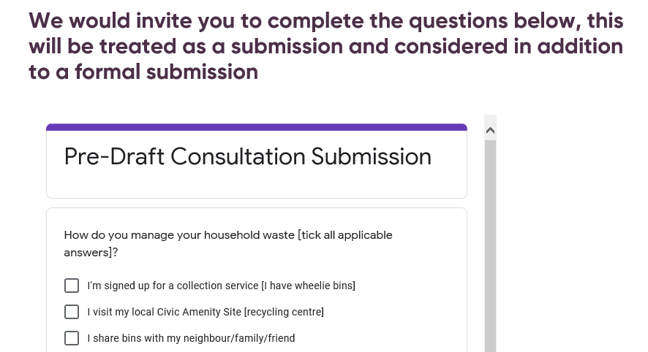
Pre Draft Consultation

Slide 5
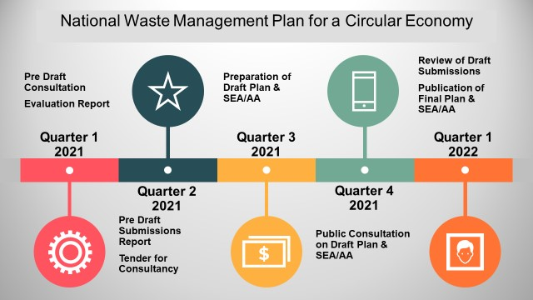
Plan Timeline

Slide 6

Deposit Refund Scheme
National Working Group led by DECC in place
Potential Scope:
            A new framework system owned and operated by industry
    Not for profit
    Reverse Vending
    Small units simply bags for small retailers
    30ml to 3L Plastic & Aluminium beverage containers
    Visible fee to be decided by Minister per container -consideration for multi-packs (based on cost components presented by IBC)
    Visible fee to be collected at the point of sale
    Reverse logistics under consideration
    Potential Role for CA Sites
    End 2022 Target Date for introduction of scheme
    Consultation on Legislative Framework & Scope – Closing 7th May on gov.ie

Slide 7
Civic Amenity Site Review

Slide 8
Vision Statement
To develop an integrated, consolidated and coordinated public waste infrastructure network that responds sustainably to consumer needs, regulatory and policy challenges, and the circular economy
Final Report Now Published – Implementation Strategy being prepared

Slide 9

Integration
New Regional Public Waste Infrastructure Manager responsible for
  Emergency management
  Administration
    National branding
  Procurement
  Policy Delivery
  Funding Model
    Gate Fee Protocol

Slide 10

Consolidation
Develop Framework for a collective approach to
  The optimisation of income
  Consistency on gate fees
  Compliance schemes
  Promotion

Slide 11

Co-ordination
National Hierarchy of Sites
Designate sites in accordance with hierarchy to ensure appropriate national coverage
Consult with Las in terms of designations
Multi-annual programme

Slide 12
National Capacity Issues

Slide 13
Summary of 2020
Treatment Options | Q1 2020 | Q2 2020 | Q3 2020 | Q4 2020 | Total
Recovery | 262,384 | 230,882 | 276,602 | 232,890 | 1,002,758
Disposal (MSW only) | 83,271 | 84,898 | 97,415 | 82,158 | 347,742
Export | 98,812 | 85,372 | 61,303 | 89,366 | 334,853
Totals | 444,467 | 401,152 | 435,320 | 404,414 | 1,685,353
A total of 1.68 Mt was processed in 2020 compared with 1.78Mt in 2019.

Slide 14
Projections 2021 Recycling Rate
 | 2020 | 2021 | 2022
MSW | 2,987,428 | 3,101,170 | 3,214,098
Recycling Rate | 44% | 43% | 45%
Balance for Treatment/Disposal | 1,685,353 | 1,767,667 | 1,767,754
Residual Waste Capacity | 1,727,000 | 1,780,000 | 1,815,000
 |  | -12,333

Slide 15
Construction and Demolition Waste
Up to the end of Q4 Exported 1/3 of Non-Haz inert was exported compared to same period in 2019 27,931 Tonnes
In addition we exported 43,899 tonnes of haz-waste similar to 2019.
Total C&D Waste moved in 2019 is 8.8Mt.
Predictions are that 2020 will see at least reduction of 37.5% so it anticipated that just under 6.0Mt will be moved in 2020

Slide 16
Waste Prevention
Awareness Campaigns and Projects

Slide 17
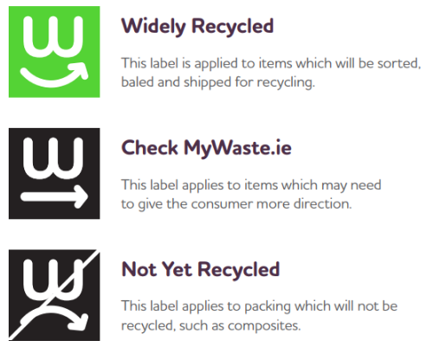
On Pack Recycling Guidance
The guide is complete and an introductory video has been produced
Repak are advising clients that these are available
The rollout of this system is now an action in the new Waste Action Plan

Slide 18











Green Clubs - GAA
The Green Clubs Pilot Initiative has been launched and working groups with clubs are underway
There are 5 thematic pillars;
  Waste
  Water
  Biodiversity
  Energy
  Travel & Transport.
The regions were tasked with the development of comprehensive waste toolkit
GAA have chosen 5 clubs for this theme, 3 of which are in the EMR;
  Cappagh GAA – Kildare
  Lucan Sarsfield – Dublin
  Park/Ratheniska – Laois
The RWMPO’s and local clubs are engaged with the EAO’s – collective approach

Slide 19
ADI - Materials
The Anti-Dumping Initiative (ADI) Campaign aims to deliver a suite of materials that can be used by both Local Authority staff and also by community groups and organisations highlighting the importance of eliminating illegal dumping activities in their functional areas and communities.
Local Authorities (LAs)
ADI Campaign materials will be
used by LAs to highlight to the
citizen, the issues associated will
illegal dumping activity:
Press (newspaper / radio)
Posters
Social Media
Local Communities
(Community Groups, Organisations,
Corporates & Schools)
Further support and enhance
LA message, targeting the citizen
at a more local level:
Local Newsletters
Posters
Social Media

Slide 20
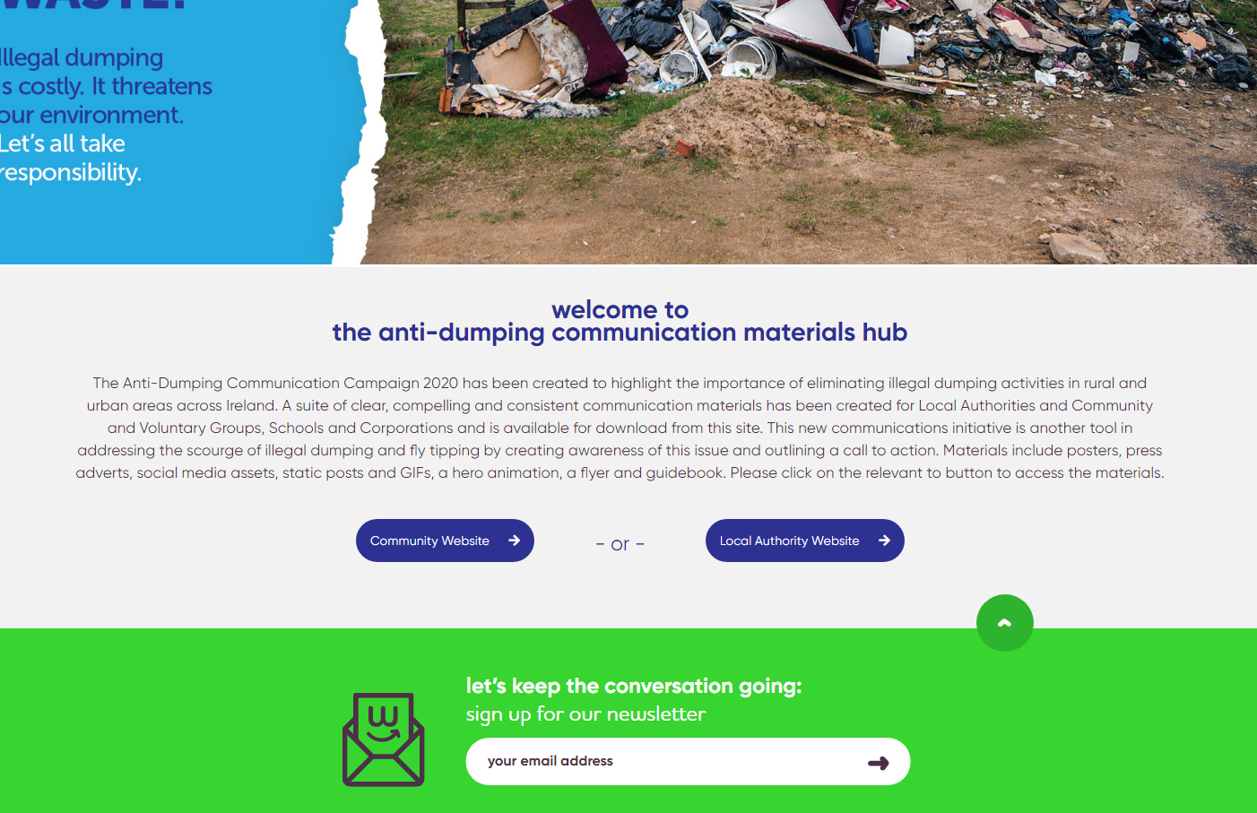
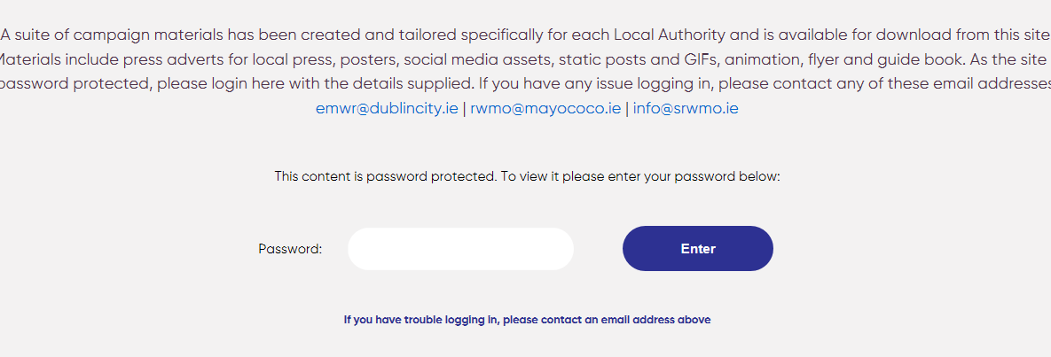
assets@adi

Slide 21
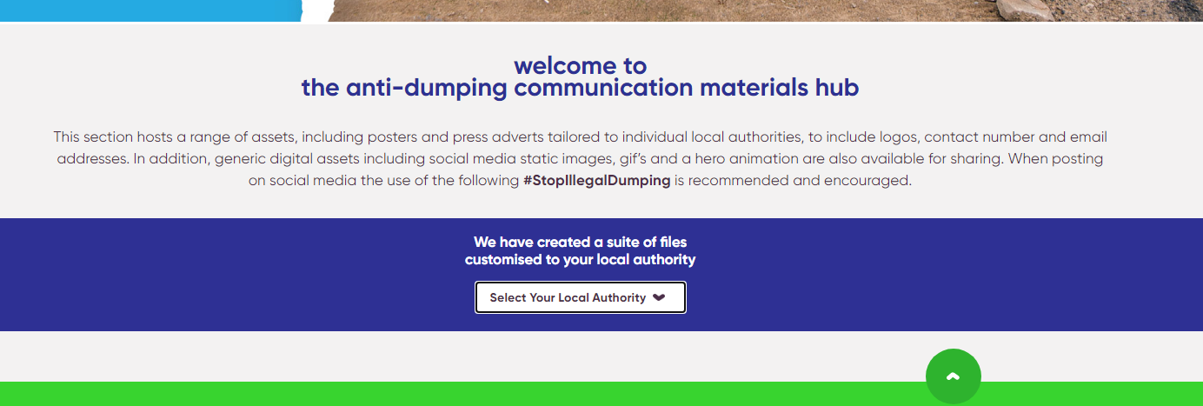
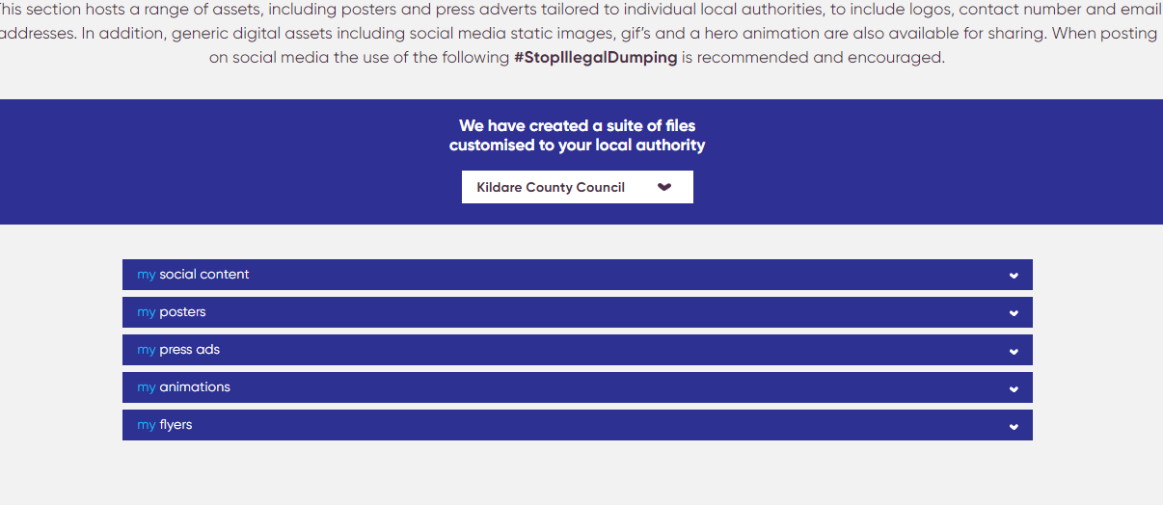

Slide 22
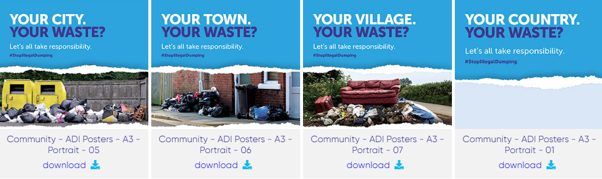
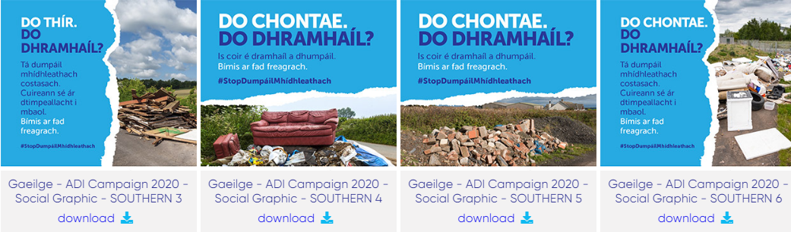

Slide 23

Business Case 2021
The Regions have submitted their combined prevention work plan to the DECC, the work carried out will fall under MyWaste and will focus on the themes of the Waste Action Plan for the Circular Economy while also aiming to achieve the objective and targets of the Regional Waste Management Plans. The work plan will focus on:
Commercial Waste Project
The reintroduction of soft plastics to the household recycle bin
Development and enhancement of the MyWaste website
A sustained digital and social advertising campaign which will focus on various seasonal/topical issues placing focus on prevention and responsible waste management throughout
Conscious Cup Campaign and Refill
Food Waste
On pack recycling guidelines
Paint prevention
Textiles

Slide 24
Resource Efficiency

Slide 25




Initiative of the Regional Waste Management Planning Office and DCC Economic Development Office
Circular Economy Training programme designed for SMEs operating in Ireland
Response to a need for increased awareness of Circular Economy among businesses in Ireland
MODOS – 4 modules; 50 businesses ; €75 per business

Slide 26

MODOS 2021
MODOS Webinar Series – attendance of 600+ live over the 4 webinars
Circular Economy concept; BioEconomy; Financing the Circular Economy; Circular Packaging
Cork Chambers MODOS Training – Feb/March 2021- 10 business
MOU – conditions include: content, branding, trainers
We’ve had a couple of enquiries from co-working hubs, local authorities regarding running it
DCC running training in Dublin 8 (partnership with Digital Hub)
Looking at our options for 2021 for running it nationally
Notes:
Funding

Slide 27

MODOS 2021
MODOS Circular Economy Mentoring and Innovation Award
EI funding this initiative for businesses in the GDA
EMRWMPO funding this initiative for businesses outside of GDA
Mentoring for 50 companies and Innovation Awards for CE projects for 8-10 businesses
Still recruiting for businesses for this

Slide 28
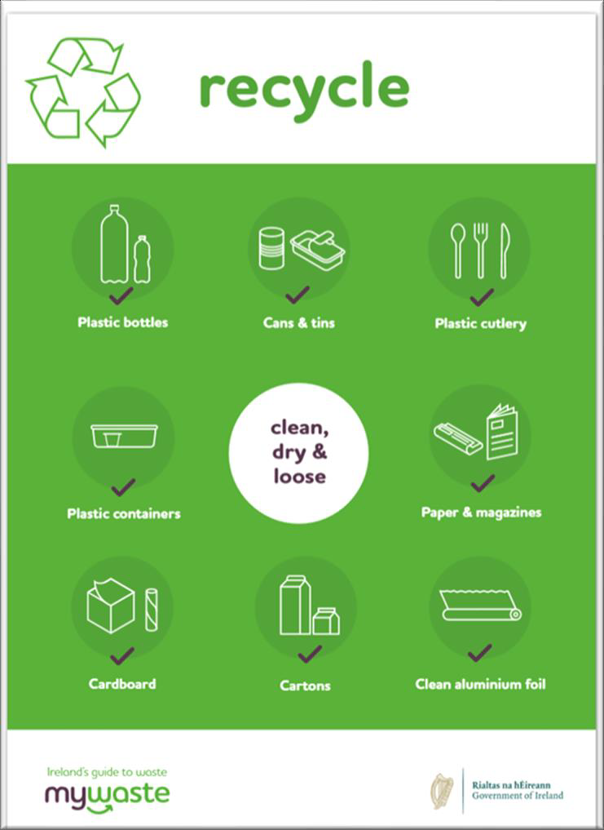
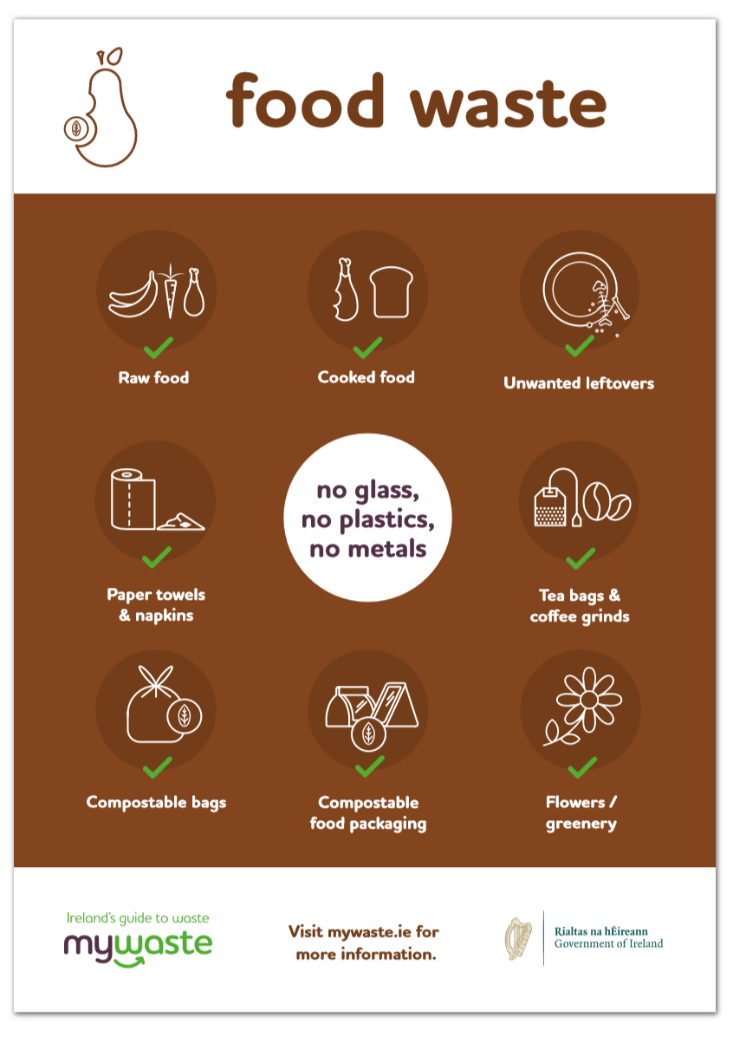
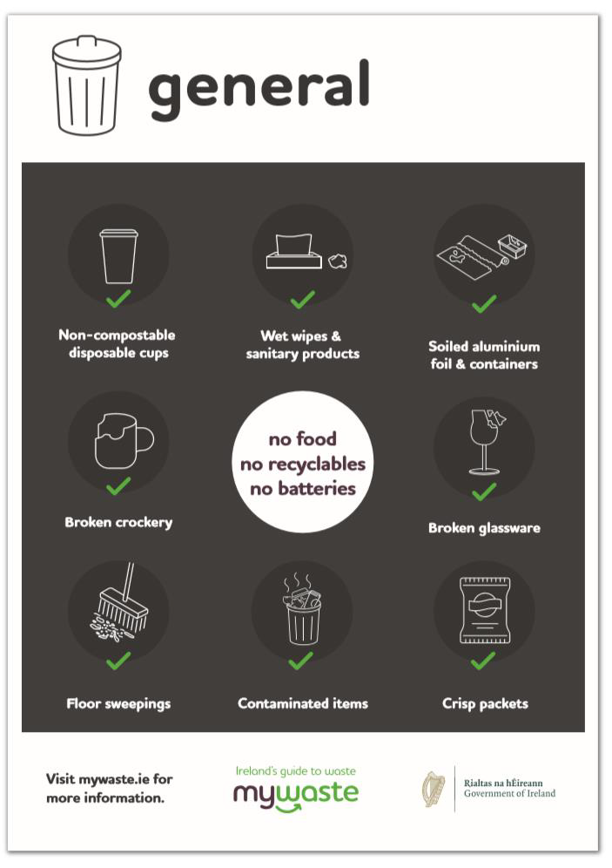
Commercial Waste Project
Support SME’s
in improving segregation
increase composting/recycling rates
reduce contamination engage staff

Slide 29

Commercial Waste Project
Poster / labels / infographics; Business information booklet; Animations; Social media assets
Campaign updated to include soft plastics
MyWaste.ie landing page where all assets will be made downloadable from early April
Press release and sectoral based editorial & advertising
Pilots planned - pushing ahead with some of these in April

Slide 30

Research Proposals
Policy Action D.4.1 requires the RWO to participate in research – national and EU where possible/appropriate
Currently involved as a partner in a number of Horizon 2020 proposals for research funding – still waiting on decisions (fingers crossed)
  TCD-led AICEP – plastics circular economy solutions (all Ireland)
  PolyCircular – circular economy solutions for difficult to treat waste streams

Slide 31
Environmental Protection

Slide 32
Historic Landfill Remediation Programme
Region | Category 1 (LA Landfills) | Category 2 (Private Landfills) | Category 3 (Illegal Landfills) | Pre-1977 Landfills | Total
EMR | 78 | 0 | 47 | 38 | 163
SR | 126 | 33 | 8 | 27 | 194
CUR | 77 | 41 | 17 | 2 | 137
Total | 280 | 74 | 72 | 68 | 494

Slide 33
Historic Landfills - 2021 Funding EMR
Applied for €5,535,833 in January to DECC
100% Allocated
Programme formally extended to Moderate risk (B) sites in 2021
Work ranges from tier assessments to remediation contracts
A number of South Dublin Sites in Programme

Slide 34

Questions & Clarifications
hugh.coughlan@dublincity.ie

