Slide 1
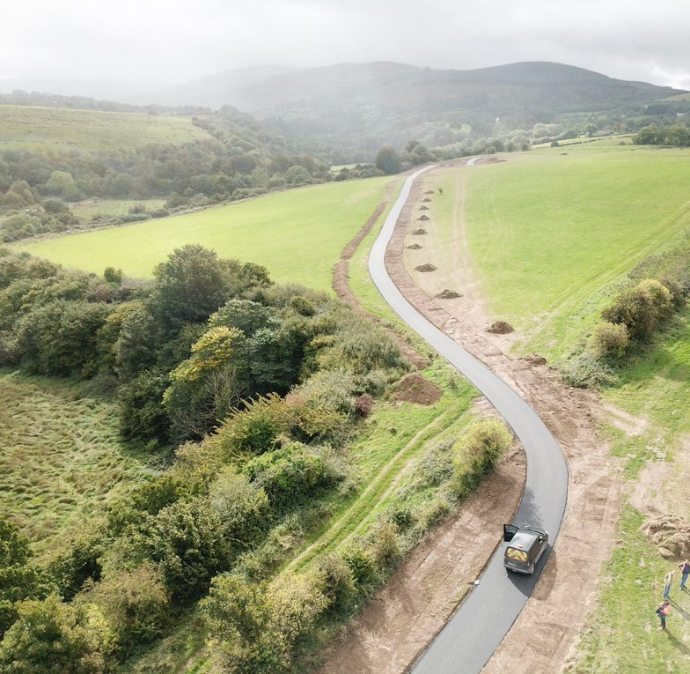
Kiltipper Park Phase 2
May 2021
Update to Council

Slide 2
Kiltipper Park Part 8 2020 Construction of 30 additional parking spaces with adjacent access footway & lengthened access roadway New shared surface entrance and access pathway Provision of 1 no. GAA pitch with vertical ball-stop netting and associated features Provision of 2 no. soccer pitches and associated features Provision of children’s playground area and linear natural play areas Integrated landscape features including woodland areas All associated swales, drainage, wetland areas and ancillary works All incidental park furniture such as benches, signage, bins.
Part 8 masterplan for Kiltipper Park.

Slide 3
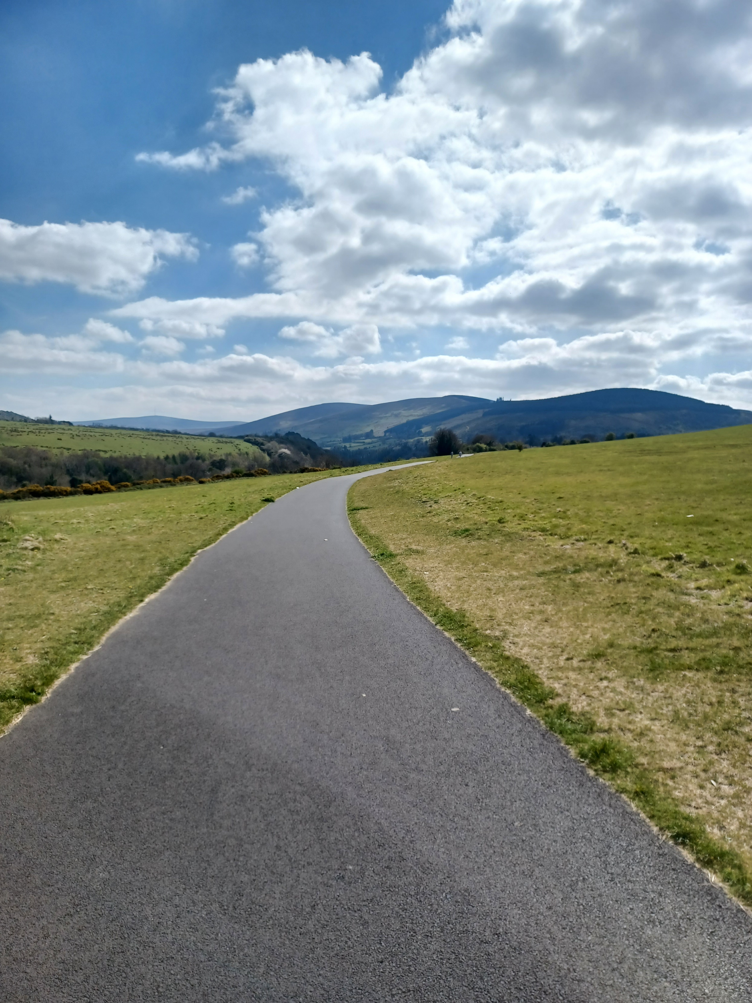
Kiltipper Park: Phase 1 Funded by an ORIS (Outdoor Recreational Infrastructure Grant) from the Department of Rural and Community Development, a grant under Sustainable Transport Measures Grant (STMG) by the National Transport Authority, funding from Dublin Mountains Partnership and SDCC capital budget. This phase delivered the: Formalisation and hard surfacing of a perimeter footpath that is wheelchair accessible. Upgrade of the route of the Dublin Mountains Way / Dodder Greenway. The upgrade and provision of universally accessible entrance ways. Commencement of planting in the park including the renovation of the existing hedgerows and new tree planting and Implementation of the first tranche of car parking at Kiltipper Road entrance.

Slide 4
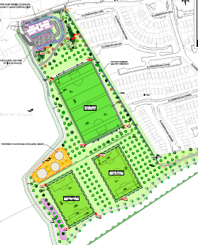
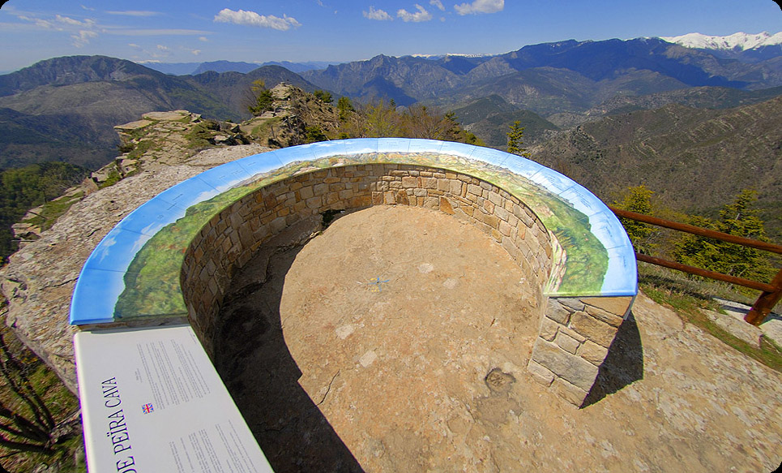
Kiltipper Park-Phase 2 SDCC plan to proceed with the next stage of development of the Part 8 plans for Kiltipper Park through Phase 2 which will proceed this year. SDCC have appointed landscape and engineering consultants to carry out the detailed design and tendering for the next phase of works at Kiltipper; based on the Part 8 proposals and prioritising the works in line with funding available as set out below: SDCC capital funding: The project has been allocated funding of €300,000 from SDCC capital funds. Sports Capital Grant: SDCC applied to the Department of Transport Tourism and Sport, Sports Capital Grants earlier this year for funding to progress the GAA and soccer pitches which are part of the Part 8 proposals. We are currently awaiting the outcome of the application. Signage and Branding: The above funding has been augmented by a recent grant of €148,500 from the Department of Rural and Community Affairs (ORIS Measure 2) which is specifically ear-marked for the signage and branding of both the Dodder Greenway and Dublin Mountains Way through Kiltipper Park as well as for the necessary park related signage (information, operational and way finding signage). It also includes the provision of the orientation table at the summit of the park which provides panoramic views of the city and into the Dublin Mountains. This signage will be in line with the signage strategy for the county.
Detail of Phase 2 plans.
Example of an orientation table.

Slide 5
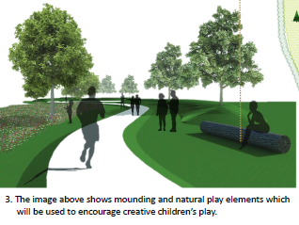
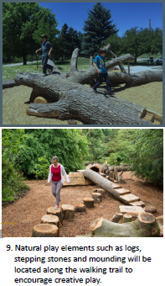
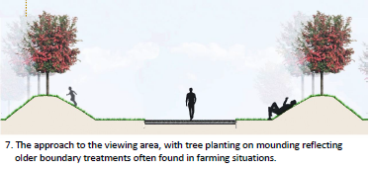
Kiltipper Park-Phase 2 Programme: Detail Design and Tender: April 2021-July 2021 Tender Assessment and Standstill: August 2021 Construction Period: Sept 2021-Q1 2022. Maintenance Period
Detail of Part 8 plans.
Examples from the image board from Kiltipper Park Part 8.

Slide 6
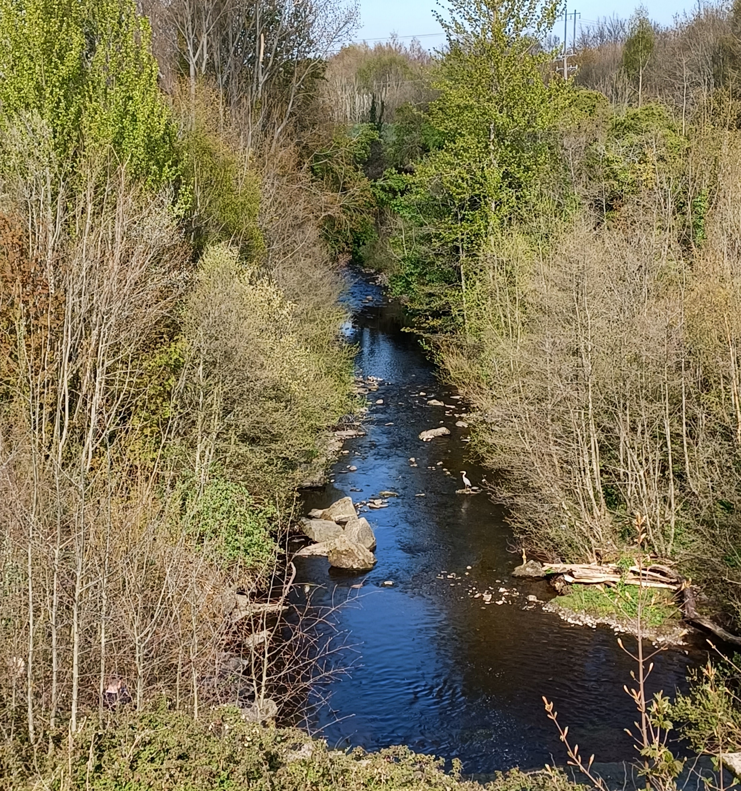
Thank you
Kiltipper Park Phase 2

